Slide 1
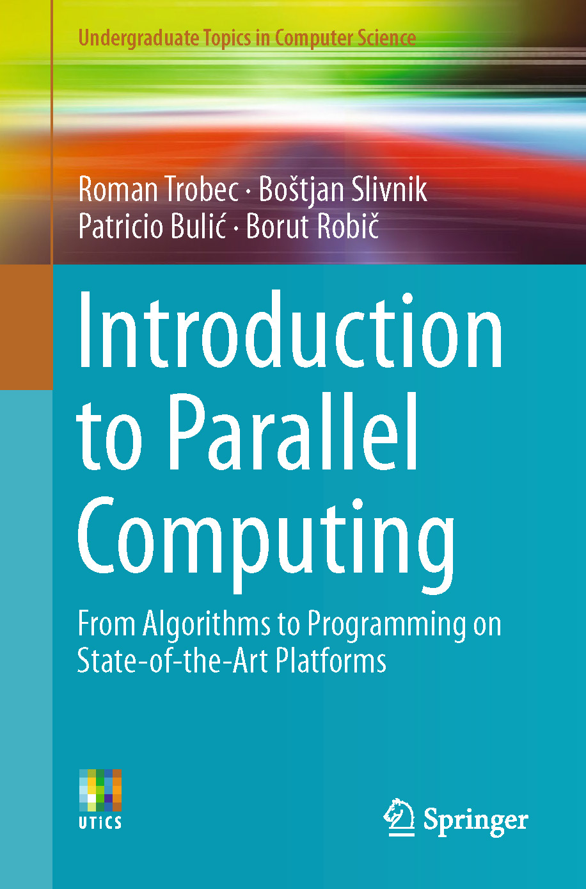

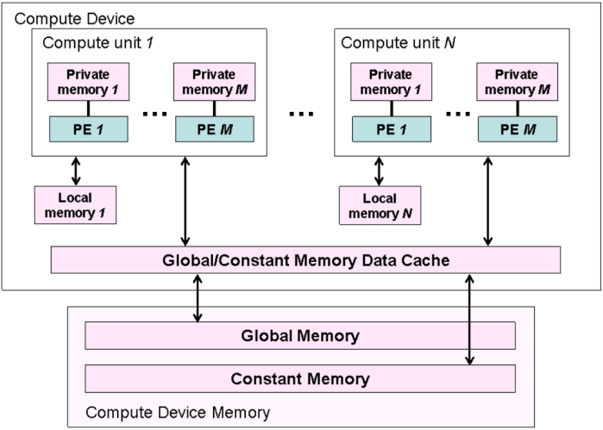
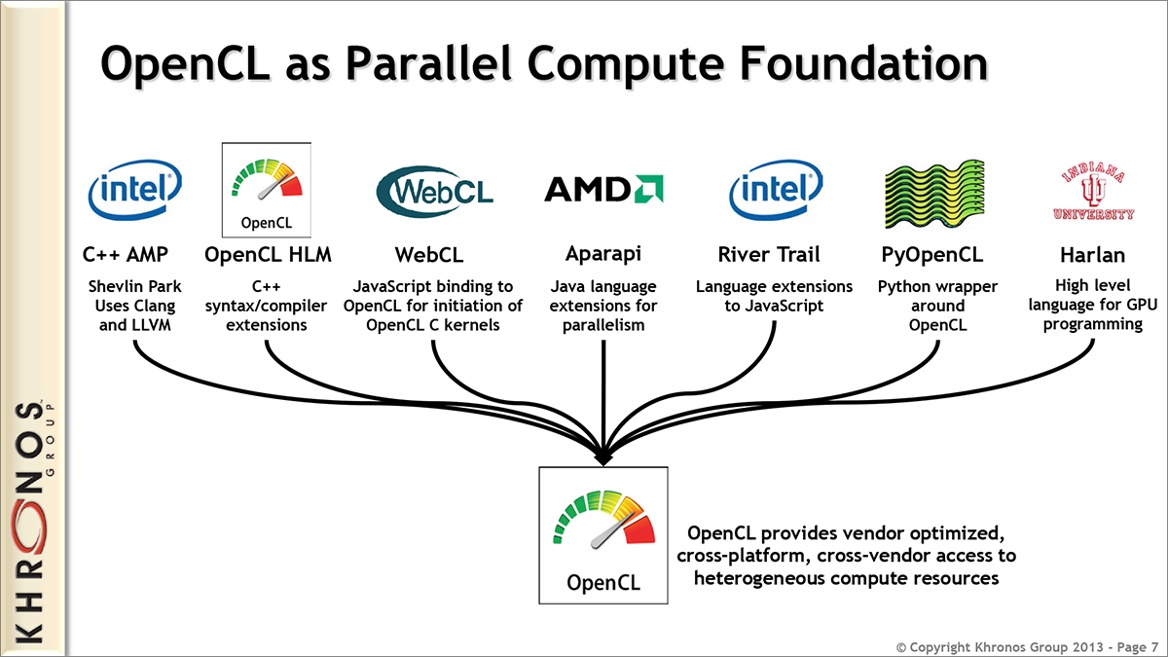
Lecture 23: Parallel Computing – Alternatives to CUDA
Books:
Introduction to Parallel Computing
Lectures:
Introduction to OpenCL
Using OpenCL
Hello World in OpenCL
Topics:
Parallel Computing Models
Introduction to Parallel Models
Open Computing Language
Vulkan Compute
Hands-On Introduction
CUDA vs. OpenCL

