Slide 1
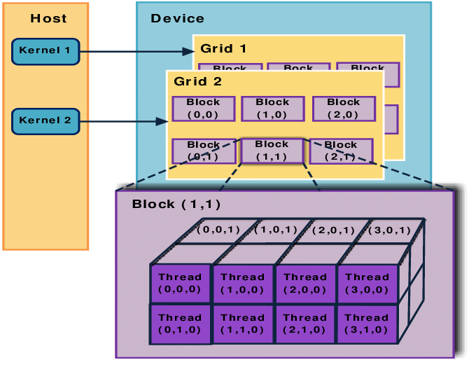
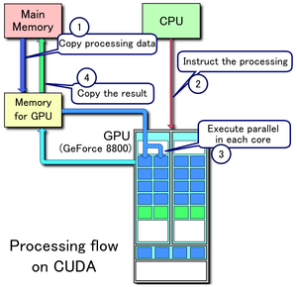
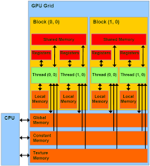
Lecture 17: Basic GPU Programming – Using Multiple GPUs (Manual)
Books:
CUDA By Example
Multi-GPU Programming
Lectures:
GPU Programming with Modern C++
Nvidia CUDA Explained
Topics:
Using Multiple GPUs
Understanding CUDA Streams
Parallel Programming with CUDA

