Slide 1
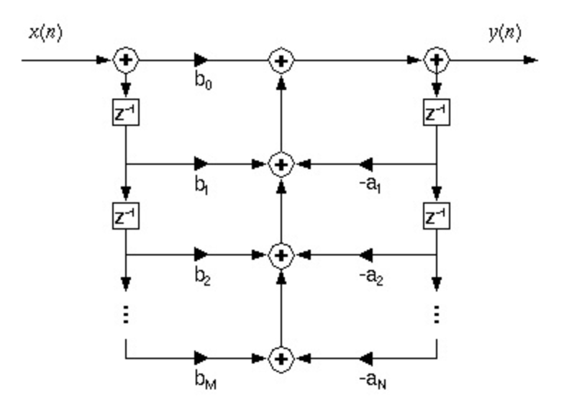
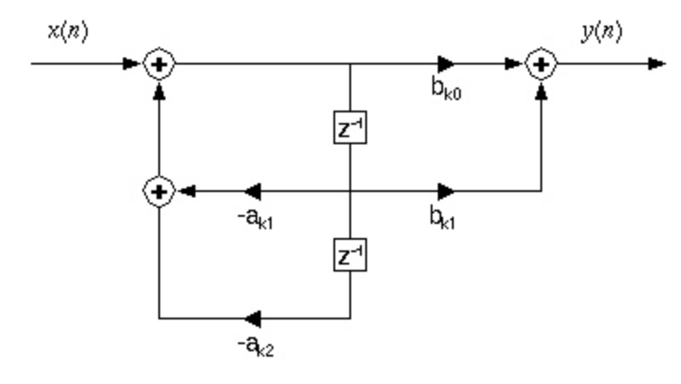
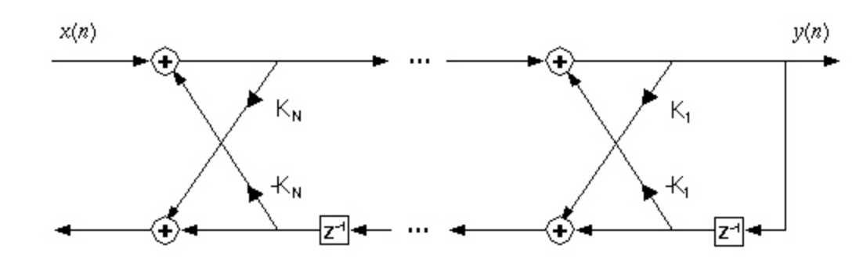
Lecture 09: DSP Review – Real-Time Systems
Topics:
A/D Converters
Sampling
Framing and Windowing
Implications of Framing
Latency
Performance Considerations

