Slide 1
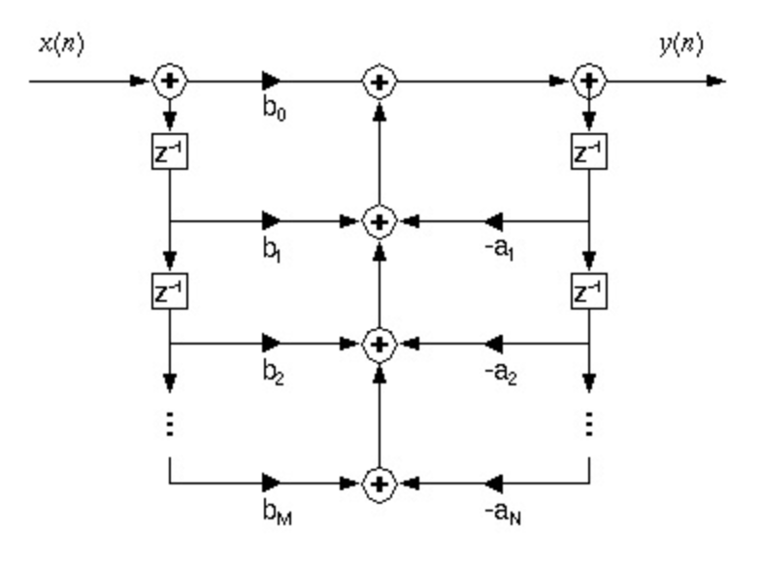
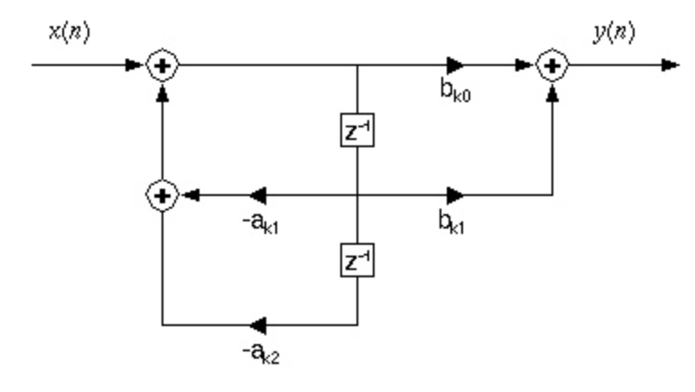
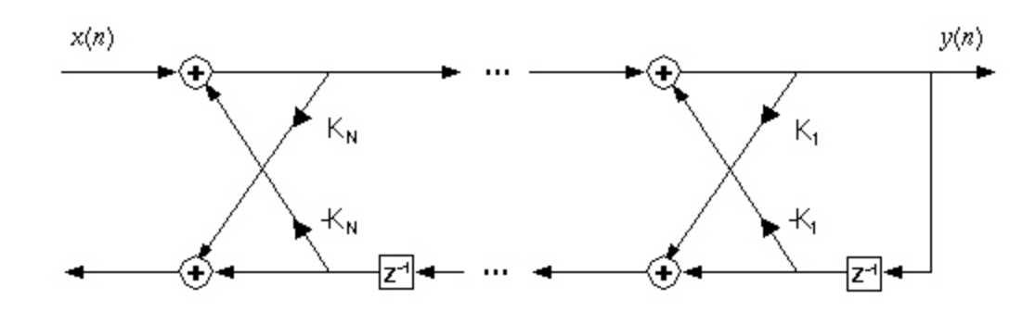
Lecture 08: DSP Review – Digital Filtering and Factoring Computations
Topics:
Direct Form Filters
Filter Realizations

