Slide 1
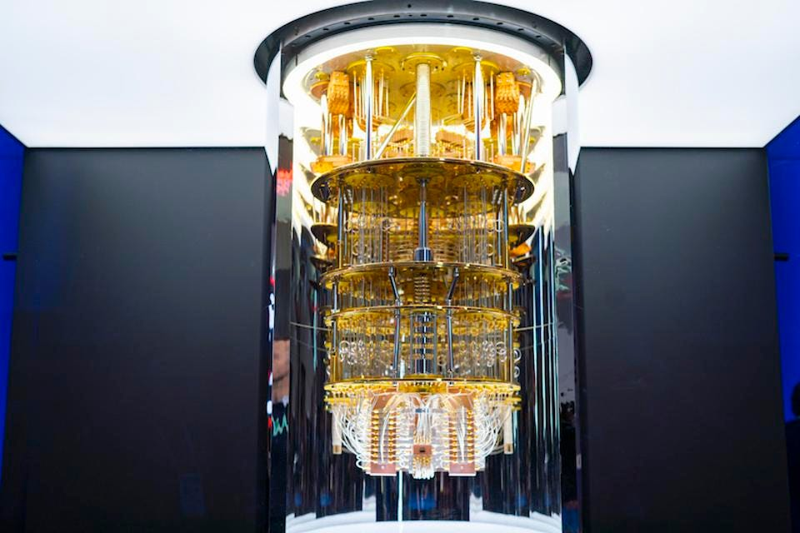
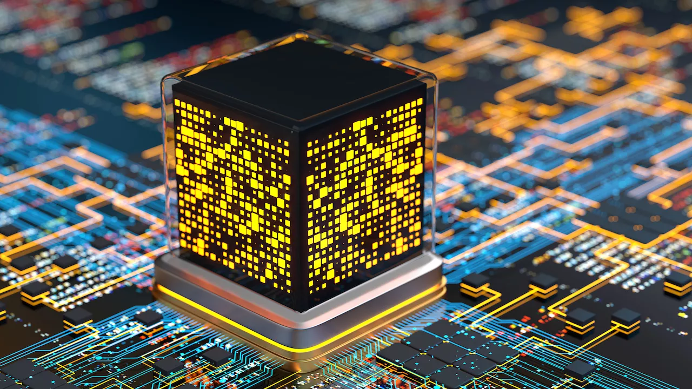
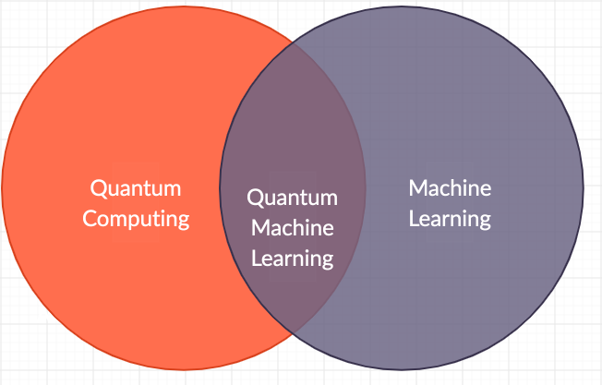
Lecture 41: Introduction to Quantum Computing
Books:
Quantum Computing: A Gentle Introduction
Lectures:
Quantum Machine Learning
Topics:
Quantum Computing For The Very Curious
Quantum Machine Learning

