Slide 1
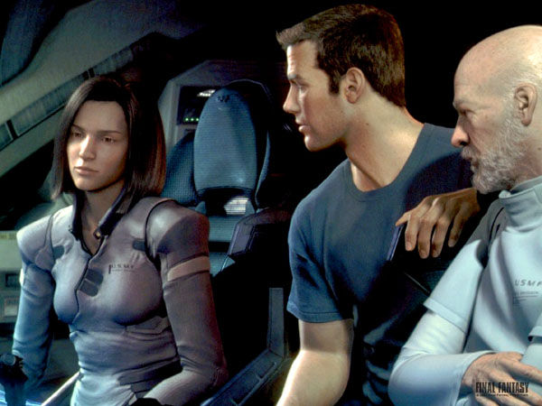


Lecture 40: Ray Tracing and Texture Mapping on a GPU
Books:
Ray Tracing in One Weekend
Computer Graphics: Principles and Practice
Lectures:
Ray Tracing in C++
GPU Ray Tracing
Topics:
Ray Tracing on a GPU

