Slide 1
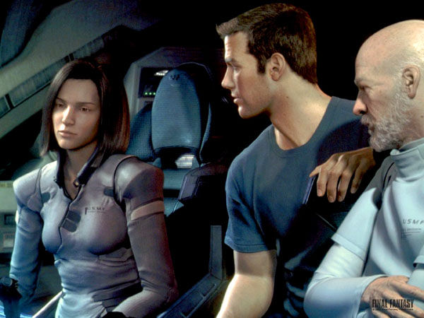

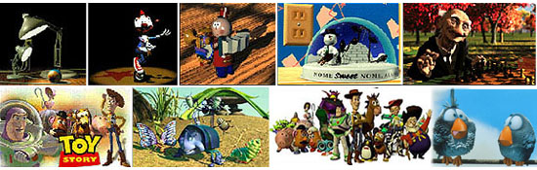
Lecture 39: Ray Tracing
Books:
Ray Tracing in One Weekend
Computer Graphics: Principles and Practice
Lectures:
Ray Tracing in C++
GPU Ray Tracing
Topics:
Introduction to Real-Time Ray Tracing
GPU Ray Tracing
Dynamic Parallelism and Recursion

Slide 2
Rendering – Raytracing
CSE 3541/5541
Matt Boggus

Slide 3
Overview
Ray tracing basic concepts
PPM image file format
Ray generation and collision
Lighting and shading
Recursive ray generation

Slide 4
Ray tracing algorithm
Image plane
Eye
Loop over all pixels
  Shoot ray through each pixel
  Determine the color of the object at the point of intersection
Notes:
Figures modified from Rick Parent’s 681 slides:
http://web.cse.ohio-state.edu/~parent.1/classes/681/WI11/schedule.html

Slide 5
Recursive rays
Image plane
Eye
Notes:
Figures modified from Rick Parent’s 681 slides:
http://web.cse.ohio-state.edu/~parent.1/classes/681/WI11/schedule.html

Slide 6
Image output

Slide 7
Generating the initial rays

Slide 8
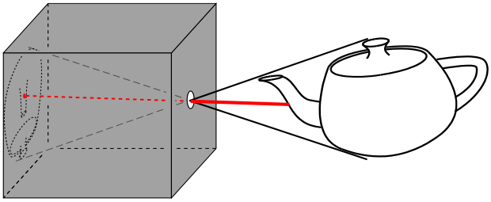
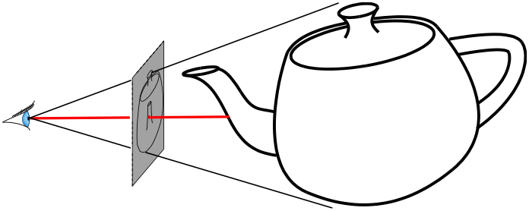
Pin-hole camera model
pin-hole camera
simplified pin-hole camera
Notes:
Figures modified from Rick Parent’s 681 slides:
http://web.cse.ohio-state.edu/~parent.1/classes/681/WI11/schedule.html

Slide 9
Pin-hole camera model
pin-hole camera
Camera’s forward and up vectors
simplified pin-hole camera
Notes:
Figures modified from Rick Parent’s 681 slides:
http://web.cse.ohio-state.edu/~parent.1/classes/681/WI11/schedule.html

Slide 10
Defining the image frame
Width ; number of columns
Height ; number of rows

Slide 11
Defining the image frame
camera
r(t)
p [ a point in the image plane ]
t=0
p [center of image frame] = camera.position + camera.forward * distanceToImageFrame
4 adjacent pixels: p + dx * camera.right ; p – dx * camera.right ;
p + dy * camera.up ; p – dy * camera.up

Slide 12
Ray construction – perspective and orthographic projects
Boardwork examples

Slide 13
Ray intersection testing in Unity
Physics.Raycast
Video tutorial
Raycast rendering algorithm:
Foreach ray r corresponding to one pixel[x,y] in image frame
if(r hit nothing)
pixel[x,y] = background color
else(r hit object o)
pixel[x,y] = color of object o at point of intersection with r

Slide 14
Lighting and Shading calculations

Slide 15
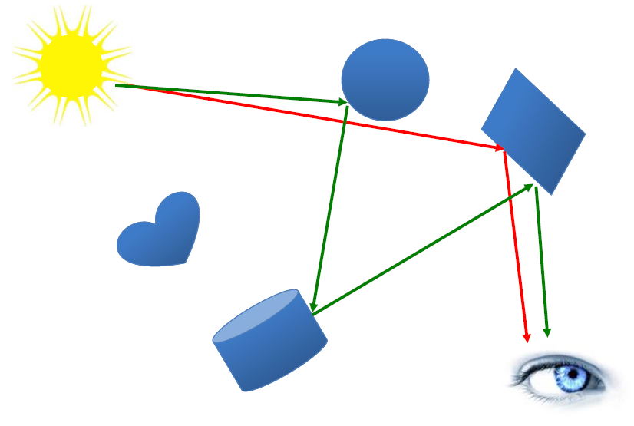
Physics of light
Red lines – single bounce ; local illumination
Green lines – multiple bounce ; global illumination

Slide 16
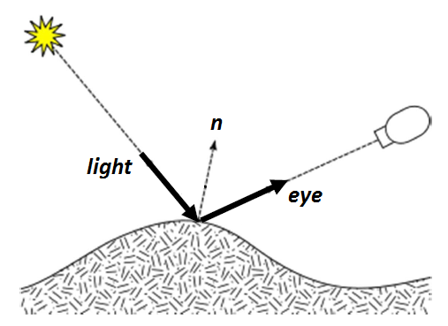
Vectors for light modeling

Slide 17
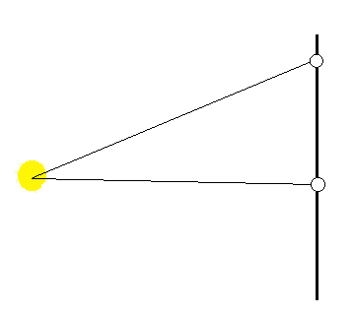
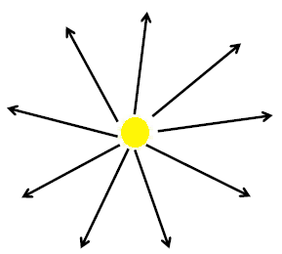
Point light
Emit light in all directions
Vector from point to light

Slide 18
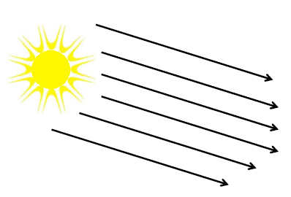
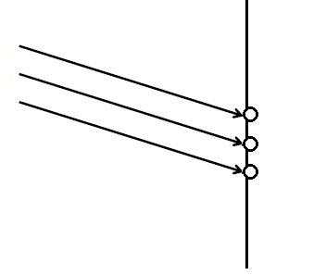
Directional light
Light vector always the same

Slide 19
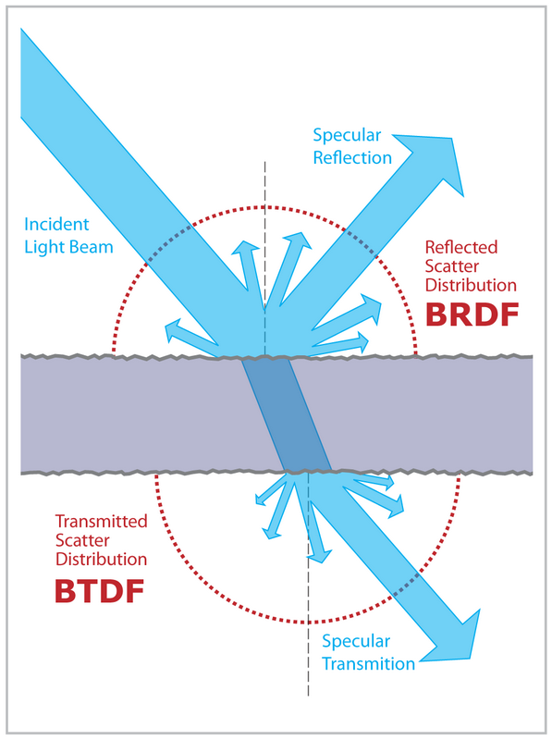
Light scattering on a surface
Figure from http://en.wikipedia.org/wiki/Bidirectional_scattering_distribution_function

Slide 20
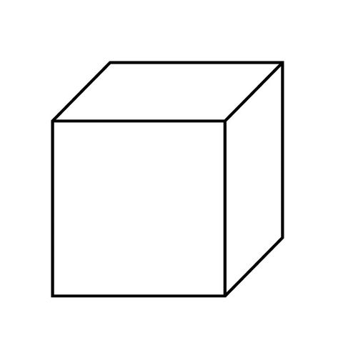
Normals of points on a cube face

Slide 21
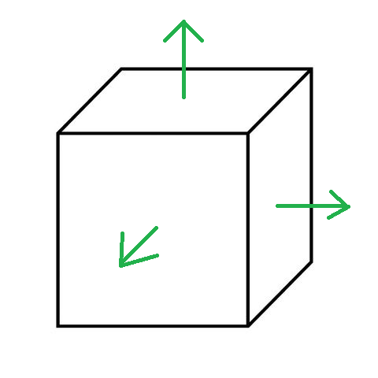
Normals of points on a cube face
Remember: the transform component has vectors for forward, up, and right

Slide 22
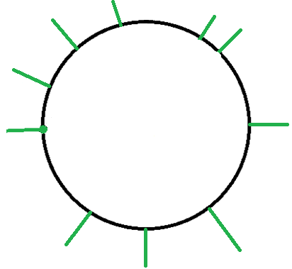
Normals of points on a sphere

Slide 23
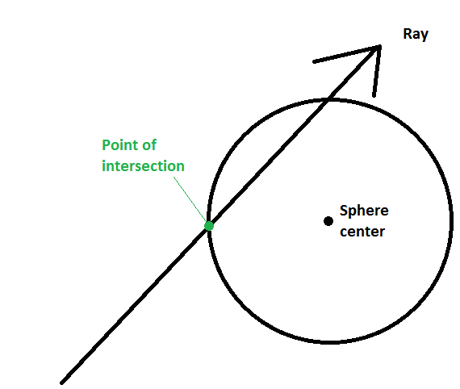
Normal of a point on a sphere

Slide 24
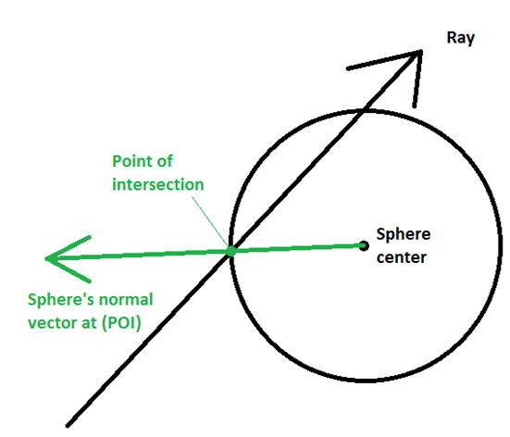
Normal of a point on a sphere

Slide 25
Defining light and material properties
(Red, Green, Blue) values
  For a light source, intensity
  For the material of an object, reflectivity
  Color = intensity * material
Examples:
  (1,1,1) white light, (1,1,1) white object ; object appears white
  (1,0,0) red light, (1,1,1) white object ; object appears red
  (1,1,1) white light, (1,0,0) red object ; object appears red
  (1,1,0) yellow light, (0,1,1) cyan object ; object appears green

Slide 26
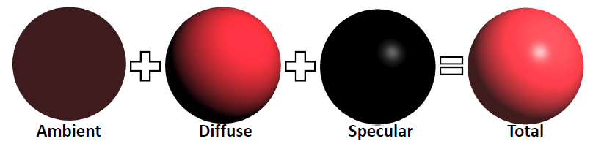
Phong illumination model

Slide 27

Ambient illumination
Approximation for global illumination
L_{ambient} = I_{ambient} * K_{ambient}
[Light = Intensity * Material]
Often I_{ambient} just a constant
Notable exceptions:
  Ambient occlusion
  Radiant flux

Slide 28
Diffuse illumination
Diffuse reflection assumes that the light is equally reflected in every direction.
In other words, if the light source and the object has fixed positions in the world space, the camera motion doesn’t affect the appearance of the object.
The reflection only depends on the incoming direction. It is independent of the outgoing (viewing) direction.

Slide 29
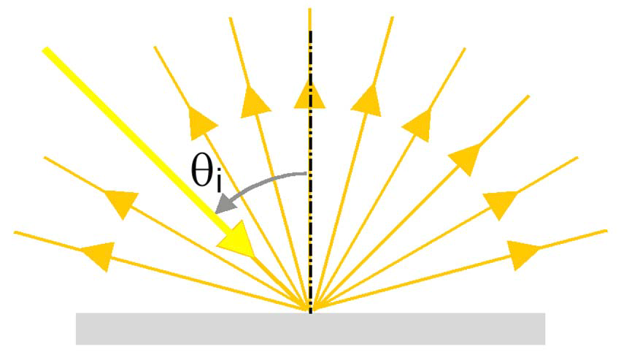
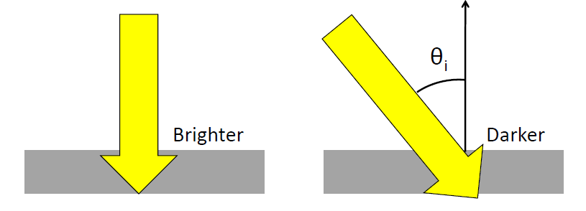
Diffuse illumination
L_{diffuse} = I_{diffuse} * K_{diffuse} * cos θ_{i}

Slide 30
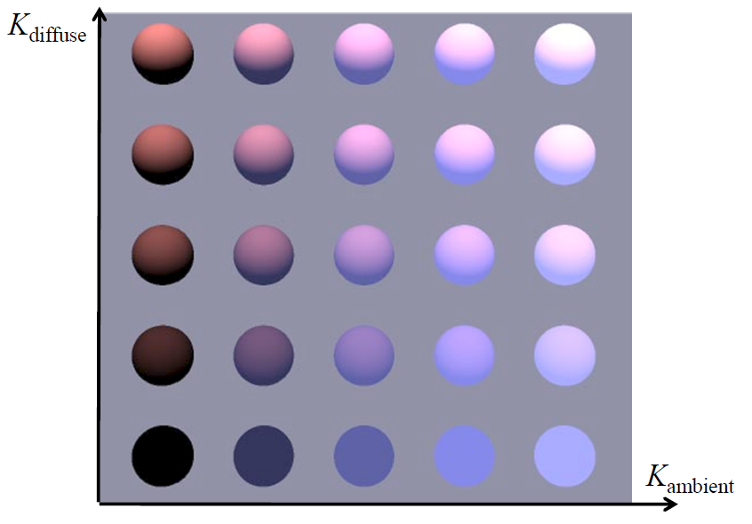
Ambient and Diffuse illumination example

Slide 31
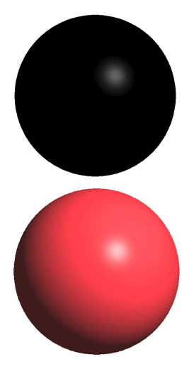
Specular illumination
Some materials, such as plastic and metal, can have shiny highlight spots.
This is due to a glossy mirror-like reflection.
Materials have different shininess/glossiness.

Slide 32
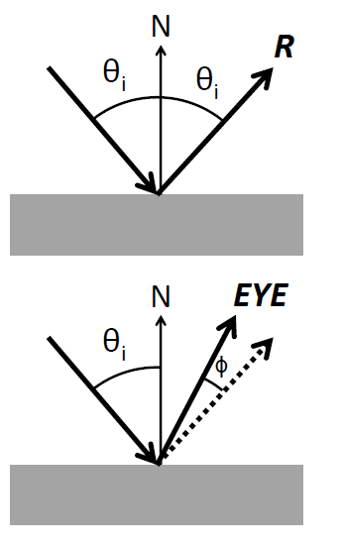
Specular reflection
R = 2(L⋅N)N- L
L_{specular} =
I_{specular} * K_{specular} * cos^{n} φ
n is shininess coefficient
φ is the angle between EYE and R

Slide 33
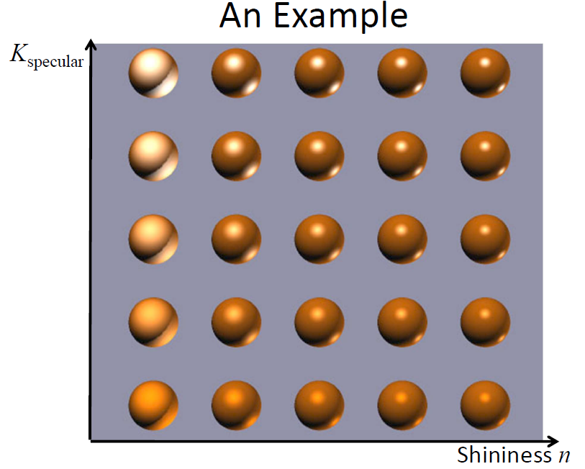
Specular illumination example

Slide 34
Algorithm to ‘color’ a ray
Color shade(R)
{
intersect objects – get closest intersection
c = ambient
For each light source
Add in diffuse and specular components to c
Return c
}

Slide 35
Recursively generated rays

Slide 36
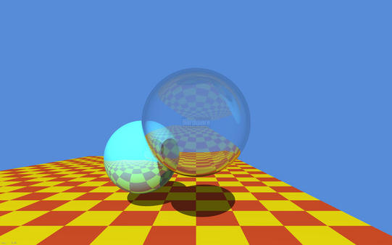
Shadows, reflections, and refractions

Slide 37
Shadows
Determine when light ray is blocked from reaching object
Ray-object intersection calculation
For each pixel
for each object
for each light source
for each object

Slide 38
Shadow algorithm (expands the code iterating over light sources)
For each light source i
  If face is backface with respect to light source (determined using normal)
    Set IN-SHADOW to TRUE
  else
    Set IN-SHADOW to FALSE
    Construct ray from point to light source
    For each object
      Test ray-object intersection (between point and l.s.)
      If intersection found
        Set IN-SHADOW to TRUE for this light source
        Break out of object loop
  If (NOT IN-SHADOW) add in effect of light source i
  accumulate diffuse light
  accumulate specular light

Slide 39
Reflection
Image plane
Eye

Slide 40
Reflection algorithm (expands previous ‘coloring’ algorithm)
Color shade(ray,recursionDepth)
{
  intersect objects to get point, normal, object
  If (intersection) {
    c = ambient color
    Compute reflective ray, R, based on ray and normal
    For each light source
      Compute and add in diffuse and specular components to c
    If ( (recursionDepth < maxRecursion) && (object is shiny) )
      c += object.shininess * shade(R,recursionDepth+1)
  }
  Else c = backgroundColor;
  Return c
}

Slide 41
Transparency & Refraction
Ray changes direction in transition between materials
Material properties give ratio of in/out angles
Details in the additional slides

Slide 42
Additional slides

Slide 43
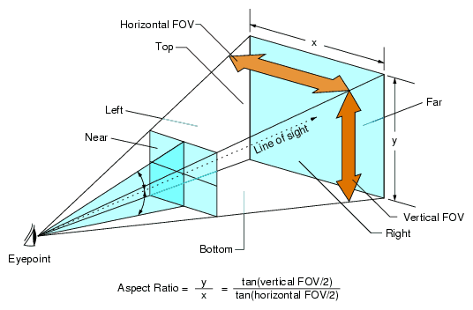
Various parameters for field of view
Notes:
Image source https://pcgamingwiki.com/wiki/Glossary:Field_of_view_(FOV)#/media/File:Fov_diagram.png

Slide 44
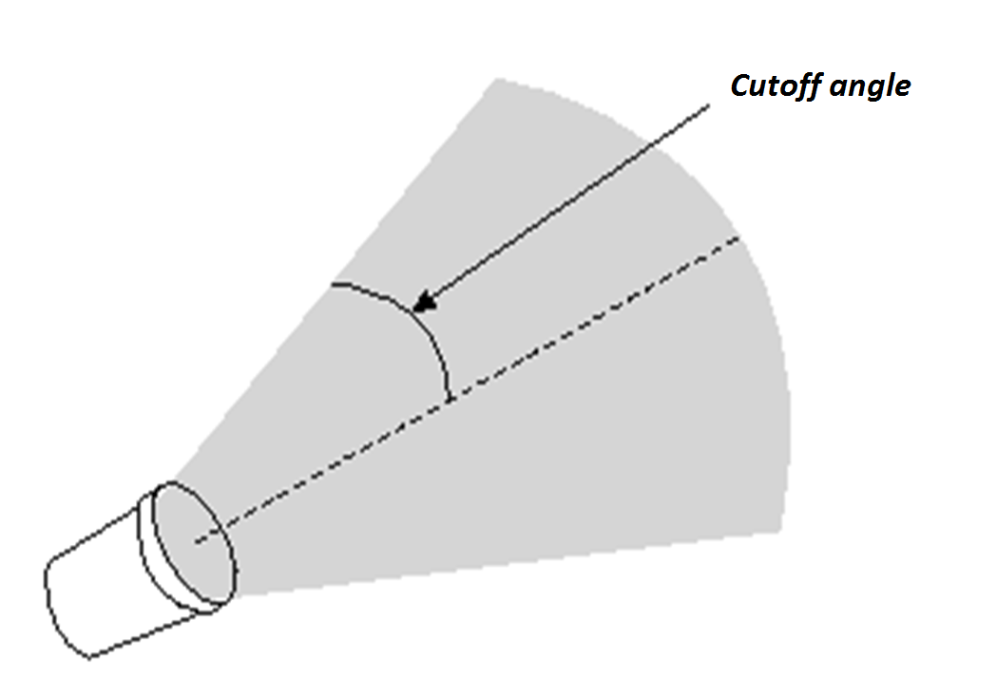
Spotlight

Slide 45
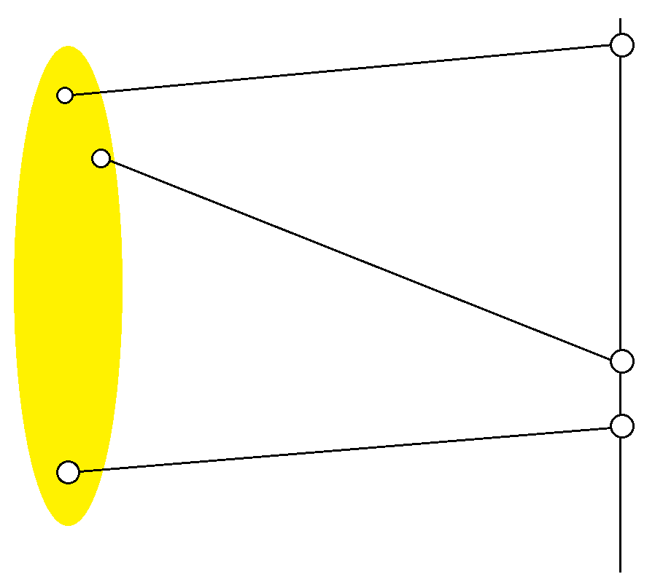
Area light
Requires sampling – pick point on the light then generate the vector from point on the surface to point on the light

Slide 46
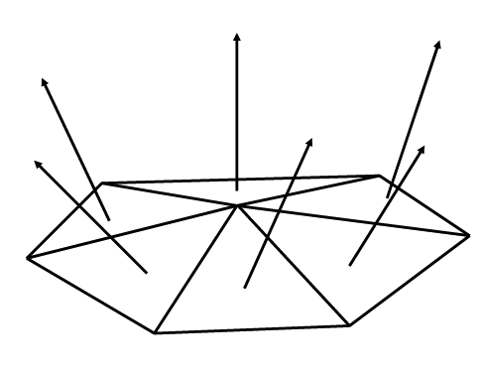
Normal of polygon(s)

Slide 47
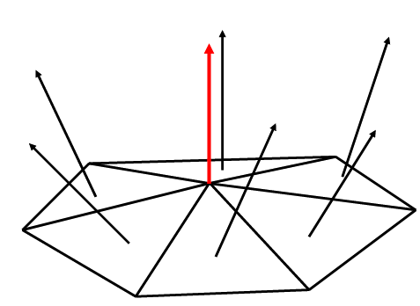
Normal of vertex
Average the normals of the polygons it is used in

Slide 48
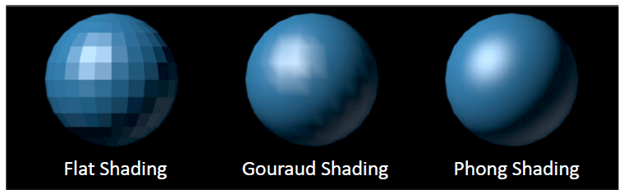
Shading model comparison
Flat shading – one normal per polygon
Gouraud shading – one normal per vertex ; compute color of a point on the polygon by:
computing color at each vertex and linearly interpolate colors inside the polygon
Phong shading – one normal per vertex ; compute color of a point on the polygon by:
linearly interpolate the normal vector, then perform lighting calculation

Slide 49
Optimizations

Slide 50
Sampling and Aliasing
Problem: Representing pixel by a single ray.
Notes:
Using higher resolution won’t solve problem.
No matter how small pixels are, objects can be smaller.

Slide 51
Efficiency
1280 x 1024 = 1,310,720 ≈ 10⁶ pixels.
10⁶ initial rays.
10⁶ reflection rays.
Potentially 10⁶ refraction rays.
3 x 10⁶ shadow rays (3 lights.)
Next level:
Potentially 4 x 10⁶ refraction/reflection rays.
1,000,000 polygons.
10⁷ x 10⁶ = 10¹³ ray-polygon intersection calculations.
Notes:
No anti-aliasing.

Slide 52
Intersection Data Structures
Coarse test to see if a ray could *possibly* intersect object
  OR
Divide space up
– sort objects into spatial buckets
– trace ray from bucket to bucket

Slide 53
Bounding Boxes

Slide 54
Spatial Subdivision

Slide 55
Additional / Cut Slides

Slide 56
Refractive Ray Tracing
Same idea as Reflective ray tracing – spawn a secondary ray
The direction of the spawned ray is in the direction of the incoming ray altered a little bit
The alteration is based on the material that the ray is leaving (e.g. air) and the material that the ray is entering (e.g., glass)
Once this direction is computed, then the shade routine is called recursively, just as with reflective rays.

Slide 57
Refractive Ray Tracing
dir
n
θ₁
Medium c₁
Medium c₂
Τ₂
θ₂
Snell’s Law

Slide 58
Refractive Ray Direction
dir
cos(θ₁) = -dir·n
θ₁
n
sin(θ₁) = sqrt(1- cos²(θ₁))
sin(θ₂) = n₁*sin(θ₁)/n₂
θ₂
cos(θ₂) = sqrt(1 - sin²(θ₂))
cos(θ₂) = sqrt(1 - (n₁*sin(θ₁)/n₂)²)
cos(θ₂) = sqrt(1 - (n₁/n₂)²* (1- cos²(θ₁)))
cos(θ₂) = sqrt(1 - (n₁/n₂)²* (1- (dir·n)²)
NOTE: if radical is negative, no refraction!

Slide 59
Refractive Ray Direction
n
Go cos(θ₂) in the -n direction
Go sin(θ₂) in the orthogonal direction
(while still in the plane of dir and n)
θ₁
dir
This direction (scaled by sin(θ₁)) is: dir - (dir·n)n
And scaled by sin(θ₂) is: (n₁/n₂)(dir-(dir·n)n)
T = (n₁/n₂)dir - (n₁/n₂)(dir·n)n - cos(θ₂)n

Slide 60
Recursive Ray Tracing
Color shade(ray,recursionDepth)
{
  intersect objects…
  compute R …
  Process each light source …
If (recursionDepth < maxRecursion) {
      If (object is shiny) c += shininess * shade(R, recursionDepth+1)
      If (object is transmittive) {
  Compute refractive ray, T, based on ray, normal, and Snell constants
      c = (1-transmittive)*c + transmittive * shade(T, recursionDepth+1)
      }
  }
  Return c
}

Slide 61
Refractive Intersection Normal

Slide 62
Recursive Ray Tracing
ray
n
R1
T1
R2
T2
T3
R3

Slide 63
Reflectivity varies with incident angle
NOTE: refraction is really wavelength dependent (where rainbows come from).
Fresnel equations
Schlick approximation:
R0 is reflectance at normal incidence:

