Slide 1
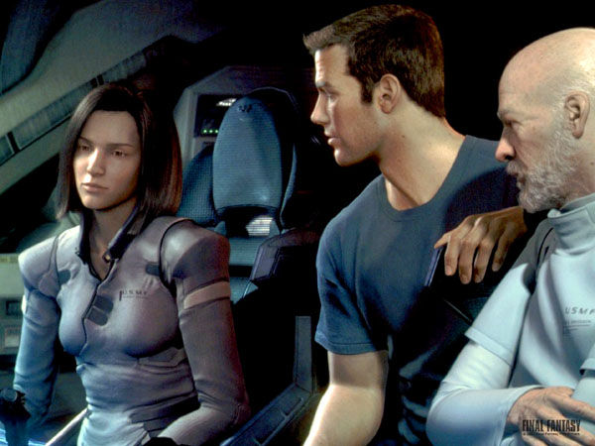

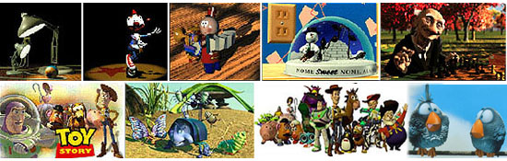
Lecture 38: Introduction to Computer Graphics
Books:
20 Good Books
Computer Graphics: Principles and Practice
Lectures:
Introduction to Computer Graphics
Computer Graphics Course
Topics:
Historical Perspective
The Graphics Pipeline
Application Overview

Slide 2
CS 445
Introduction to Computer Graphics
Fall 2006
Aaron Bloomfield

Slide 3
Overview
Introduction
  What is computer graphics?
Applications
  What is it good for?
Syllabus
  What will I learn in this course?
Coursework
  How much work will there be?

Slide 4
What is Computer Graphics?
Sliced by specialty
  Imaging = representing 2D images
  Modeling = representing 3D objects
  Rendering = building 2D images from 3D models
  Animation = simulating changes over time
  Hardware = computer architecture for graphics

Slide 5
What is Computer Graphics?
Sliced by task
  Creating pictures on a computer
  Interacting with those pictures
  Drawing those pictures faster
  Displaying those pictures bigger, brighter
  Simulating physical phenomena
  Visualization of complex data
  Acquiring real-world geometry
  Simulating plants
  Video games
  Breaking stuff
  …

Slide 6
Why is Graphics Cool?
Interdisciplinary
  Biology, Physics, Math, Psychology, CS, Art
Visual
Interactive
Work can be demoed to technically illiterate friends
Movies
Games
Money
  Video games: $11B (2004)
  Movies: $8.5B (2001)

Slide 7
Overview
Introduction
  What is computer graphics?
Applications
  What is it good for?
Syllabus
  What will I learn in this course?
Coursework
  How much work will there be?

Slide 8
Entertainment (passive)
Final Fantasy (Square, USA)

Slide 9
Entertainment (passive)
A Bug’s Life (Pixar)

Slide 10
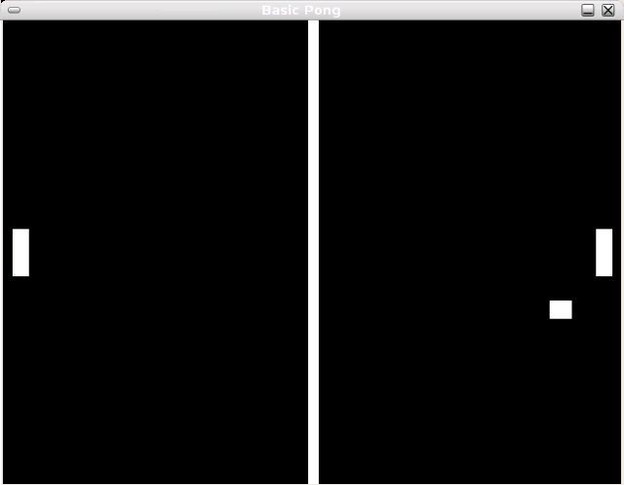
Entertainment (Active)
Pong

Slide 11
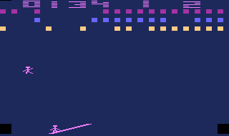
Entertainment (Active)
Circus Atari (Atari)

Slide 12
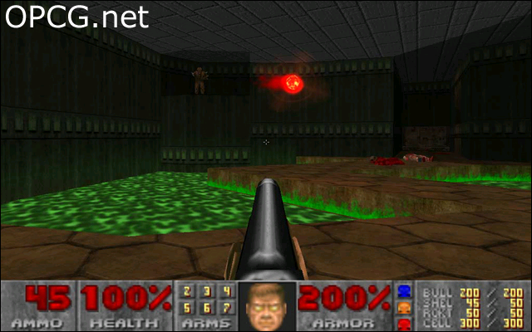
Entertainment (Active)
Doom (ID Software)

Slide 13
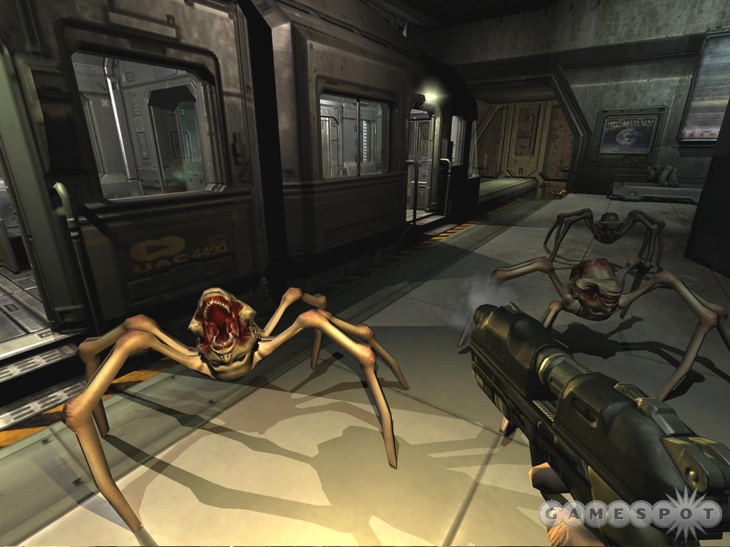
Entertainment (Active)
Doom III (ID Software)

Slide 14
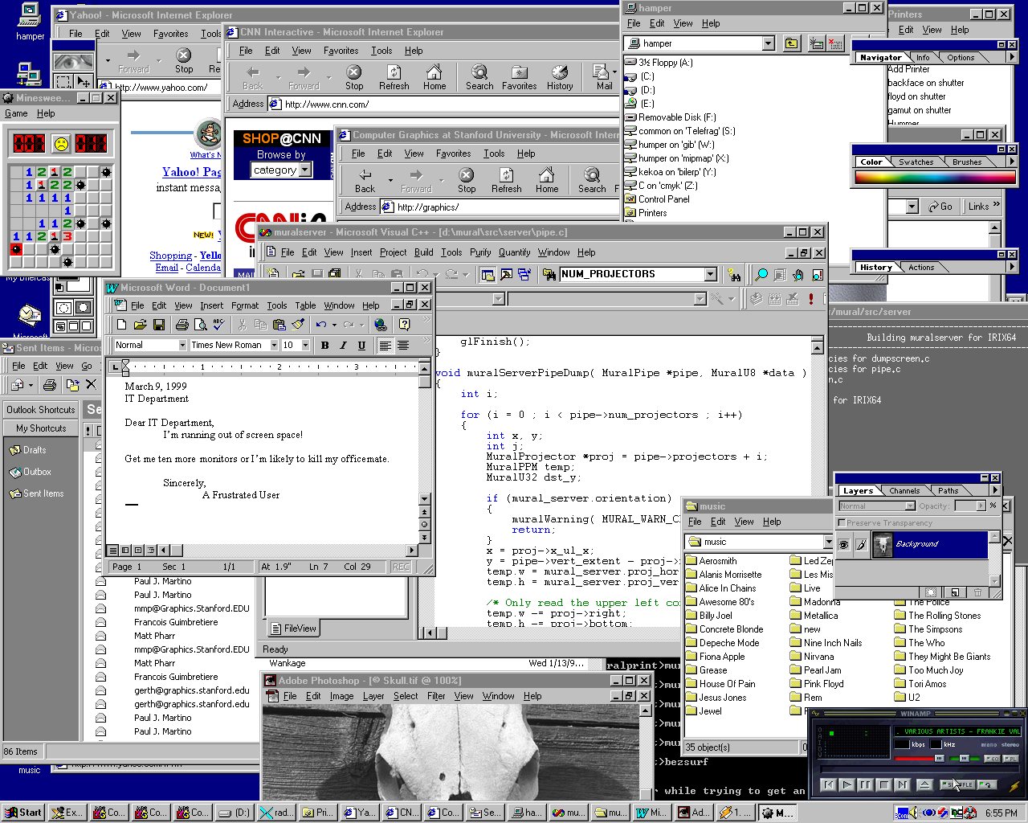
Graphical User Interfaces

Slide 15
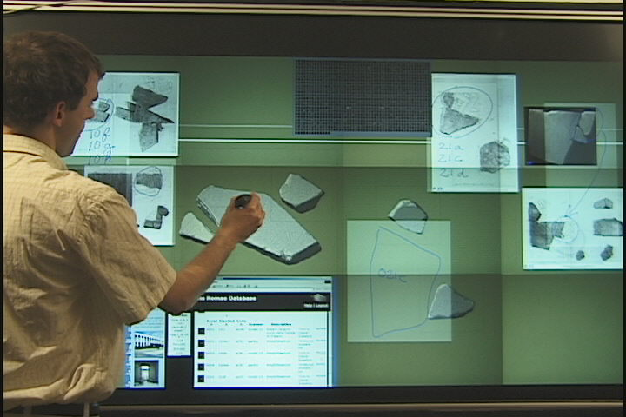
Graphical User Interfaces
Window system and large-screen interaction metaphors (François Guimbretière)

Slide 16
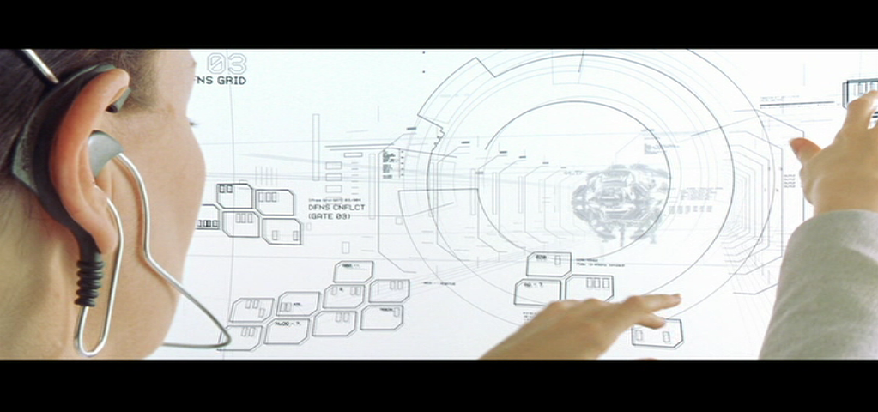
GUIs from The Matrix Reloaded
Matrix Reloaded

Slide 17
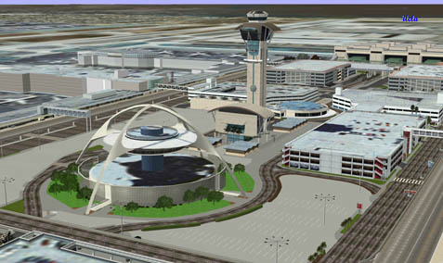
Computer Aided Design
Los Angeles Airport (Bill Jepson, UCLA)

Slide 18
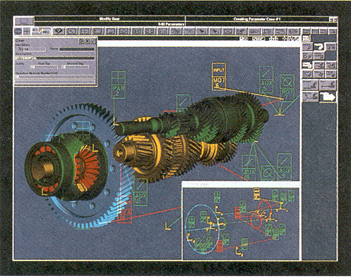
Computer Aided Design
Gear Shaft Design (Intergraph Corporation)

Slide 19
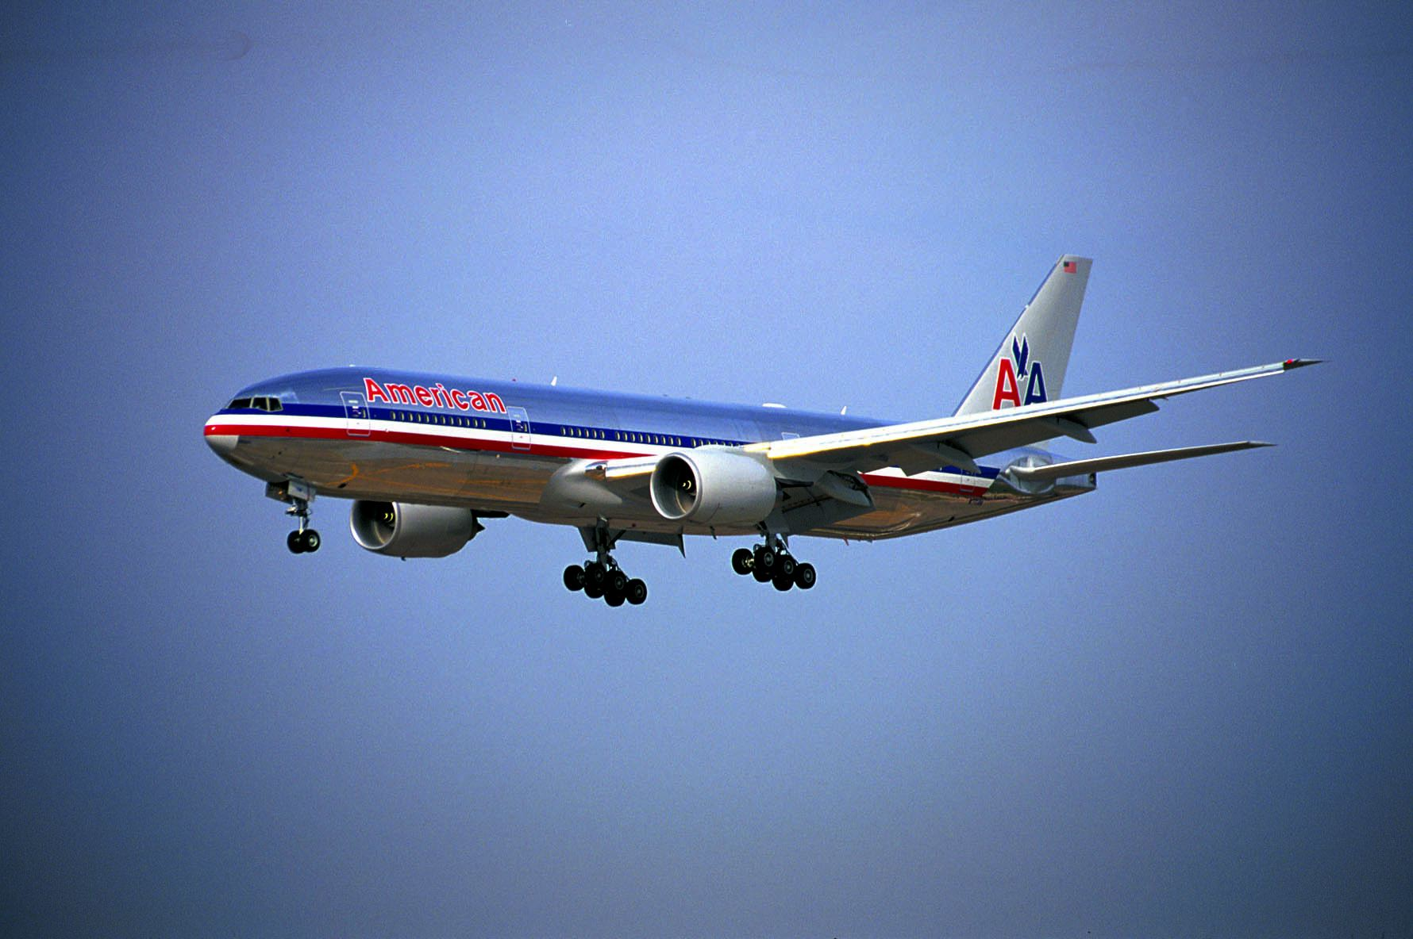
Computer Aided Design
Boeing 777 Airplane (Boeing Corporation)

Slide 20
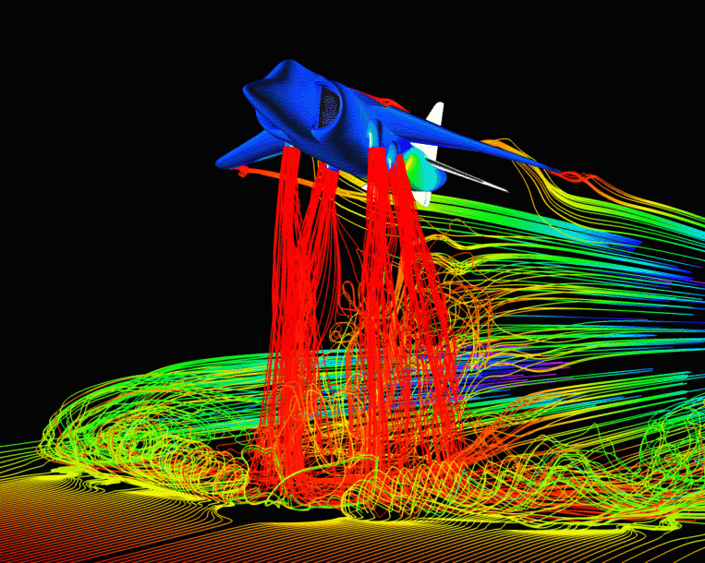
Scientific Visualization
Airflow around a Harrier Jet (NASA Ames)

Slide 21
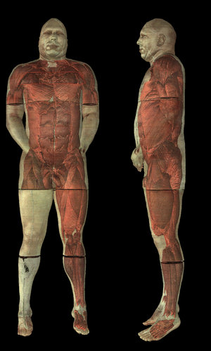
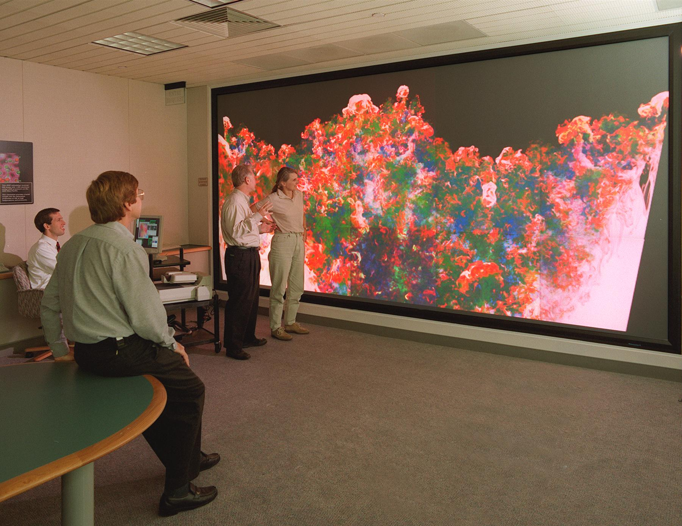
Scientific Visualization
Compressible Turbulence (Lawrence Livermore National Labs)
Visible Human (National Library of Medicine)

Slide 22
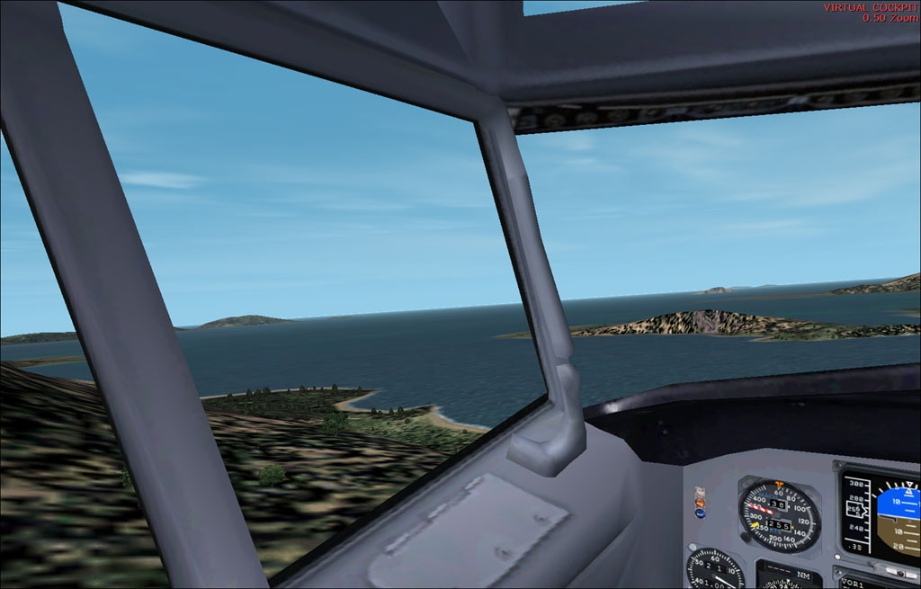
Training
Flight Simulator 2002 (Microsoft)

Slide 23
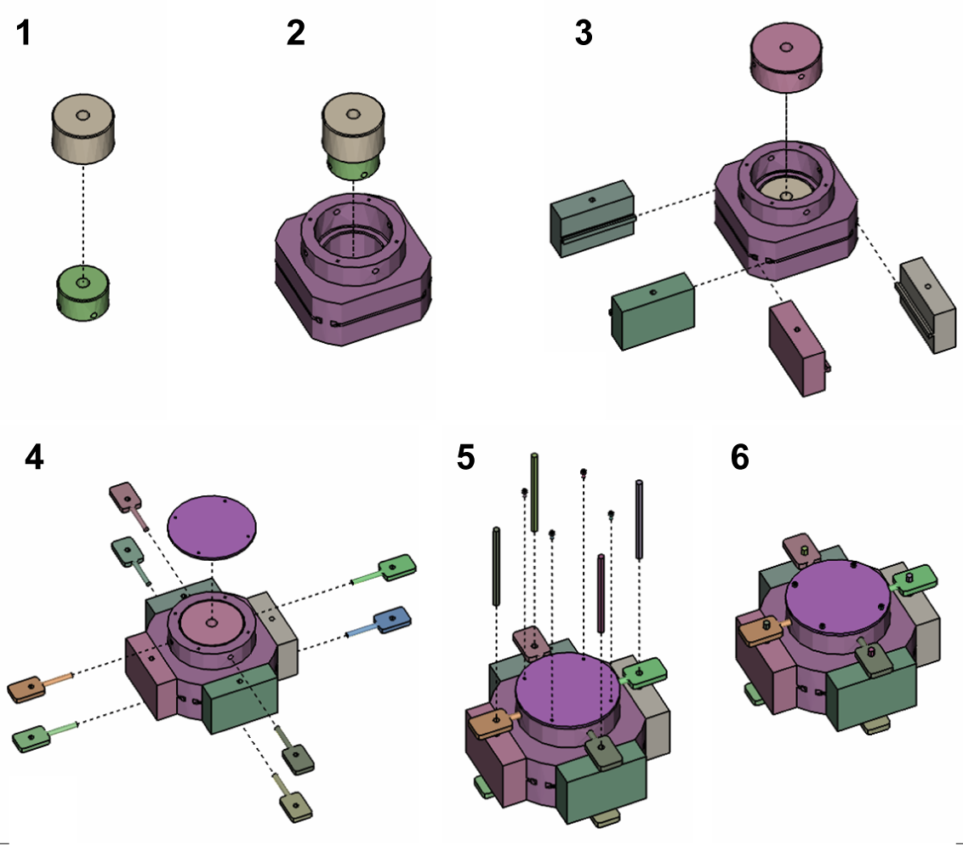
Training
Designing Effective Step-By-Step Assembly Instructions (Maneesh Agrawala et. al)

Slide 24
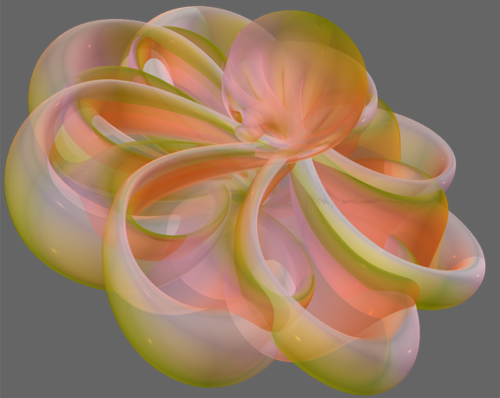
Education
Outside In (Geometry Center, University of Minnesota)

Slide 25
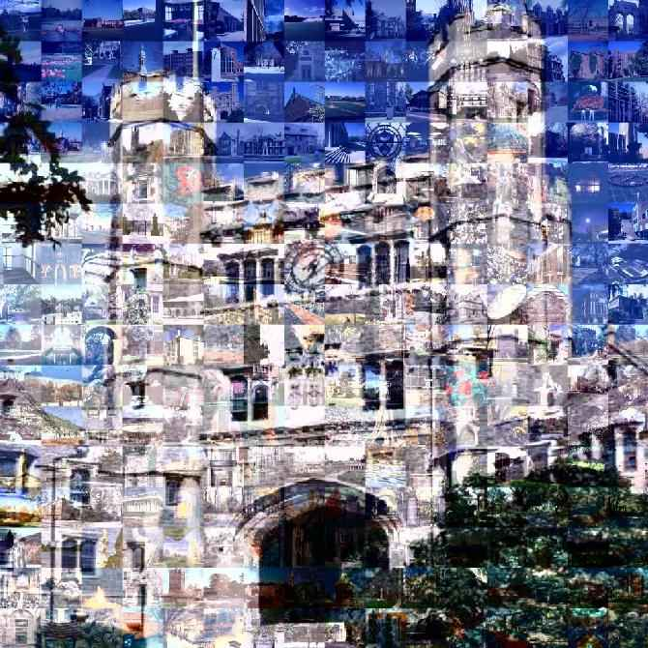
Art
Blair Arch (Marissa Range, Princeton University)

Slide 26
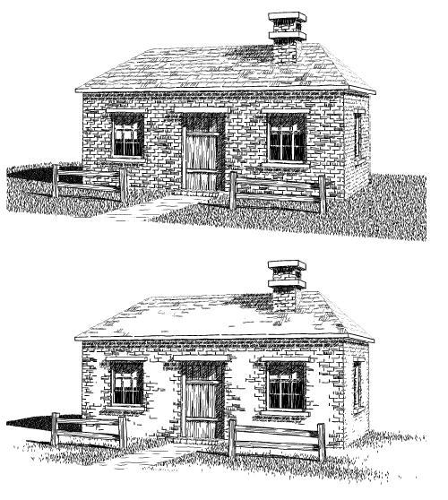
Art
Computer Generated Pen-and-Ink Illustration (Winkenbach and Salesin, University of Washington)

Slide 27
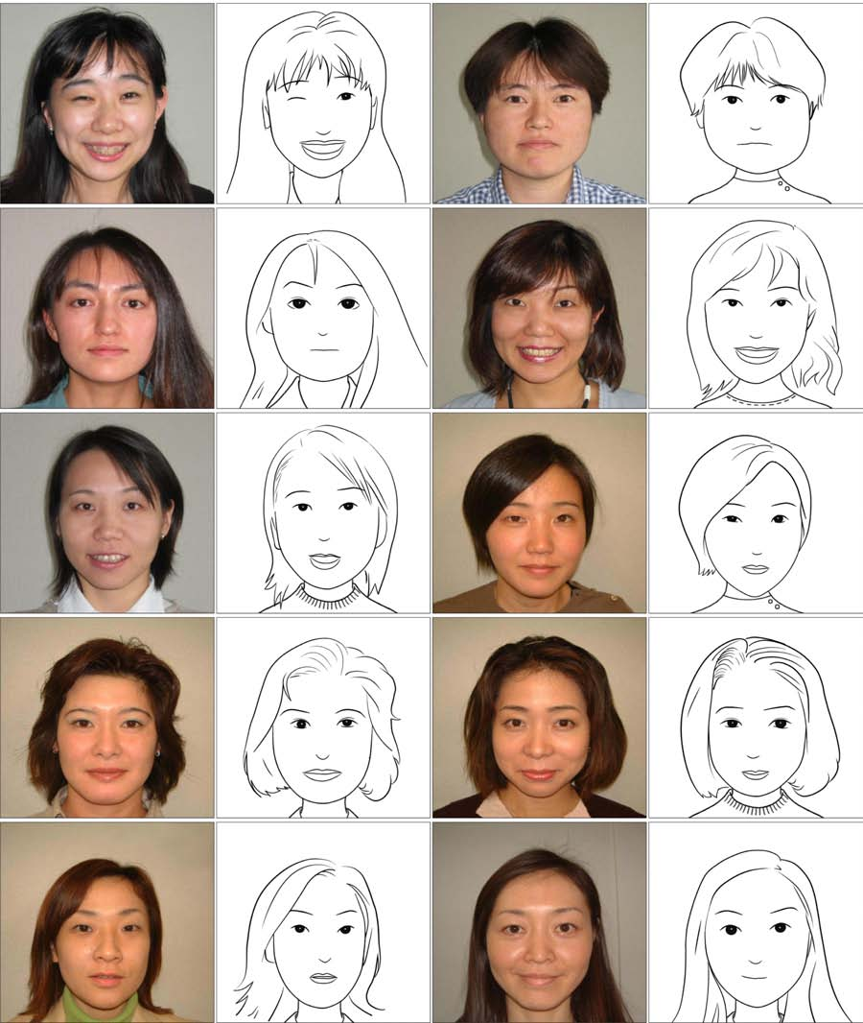
Art
Example-Based Composite Sketching of Human Portraits (Chen et al., MSRA, UCLA, MSR, UW, Microsoft)

Slide 28
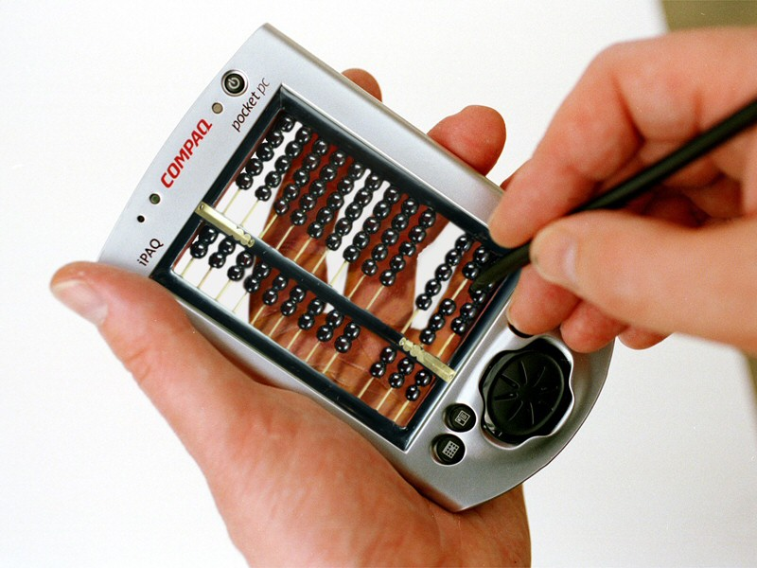
Photo Editing
Pocket PC (Jon Manning, www.worth1000.com)

Slide 29
Overview
Introduction
  What is computer graphics?
Applications
  What is it good for?
Syllabus
  What will I learn in this course?
Coursework
  How much work will there be?

Slide 30
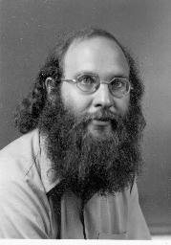

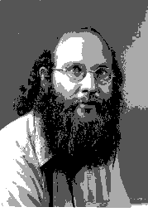
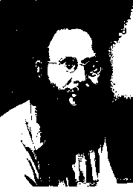
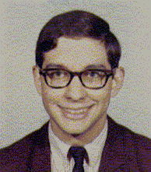
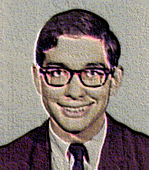
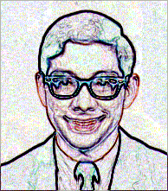
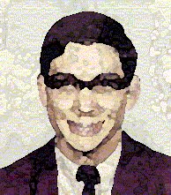
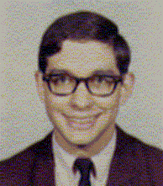
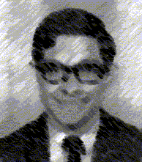
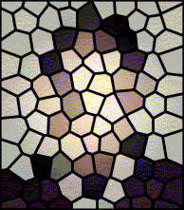
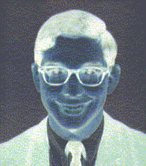
Image Processing
Image Representation
  Sampling
  Reconstruction
  Quantization & Aliasing
Image Processing
  Filtering
  Warping
  Morphing
  Composition
Raster Graphics
  Display devices
  Color models

Slide 31
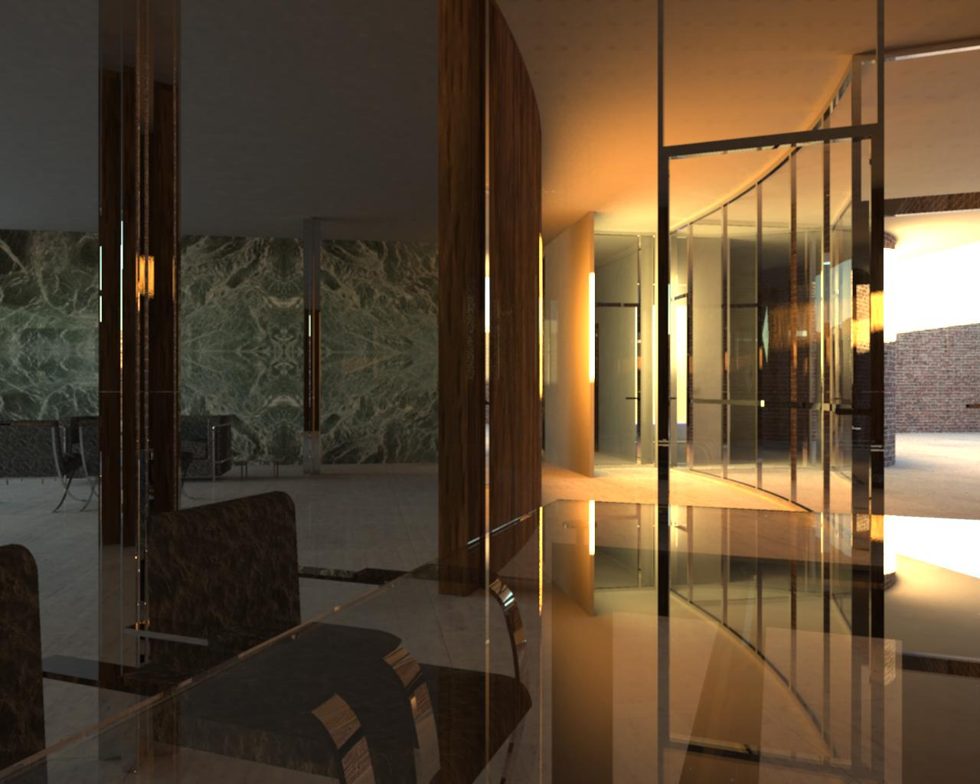
Rendering
3D Rendering Pipeline
  Modeling transformations
  Viewing transformations
  Hidden surface removal
  Illumination, shading, and textures
  Scan conversion, clipping
  Hierarchical scene graphs
  OpenGL
Global illumination
  Ray tracing
  Radiosity
  Monte Carlo

Slide 32
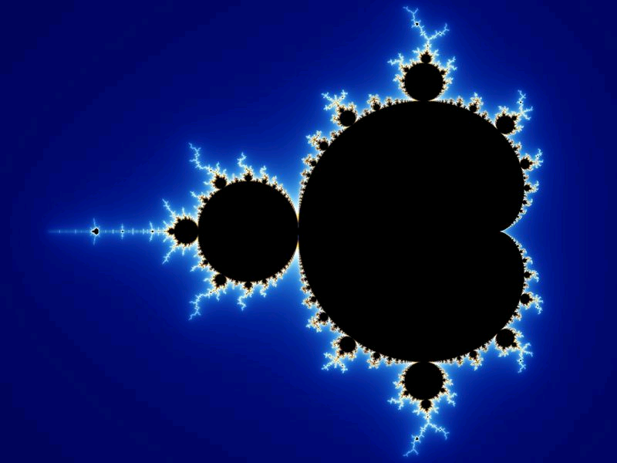
Modeling
Representations of geometry
  Curves: splines
  Surfaces: meshes, splines, subdivision
  Solids: voxels, CSG, BSP
Procedural modeling
  Sweeps
  Fractals
  Grammars

Slide 33
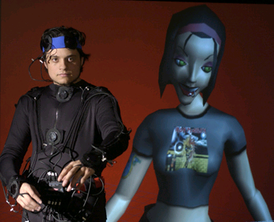
Animation
Keyframing
  Kinematics
  Articulated figures
Motion capture
  Capture
  Warping
  http://hms.upenn.edu/LiveActor/benDance.mov
Dynamics
  Physically-based simulations
  Particle systems
Behaviors
  Planning, learning, etc.

Slide 34
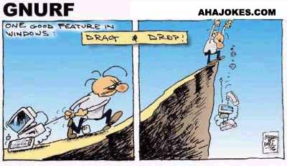
School of Continuing Studies
CS 351: Introduction to
Computer Graphics
CS 351

Slide 35
What is Computer Graphics?
Creation, Manipulation, and Storage of geometric objects (modeling) and their images (rendering)
Display those images on screens or hardcopy devices
Image processing
Others: GUI, Haptics, Displays (VR)...

Slide 36


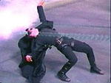
What drives computer graphics?
Movie Industry
  Leaders in quality and artistry
  Not slaves to conceptual purity
  Big budgets and tight schedules
  Reminder that there is more to
  CG than technology
  Hey, How'd they do that?
  Defines our expectations
Slide information from Leonard McMillian's slides
http://www.cs.unc.edu/~mcmillan/comp136/Lecture1/compgraf.html

Slide 37

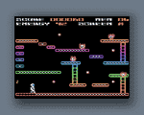
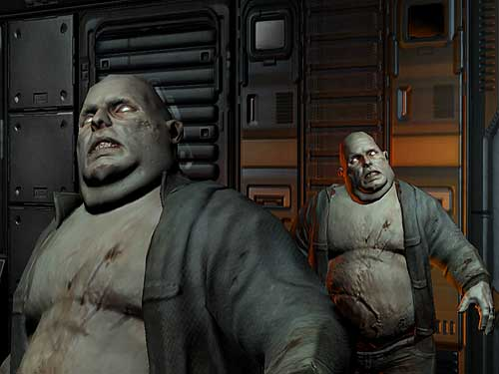
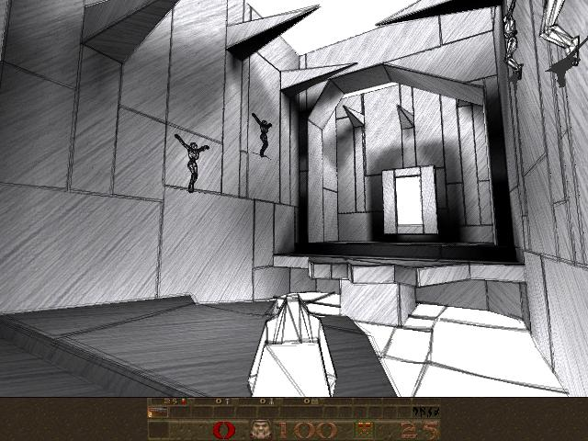
What drives computer graphics?
Game Industry
  The newest driving force in CG
    Why? Volume and Profit
    This is why we have commodity GPUs
  Focus on interactivity
  Cost effective solutions
  Avoiding computating and other tricks
  Games drive the baseline
Slide information from Leonard McMillian's slides
http://www.cs.unc.edu/~mcmillan/comp136/Lecture1/compgraf.html

Slide 38
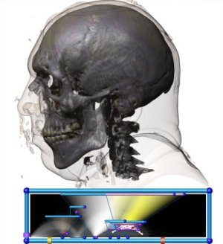
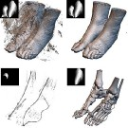
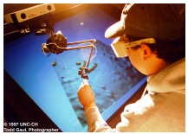
What drives computer graphics?
Medical Imaging and Scientific Visualization
  Tools for teaching and diagnosis
    No cheating or tricks allowed
  New data representations and modalities
  Drive issues of precision and correctness
  Focus on presentation and interpretation of data
  Construction of models from acquired data
Nanomanipulator, UNC
Joe Kniss, Utah
Gordon Kindelman, Utah

Slide 39
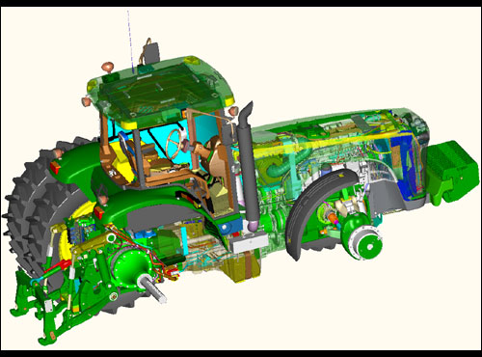
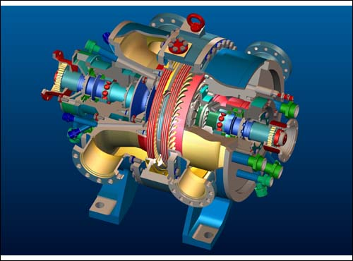
What drives computer graphics?
Computer Aided Design
  Mechanical, Electronic, Architecture,...
  Drives the high end of the hardware market
  Integration of computing and display resources
  Reduced design cyles == faster systems, sooner
ProEngineer, www.ptc.com

Slide 40
What drives computer graphics?
Graphic User Interfaces (GUI)
  www.webpagesthatsuck.com
Slide information from Leonard McMillian's slides
http://www.cs.unc.edu/~mcmillan/comp136/Lecture1/compgraf.html

Slide 41
What is Computer Graphics?
Look at 5 areas
  Hardware
  Rendering
  Interaction
  Modeling
  Scientific Visualization
Slide information from Richard Riesenfeld

Slide 42
Hardware: Amazing Changes
Fundamental architecture shift
  Dual computing engines:
    CPU and GPU
    More in GPU than CPU

Slide 43
Hardware: Amazing Changes
Fast, cheap GPUs
  ~$300
Cheap memory
Displays at low cost
  How many monitors do you have/use?

Slide 44
Hardware: Amazing Changes
Wired -> Unwired
World of Access

Slide 45
Hardware... some not so good
Devices
3D displays
Etc

Slide 46
Hardware
How old is Nvidia
How big is Nvidia
QED

Slide 47
Rendering
Many think/thought graphics synonymous with rendering
Well researched
  Working on second and third order effects
  Fundamentals largely in place

Slide 48
Rendering
Major areas:
  Ealiest: PhotoRealism
  Recent: Non-Photorealistic Graphics (NPR)
  Recent: Image-based Rendering (IBR)

Slide 49
Rendering
Ray Tracing has become practical
  Extremely high quality images
  Photorealism, animation, special effects
Accurate rendering, not just pretty

Slide 50
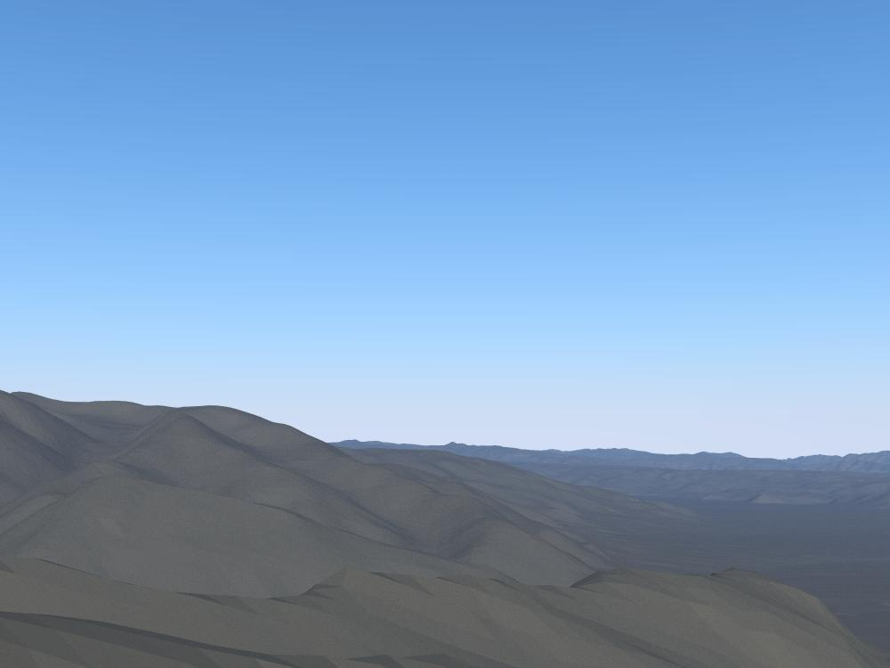
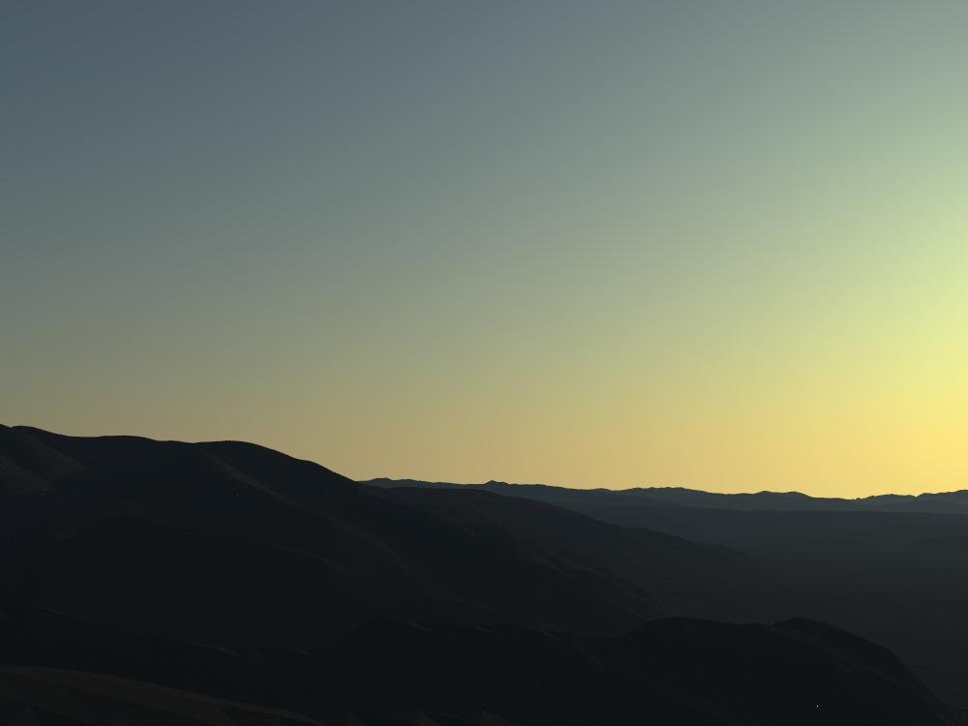
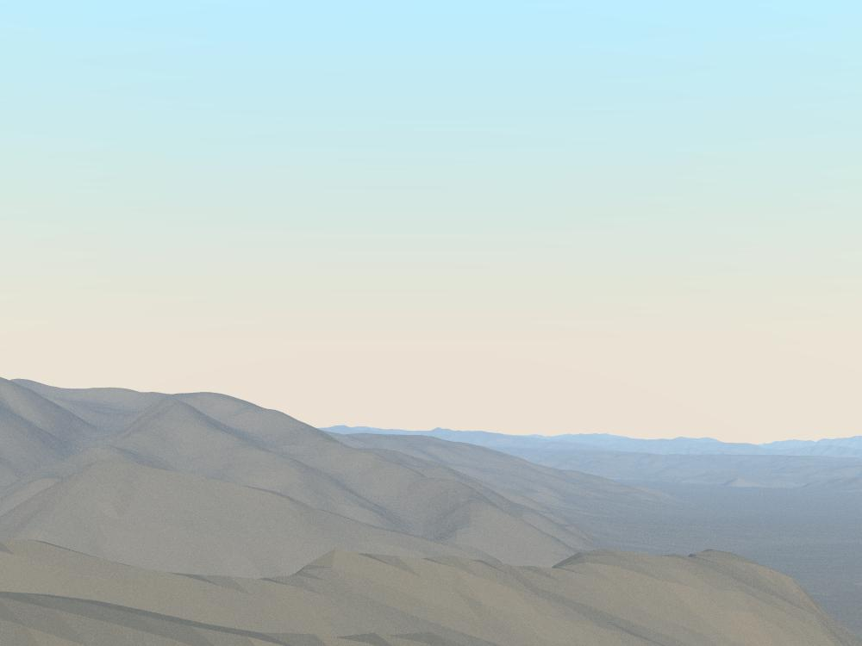

Rendering Realism
Morning
Evening
a preetham, et. al., utah

Slide 51
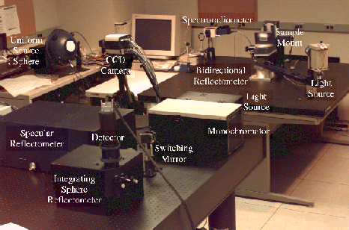
Rendering Realism
Cornel Measurement Lab

Slide 52


Rendering Realism
Real
Synthetic
Shirley, et. al., cornell

Slide 53

Is this real?
m fajaro, usc

Slide 54

Terrain Modeling:
Snow and Trees Added
s premoze, et.al., utah

Slide 55


Growth Models
o deusson,

Slide 56



Rendering/Modeling Hair
http://www.rhythm.com/~ivan/hairRender.html

Slide 57



Humans
Final Fantasy (Sony)
Jensen et al.

Slide 58


Is Photorealism Everything?

Slide 59

Is Photorealism Everything?

Slide 60



Non-Photorealistic Rendering
b gooch, et.al., utah

Slide 61
Tone Shading
a gooch, et. al., utah

Slide 62





NonPhotorealistic Rendering

Slide 63
Image Based Rendering
Model light field
Do not have to model geometry
Good for complex 3D scenes
Can leave holes where no data is available

Slide 64




3D Scene Capture
Fuchs et.al., UNC
UNC and UVA

Slide 65

3D Scene Recreation
Faugeras et. al

Slide 66

360º Scan
p willemsen, et. al., utah

Slide 67
Interaction
Way behind rest of graphic's spectacular advances
Still doing WIMP:
  Windows, icons, menus, pull-downs/pointing
Once viewed as “soft” research
  Turns out to be one of hardest problems

Slide 68

Interaction still needs...
Better input devices
Better output devices
Better interaction paradigms
Better understanding of HCI
  Bring in psychologists

Slide 69




Modeling
Many model reps
  Bezier, B-spline, box splines, simplex splines, polyhedral splines, quadrics, super-quadrics, implicit, parametric, subdivision, fractal, level sets, etc (not to mention polygonal)

Slide 70

Modeling
Physically based
  Newton
  Behavior as well as geometry
Materials
  Metal, cloth, organic forms, fluids, etc
Procedural (growth) models

Slide 71

Modeling... is hard
Complexity
Shape
Specifying
Realistic constraints
Detail vs concept
Tedious, slow
s drake, et. al., utah

Slide 72
Modeling is hard
Mathematical challenge
Computational challenge
Interaction challenge
Display challenge (want 3D)
Domain knowledge, constraints

Slide 73


Growth Models
o deusson,

Slide 74


Model Capture
marc levoy, et. al., stanford

Slide 75


Models
D Johnson and
J D St Germain, Utah
Russ Fish et al., Utah

Slide 76



Scientific Visualization
National Library of Medicine
Visual Human
Johnson et al., Utah

Slide 77
Rendering – Raytracing
CSE 3541/5541
Matt Boggus

Slide 78
Overview
Ray tracing basic concepts
PPM image file format
Ray generation and collision
Lighting and shading
Recursive ray generation

Slide 79
Ray tracing algorithm
Image plane
Eye
Loop over all pixels
  Shoot ray through each pixel
  Determine the color of the object at the point of intersection
Notes:
Figures modified from Rick Parent’s 681 slides:
http://web.cse.ohio-state.edu/~parent.1/classes/681/WI11/schedule.html

Slide 80
Lab 6 introduction

Slide 81
Recursive rays
Image plane
Eye
Notes:
Figures modified from Rick Parent’s 681 slides:
http://web.cse.ohio-state.edu/~parent.1/classes/681/WI11/schedule.html

Slide 82
Image output

Slide 83
PPM image format
One of the simplest formats
Image format and color values written using ASCII characters
Allows whitespace for human readability
Limited color range and inefficient storage compared to other image file types

Slide 84


PPM file format and example
P3
width height
maximum color value
A raster of height rows
More formal description of file contents here
Example file:
P3
4 4
255
0 0 0 100 0 0 0 0 0 255 0 255
0 0 0 0 255 175 0 0 0 0 0 0
0 0 0 0 0 0 0 15 175 0 0 0
255 0 255 0 0 0 0 0 0 255 255 255
Image as uniformly scaled up
Image as drawn and zoomed in on within IrfanView
Notes:
Sample image from: https://www.cs.swarthmore.edu/~soni/cs35/f13/Labs/extras/01/ppm_info.html

Slide 85
Algorithm to output ppm image file
Suppose Vector3 colorGrid[n,m] exists
Print “P3”
Print colorGrid’s width
Print colorGrid’s height
Print max value in colorGrid (this should just be a constant)
Loop over colorGrid rows, printing x, y, z values for each Vector3 in the row (white space must follow each color value)

Slide 86
Reference materials on file output within Unity scripts
File component is for binary files, not plaintext
StreamWriter (.NET documentation)
JavaScript and C# code samples using StreamWriter (link)

Slide 87
Generating the initial rays

Slide 88


Pin-hole camera model
pin-hole camera
simplified pin-hole camera
Notes:
Figures modified from Rick Parent’s 681 slides:
http://web.cse.ohio-state.edu/~parent.1/classes/681/WI11/schedule.html

Slide 89
Pin-hole camera model
pin-hole camera
Camera’s forward and up vectors
simplified pin-hole camera
Notes:
Figures modified from Rick Parent’s 681 slides:
http://web.cse.ohio-state.edu/~parent.1/classes/681/WI11/schedule.html

Slide 90
Defining the image frame
Width ; number of columns
Height ; number of rows

Slide 91
Defining the image frame
camera
r(t)
p [ a point in the image plane ]
t=0
p [center of image frame] = camera.position + camera.forward * distanceToImageFrame
4 adjacent pixels: p + dx * camera.right ; p – dx * camera.right ;
p + dy * camera.up ; p – dy * camera.up

Slide 92
Ray construction – perspective and orthographic projects
Boardwork examples

Slide 93
Ray intersection testing in Unity
Physics.Raycast
Video tutorial
Raycast rendering algorithm:
Foreach ray r corresponding to one pixel[x,y] in image frame
if(r hit nothing)
pixel[x,y] = background color
else(r hit object o)
pixel[x,y] = color of object o at point of intersection with r

Slide 94
Lighting and Shading calculations

Slide 95

Physics of light
Red lines – single bounce ; local illumination
Green lines – multiple bounce ; global illumination

Slide 96

Vectors for light modeling

Slide 97


Point light
Emit light in all directions
Vector from point to light

Slide 98


Directional light
Light vector always the same

Slide 99

Light scattering on a surface
Figure from http://en.wikipedia.org/wiki/Bidirectional_scattering_distribution_function

Slide 100

Normals of points on a cube face

Slide 101

Normals of points on a cube face
Remember: the transform component has vectors for forward, up, and right

Slide 102

Normals of points on a sphere

Slide 103

Normal of a point on a sphere

Slide 104

Normal of a point on a sphere

Slide 105
Defining light and material properties
(Red, Green, Blue) values
  For a light source, intensity
  For the material of an object, reflectivity
  Color = intensity * material
Examples:
  (1,1,1) white light, (1,1,1) white object ; object appears white
  (1,0,0) red light, (1,1,1) white object ; object appears red
  (1,1,1) white light, (1,0,0) red object ; object appears red
  (1,1,0) yellow light, (0,1,1) cyan object ; object appears green

Slide 106

Phong illumination model

Slide 107

Ambient illumination
Approximation for global illumination
L_{ambient} = I_{ambient} * K_{ambient}
[Light = Intensity * Material]
Often I_{ambient} just a constant
Notable exceptions:
  Ambient occlusion
  Radiant flux

Slide 108
Diffuse illumination
Diffuse reflection assumes that the light is equally reflected in every direction.
In other words, if the light source and the object has fixed positions in the world space, the camera motion doesn’t affect the appearance of the object.
The reflection only depends on the incoming direction. It is independent of the outgoing (viewing) direction.

Slide 109


Diffuse illumination
L_{diffuse} = I_{diffuse} * K_{diffuse} * cos θ_{i}

Slide 110

Ambient and Diffuse illumination example

Slide 111

Specular illumination
Some materials, such as plastic and metal, can have shiny highlight spots.
This is due to a glossy mirror-like reflection.
Materials have different shininess/glossiness.

Slide 112

Specular reflection
R = 2(L⋅N)N- L
L_{specular} =
I_{specular} * K_{specular} * cos^{n} φ
n is shininess coefficient
φ is the angle between EYE and R

Slide 113

Specular illumination example

Slide 114
Algorithm to ‘color’ a ray
Color shade(R)
{
intersect objects – get closest intersection
c = ambient
For each light source
Add in diffuse and specular components to c
Return c
}

Slide 115
Recursively generated rays

Slide 116

Shadows, reflections, and refractions

Slide 117
Shadows
Determine when light ray is blocked from reaching object
Ray-object intersection calculation
For each pixel
for each object
for each light source
for each object

Slide 118
Shadow algorithm (expands the code iterating over light sources)
For each light source i
  If face is backface with respect to light source (determined using normal)
    Set IN-SHADOW to TRUE
  else
    Set IN-SHADOW to FALSE
    Construct ray from point to light source
    For each object
      Test ray-object intersection (between point and l.s.)
      If intersection found
        Set IN-SHADOW to TRUE for this light source
        Break out of object loop
  If (NOT IN-SHADOW) add in effect of light source i
  accumulate diffuse light
  accumulate specular light

Slide 119
Reflection
Image plane
Eye

Slide 120
Reflection algorithm (expands previous ‘coloring’ algorithm)
Color shade(ray,recursionDepth)
{
  intersect objects to get point, normal, object
  If (intersection) {
    c = ambient color
    Compute reflective ray, R, based on ray and normal
    For each light source
      Compute and add in diffuse and specular components to c
    If ( (recursionDepth < maxRecursion) && (object is shiny) )
      c += object.shininess * shade(R,recursionDepth+1)
  }
  Else c = backgroundColor;
  Return c
}

Slide 121
Transparency & Refraction
Ray changes direction in transition between materials
Material properties give ratio of in/out angles
Details in the additional slides

Slide 122
Additional slides

Slide 123

Various parameters for field of view
Notes:
Image source https://pcgamingwiki.com/wiki/Glossary:Field_of_view_(FOV)#/media/File:Fov_diagram.png

Slide 124

Spotlight

Slide 125

Area light
Requires sampling – pick point on the light then generate the vector from point on the surface to point on the light

Slide 126

Normal of polygon(s)

Slide 127

Normal of vertex
Average the normals of the polygons it is used in

Slide 128

Shading model comparison
Flat shading – one normal per polygon
Gouraud shading – one normal per vertex ; compute color of a point on the polygon by:
computing color at each vertex and linearly interpolate colors inside the polygon
Phong shading – one normal per vertex ; compute color of a point on the polygon by:
linearly interpolate the normal vector, then perform lighting calculation

Slide 129
Optimizations

Slide 130
Sampling and Aliasing
Problem: Representing pixel by a single ray.
Notes:
Using higher resolution won’t solve problem.
No matter how small pixels are, objects can be smaller.

Slide 131
Efficiency
1280 x 1024 = 1,310,720 ≈ 10⁶ pixels.
10⁶ initial rays.
10⁶ reflection rays.
Potentially 10⁶ refraction rays.
3 x 10⁶ shadow rays (3 lights.)
Next level:
Potentially 4 x 10⁶ refraction/reflection rays.
1,000,000 polygons.
10⁷ x 10⁶ = 10¹³ ray-polygon intersection calculations.
Notes:
No anti-aliasing.

Slide 132
Intersection Data Structures
Coarse test to see if a ray could *possibly* intersect object
  OR
Divide space up
– sort objects into spatial buckets
– trace ray from bucket to bucket

Slide 133
Bounding Boxes

Slide 134
Spatial Subdivision

Slide 135
Additional / Cut Slides

Slide 136
Refractive Ray Tracing
Same idea as Reflective ray tracing – spawn a secondary ray
The direction of the spawned ray is in the direction of the incoming ray altered a little bit
The alteration is based on the material that the ray is leaving (e.g. air) and the material that the ray is entering (e.g., glass)
Once this direction is computed, then the shade routine is called recursively, just as with reflective rays.

Slide 137
Refractive Ray Tracing
dir
n
θ₁
Medium c₁
Medium c₂
Τ₂
θ₂
Snell’s Law

Slide 138
Refractive Ray Direction
dir
cos(θ₁) = -dir·n
θ₁
n
sin(θ₁) = sqrt(1- cos²(θ₁))
sin(θ₂) = n₁*sin(θ₁)/n₂
θ₂
cos(θ₂) = sqrt(1 - sin²(θ₂))
cos(θ₂) = sqrt(1 - (n₁*sin(θ₁)/n₂)²)
cos(θ₂) = sqrt(1 - (n₁/n₂)²* (1- cos²(θ₁)))
cos(θ₂) = sqrt(1 - (n₁/n₂)²* (1- (dir·n)²)
NOTE: if radical is negative, no refraction!

Slide 139
Refractive Ray Direction
n
Go cos(θ₂) in the -n direction
Go sin(θ₂) in the orthogonal direction
(while still in the plane of dir and n)
θ₁
dir
This direction (scaled by sin(θ₁)) is: dir - (dir·n)n
And scaled by sin(θ₂) is: (n₁/n₂)(dir-(dir·n)n)
T = (n₁/n₂)dir - (n₁/n₂)(dir·n)n - cos(θ₂)n

Slide 140
Recursive Ray Tracing
Color shade(ray,recursionDepth)
{
  intersect objects…
  compute R …
  Process each light source …
If (recursionDepth < maxRecursion) {
      If (object is shiny) c += shininess * shade(R, recursionDepth+1)
      If (object is transmittive) {
  Compute refractive ray, T, based on ray, normal, and Snell constants
      c = (1-transmittive)*c + transmittive * shade(T, recursionDepth+1)
      }
  }
  Return c
}

Slide 141
Refractive Intersection Normal

Slide 142
Recursive Ray Tracing
ray
n
R1
T1
R2
T2
T3
R3

Slide 143
Reflectivity varies with incident angle
NOTE: refraction is really wavelength dependent (where rainbows come from).
Fresnel equations
Schlick approximation:
R0 is reflectance at normal incidence:

