Slide 1
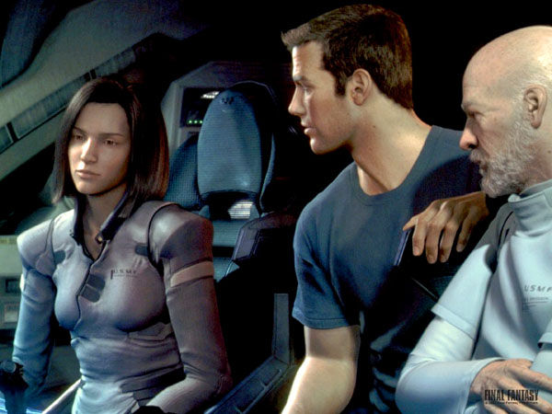

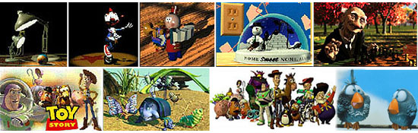
Lecture 36: Introduction to Computer Graphics
Books:
20 Good Books
Computer Graphics: Principles and Practice
Lectures:
Introduction to Computer Graphics
Computer Graphics Course
Topics:
Historical Perspective
The Graphics Pipeline
Application Overview

Slide 2
CS 445
Introduction to Computer Graphics
Fall 2006
Aaron Bloomfield

Slide 3
Overview
Introduction
  What is computer graphics?
Applications
  What is it good for?
Syllabus
  What will I learn in this course?
Coursework
  How much work will there be?

Slide 4
What is Computer Graphics?
Sliced by specialty
  Imaging = representing 2D images
  Modeling = representing 3D objects
  Rendering = building 2D images from 3D models
  Animation = simulating changes over time
  Hardware = computer architecture for graphics

Slide 5
What is Computer Graphics?
Sliced by task
  Creating pictures on a computer
  Interacting with those pictures
  Drawing those pictures faster
  Displaying those pictures bigger, brighter
  Simulating physical phenomena
  Visualization of complex data
  Acquiring real-world geometry
  Simulating plants
  Video games
  Breaking stuff
  …

Slide 6
Why is Graphics Cool?
Interdisciplinary
  Biology, Physics, Math, Psychology, CS, Art
Visual
Interactive
Work can be demoed to technically illiterate friends
Movies
Games
Money
  Video games: $11B (2004)
  Movies: $8.5B (2001)

Slide 7
Overview
Introduction
  What is computer graphics?
Applications
  What is it good for?
Syllabus
  What will I learn in this course?
Coursework
  How much work will there be?

Slide 8
Entertainment (passive)
Final Fantasy (Square, USA)

Slide 9
Entertainment (passive)
A Bug’s Life (Pixar)

Slide 10
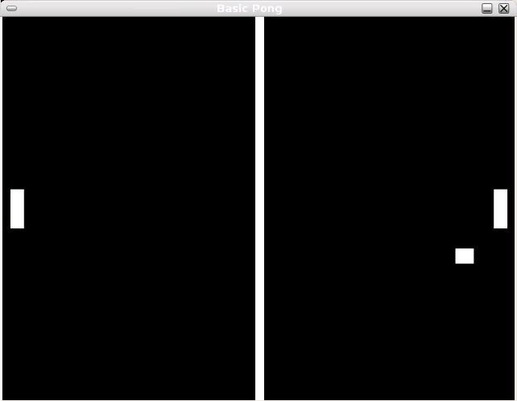
Entertainment (Active)
Pong

Slide 11
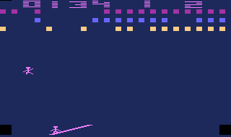
Entertainment (Active)
Circus Atari (Atari)

Slide 12
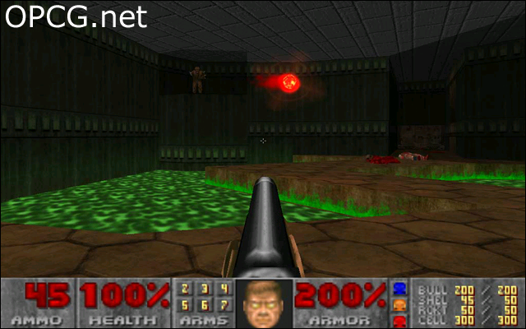
Entertainment (Active)
Doom (ID Software)

Slide 13
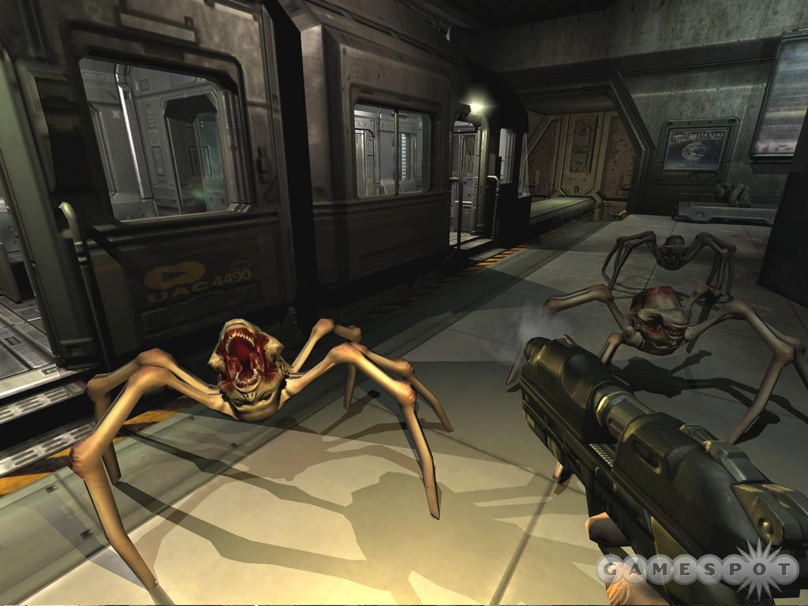
Entertainment (Active)
Doom III (ID Software)

Slide 14
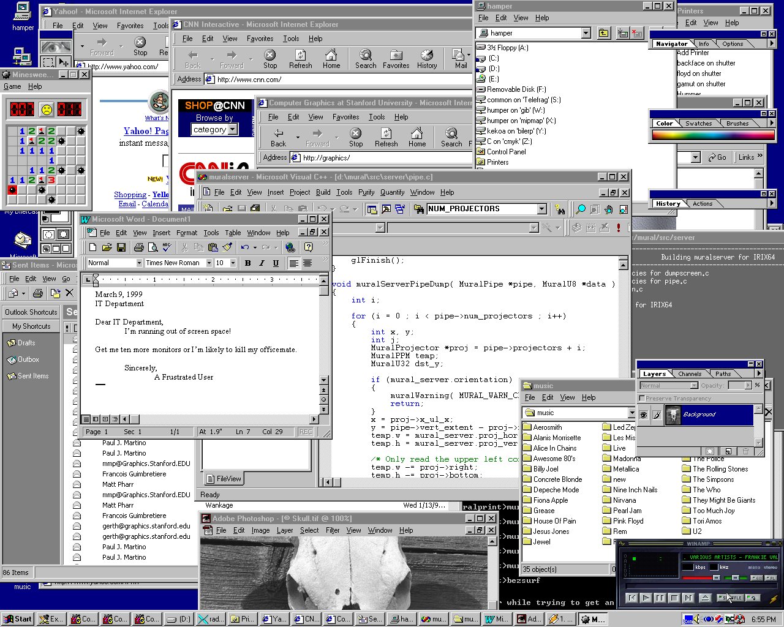
Graphical User Interfaces

Slide 15
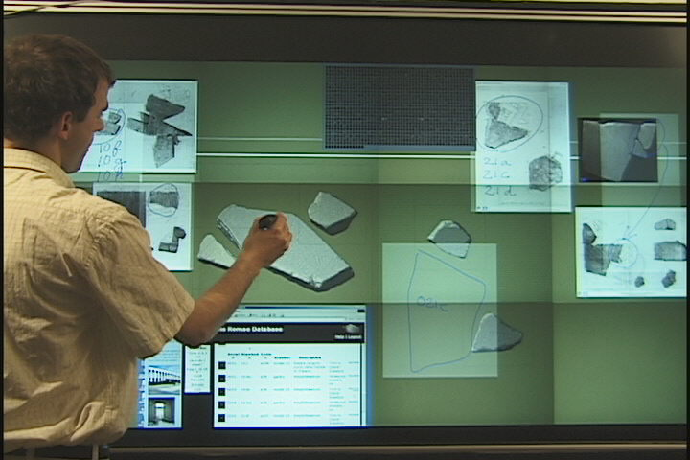
Graphical User Interfaces
Window system and large-screen interaction metaphors (François Guimbretière)

Slide 16
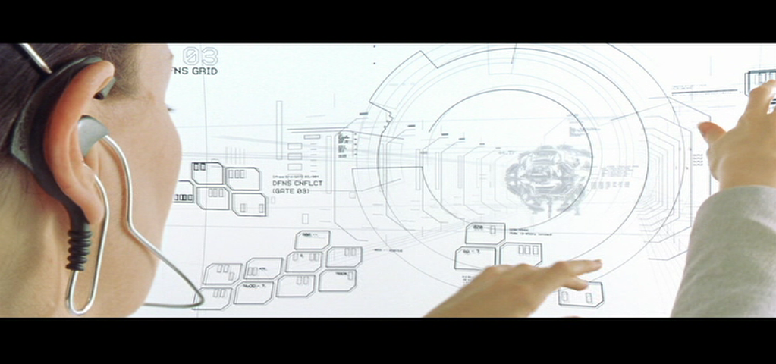
GUIs from The Matrix Reloaded
Matrix Reloaded

Slide 17
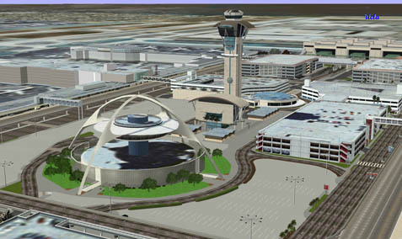
Computer Aided Design
Los Angeles Airport (Bill Jepson, UCLA)

Slide 18
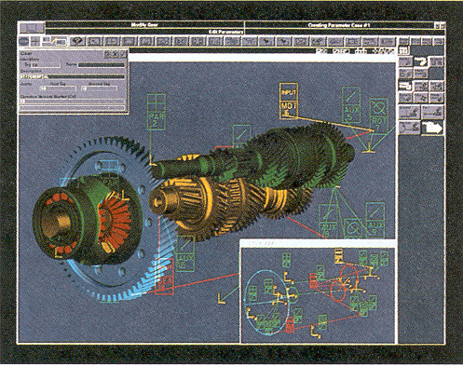
Computer Aided Design
Gear Shaft Design (Intergraph Corporation)

Slide 19

Computer Aided Design
Boeing 777 Airplane (Boeing Corporation)

Slide 20
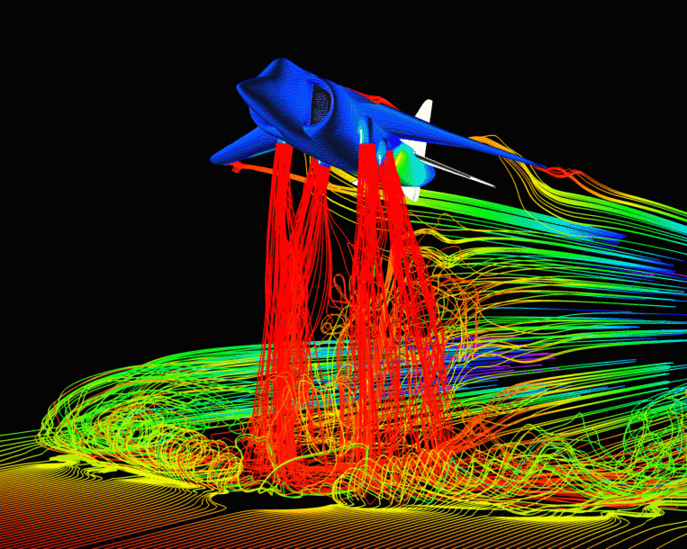
Scientific Visualization
Airflow around a Harrier Jet (NASA Ames)

Slide 21
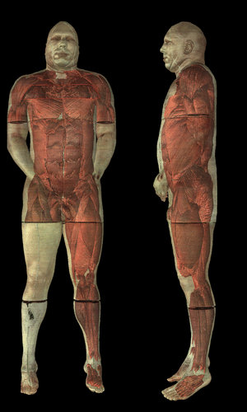
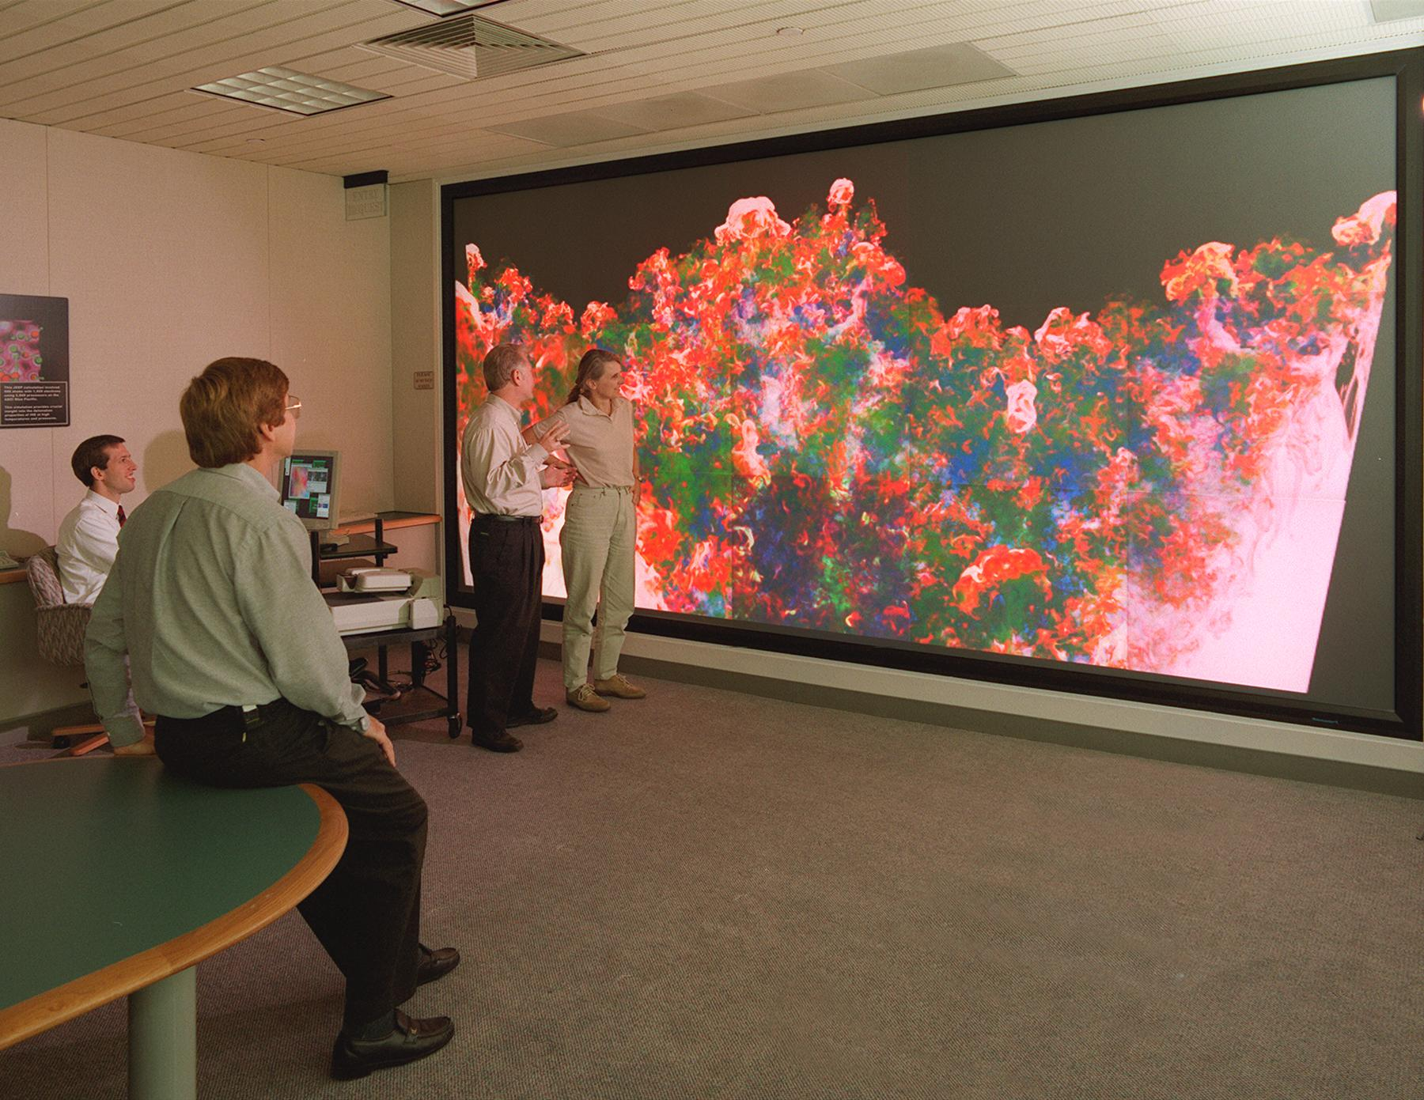
Scientific Visualization
Compressible Turbulence (Lawrence Livermore National Labs)
Visible Human (National Library of Medicine)

Slide 22
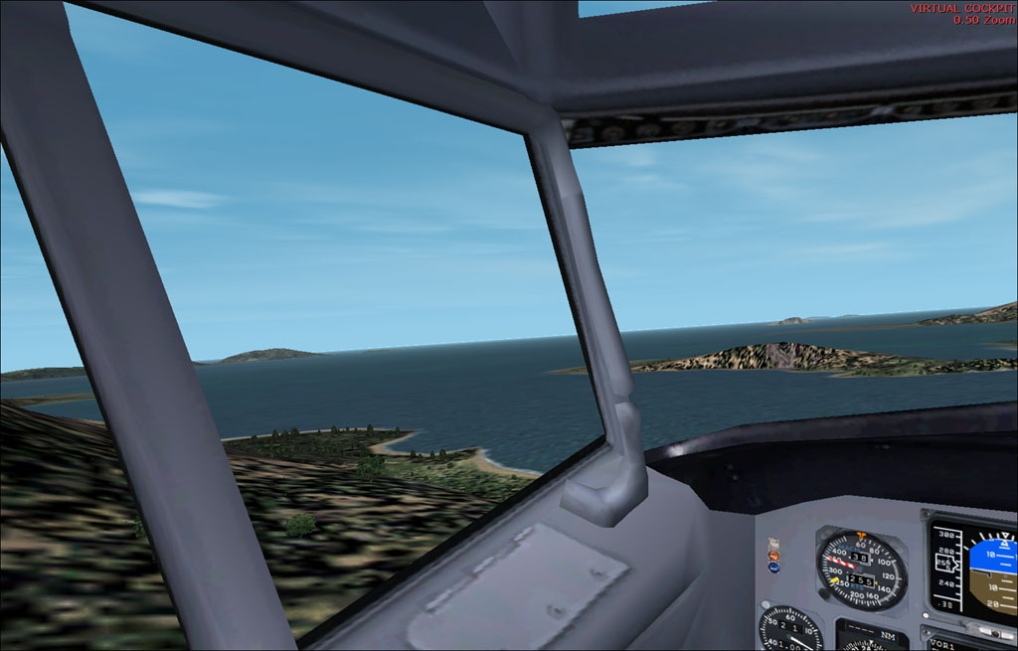
Training
Flight Simulator 2002 (Microsoft)

Slide 23
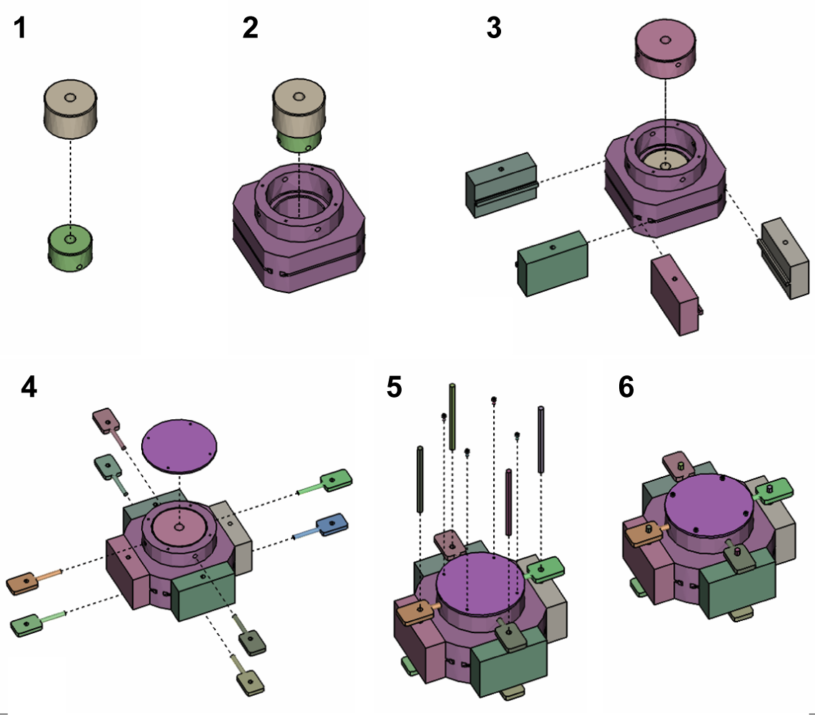
Training
Designing Effective Step-By-Step Assembly Instructions (Maneesh Agrawala et. al)

Slide 24
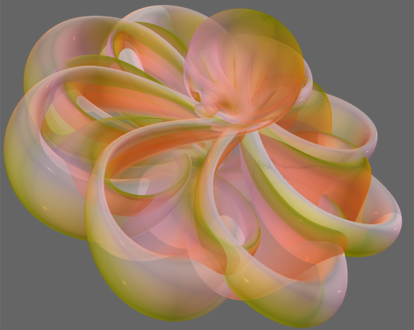
Education
Outside In (Geometry Center, University of Minnesota)

Slide 25
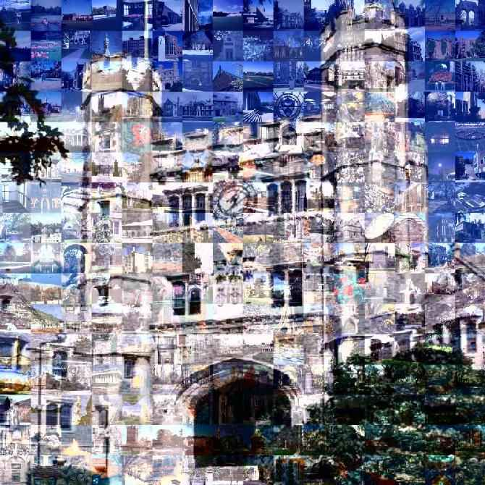
Art
Blair Arch (Marissa Range, Princeton University)

Slide 26
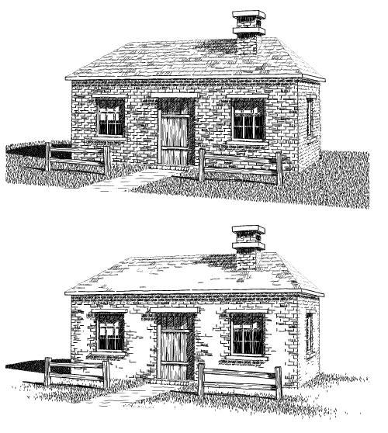
Art
Computer Generated Pen-and-Ink Illustration (Winkenbach and Salesin, University of Washington)

Slide 27
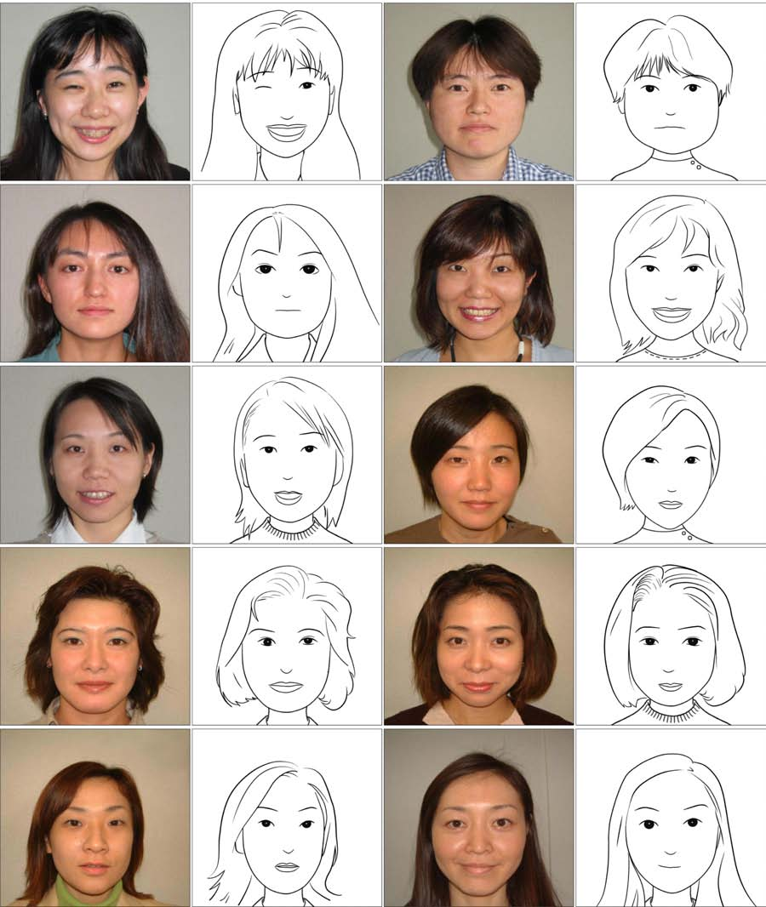
Art
Example-Based Composite Sketching of Human Portraits (Chen et al., MSRA, UCLA, MSR, UW, Microsoft)

Slide 28
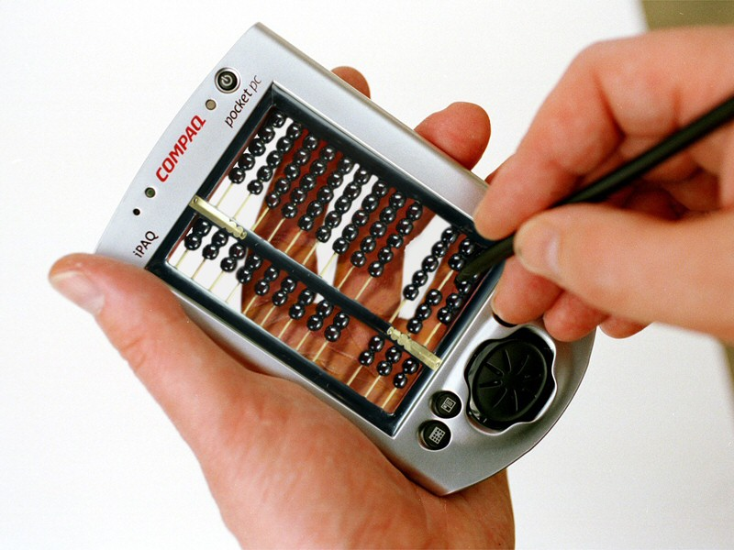
Photo Editing
Pocket PC (Jon Manning, www.worth1000.com)

Slide 29
Overview
Introduction
  What is computer graphics?
Applications
  What is it good for?
Syllabus
  What will I learn in this course?
Coursework
  How much work will there be?

Slide 30
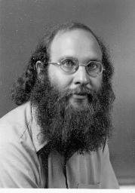

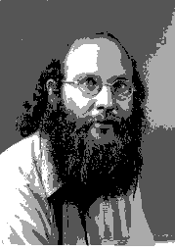
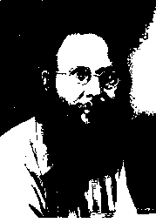
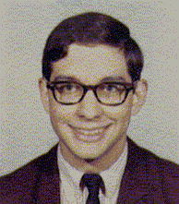
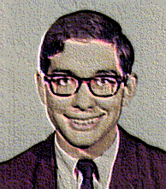
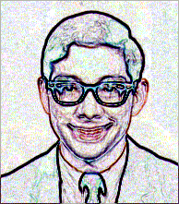
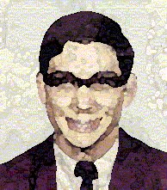
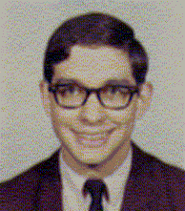
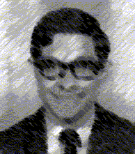
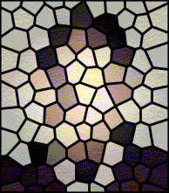
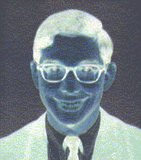
Image Processing
Image Representation
  Sampling
  Reconstruction
  Quantization & Aliasing
Image Processing
  Filtering
  Warping
  Morphing
  Composition
Raster Graphics
  Display devices
  Color models

Slide 31
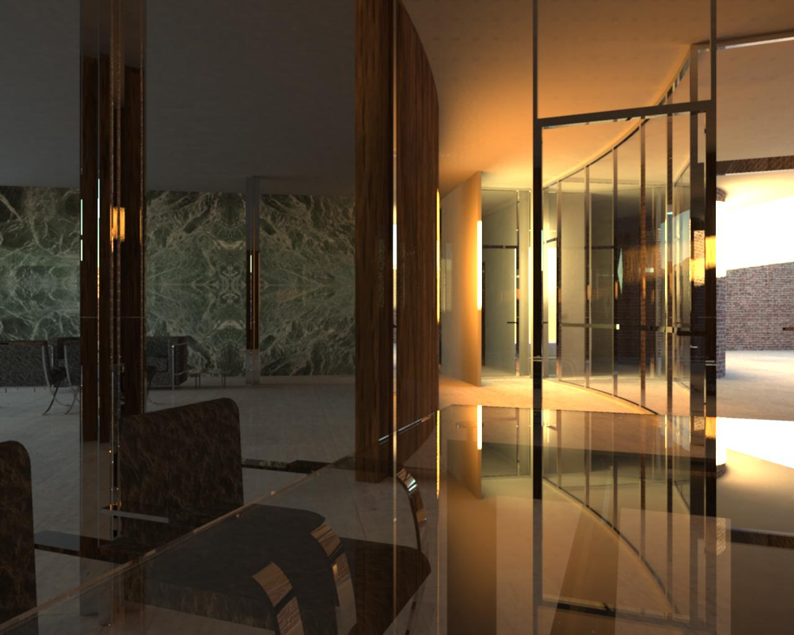
Rendering
3D Rendering Pipeline
  Modeling transformations
  Viewing transformations
  Hidden surface removal
  Illumination, shading, and textures
  Scan conversion, clipping
  Hierarchical scene graphs
  OpenGL
Global illumination
  Ray tracing
  Radiosity
  Monte Carlo

Slide 32

Modeling
Representations of geometry
  Curves: splines
  Surfaces: meshes, splines, subdivision
  Solids: voxels, CSG, BSP
Procedural modeling
  Sweeps
  Fractals
  Grammars

Slide 33
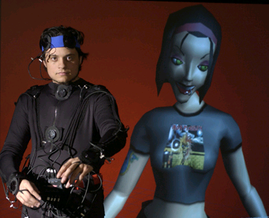
Animation
Keyframing
  Kinematics
  Articulated figures
Motion capture
  Capture
  Warping
  http://hms.upenn.edu/LiveActor/benDance.mov
Dynamics
  Physically-based simulations
  Particle systems
Behaviors
  Planning, learning, etc.

Slide 34
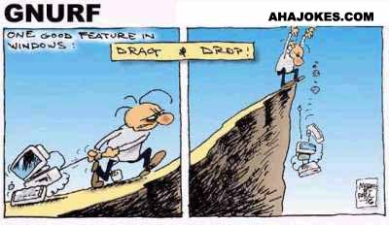
School of Continuing Studies
CS 351: Introduction to
Computer Graphics
CS 351

Slide 35
What is Computer Graphics?
Creation, Manipulation, and Storage of geometric objects (modeling) and their images (rendering)
Display those images on screens or hardcopy devices
Image processing
Others: GUI, Haptics, Displays (VR)...

Slide 36


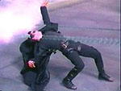
What drives computer graphics?
Movie Industry
  Leaders in quality and artistry
  Not slaves to conceptual purity
  Big budgets and tight schedules
  Reminder that there is more to
  CG than technology
  Hey, How'd they do that?
  Defines our expectations
Slide information from Leonard McMillian's slides
http://www.cs.unc.edu/~mcmillan/comp136/Lecture1/compgraf.html

Slide 37

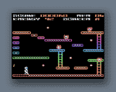
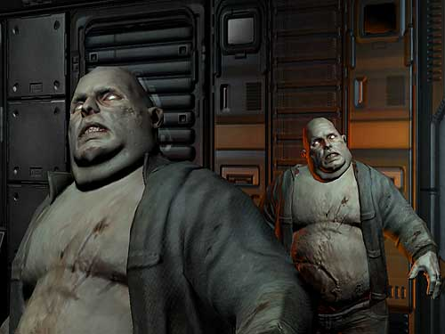
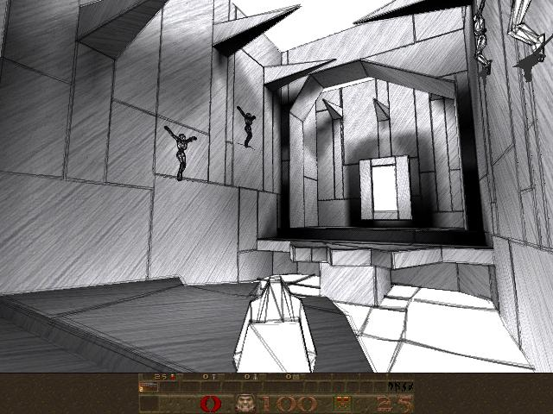
What drives computer graphics?
Game Industry
  The newest driving force in CG
    Why? Volume and Profit
    This is why we have commodity GPUs
  Focus on interactivity
  Cost effective solutions
  Avoiding computating and other tricks
  Games drive the baseline
Slide information from Leonard McMillian's slides
http://www.cs.unc.edu/~mcmillan/comp136/Lecture1/compgraf.html

Slide 38
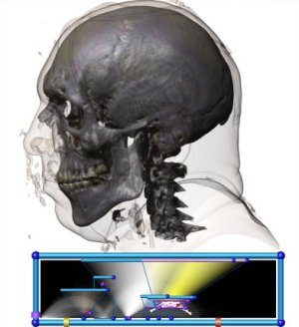
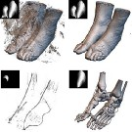
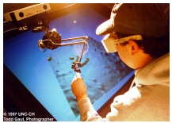
What drives computer graphics?
Medical Imaging and Scientific Visualization
  Tools for teaching and diagnosis
    No cheating or tricks allowed
  New data representations and modalities
  Drive issues of precision and correctness
  Focus on presentation and interpretation of data
  Construction of models from acquired data
Nanomanipulator, UNC
Joe Kniss, Utah
Gordon Kindelman, Utah

Slide 39
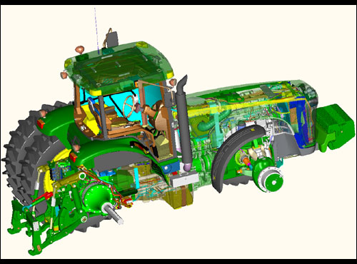
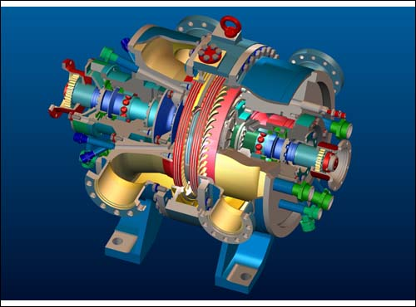
What drives computer graphics?
Computer Aided Design
  Mechanical, Electronic, Architecture,...
  Drives the high end of the hardware market
  Integration of computing and display resources
  Reduced design cyles == faster systems, sooner
ProEngineer, www.ptc.com

Slide 40
What drives computer graphics?
Graphic User Interfaces (GUI)
  www.webpagesthatsuck.com
Slide information from Leonard McMillian's slides
http://www.cs.unc.edu/~mcmillan/comp136/Lecture1/compgraf.html

Slide 41
What is Computer Graphics?
Look at 5 areas
  Hardware
  Rendering
  Interaction
  Modeling
  Scientific Visualization
Slide information from Richard Riesenfeld

Slide 42
Hardware: Amazing Changes
Fundamental architecture shift
  Dual computing engines:
    CPU and GPU
    More in GPU than CPU

Slide 43
Hardware: Amazing Changes
Fast, cheap GPUs
  ~$300
Cheap memory
Displays at low cost
  How many monitors do you have/use?

Slide 44
Hardware: Amazing Changes
Wired -> Unwired
World of Access

Slide 45
Hardware... some not so good
Devices
3D displays
Etc

Slide 46
Hardware
How old is Nvidia
How big is Nvidia
QED

Slide 47
Rendering
Many think/thought graphics synonymous with rendering
Well researched
  Working on second and third order effects
  Fundamentals largely in place

Slide 48
Rendering
Major areas:
  Ealiest: PhotoRealism
  Recent: Non-Photorealistic Graphics (NPR)
  Recent: Image-based Rendering (IBR)

Slide 49
Rendering
Ray Tracing has become practical
  Extremely high quality images
  Photorealism, animation, special effects
Accurate rendering, not just pretty

Slide 50
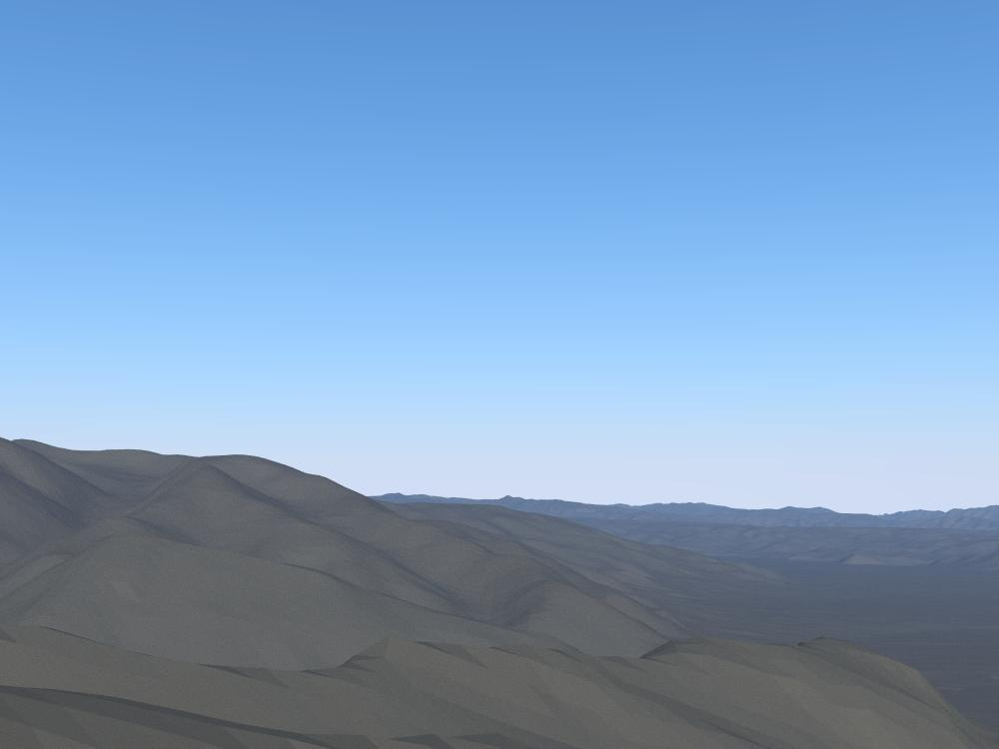

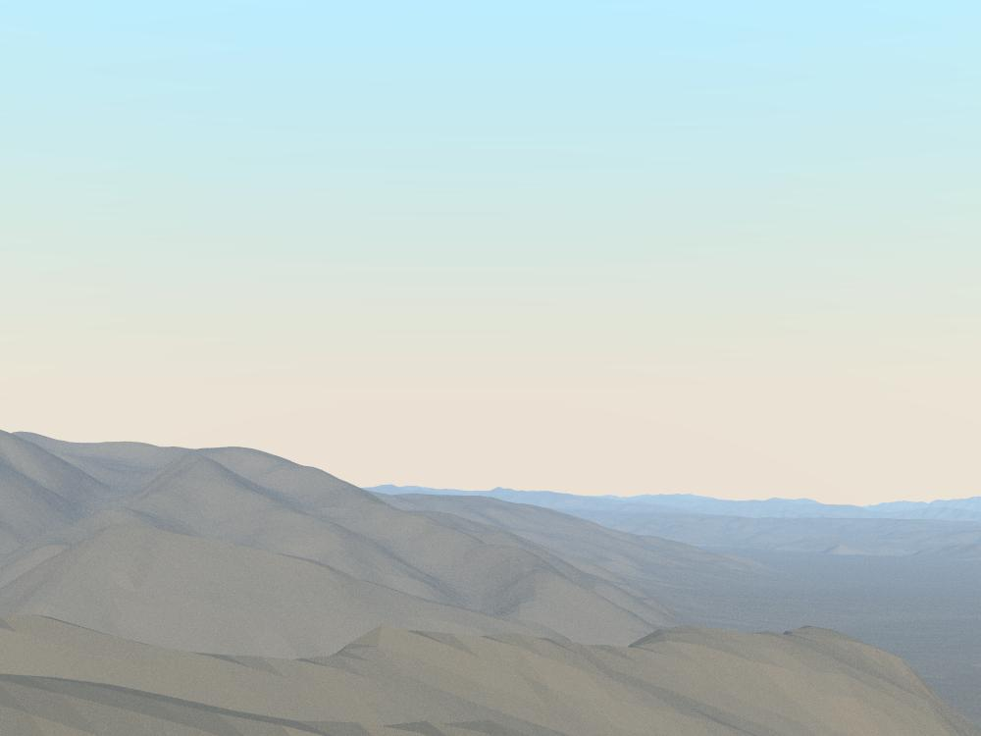

Rendering Realism
Morning
Evening
a preetham, et. al., utah

Slide 51
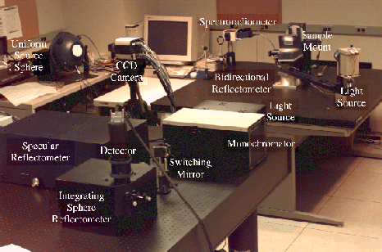
Rendering Realism
Cornel Measurement Lab

Slide 52
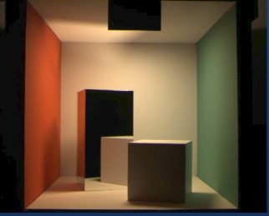
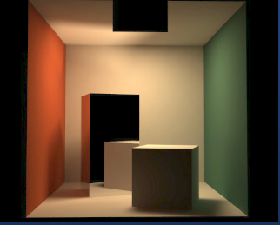
Rendering Realism
Real
Synthetic
Shirley, et. al., cornell

Slide 53
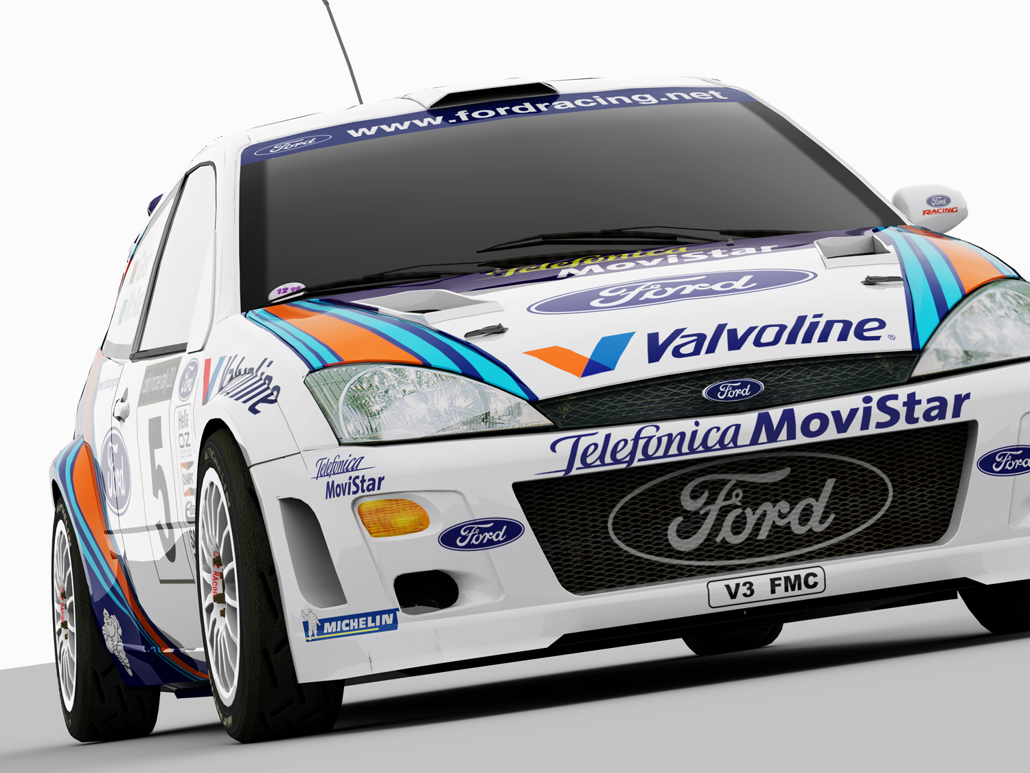
Is this real?
m fajaro, usc

Slide 54

Terrain Modeling:
Snow and Trees Added
s premoze, et.al., utah

Slide 55


Growth Models
o deusson,

Slide 56



Rendering/Modeling Hair
http://www.rhythm.com/~ivan/hairRender.html

Slide 57



Humans
Final Fantasy (Sony)
Jensen et al.

Slide 58


Is Photorealism Everything?

Slide 59

Is Photorealism Everything?

Slide 60



Non-Photorealistic Rendering
b gooch, et.al., utah

Slide 61
Tone Shading
a gooch, et. al., utah

Slide 62





NonPhotorealistic Rendering

Slide 63
Image Based Rendering
Model light field
Do not have to model geometry
Good for complex 3D scenes
Can leave holes where no data is available

Slide 64




3D Scene Capture
Fuchs et.al., UNC
UNC and UVA

Slide 65

3D Scene Recreation
Faugeras et. al

Slide 66

360º Scan
p willemsen, et. al., utah

Slide 67
Interaction
Way behind rest of graphic's spectacular advances
Still doing WIMP:
  Windows, icons, menus, pull-downs/pointing
Once viewed as “soft” research
  Turns out to be one of hardest problems

Slide 68

Interaction still needs...
Better input devices
Better output devices
Better interaction paradigms
Better understanding of HCI
  Bring in psychologists

Slide 69




Modeling
Many model reps
  Bezier, B-spline, box splines, simplex splines, polyhedral splines, quadrics, super-quadrics, implicit, parametric, subdivision, fractal, level sets, etc (not to mention polygonal)

Slide 70

Modeling
Physically based
  Newton
  Behavior as well as geometry
Materials
  Metal, cloth, organic forms, fluids, etc
Procedural (growth) models

Slide 71

Modeling... is hard
Complexity
Shape
Specifying
Realistic constraints
Detail vs concept
Tedious, slow
s drake, et. al., utah

Slide 72
Modeling is hard
Mathematical challenge
Computational challenge
Interaction challenge
Display challenge (want 3D)
Domain knowledge, constraints

Slide 73


Growth Models
o deusson,

Slide 74


Model Capture
marc levoy, et. al., stanford

Slide 75


Models
D Johnson and
J D St Germain, Utah
Russ Fish et al., Utah

Slide 76



Scientific Visualization
National Library of Medicine
Visual Human
Johnson et al., Utah

