Slide 1
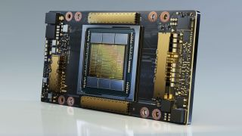
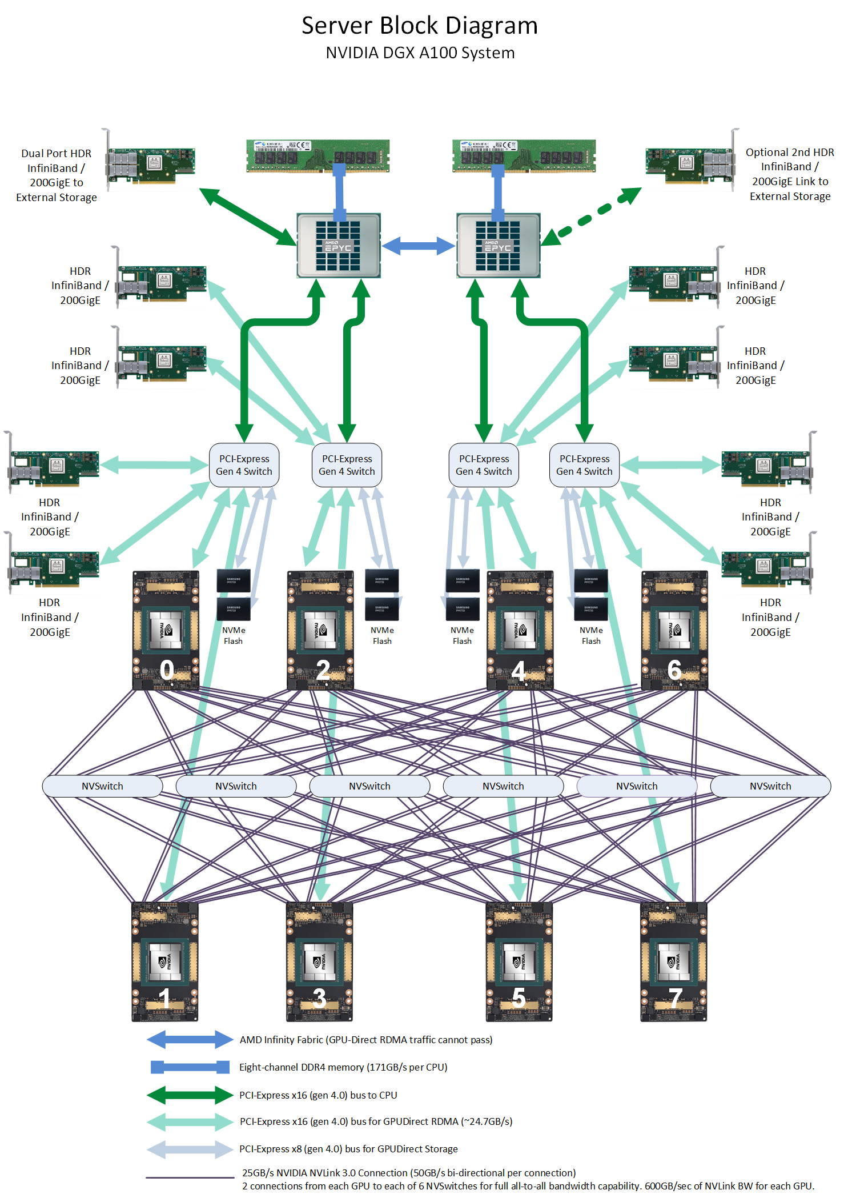
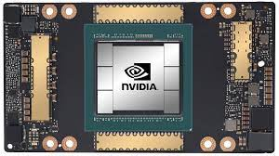
Lecture 35: A Deep Dive into the NVIDIA GeForce RTX4090
Books:
Graphics Processor Architectures
Lectures:
NVIDIA GTC 2022 Spring Keynote
NVIDIA Data Center Tour
Topics:
NVIDIA GeForce RTX4090
GeForce RTX4090 Architecture
GeForce RTX4090 Video
Ada Architecture White Paper
Texture Processing Cores (TPC)
NVIDIA Hopper Architecture
Next Generation Data Centers
NVIDIA A100 Tensor Core GPU Architecture
NVIDIA A100 GPU: Performance & Innovation

