Slide 1
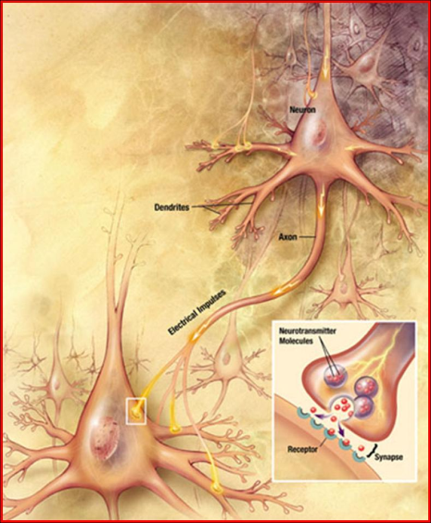
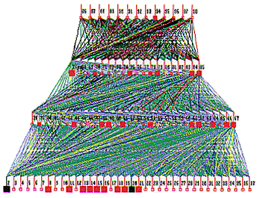
Lecture 31: Introduction to Neural Networks and Deep Learning
Books:
Hands-On Machine Learning
Lectures:
Neural Networks in 5 Minutes
Introduction to Machine Learning
Deep Learning in Human Language Technology
Topics:
DHS: Chapter 6
AM: Neural Network Tutorial
NSFC: Introduction to NNs
GH: Short Courses
UA: Transformers

Slide 2
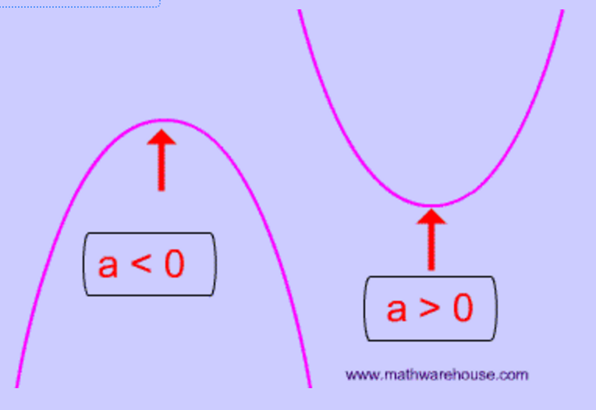
What Is A Function?
Equation of a line: y = mx + b
Equation of a parabola: y = ax² + bx + c
How do we estimate the equation of a line from two points?
  m = slope = (y₂-y₁) / (x₂-x₁)
  b = y intercept:
  y₁ = m(x₁) + b
  b = y₁ – m(x₁)
  check:
  b = y₂ – m(x₂)
How do we estimate the equation of a line from three points or more (hint: mean square error or regression?

Slide 3
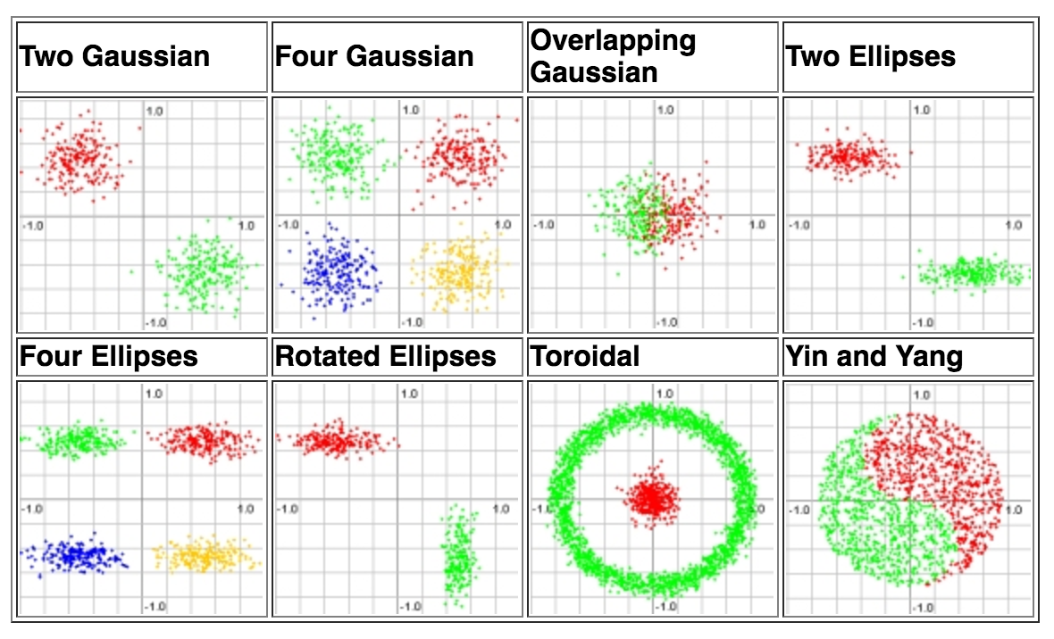
What Is A Functional Mapping?
Emulating human performance can be a complicated process involving highly nonlinear functions.
Example: Equal Loudness Curves
Your perception of loudness varies with frequency.
Perceived loudness also changes depending on the intensity.
Classifying data can be easy:
But generalization can be difficult:

Slide 4
How Do We Minimize An Objective Function?
Most modern learning algorithms use a variant of gradient descent in which we iteratively search for a maximum (or minimum) in a function:
The algorithmic details vary from implementation to implementation, but most approaches are based on derivatives (slopes).

Slide 5
Ideal Search Spaces Are Convex
If the search space for a solution is convex, gradient descent or hill-climbing will find an optimal solution.
This is one reason solutions that minimize the mean square error are popular.
However, real world problems involve optimization in very high dimensional spaces that are extremely complex.
To simplify things, we often try to “regularize” the problem:

Slide 6
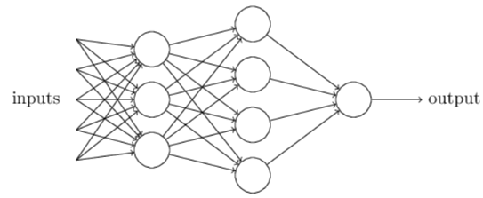
Neural Networks
Artificial neural networks (ANNs) are algorithms modeled after how the human brain operates.
ANNs today perform a number of functions including feature extraction, signal modeling and language or domain modeling.
Neural networks are comprised of nodes, which combine the inputs from the data with a set of coefficients or weights and determine whether the signal will progress further through the network.

Slide 7
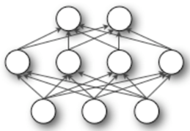
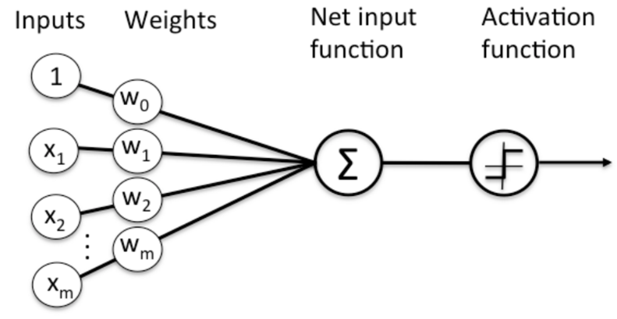
Nodes in Neural Networks
The products between the inputs $x_{n}$ and the weight $ω_{n}$ are summed in the node and the result is passed to the node’s activation function, which determines whether the node will fire.
Perceptrons are the most fundamental and simplest models of neurons.
Node Diagram

Slide 8
Perceptrons
Perceptrons are very simple. They take several binary inputs and generate a single binary output.
Given a set of inputs $x_{1}, x_{2}, x_{3}$, and a set of corresponding weights $ω_{1},ω_{2}$, $ω_{3},$the neuron’s output is given by:
$$output=\left\{\begin{aligned}0 if \sum_{j}{ω_{j}x_{j}≤threshold} \\ 1 if \sum_{j}{ω_{j}x_{j}>threshold}\end{aligned}\right.$$
To simplify, $x$ and $ω$ can be seen as vectors and the threshold is presented as a bias b, where $bias≡−threshold$
$$x_{1}$$
$$ω_{1}$$
$$output=\left\{\begin{aligned}0 if ω∙x+b ≤0 \\ 1 if ω∙x+b >0\end{aligned}\right.$$
$$ω_{2}$$
$$x_{2}$$
$$output$$
$$ω_{3}$$
$$x_{3}$$

Slide 9
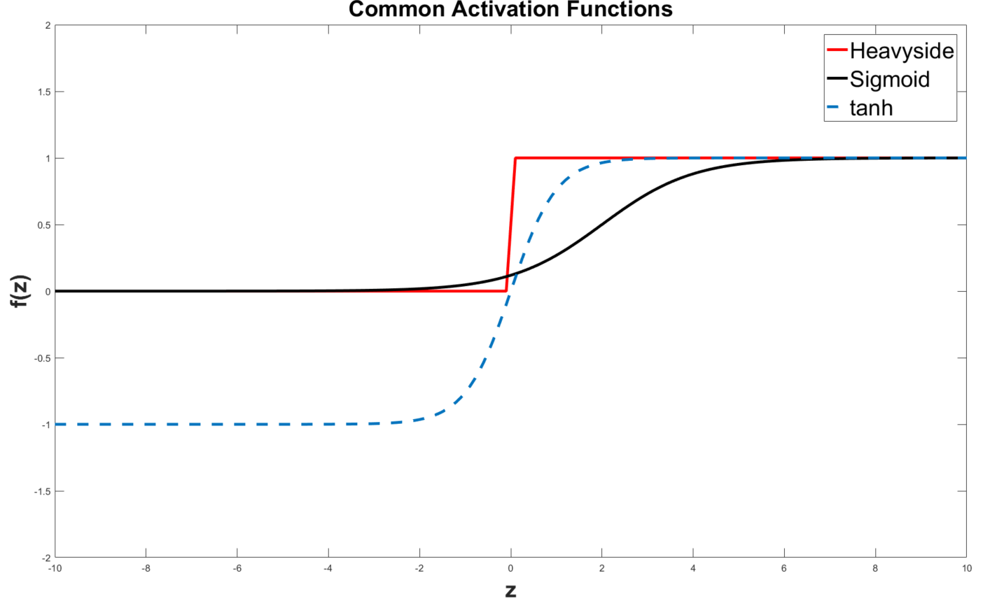
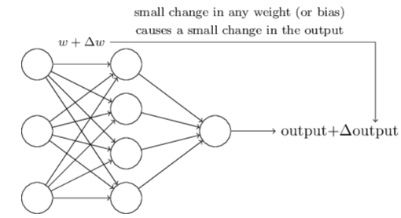
Sigmoid Neurons
Learning algorithms involve the adjustment of the weights and bias
If the neuron model used is the perceptron, a small change in a weight or bias can cause output to completely flip (being a binary model), and the flip can cause a change in the behavior of the entire network
A new type of artificial neuron, a sigmoid neuron, is commonly used to overcome this issue
In this case, the output is given by $σ\left(z\right)≡ \frac{1}{1+e^{z}}$, where $z=ω∙x+b$
This means, the activation function is a logistic function. Other common activation function is the tanh function, given by $tanh\left(z\right)=\frac{{e^{z}−e}^{−z}}{e^{z}+e^{−z}}$

Slide 10
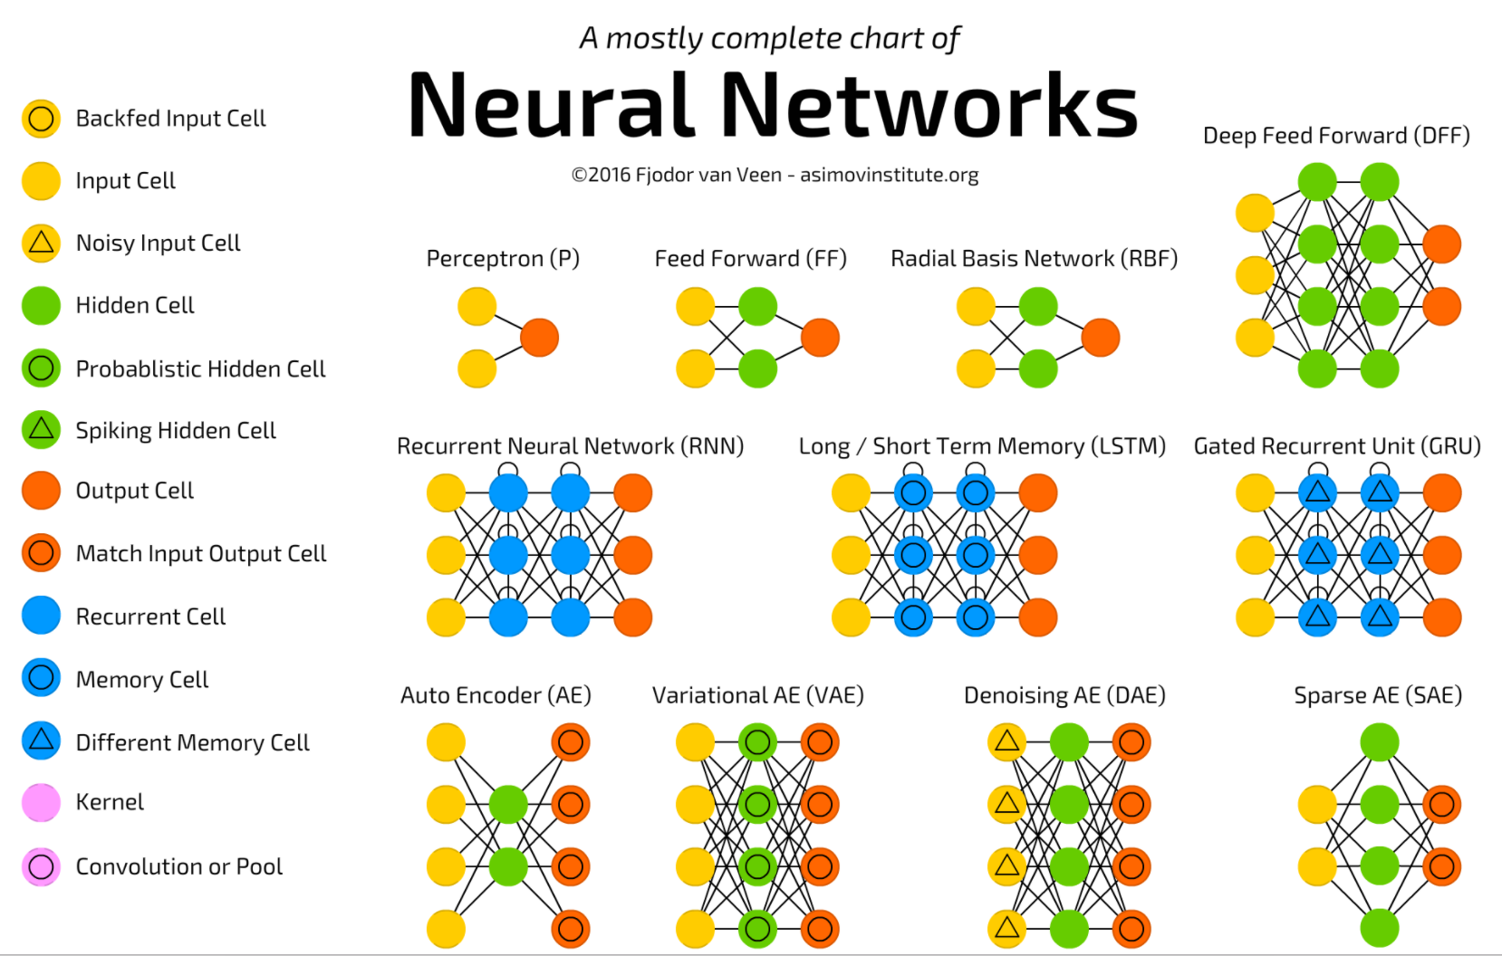
There Are Many Types Of Neural Networks

Slide 11
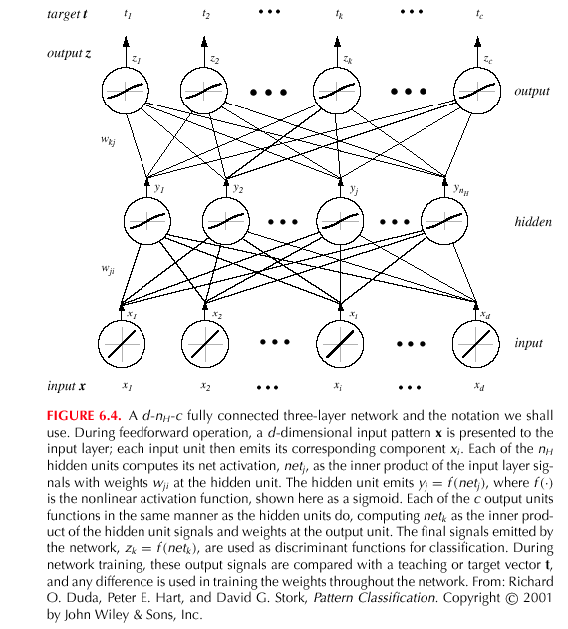
Networks of Nodes

Slide 12
So, 1. what exactly is deep learning ?
And, 2. why is it generally better than other methods on image, speech and certain other types of data?

Slide 13
So, 1. what exactly is deep learning ?
And, 2. why is it generally better than other methods on image, speech and certain other types of data?
The short answers
1. ‘Deep Learning’ means using a neural network
with several layers of nodes between input and output
2. the series of layers between input & output do
feature identification and processing in a series of stages,
just as our brains seem to.

Slide 14
hmmm… OK, but:
3. multilayer neural networks have been around for
25 years. What’s actually new?

Slide 15
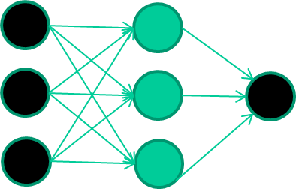
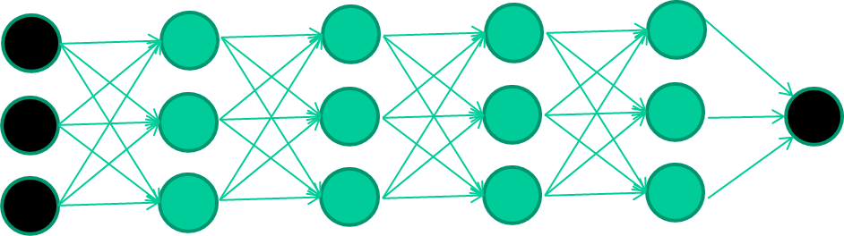
hmmm… OK, but:
3. multilayer neural networks have been around for
25 years. What’s actually new?
we have always had good algorithms for learning the
weights in networks with 1 hidden layer
but these algorithms are not good at learning the weights for
networks with more hidden layers
what’s new is: algorithms for training many-later networks

Slide 16
longer answers
reminder/quick-explanation of how neural network weights are learned;
the idea of unsupervised feature learning (why ‘intermediate features’ are important for difficult classification tasks, and how NNs seem to naturally learn them)
The ‘breakthrough’ – the simple trick for training Deep neural networks

Slide 17
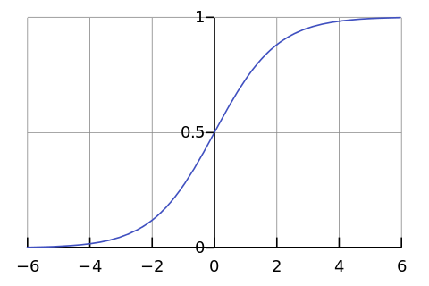

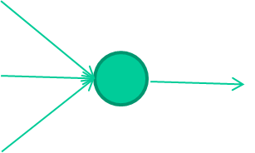
-0.06
W1
W2
f(x)
-2.5
W3
1.4

Slide 18
-0.06
2.7
-8.6
f(x)
-2.5
0.002
x = -0.06×2.7 + 2.5×8.6 + 1.4×0.002 = 21.34
1.4

Slide 19
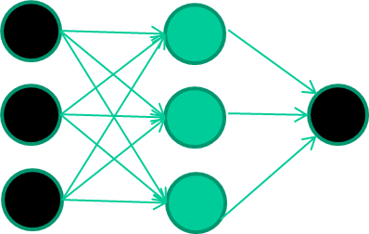
A dataset
Fields class
1.4 2.7 1.9 0
3.8 3.4 3.2 0
6.4 2.8 1.7 1
4.1 0.1 0.2 0
etc …

Slide 20
Training the neural network
Fields class
1.4 2.7 1.9 0
3.8 3.4 3.2 0
6.4 2.8 1.7 1
4.1 0.1 0.2 0
etc …

Slide 21
Training data
Fields class
1.4 2.7 1.9 0
3.8 3.4 3.2 0
6.4 2.8 1.7 1
4.1 0.1 0.2 0
etc …
Initialise with random weights

Slide 22
Training data
Fields class
1.4 2.7 1.9 0
3.8 3.4 3.2 0
6.4 2.8 1.7 1
4.1 0.1 0.2 0
etc …
Present a training pattern
1.4
2.7
1.9

Slide 23
Training data
Fields class
1.4 2.7 1.9 0
3.8 3.4 3.2 0
6.4 2.8 1.7 1
4.1 0.1 0.2 0
etc …
Feed it through to get output
1.4
2.7 0.8
1.9

Slide 24
Training data
Fields class
1.4 2.7 1.9 0
3.8 3.4 3.2 0
6.4 2.8 1.7 1
4.1 0.1 0.2 0
etc …
Compare with target output
1.4
2.7 0.8
0
1.9 error 0.8

Slide 25


Training data
Fields class
1.4 2.7 1.9 0
3.8 3.4 3.2 0
6.4 2.8 1.7 1
4.1 0.1 0.2 0
etc …
Adjust weights based on error
1.4
2.7 0.8
0
1.9 error 0.8

Slide 26
Training data
Fields class
1.4 2.7 1.9 0
3.8 3.4 3.2 0
6.4 2.8 1.7 1
4.1 0.1 0.2 0
etc …
Present a training pattern
6.4
2.8
1.7

Slide 27
Training data
Fields class
1.4 2.7 1.9 0
3.8 3.4 3.2 0
6.4 2.8 1.7 1
4.1 0.1 0.2 0
etc …
Feed it through to get output
6.4
2.8 0.9
1.7

Slide 28
Training data
Fields class
1.4 2.7 1.9 0
3.8 3.4 3.2 0
6.4 2.8 1.7 1
4.1 0.1 0.2 0
etc …
Compare with target output
6.4
2.8 0.9
1
1.7 error -0.1

Slide 29
Training data
Fields class
1.4 2.7 1.9 0
3.8 3.4 3.2 0
6.4 2.8 1.7 1
4.1 0.1 0.2 0
etc …
Adjust weights based on error
6.4
2.8 0.9
1
1.7 error -0.1

Slide 30
Training data
Fields class
1.4 2.7 1.9 0
3.8 3.4 3.2 0
6.4 2.8 1.7 1
4.1 0.1 0.2 0
etc …
And so on ….
6.4
2.8 0.9
1
1.7 error -0.1
Repeat this thousands, maybe millions of times – each time
taking a random training instance, and making slight
weight adjustments
Algorithms for weight adjustment are designed to make
changes that will reduce the error

Slide 31
The decision boundary perspective…
Initial random weights

Slide 32
The decision boundary perspective…
Present a training instance / adjust the weights

Slide 33
The decision boundary perspective…
Present a training instance / adjust the weights

Slide 34
The decision boundary perspective…
Present a training instance / adjust the weights

Slide 35
The decision boundary perspective…
Present a training instance / adjust the weights

Slide 36
The decision boundary perspective…
Eventually ….

Slide 37
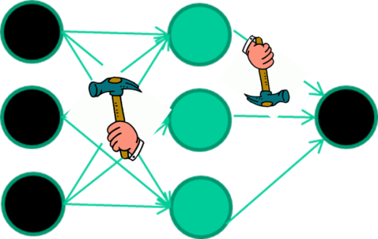
The point I am trying to make
weight-learning algorithms for NNs are dumb
they work by making thousands and thousands of tiny adjustments, each making the network do better at the most recent pattern, but perhaps a little worse on many others
but, by dumb luck, eventually this tends to be good enough to
learn effective classifiers for many real applications

Slide 38
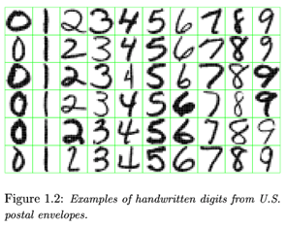
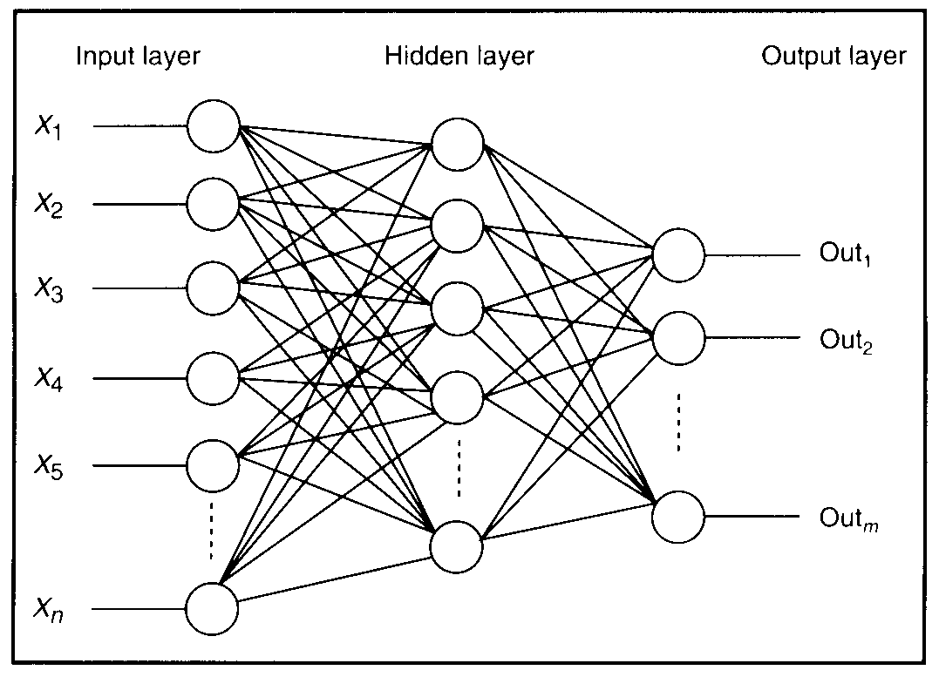
Feature detectors

Slide 39
what is this unit doing?

Slide 40
Hidden layer units become self-organised feature detectors
1 5 10 15 20 25 …
…
1
strong +ve weight
low/zero weight
63

Slide 41
What does this unit detect?
1 5 10 15 20 25 …
…
1
strong +ve weight
low/zero weight
63

Slide 42
What does this unit detect?
1 5 10 15 20 25 …
…
1
strong +ve weight
low/zero weight
it will send strong signal for a horizontal
line in the top row, ignoring everywhere else
63

Slide 43
What does this unit detect?
1 5 10 15 20 25 …
…
1
strong +ve weight
low/zero weight
63

Slide 44
What does this unit detect?
1 5 10 15 20 25 …
…
1
strong +ve weight
low/zero weight
Strong signal for a dark area in the top left
corner
63

Slide 45
What features might you expect a good NN
to learn, when trained with data like this?

Slide 46
vertical lines
1
63

Slide 47
Horizontal lines
1
63

Slide 48
Small circles
1
63

Slide 49
Small circles
1
But what about position invariance ???
our example unit detectors were tied to
specific parts of the image
63

Slide 50
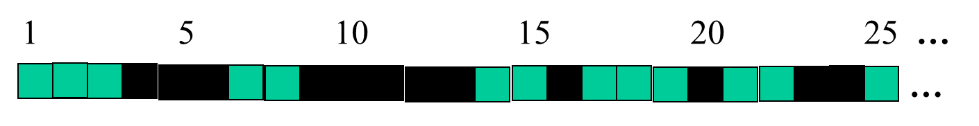
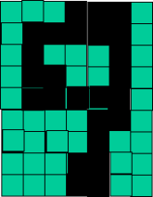
successive layers can learn higher-level features …
detect lines in
Specific positions
etc …
Higher level detetors
( horizontal line,
“RHS vertical lune”
“upper loop”, etc…
etc …
v

Slide 51
successive layers can learn higher-level features …
detect lines in
Specific positions
etc …
Higher level detetors
( horizontal line,
“RHS vertical lune”
“upper loop”, etc…
etc …
v
What does this unit detect?

Slide 52
So: multiple layers make sense

Slide 53
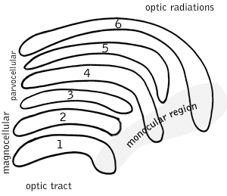
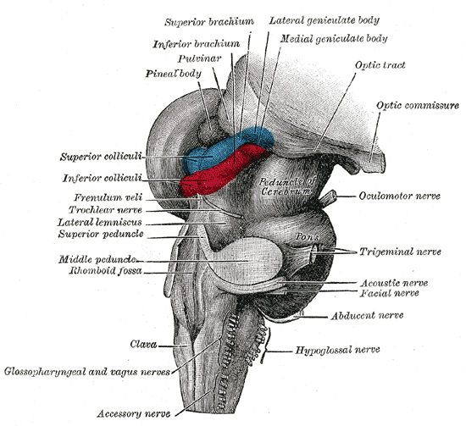
So: multiple layers make sense
Your brain works that way

Slide 54
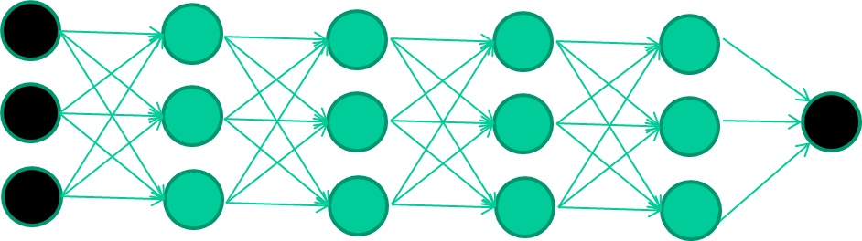
So: multiple layers make sense
Many-layer neural network architectures should be capable of learning the true underlying features and ‘feature logic’, and therefore generalise very well …

Slide 55
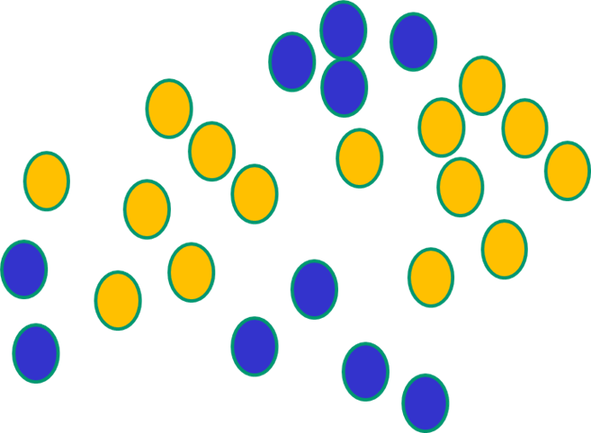

But, until very recently, our weight-learning algorithms simply did not work on multi-layer architectures

Slide 56
Along came deep learning …

Slide 57
The new way to train multi-layer NNs…

Slide 58
The new way to train multi-layer NNs…
Train this layer first

Slide 59
The new way to train multi-layer NNs…
Train this layer first
then this layer

Slide 60
The new way to train multi-layer NNs…
Train this layer first
then this layer
then this layer

Slide 61
The new way to train multi-layer NNs…
Train this layer first
then this layer
then this layer
then this layer

Slide 62
The new way to train multi-layer NNs…
Train this layer first
then this layer
then this layer
then this layer
finally this layer

Slide 63
The new way to train multi-layer NNs…
EACH of the (non-output) layers is trained to be an auto-encoder
Basically, it is forced to learn good features that describe what comes from the previous layer

Slide 64
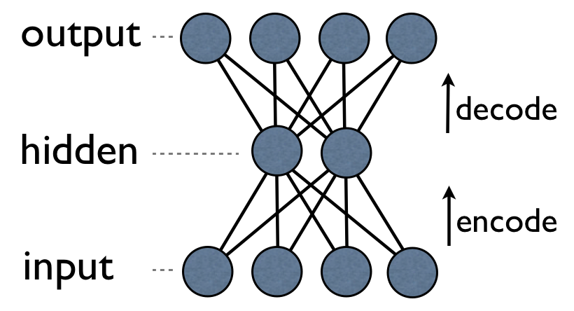
an auto-encoder is trained, with an absolutely standard weight-adjustment algorithm to reproduce the input

Slide 65
an auto-encoder is trained, with an absolutely standard weight-adjustment algorithm to reproduce the input
By making this happen with (many) fewer units than the inputs, this forces the ‘hidden layer’ units to become good feature detectors

Slide 66
intermediate layers are each trained to be auto encoders (or similar)

Slide 67
Final layer trained to predict class based on outputs from previous layers

Slide 68
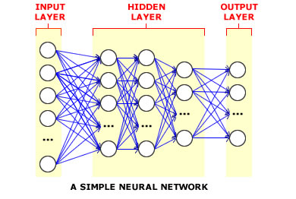
And that’s that
That’s the basic idea
There are many many types of deep learning,
different kinds of autoencoder, variations on architectures and training algorithms, etc…
Very fast growing area …

Slide 69
Summary
A neural network attempts to emulate properties observed in the human brain: a simple computational element is used that emulates the basic properties of a neuron. By combining large numbers of these nodes in various topologies, we can solve complex engineering and scientific problems.
Nodes can use a variety of activation functions ranging from simply hard limiters to soft mappings such as a sigmoid function.
The ability to learn complex mappings from data can be a powerful way to predict and classify data, and can lead to a better understanding of underlying dependencies.
This type of learning, however, requires iterative algorithms that are computationally expensive.
Gradient descent is a popular way to find good solutions.
There are many types of neural networks in use today. The best choice of a network is very application dependent.
State of the art systems today leverage a process known as transfer learning where users start from pretrained networks trained on large amounts of data.

