Slide 1
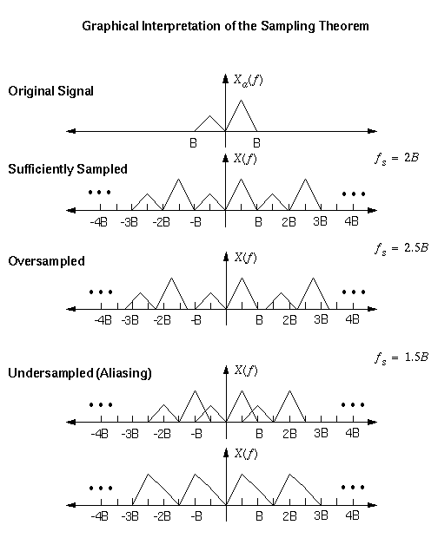
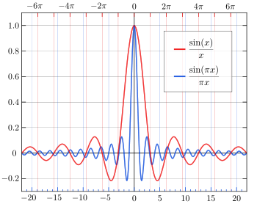
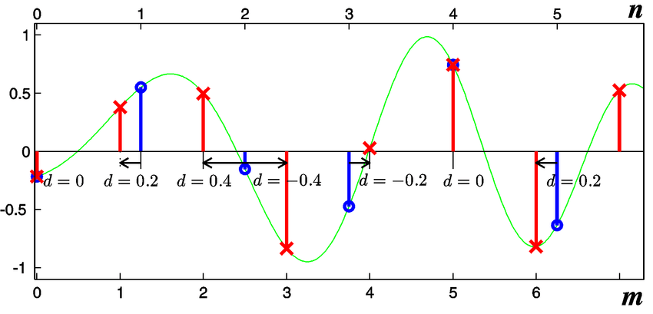
Lecture 30: Final Exam – Digital Resampling
Books:
DSP Guide
Lectures:
Resampling Theory
Topics:
Final Exam: Digital Resampling
The Sampling Theorem
Changing the Sample Frequency
Multidimensional DSP

