Slide 1

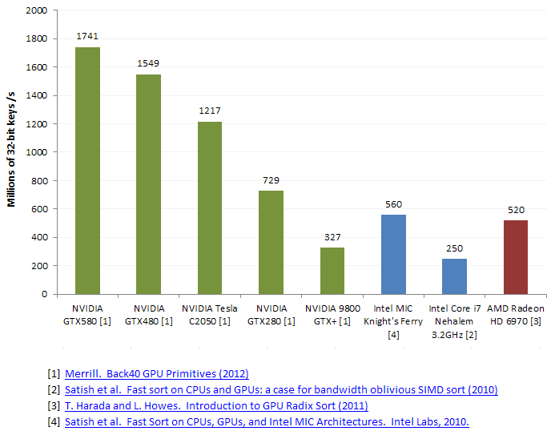
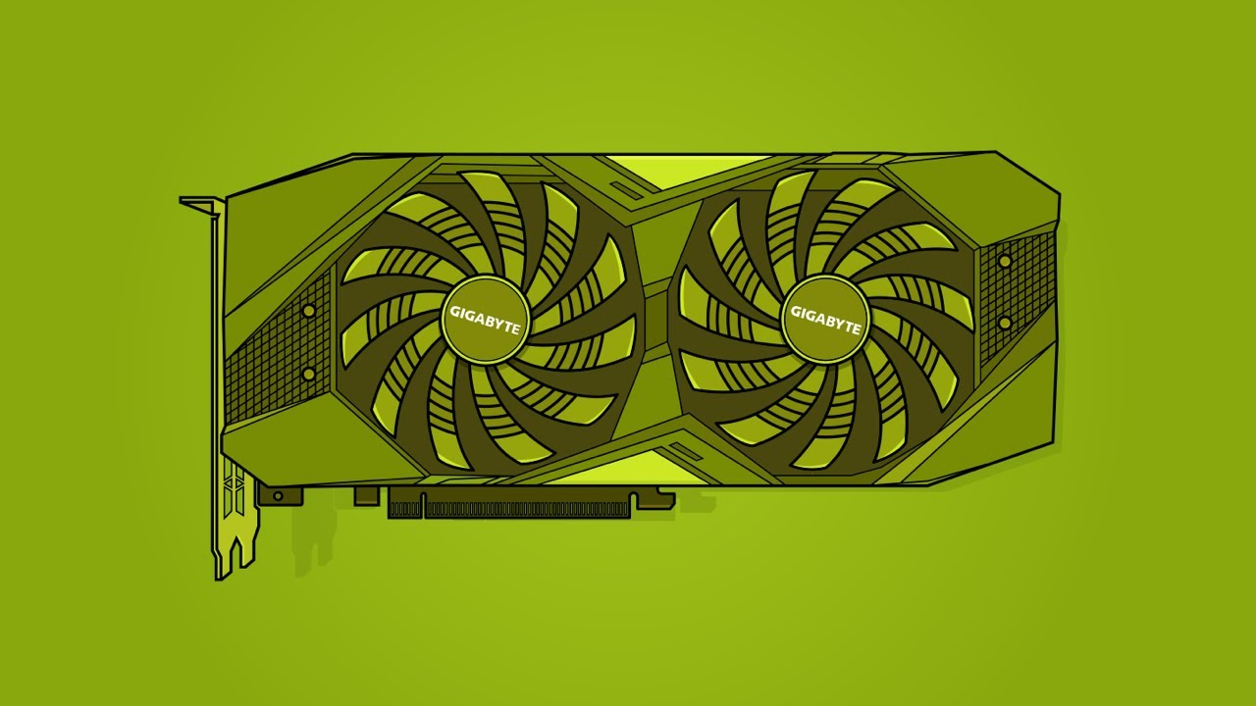
Lecture 29: Advanced Topics – The Thrust Library
Books:
Programming on Parallel Machines
Lectures:
GPU Programming With Thrust and CUDA
Thrust Library Intro
Topics:
Parallel Processing
Nvidia Thrust Documentation
Thrust (NVIDIA Developer)
Matrix Multiplication
Selecting Devices
Thrust Github

