Slide 1
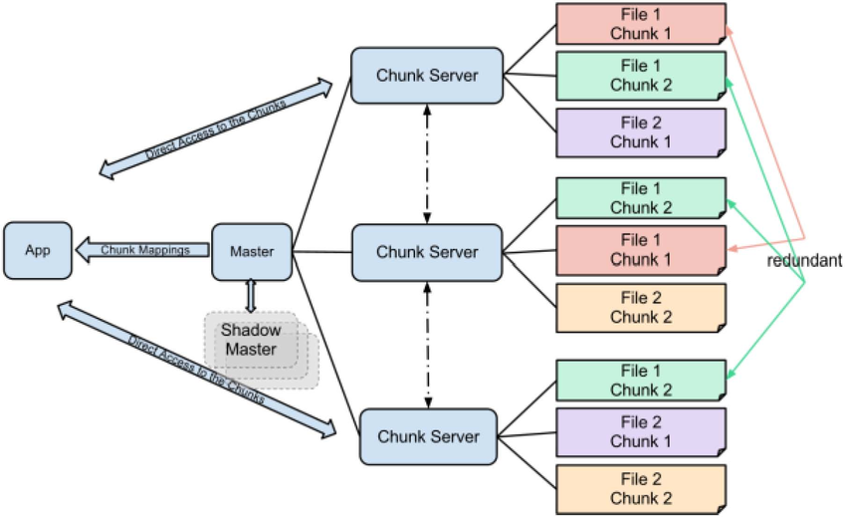
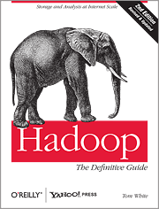
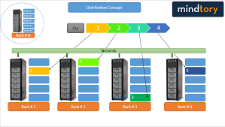
Lecture 28: Hadoop – A Distributed File System
Books:
Hadoop: The Definitive Guide
Lectures:
What is Hadoop?
Hadoop in 5 Minutes
What is RAID?
Topics:
Comparison of Distributed File Systems
Hadoop Introduction
Hadoop: A Distributed Framework
Hadoop for Big Data
Apache Hadoop Tutorial
How do hard drives work?
RAID

