Slide 1
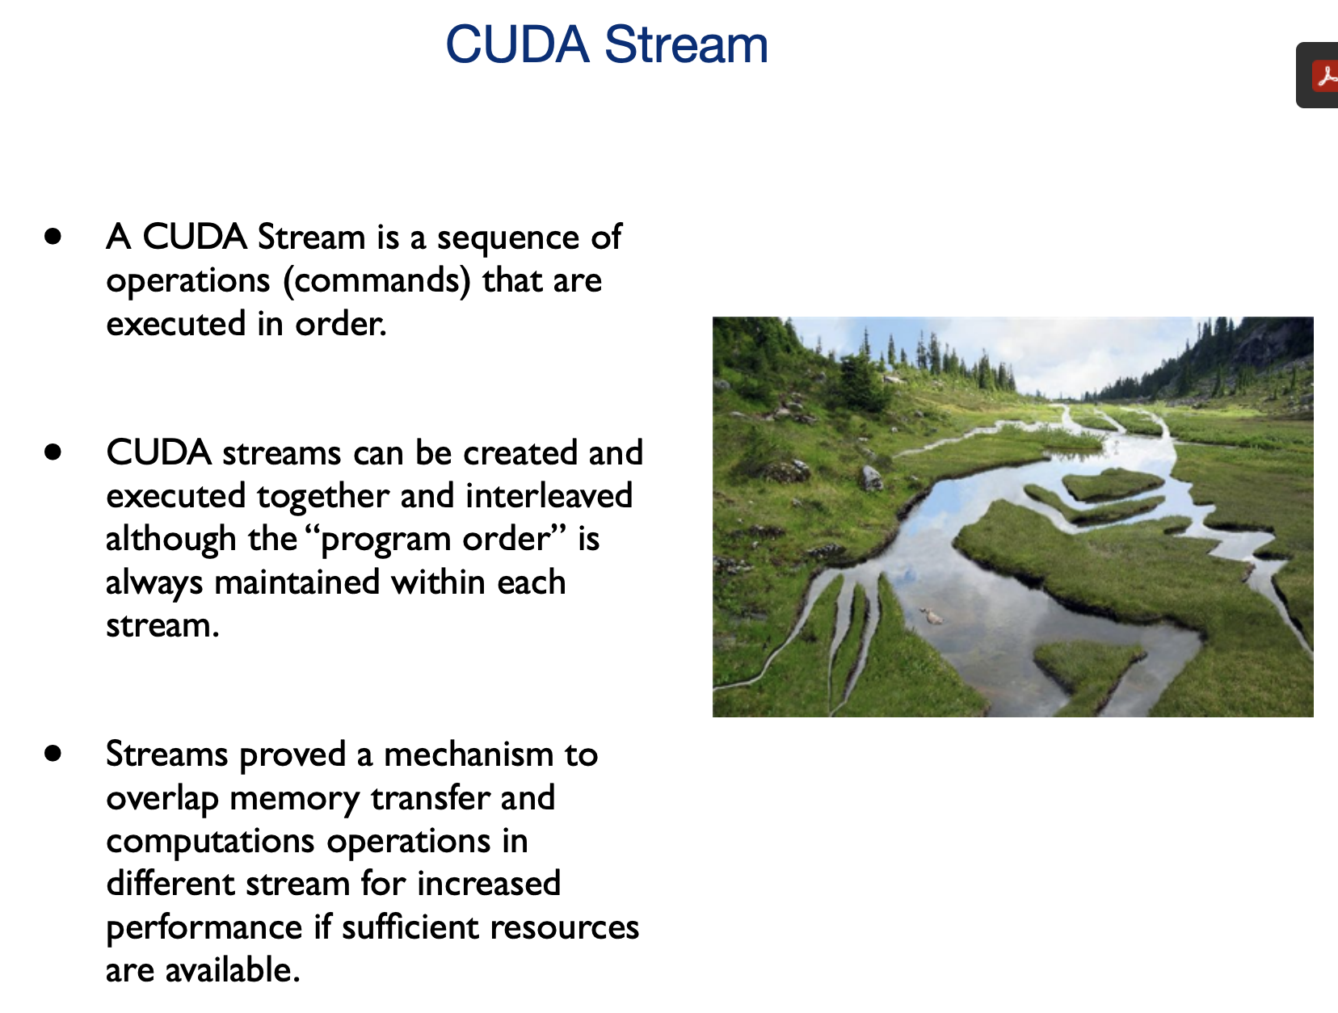
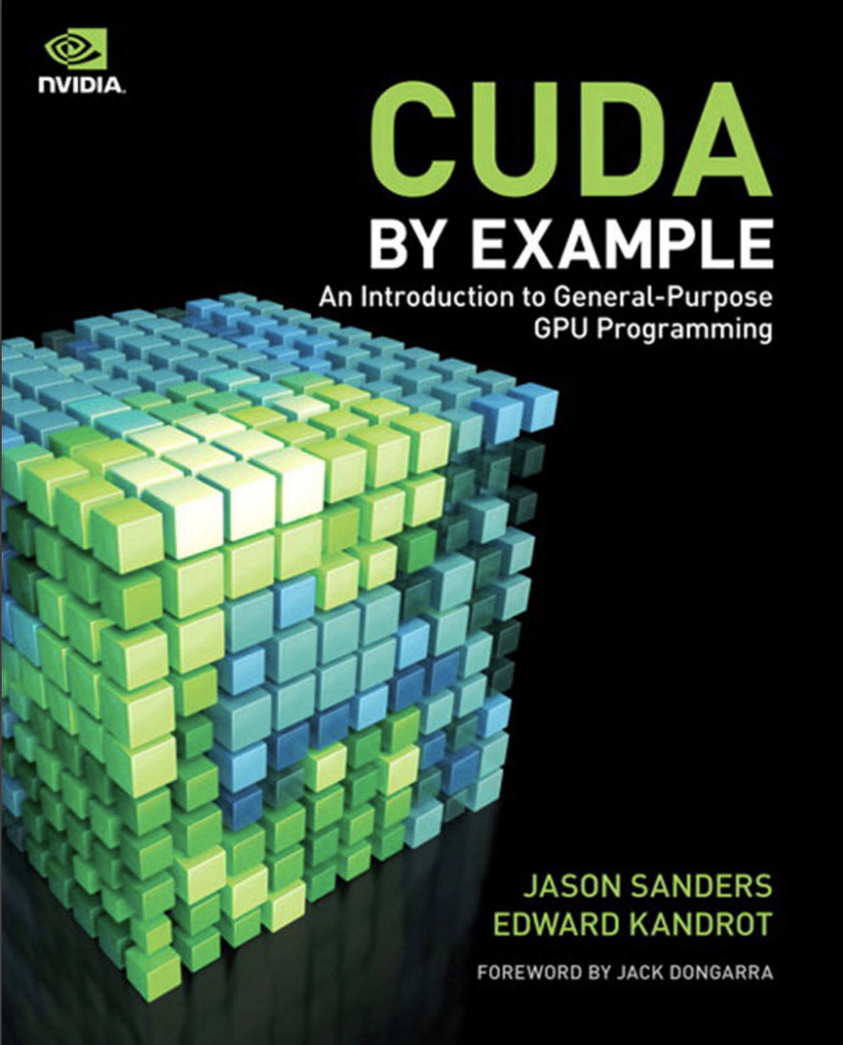
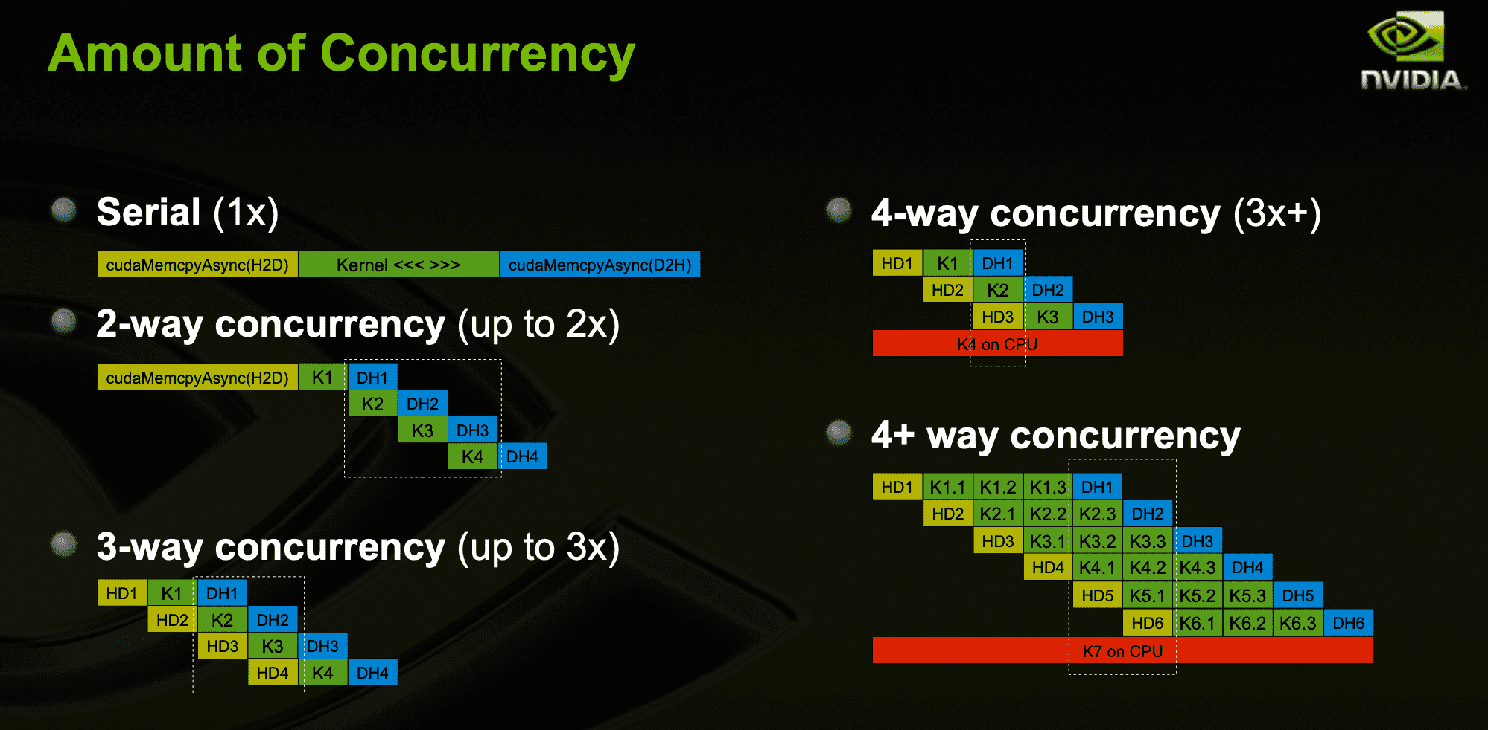
Lecture 24: Streams and Concurrency
Books:
CUDA By Example
Lectures:
CUDA in Your Python
Concurrency and Streams
Topics:
Streams
More About Streams (Chapter 10)
Streams and Concurrency
Page-Locked Memory
Unix Streams
C++ Files and Streams

