Slide 1
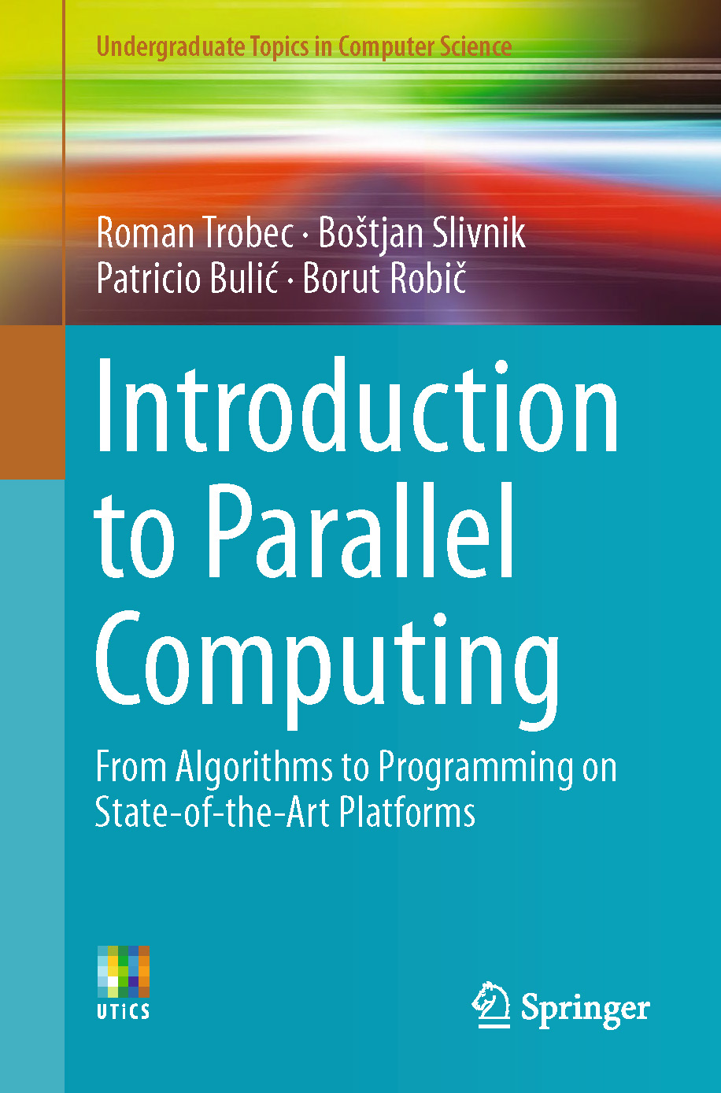

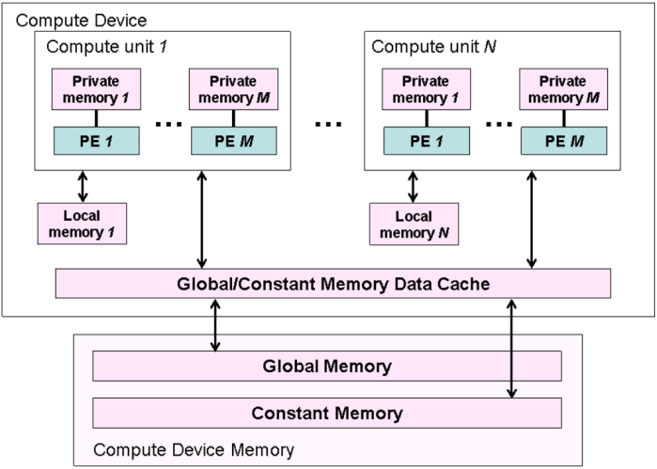
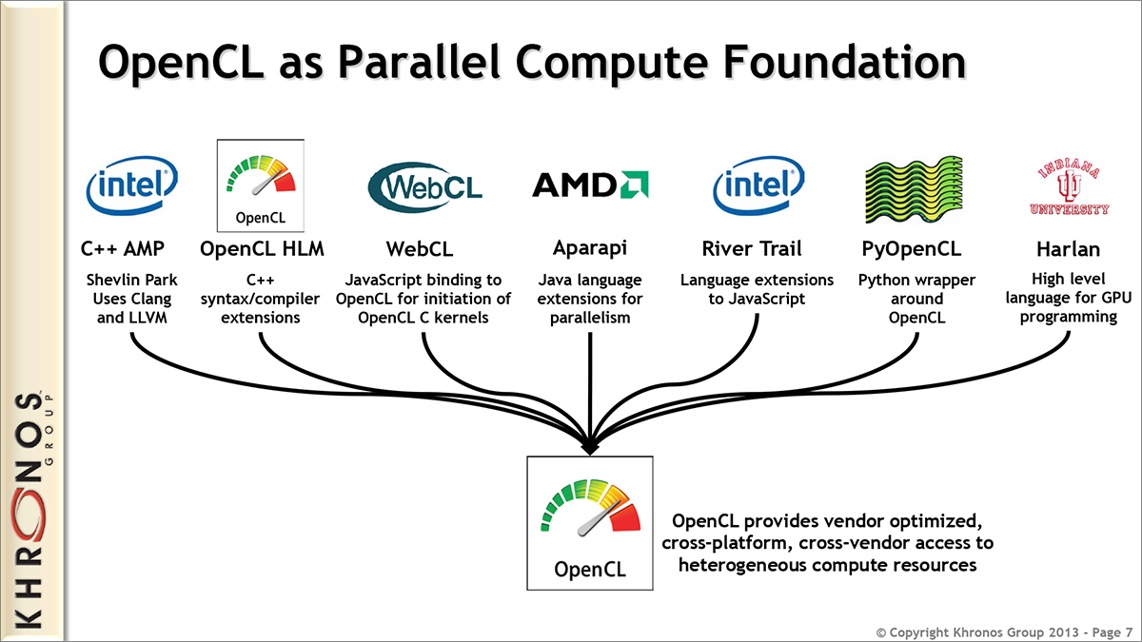
Lecture 23: OpenCL – An Alternative to CUDA
Books:
Introduction to Parallel Computing
Lectures:
Introduction to OpenCL
Using OpenCL
Hello World in OpenCL
Topics:
Open Computing Language
Hands-On Introduction
CUDA vs. OpenCL

