Slide 1
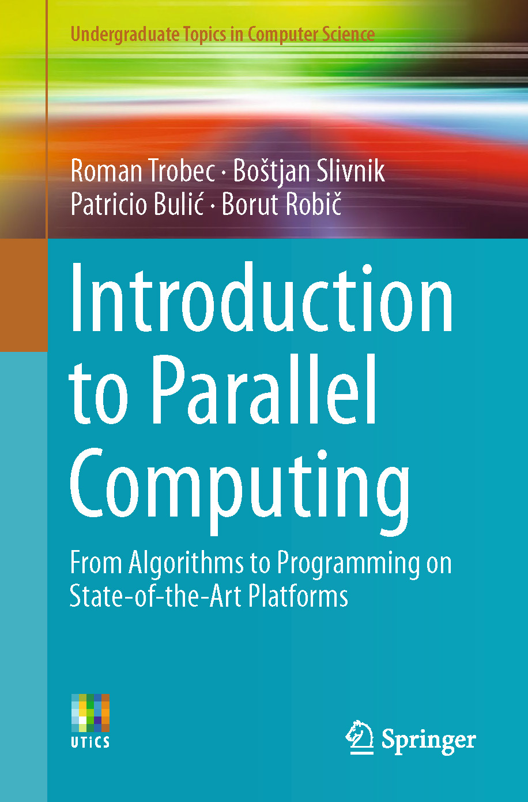
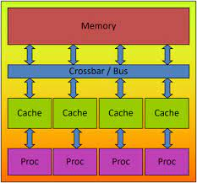
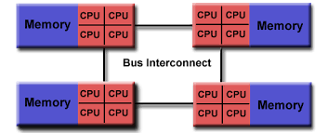
Lecture 20: OpenMP – Parallelization of Loops and Tasks
Books:
Introduction to Parallel Computing
Lectures:
Parallelization of Loops
Parallelization of Tasks
Parallel Loops
Topics:
Loop-Level Parallelism
Parallel For Loops With OpenMP
OpenMP in a Nutshell
Exploiting Task-Level Parallelism

