Slide 1
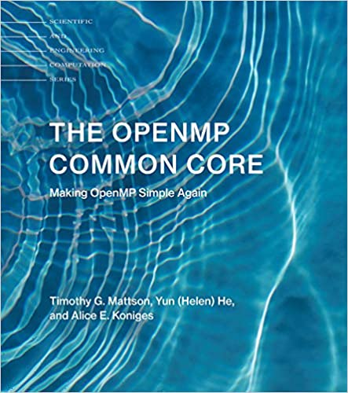
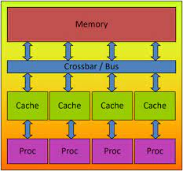
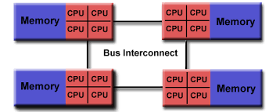
Lecture 18: Parallel Programming Using OpenMP
Books:
The OpenMP Common Core
Lectures:
OpenMP Basics
OpenMP Tasking
Parallel Programming using OpenMP
Topics:
OpenMP
Open MP Hello World
OpenMP Tasks

