Slide 1
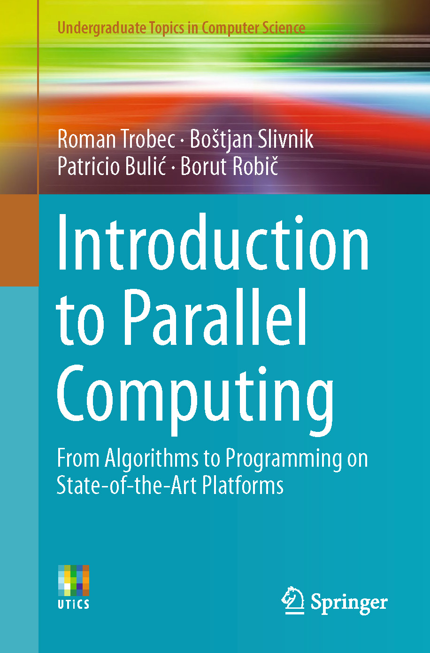
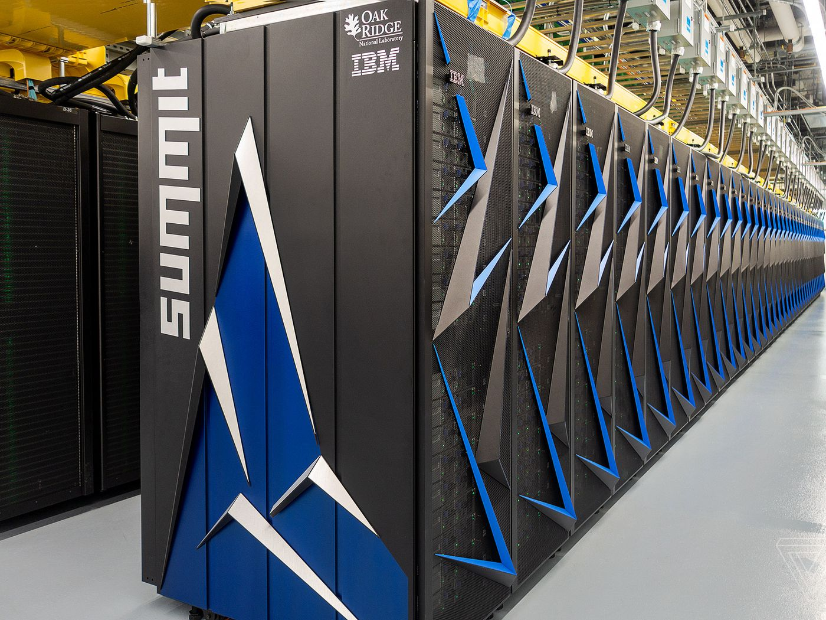
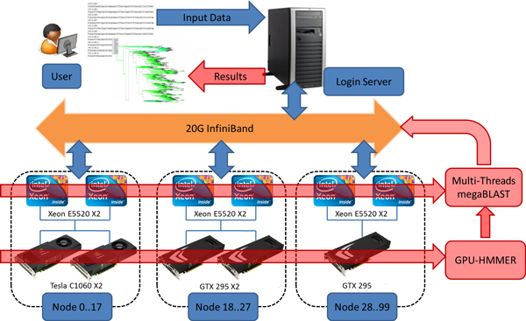
Lecture 17: Foundations of Parallel Computing
Books:
Introduction to Parallel Computing
Lectures:
Coursera
Slideplayer
Topics:
Parallel Computing Overview
Types of Parallel Computing
Classification of Parallel Computers

