Slide 1
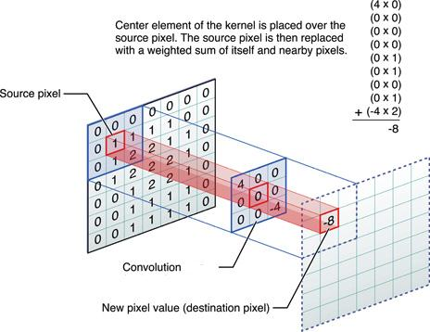
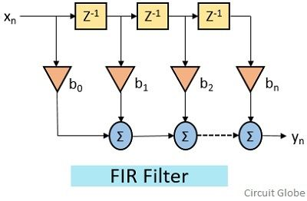
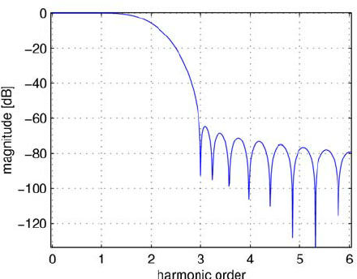
Lecture 15: Finite Impulse Response (FIR) Filters
Books:
Digital Signal Processing
The Scientist’s and Engineer’s Guide
Lectures:
FIR Filter Design and Implementation
Simple C Implementation
Topics:
Convolution
Practical Implementations
Discete-Time Convolution
Finite Impulse Response Filters
GPU Implementation

Slide 2
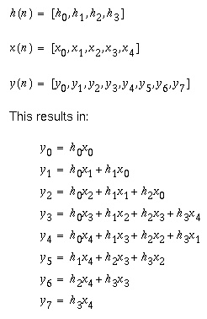
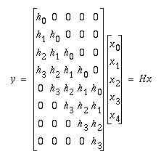

Discrete Convolution – Difference Equations
The math: $y\left(n\right)=\sum_{m=0}^{M−1}{x\left(m\right)h\left(n−m\right)}$
A direct form implementation:

Slide 3
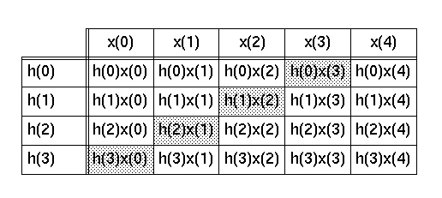
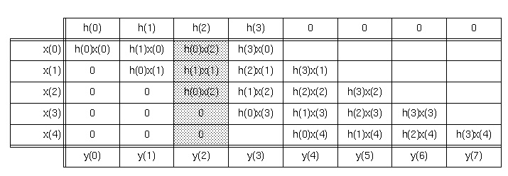
Discrete Convolution – Table Form

Slide 4

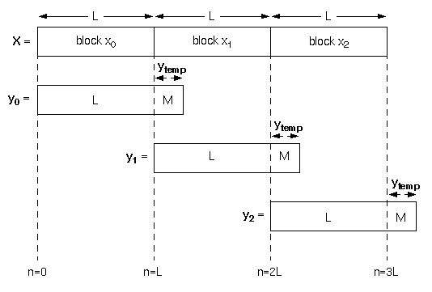
Discrete Convolution – Overlapping Windows
Streaming form:
Streaming form:

Slide 5
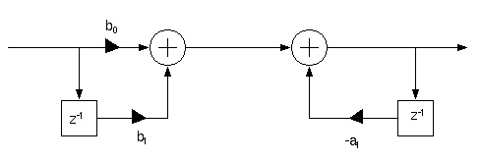
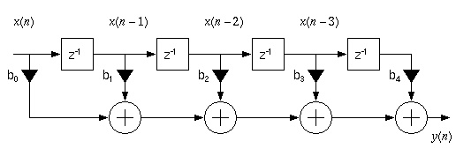
Finite Impulse Response Filters – Direct Form

Slide 6
Software Implementation
Filter:
double fir(int M, double* h, double *w, double x) {
w[0] = x;
for (double y=0, int i=0; i<=M; i++) {
y += h[i] * w[i];
}
for (int i=M; i>=1; i--) {
w[i] = w[i-1]; } return y;
}
return y;
}
Dot Product:
double dot(int M, double* h, double* w) {
for (double y=0, int i=0; i<=M; i++) {
y += h[i] * w[i];
}
return y;
}

