Slide 1
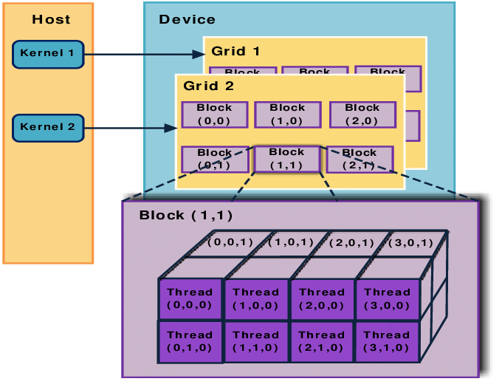
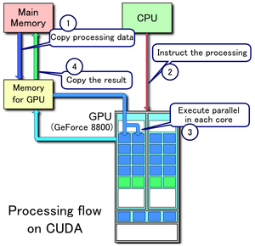
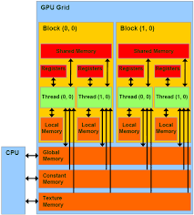
Lecture 14: Using Multiple GPUs (Manual)
Books:
CUDA By Example
Professional CUDA C Programming
Nvidia Archive
Lectures:
Python Parallel Programming Solutions
CUDA In Your Python
CUDA C/C++ Basics
Topics:
Examples

