Slide 1
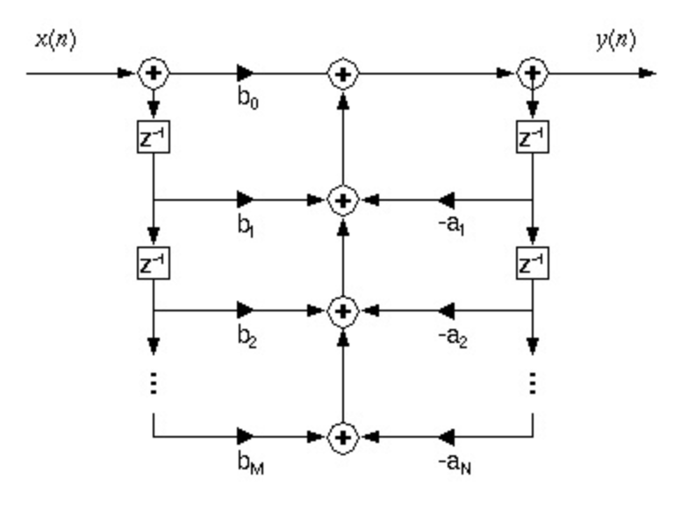
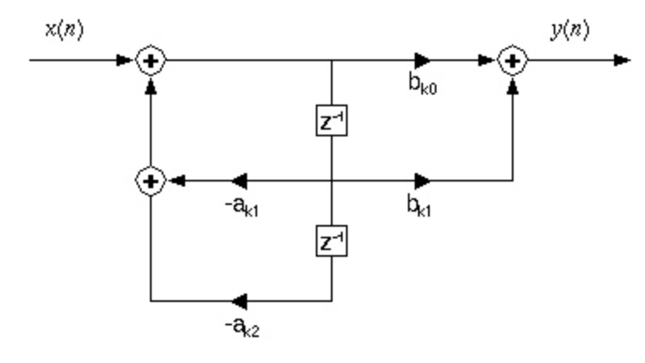
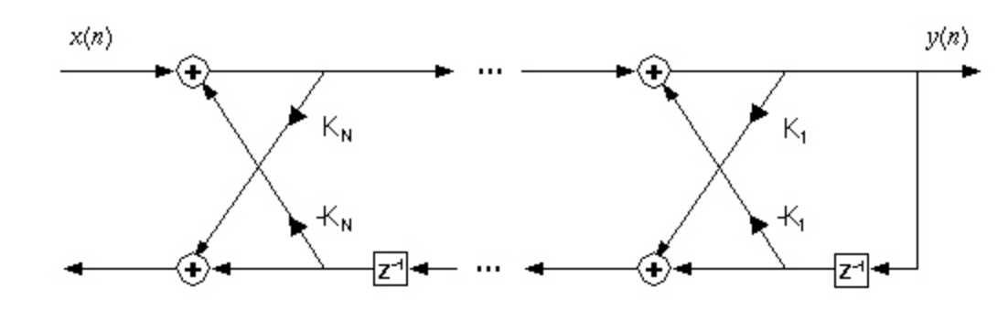
Lecture 09: DSP Review (Factoring Computations)
Topics:
Direct Form Filters
Filter Realizations

