Slide 1
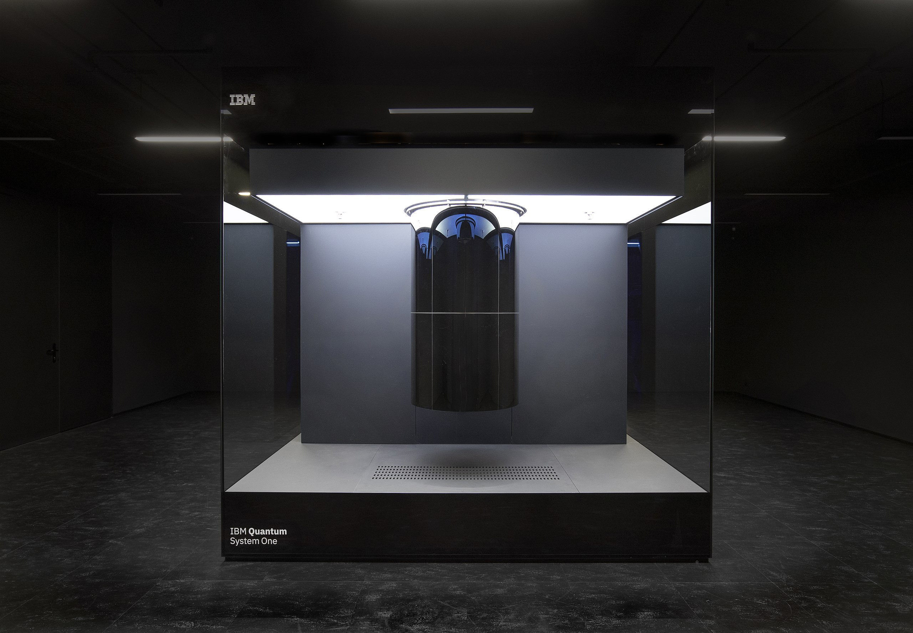
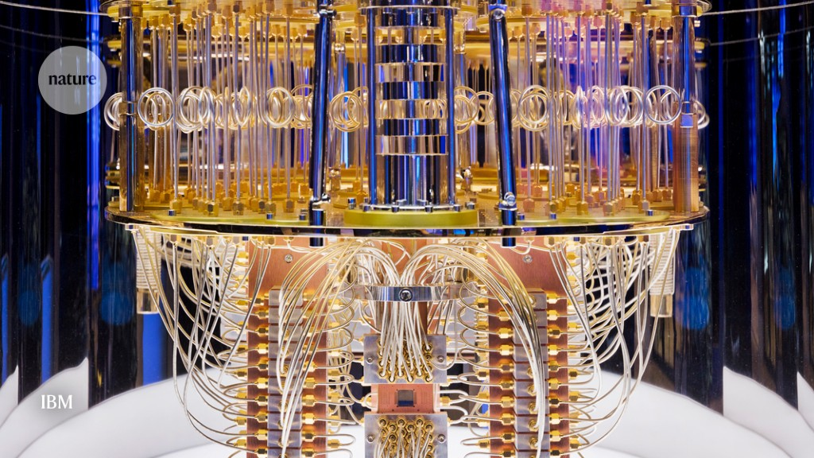
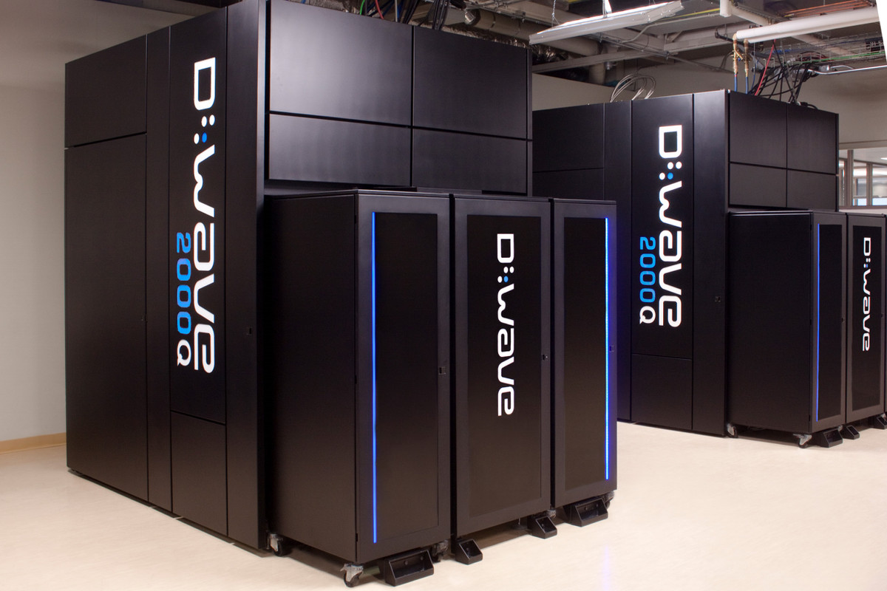
Lecture 42: Quantum Computing
Books:
Quantum Computing and Quantum Information
A First Introduction to Quantum Computing
Lectures:
IEEE SPMB
Quantum Computing for the Determined
Topics:
Quantum Annealing
Quantum for the Curious
Quantum Neural Networks

