Slide 1

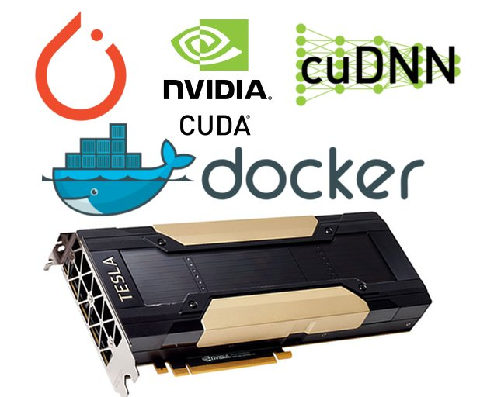
Lecture 41: Implementation of Deep Learning Systems Using Python
Books:
Deep Learning Wth PyTorch
Lectures:
PyTorch Course
PyTorch: Zero to GANs
AI For Everyone
ECE 8527
Topics:
Deep Learning
PyTorch
CPU vs. GPU

Slide 2


Deploying Neural Network Architectures
using PyTorch
Nabila Shawki
Neural Engineering Data Consortium
Temple University

Slide 3
Outline
Machine Learning/Deep Learning Pipeline
A Brief Introduction to PyTorch
Data Preparation
Model Design and Training
Decoding
Hyperparameter Tuning
Evaluation

Slide 4
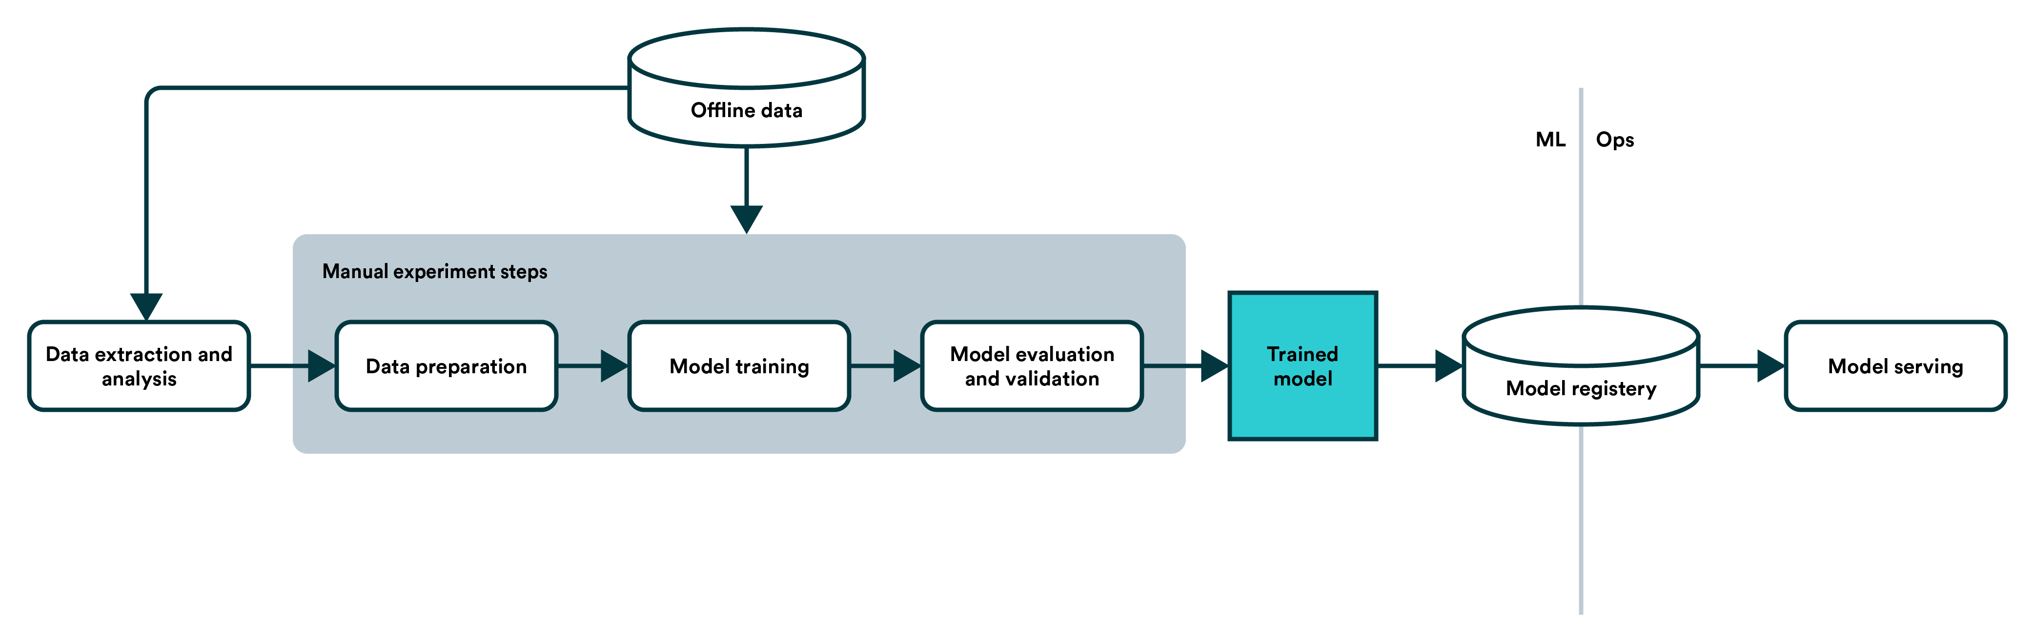
Machine Learning/Deep Learning Pipeline
To successfully design and implement a machine learning model, researchers often follow the steps below:
  Data collection
  Data Preparation
  Designing and training model
  Evaluation
We will explore these steps using PyTorch.
Notes:
https://valohai.com/machine-learning-pipeline/
https://www.kaggle.com/pouryaayria/a-complete-ml-pipeline-tutorial-acu-86
https://machinelearningmastery.com/pytorch-tutorial-develop-deep-learning-models/

Slide 5
A Brief Introduction to PyTorch
PyTorch is a machine and deep learning library by Facebook’s AI Research Lab (FAIR).
PyTorch has gained popularity among the research community as it is easy to develop and debug machine learning models in PyTorch.
Nowadays, all state-of-the-art models and more are available in PyTorch and easy to integrate with any pipeline.
With proper seeding, PyTorch can generate reproducible models.
Like Tensorflow, a machine learning library by Google, PyTorch works with tensors which can be thought of as matrices with higher dimensions. These are equivalent to ndarrays in NumPy.
There are other deep learning framework available. For example, MATLAB can be used to design and train models.
Keras is a high-level API library that uses TensorFlow as backend and suitable for beginners. It is straightforward to build and test models using Keras. However, it can be difficult to debug in Keras.
Notes:
https://cs230.stanford.edu/blog/pytorch/
https://heartbeat.fritz.ai/10-reasons-why-pytorch-is-the-deep-learning-framework-of-future-6788bd6b5cc2
https://pytorch.org/tutorials/beginner/basics/tensorqs_tutorial.html

Slide 6
Deep Learning Pipeline Implementation with PyTorch
Model
and Data Preparation
Design model
Define architecture (layers, dropout, activation functions)
Forward function: the flow of data through the model
Collected Data
Preprocess data offline (if necessary)
Design Dataset class to produce data in mini batches.
Model architecture
Processed Data
Initialize device (CPU or GPU)
Initialize model and send to device
Initialize loss function, optimizer, epoch count, batch size, other hyperparameters.
Separate a small part of the train set for validation
Initialize train and validation Dataloaders with the designed Dataset
Initialization
for training
Initialized model and batch data
N epochs
Train Model (model.train())
Set optimizer.zero_grad() and torch.set_grad_enabled
Get data from train loader, convert to tensor (if necessary), send to device.
Get prediction from model
Calculate loss
Perform backpropagation (loss.backward(), optimizer.step())
Validate Model (model.eval())
Set torch.no_grad()
Get data val loader, convert to tensor (if necessary), send to device.
Get prediction
Compare performance measurement
Save best weights
Training
Trained weights
Decoding
Data
Prepare data in the same way as the training step
Initialize device and model, load Trained Weights, and send to device
Get and save the predicted labels for the samples
Predicted labels
Scoring
Get ground truth and prediction for the samples
Perform scoring as necessary

Slide 7
Run a PyTorch Process on GPU
Anaconda is popular platform to deploy various deep learning and data science libraries. It facilitates the usage of separate environments for different setups.
The appropriate conda environment should be activated with:
  “conda activate <env_name>”
Source the .bashrc script from the home directory.
The available GPU might need to be set up as an environment variable (it may vary in different setups): export CUDA_VISIBLE_DEVICES=‘0’
The PyTorch script needs to recognize the available devices:
  device = torch.device("cuda:0" if torch.cuda.is_available() else "cpu")
This code checks if a GPU is available. If it is not available, the code utilizes CPU.
  Sending data/model/objects is easy: obj.to(device)
Alternate: cuda = True if torch.cuda.is_available() else False
  However, this requires branching when an entity is being sent to the device.

Slide 8
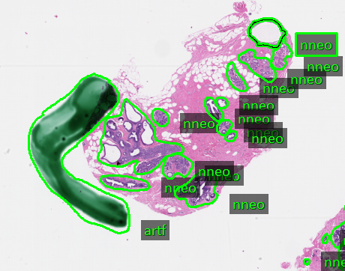
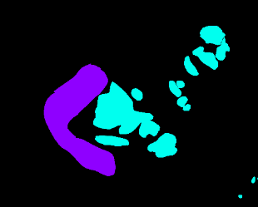
Data Collection and Preparation
The data in real world is messy. One needs to collect and prepare data in order to make the best use of machine learning models.
For example, the Whole Slide Images (WSIs) can be as big as 89262 x 208796 in size with multiple levels.
It is infeasible to train models with such data. We extract patches from the useful parts before we can move forward to train a model.
For this course, the text files need to be parsed and, the labels and the features need to be separated.
Annotated Slide
Mask
Extracted Patches

Slide 9
Batch Processing for Model Training
Once data preparation is complete, it needs to be fed to the model in minibatches.
PyTorch provides Dataset and DataLoader classes to streamline that process.
Custom Datasets can be implemented as per user requirement.
A Dataset class must have three functions:
  __init__
  __len__
  __getitem__
DataLoader uses the Dataset class to retrieve labels and samples.
Notes:
https://pytorch.org/tutorials/beginner/basics/data_tutorial.html

Slide 10
Model Design and Implementation in PyTorch
Models are designed as classes in PyTorch with a forward function.
A loss function and an optimizer with a learning rate must be selected to train the model.
Special functions like optimizer.zero_grad(), loss.backward(), and optimizer.step(), model.train(), model.eval(), etc. are essential in PyTorch for training a model.
We normally use three types of data sets:
  Training set
  Development set
  Evaluation set
20-25% of the training set data should be separated for validation.
The best weights can be chosen based on loss, error rate, or accuracy.
Once the model is trained, we decode and score the development set.
When the score of dev set is satisfactory, we then decode and score the eval set.
Notes:
https://pytorch.org/tutorials/beginner/basics/data_tutorial.html
https://pytorch.org/tutorials/beginner/transfer_learning_tutorial.html

Slide 11
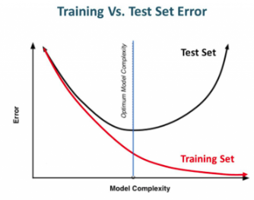
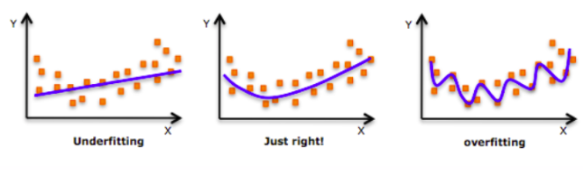
Hyperparameter Tuning
Hyperparameters play a crucial part on the performance of the model.
Simply seeding the random number generators with different initial values can impact the performance of the model.
Hyperparameters include but not limited to:
By carefully selecting these hyperparameters and using techniques like early stopping and validation, we can avoid overfitting and underfitting.
Learning rate Number of epochs Batch Size | Optimizer selection Number of layers Dropout Layers
Notes:
https://medium.com/@jorgesleonel/hyperparameters-in-machine-deep-learning-ca69ad10b981
https://medium.com/@jorgesleonel/bias-variance-in-machine-learning-656a1b58e1c9

