Slide 1
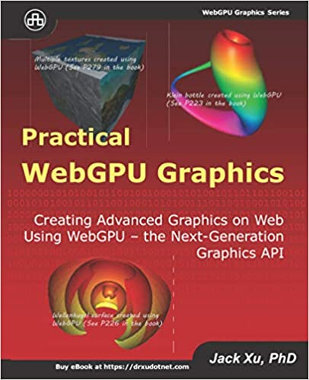
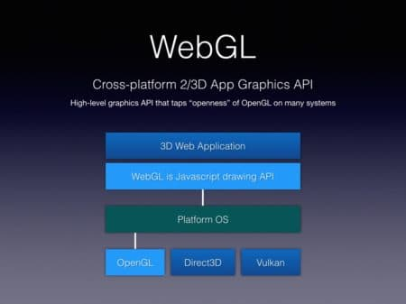
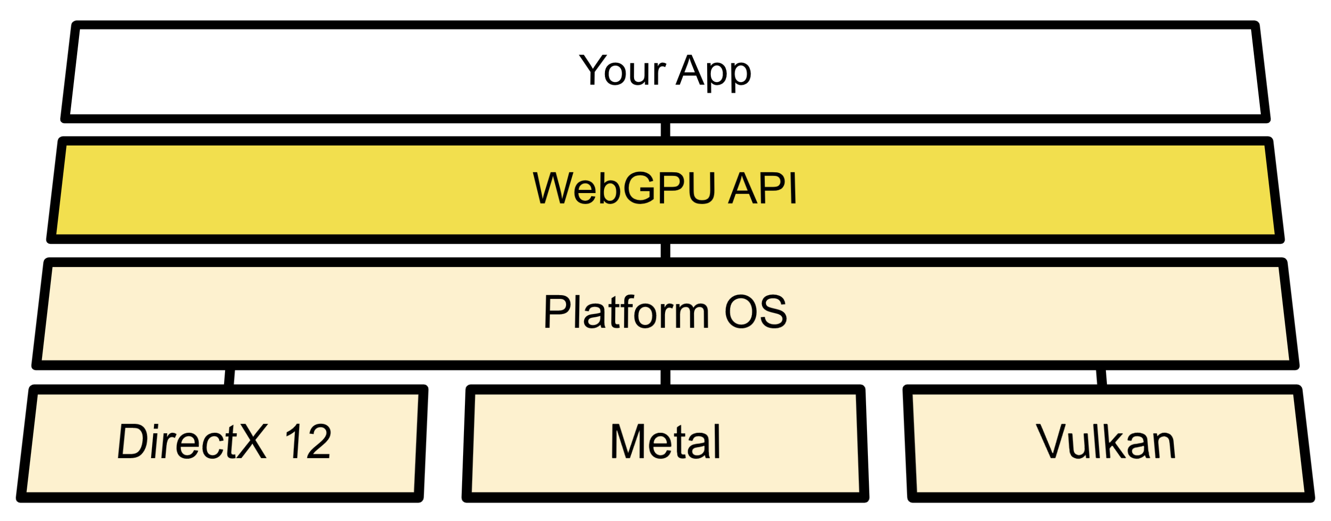
Lecture 39: Concurrency and Streams
Books:
Practical WebGPU Graphics
Lectures:
Concurrency and Streams
Video Analytics
WebGPU Graphics Programming
WebGPU WIll Revolutionize the Web
Topics:
Introduction to Streams and Concurrency
NVIDIA Nsight Visual Studio Debugging
Fast Matrix Multiplication on a GPU
WebGPU
WebGPU Graphics Programming

