Slide 1
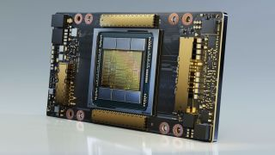
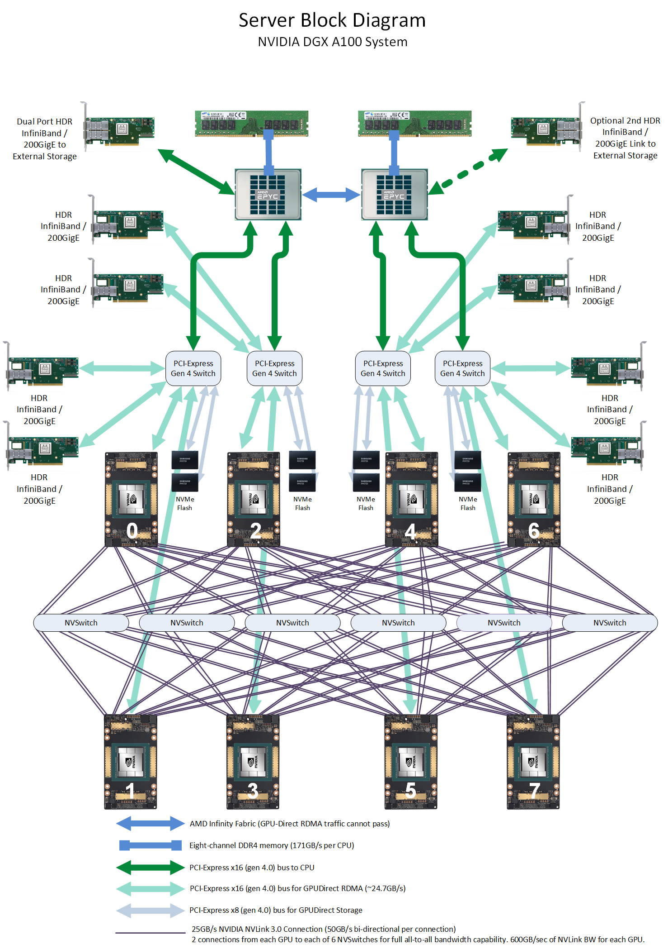
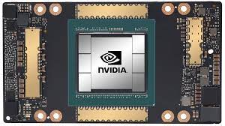
Lecture 38: A Deep Dive into the NVIDIA A100
Books:
Deep Learning With PyTorch
Lectures:
NVIDIA A100 Product Announcement
NVIDIA Data Center Tour
NVIDIA Investor Day
Multi-Instance Programming
Topics:
Next Generation Data Centers
NVIDIA A100 Tensor Core GPU Architecture
NVIDIA A100 GPU: Performance & Innovation

