Slide 1
Coordinated Checkpointing
Presented by Sarah Arnold

Slide 2

Agenda
Goals
Fault Tolerance
Failure Recovery
System Overview
Coordinated Checkpointing
Communication-Induced Checkpointing
Logging
Conclusions

Slide 3
Goals
To recover the system after any type of fault has been introduced to the system and to minimize the amount of computation lost
  Hardware
  Software
  Processors
  Network
  Memory
  Disk
fault
causes
erroneous state
error
recovery
leads to
valid state
failure

Slide 4

Fault Tolerance
Fault Tolerance – a design that enables a system to continue operation, rather than failing completely, when some part of the system fails
  Looking at problem from system perspective in terms of the state of the system being its “memory state”
  We know nothing of the application or outside world processes that may have introduced the error, but must still get the system back to a valid state
Notes:
Forward recovery is usually application dependent

Slide 5

Failure Recovery
Failure Recovery – an attempt to put the system back into a valid state
  Backward Recovery: Retreating back to an earlier state of the system
    Operation-based: Logs of operations are maintained and replayed
    State-based: Check-pointing particular states of the system as it evolves
  Forward Recovery: Usually no previous state to retreat to; instead must fail into some forward condition
    Messages sent to outside world are sent and cannot be retrieved: Imagine trying to recover Space Shuttle after liftoff!

Slide 6

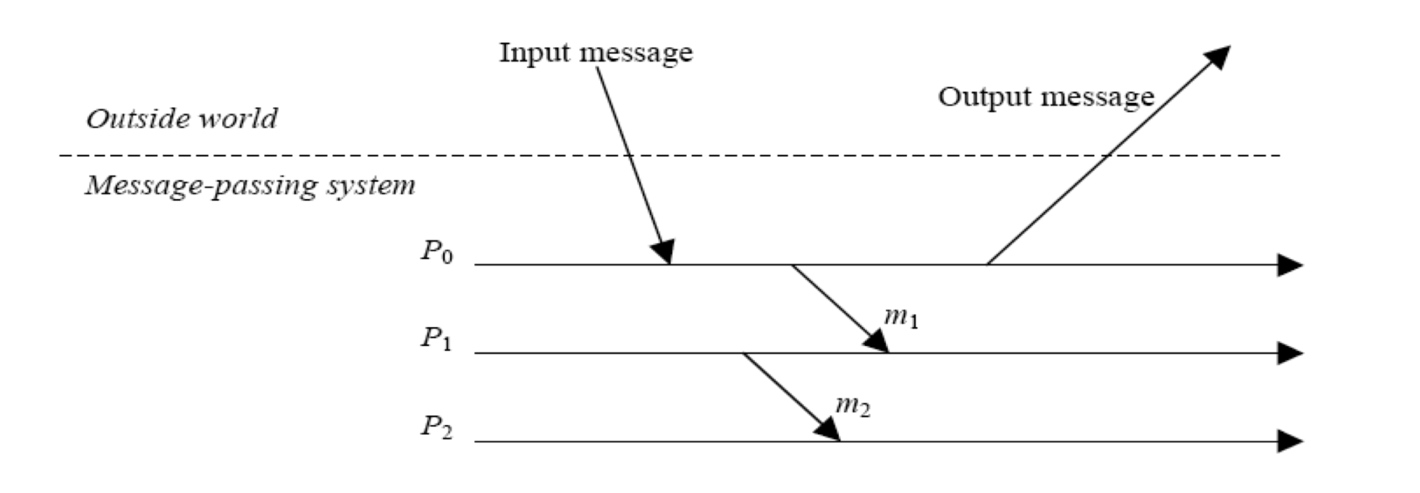
System Model
Processes
Messages
System interacts with outside world as well as sends messages internally
  System must be kept in a coherent state with the outside world process

Slide 7

Orphan Messages
Orphan Message: A message that is received but never sent (i.e. message m below); no sender can be identified
  Due to the fact that, when restored back to their checkpoints, one part of the system is incoherent with another part of the system
Checkpoint: Complete recorded state of the application or
Failure:
X₁
x₁
X
y₁
m
Y

Slide 8
Lost Messages
If a process fails and has to recover to a previous state before it received a message, the message is lost
  Sender might try and send again, but potential receiver doesn’t even know it had been sent already
x₁
X
m
y₁
Y

Slide 9
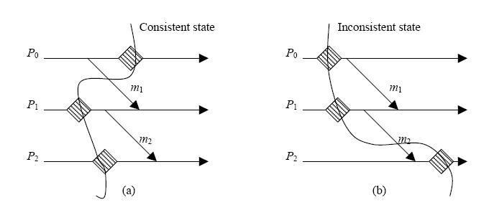
In-/Consistent States
When rolling back to a checkpoint, the system is in a consistent state if there are no orphan messages (see a below) and is in an inconsistent state if there are orphan messages (see b below)

Slide 10

Domino Effect
In order to avoid orphan messages and rolling back to an inconsistent state, a failed process may trigger other processes to rollback as well – this is Domino Effect.
  Goal is to checkpoint at most useful time/state
Consider the effect if Z failed after sending message n
x₁
x₂
x₃
X
y₁
y₂
m
Y
z₁
z₂
n
Z
Notes:
The whole system had to be reset to the beginning because the checkpoints weren’t taken at times that were of much use to the system

Slide 11
Algorithm Considerations
Output commit: when a message is sent to the outside world, there is no way to pull that message back; similarly, there may not be a way to reproduce a message from the outside world.
  Therefore, the state of the system must be solid to ensure no failure past that point
  Expense: Affects latency of message and additional checkpointing
Garbage Collection: when can I get rid of older checkpoints?
Stable Storage
  All algorithms assume that the location of checkpointing data is on stable storage

Slide 12
Logging Elements
L
Determinant: The information that must be logged that is needed to recover a message
  How to record this depends on type of algorithm
Piecewise-Deterministic
  Postulates that all nondeterministic events that a process executes can be identified and the information needed to replay the events can be logged in its determinant
  By logging and replaying the nondeterministic events in their exact order, a process can deterministically recreate its pre-failure state, even without a checkpoint

Slide 13
Recovery Algorithms
Rollback-Recovery
checkpointing
logging
uncoordinated
coordinated
communication-induced
pessimistic
optimistic
causal
blocking
non-blocking
model-based
index-based

Slide 14
Coordinated Checkpointing Protocol (Blocking)
✔
When a process takes a checkpoint, it engages a protocol to coordinate with other processes to also checkpoint
  Coordinator takes a checkpoint; broadcasts a message to all processes
  Process receives this message and halts execution; takes tentative checkpoint
  Coordinator receives acknowledgement from all processes; broadcasts commit message to end protocol
  Process receives commit message, removes old permanent checkpoint and makes tentative checkpoint permanent
  Processes resume execution

Slide 15
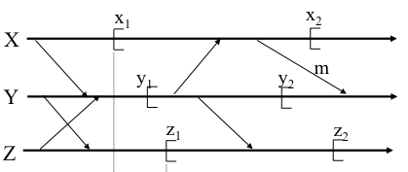
Coordinated Checkpointing Protocol (Blocking)
✔
Recovery line: guarantee that system will never have to go back to a state earlier than this line
  {x1, y1, z1} forms “recovery line”
  Good for garbage collection
Blocking: Application is paused and no messages can be in transit during checkpointing

Slide 16
Coordinated Checkpointing Notation
Each message has a sequence number (an increasing counter) affixed to it by the system
When we checkpoint, we keep these vectors along with it
last_label_rcvd_{X}[Y]
last_label_sent_{X}[Y]
Last label X received before checkpoint was from Y
Last label X sent before checkpoint was to Y
X
m.l (a message m and its label l)
Y
first_label_sent_{Y}[X]
First label Y sent after checkpoint was to X

Slide 17
Coordinated Checkpointing Questions
?
When to take a checkpoint?
  Application specific
  Balance the cost of taking the checkpoint against the amount of computation that you’re going to lose by not taking one and having to use an earlier one
Checkpoint protocol
  When should I do a checkpoint?
  If I take a checkpoint, who else do I have to ensure also takes a checkpoint?
  and…
  When must I rollback?
  If I rollback, who else must rollback?
Answers are based on label vectors!

Slide 18

Coordinated Checkpointing Algorithm
(1) When must I take a checkpoint?
(2) Who else has to take a checkpoint when I do?
x₁
x₂
tentative checkpoint
X
y₁
m
y₂
Y
z₁
z₂
Z
(1) When I (Y) have sent a message to the checkpointing process, X, since my last
checkpoint:
last_label_rcvd_{X}[Y] >= first_label_sent_{Y}[X] >sl
(2) Any other process from whom I have received messages since my last checkpoint.
ckpt_cohort_{X} = {Y | last_label_rcvd_{X}[Y] >sl}

Slide 19

Coordinated Checkpointing Algorithm
(1) When must I rollback?
(2) Who else might have to rollback when I do?
x₁
x₂
X
y₁
y₂
Y
z₁
z₂
Z
(1) When I ,Y, have received a message from the restarting process,X, since X's last checkpoint.
    last_label_rcvd_{Y}(X) >last_label_sent_{X}(Y)
(2) Any other process to whom I can send messages.
roll_cohort_{Y} = {Z | Y can send message to Z}

Slide 20
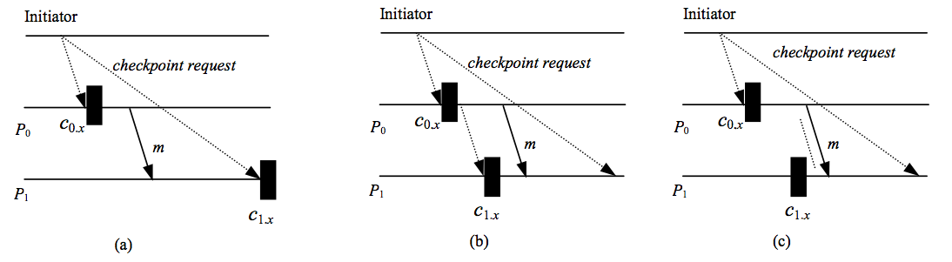
Coordinated Checkpointing: Non-blocking Protocol ✔
Key issue with coordinated checkpointing:
  Being able to prevent a process from receiving application messages that could make the checkpoint inconsistent
Problem can be avoided by preceding the first post-checkpoint message on each channel by a checkpoint request, forcing each process to take a checkpoint upon receiving the first checkpoint-request message

Slide 21
Communication-Induced Checkpointing
Avoids domino effect without coordinated checkpoints
Processes take two kinds of checkpoints
  Local: can be taken independently
  Forced: must be taken to guarantee progress of recovery line
    Piggyback protocol-specific information on each application message
Follow application trends to make sure checkpoint is necessary
  Z-paths and Z-cycles form patterns

Slide 22

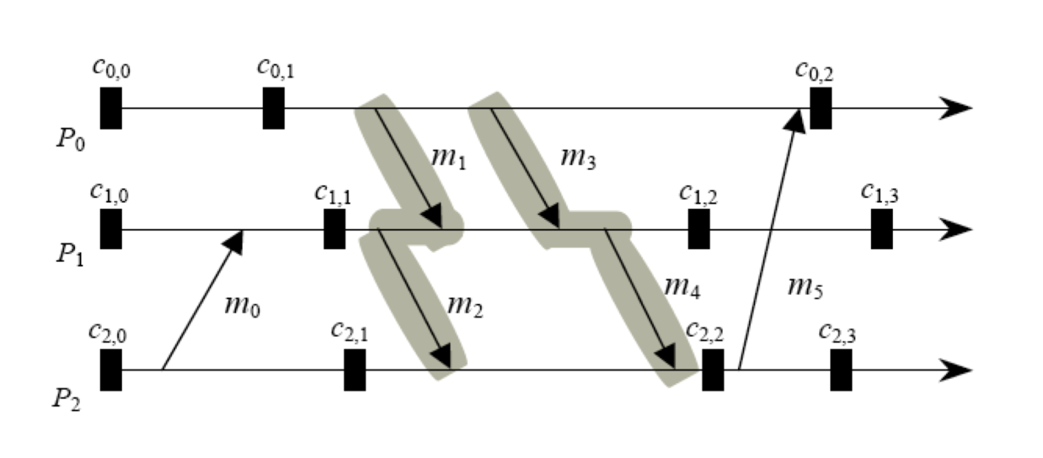
Communication-Induced Checkpointing
Z-path: sequence of messages in the interval between two checkpoints
  [m₁, m₂], [m₁, m₄], [m₃, m₂] and [m₃, m₄]
Z-cycle: Z-path that begins and ends within the same interval
  [m₅, m₃, m₄]
  Makes checkpoint c₂,₂ useless

Slide 23
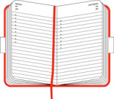
Logging
Goal: Capture messages that are received and avoid orphan processes
  Always-no-orphans condition: If any surviving processes depends on an event e, either the event is logged on stable storage or the process has a copy of e’s determinant.
Uses checkpointing and logs
Useful with applications that interact frequently with the outside world
  Enables process to repeat its execution without having to take expensive checkpoints before sending messages
Not susceptible to domino effect
Piecewise determinism
  Rollback recovery protocol can identify all nondeterministic events (messages received, input from outside world, etc.) executed and logs the determinant; can recover a failed process and replay its execution as it occurred before the failure

Slide 24
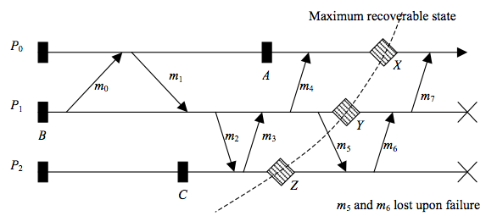
Logging
Recoverable: a state interval is recoverable if there is sufficient information to replay the execution up to that point despite any future failures
Stable: a state interval is stable if the determinant of the nondeterministic event that started it is logged on stable storage
  Recoverable is always stable, but opposite is not always true
P₁ and P₂ fail before logging m₅ and m_{6?} M₇ becomes an orphan message → Maximum Recoverable State: X, Y, Z

Slide 25
Pessimistic Logging
☹
Designed under assumption that a failure can occur after any nondeterministic event
  Protocol logs determinant to stable storage before event is allowed to affect computation
Periodic checkpoints are taken to aid in repeating execution
  Application is restarted from most recent checkpoint and the logged determinants are used to recreate execution
Pros:
  Immediate output commit
  Restart from most recent checkpoint
  Recovery limited to failed processes
    Always-no-orphans: if a surviving process depends on an event, either the event is logged or that process has a copy of the event’s determinant
  Simple garbage collection
Con:
  Performance Penalty due to synchronous logging

Slide 26
Optimistic Logging
☺
Log determinants asynchronously
  Optimistic assumption that logging will complete before a failure occurs
Determinants are kept in a volatile log that is periodically flushed to stable storage
  No blocking necessary (less overhead)
  More complicated recovery, garbage collection, and slower output commit
Does not implement always-no-orphans
  Permits temporary creation of orphan processes
  Upon a failure, dependency information is used to recover latest global state of pre-failure execution in which no process is an orphan
Great for failure free executions

Slide 27
Causal Logging
X → Y
Failure-free performance from optimistic + allowing processes to commit output independently and always-no-orphans from pessimistic
Determinants of all causally preceding events are logged to stable storage or are available locally
Limits rollback to most recent checkpoint
  Reduces overhead of storage and work at risk
Piggybacks on each message information about preceding messages

Slide 28

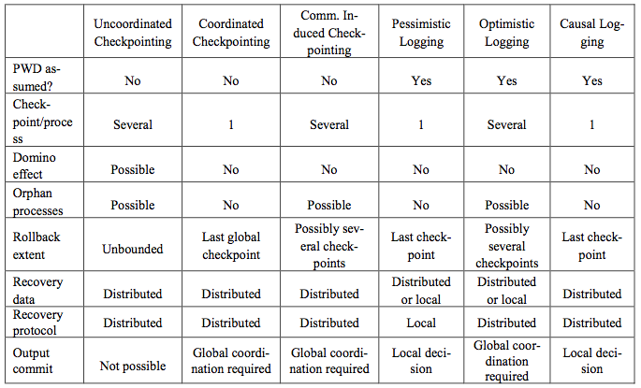
Rollback-Recovery Protocols

Slide 29
Conclusions
Issues at hand: Piecewise determinism, performance overhead, storage overhead, ease of output commits, ease of garbage collection, ease of recovery, avoiding domino effect and orphan processes
Checkpointing:
  Coordinated: simplifies recovery and garbage collection, overall good performance
  Uncoordinated: suffers from potential domino effects and complicates recovery
  Communication-Induced: no domino effect or coordination, but nondeterministic nature complicates garbage collection and degrades performance
Logging: Natural choice for applications that often interact with outside world
  Pessimistic: simplifies recovery and output commit; simple and robust
  Causal: reduces overhead, fast output commit and orphan-free recovery
  Optimistic: reduces overhead more than Causal, but complicates recovery by increasing extent of future rollbacks

Slide 30
Questions?
Thank you!

Slide 31

References
“A Survey of Rollback-Recovery Protocols in Message-Passing Systems” by E.N. (Mootaz) Elnozahy, Lorenzo Alvisi, Yi-Min Wang, and David B. Johnson
Fault Tolerance: en.wikipedia.org/wiki/Fault_tolerance
Checkpointing-Recovery, Dr. Dennis Kafura

