Slide 1
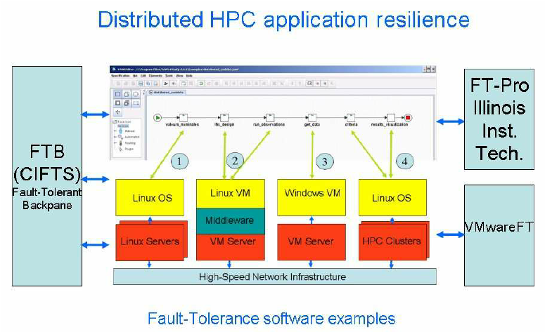
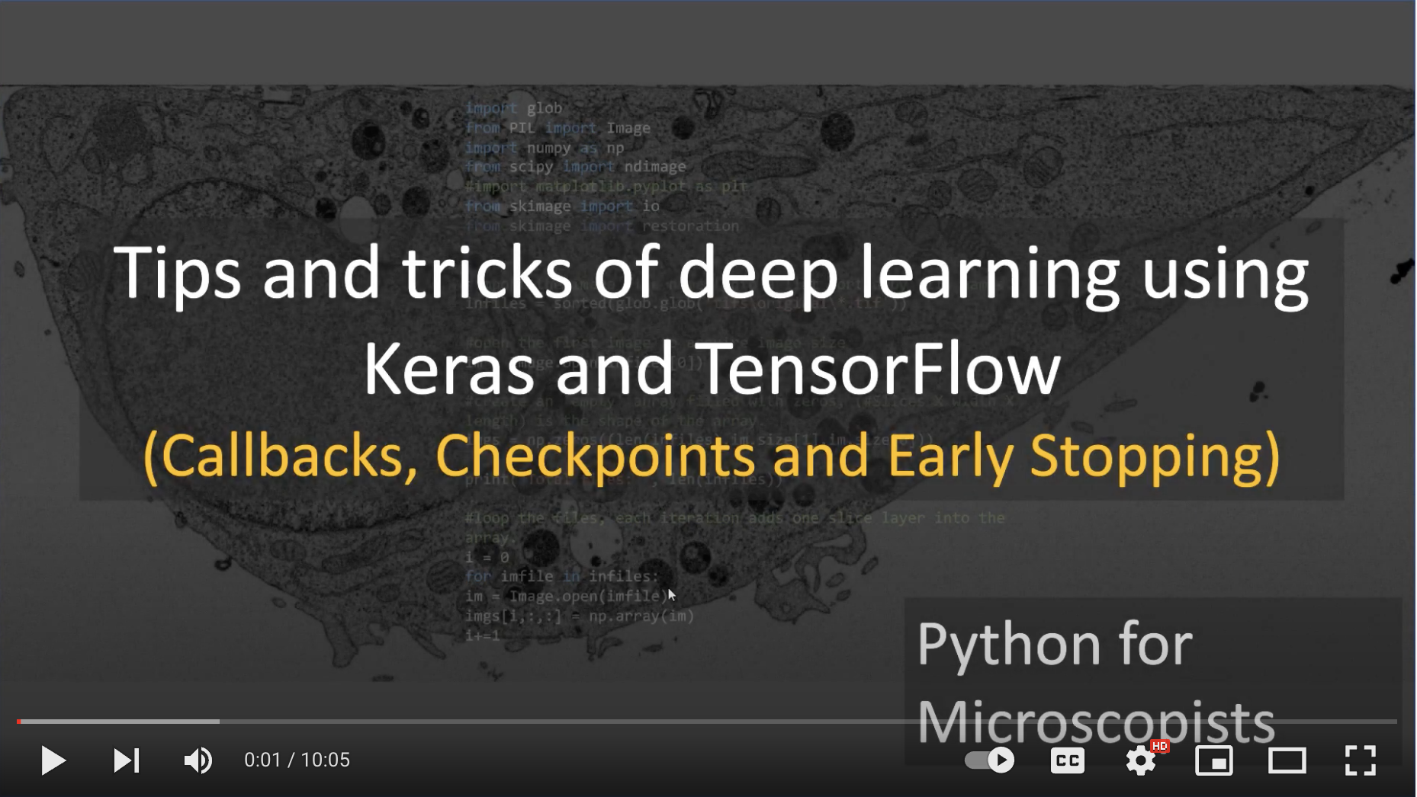
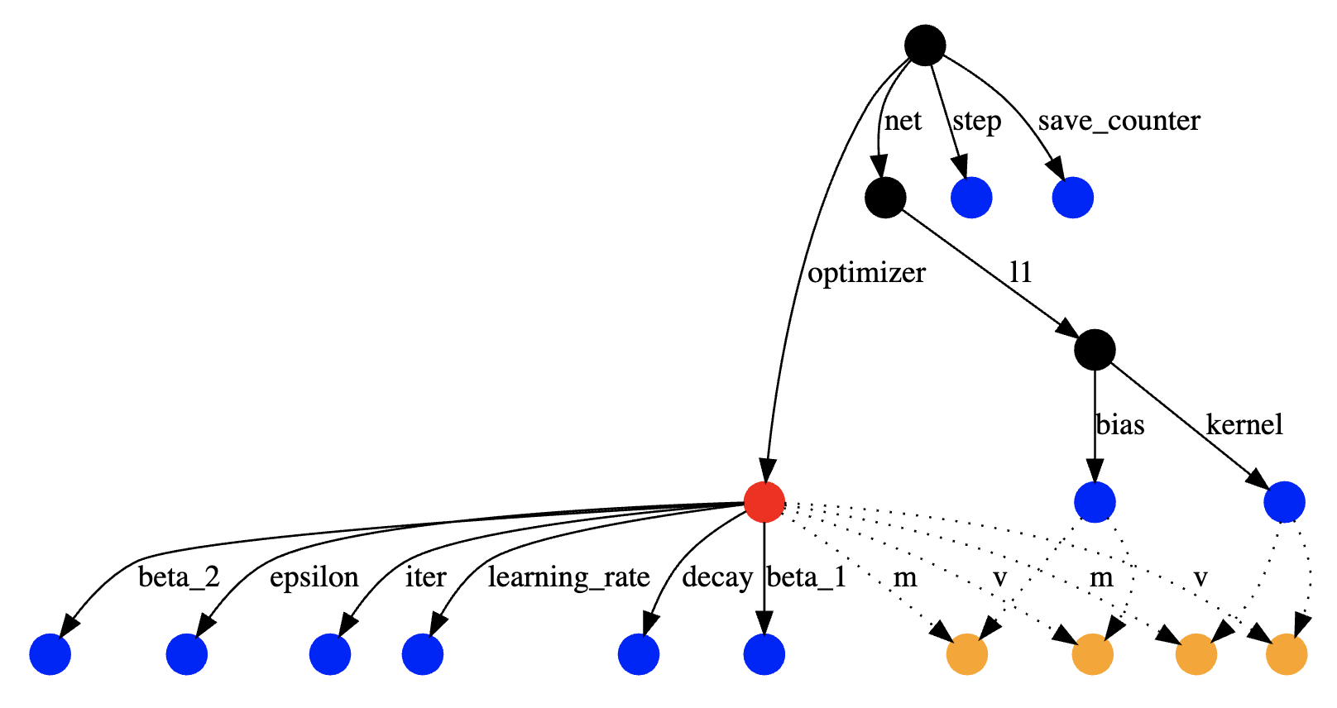
Lecture 37: Advanced Topics – Checkpointing and Recovery
Books:
Encyclopedia of Parallel Computing
Lectures:
System-Level vs. Application-Level
Checkpointing the Un-checkable
Topics:
Coordinated Checkpointing
Application Checkpointing
Checkpointing in PyTorch
Checkpointing in Python
Python Checkpoint Libraries
Checkpoints in Deep Learning
Undo Models

