Slide 1

Introduction to Parallel Algorithms and Parallel Program Design
Parallel Computing
CIS 410/510
Department of Computer and Information Science

Slide 2
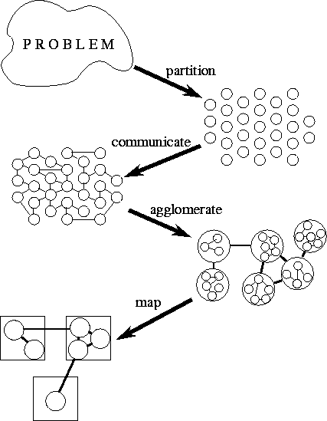
Methodological Design
Partition
  Task/data
  decomposition
Communication
  Task execution
  coordination
Agglomeration
  Evaluation of the
  structure
Mapping
  Resource assignment
  I. Foster, “Designing and Building Parallel Programs,” Addison-Wesley, 1995. Book is online, see webpage.

Slide 3
Partitioning
Partitioning stage is intended to expose
opportunities for parallel execution
Focus on defining large number of
small task to yield a fine-grained
decomposition of the problem
A good partition divides into small pieces
both the computational tasks associated with a problem and the data on which the tasks operates
Domain decomposition focuses on computation data
Functional decomposition focuses on computation tasks
Mixing domain/functional decomposition is possible

Slide 4
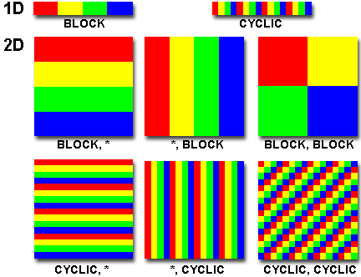
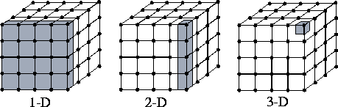
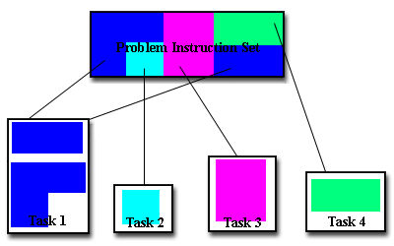
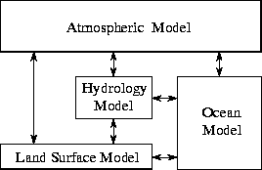
Domain and Functional Decomposition
Domain decomposition of 2D / 3D grid
Functional decomposition of a climate model

Slide 5
Partitioning Checklist
Does your partition define at least an order of magnitude more tasks than there are processors in your target computer? If not, may loose design flexibility.
Does your partition avoid redundant computation and storage requirements? If not, may not be scalable.
Are tasks of comparable size? If not, it may be hard to allocate each processor equal amounts of work.
Does the number of tasks scale with problem size? If not may not be able to solve larger problems with more processors
Have you identified several alternative partitions?

Slide 6
Communication (Interaction)
Tasks generated by a partition must
interact to allow the computation
to proceed
  Information flow: data and control
Types of communication
  Local vs. Global: locality of communication
  Structured vs. Unstructured: communication patterns
  Static vs. Dynamic: determined by runtime conditions
  Synchronous vs. Asynchronous: coordination degree
Granularity and frequency of communication
  Size of data exchange
Think of communication as interaction and control
  Applicable to both shared and distributed memory parallelism

Slide 7
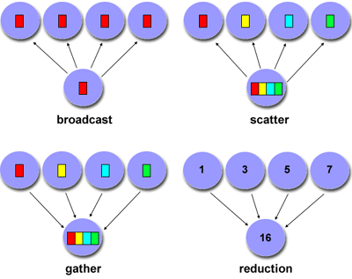
Types of Communication
Point-to-point
Group-based
Hierachical
Collective

Slide 8
Communication Design Checklist
Is the distribution of communications equal?
  Unbalanced communication may limit scalability
What is the communication locality?
  Wider communication locales are more expensive
What is the degree of communication concurrency?
  Communication operations may be parallelized
Is computation associated with different tasks able to proceed concurrently? Can communication be overlapped with computation?
  Try to reorder computation and communication to expose opportunities for parallelism

Slide 9
Agglomeration
Move from parallel abstractions
to real implementation
Revisit partitioning and communication
  View to efficient algorithm execution
Is it useful to agglomerate?
  What happens when tasks are combined?
Is it useful to replicate data and/or computation?
Changes important algorithm and performance ratios
  Surface-to-volume: reduction in communication at the expense of decreasing parallelism
  Communication/computation: which cost dominates
Replication may allow reduction in communication
Maintain flexibility to allow overlap

Slide 10
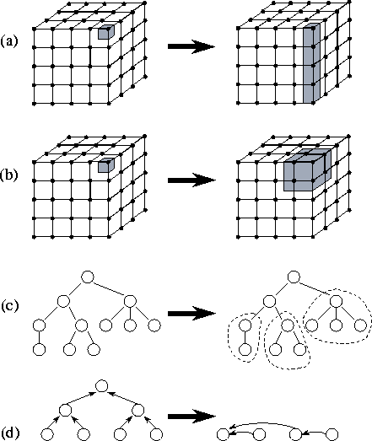
Types of Agglomeration
Element to column
Element to block
  Better surface to volume
Task merging
Task reduction
  Reduces communication

Slide 11
Agglomeration Design Checklist
Has increased locality reduced communication costs?
Is replicated computation worth it?
Does data replication compromise scalability?
Is the computation still balanced?
Is scalability in problem size still possible?
Is there still sufficient concurrency?
Is there room for more agglomeration?
Fine-grained vs. coarse-grained?

Slide 12
Mapping
Specify where each task is to execute
  Less of a concern on shared-memory
  systems
Attempt to minimize execution time
  Place concurrent tasks on different
  processors to enhance physical concurrency
  Place communicating tasks on same processor, or on processors close to each other, to increase locality
  Strategies can conflict!
Mapping problem is NP-complete
  Use problem classifications and heuristics
Static and dynamic load balancing

Slide 13
Mapping Algorithms
Load balancing (partitioning) algorithms
Data-based algorithms
  Think of computational load with respect to amount of data being operated on
  Assign data (i.e., work) in some known manner to balance
  Take into account data interactions
Task-based (task scheduling) algorithms
  Used when functional decomposition yields many tasks with weak locality requirements
  Use task assignment to keep processors busy computing
  Consider centralized and decentralize schemes

Slide 14
Mapping Design Checklist
Is static mapping too restrictive and non-responsive?
Is dynamic mapping too costly in overhead?
Does centralized scheduling lead to bottlenecks?
Do dynamic load-balancing schemes require too much coordination to re-balance the load?
What is the tradeoff of dynamic scheduling complexity versus performance improvement?
Are there enough tasks to achieve high levels of concurrency? If not, processors may idle.

Slide 15
Types of Parallel Programs
Flavors of parallelism
  Data parallelism
    all processors do same thing on different data
  Task parallelism
    processors are assigned tasks that do different things
Parallel execution models
  Data parallel
  Pipelining (Producer-Consumer)
  Task graph
  Work pool
  Master-Worker

Slide 16
Data Parallel
Data is decomposed (mapped) onto processors
Processors performance similar (identical) tasks on data
Tasks are applied concurrently
Load balance is obtained through data partitioning
  Equal amounts of work assigned
Certainly may have interactions between processors
Data parallelism scalability
  Degree of parallelism tends to increase with problem size
  Makes data parallel algorithms more efficient
Single Program Multiple Data (SPMD)
  Convenient way to implement data parallel computation
  More associated with distributed memory parallel execution

Slide 17
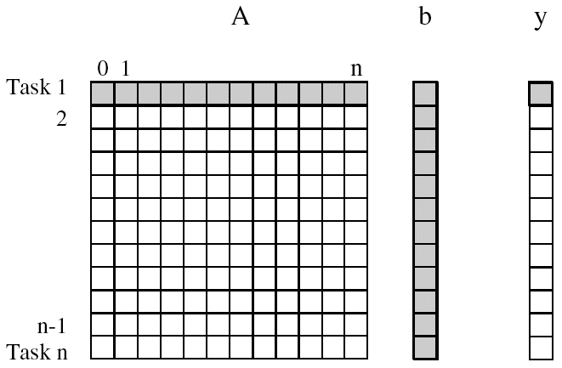
Matrix - Vector Multiplication
A x b = y
Allocate tasks to rows of A
  y[i] = ∑A[i,j]*b[j]
Dependencies?
Speedup?
Computing each
element of y can be
done independently
j

Slide 18
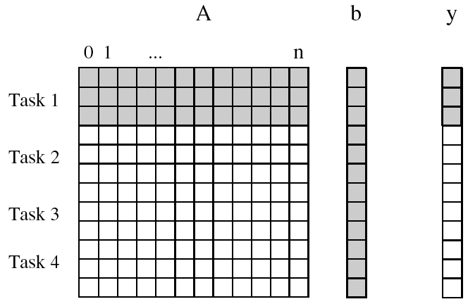
Matrix-Vector Multiplication (Limited Tasks)
Suppose we only have 4 tasks
Dependencies?
Speedup?

Slide 19
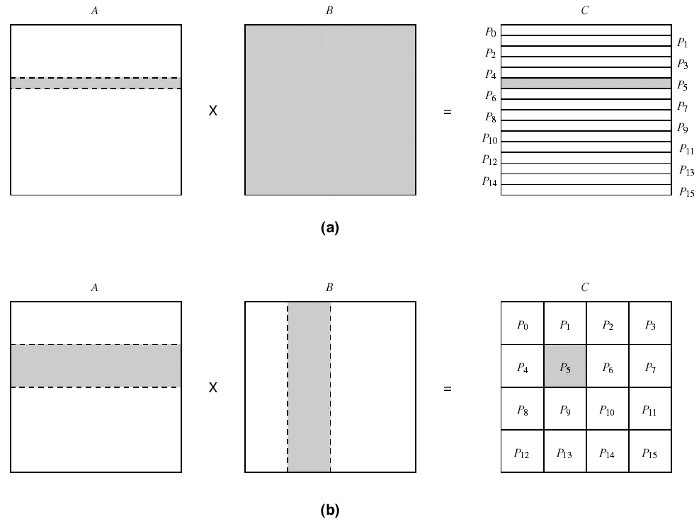
Matrix Multiplication
A
B
C
A x B = C
A[i,:] • B[:,j] = C[i,j]
Row partitioning
  N tasks
Block partitioning
  N*N/B tasks
Shading shows data
sharing in B matrix
x
=

Slide 20
Granularity of Task and Data Decompositions
Granularity can be with respect to tasks and data
Task granularity
  Equivalent to choosing the number of tasks
  Fine-grained decomposition results in large # tasks
  Large-grained decomposition has smaller # tasks
  Translates to data granularity after # tasks chosen
    consider matrix multiplication
Data granularity
  Think of in terms of amount of data needed in operation
  Relative to data as a whole
  Decomposition decisions based on input, output, input-output, or intermediate data

Slide 21


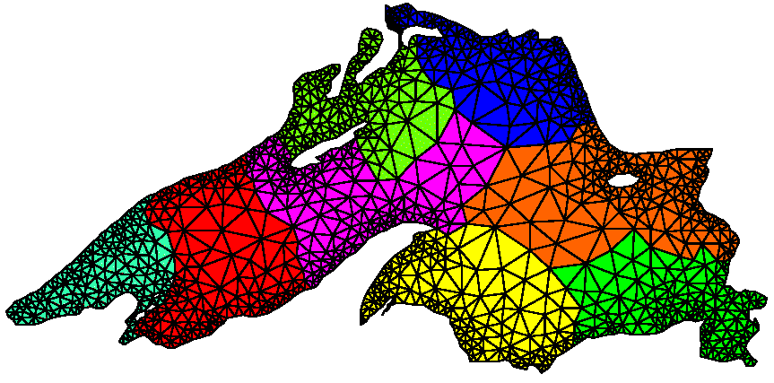
Mesh Allocation to Processors
Mesh model of Lake Superior
How to assign mesh elements
to processors
Distribute onto 8 processors
randomly
graph partitioning
for minimum
edge cut

Slide 22
Pipeline Model
Stream of data operated on by succession of tasks
  Task 1 Task 2 Task 3 Task 4
  Tasks are assigned to processors
Consider N data units
data
input
P1
P2
P3
P4
Task 1
Task 2
Task 3
Task 4
Sequential
Parallel (each task assigned to a processor)
4 data units
8 data units
4-way parallel, but
for longer time
4-way parallel

Slide 23
Pipeline Performance
N data and T tasks
Each task takes unit time t
Sequential time = N*T*t
Parallel pipeline time = start + finish + (N-2T)/T * t
= O(N/T) (for N>>T)
Try to find a lot of data to pipeline
Try to divide computation in a lot of pipeline tasks
  More tasks to do (longer pipelines)
  Shorter tasks to do
Pipeline computation is a special form of
producer-consumer parallelism
  Producer tasks output data input by consumer tasks

Slide 24
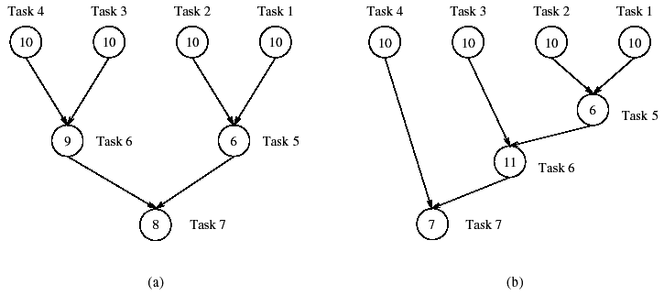
Tasks Graphs
Computations in any parallel algorithms can be viewed as a task dependency graph
Task dependency graphs can be non-trivial
  Pipeline
  Arbitrary (represents the algorithm dependencies)
Task 1
Task 2
Task 3
Task 4
Numbers are
time taken to
perform task

Slide 25
Task Graph Performance
Determined by the critical path (span)
  Sequence of dependent tasks that takes the longest time
  Critical path length bounds parallel execution time
Min time = 27
Min time = 34

Slide 26
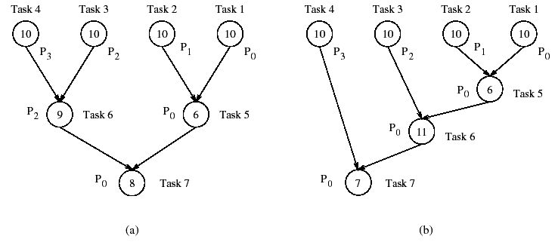
Task Assignment (Mapping) to Processors
Given a set of tasks and number of processors
How to assign tasks to processors?
Should take dependencies into account
Task mapping will determine execution time
Total time = ?
Total time = ?

Slide 27
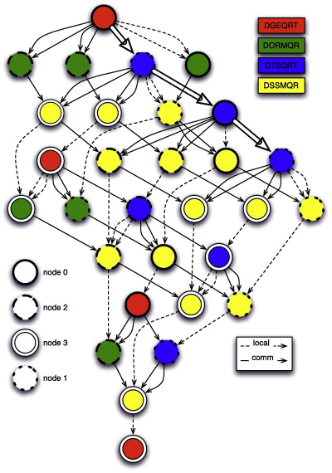
Task Graphs in Action
Task graph for
PDE solver
Uintah task graph scheduler
  C-SAFE: Center for Simulation of
  Accidental Fires and Explosions,
  University of Utah
  Large granularity tasks
PLASMA
  DAG-based parallel
  linear algebra
  DAGuE: A generic
  distributed DAG engine
  for HPC
DAG of QR for a 4 × 4 tiles matrix on a 2 × 2 grid of processors.

Slide 28
Bag o’ Tasks Model and Worker Pool
Set of tasks to be performed
How do we schedule them?
  Find independent tasks
  Assign tasks to available processors
Bag o’ Tasks approach
  Tasks are stored in
  a bag waiting to run
  If all dependencies
  are satisified, it is
  moved to a ready to run queue
  Scheduler assigns a task to a free processor
Dynamic approach that is effective for load balancing
Processors
Bag o‘
tasks
independent tasks
ready to run
…

Slide 29
Master-Worker Parallelism
One or more master processes generate work
Masters allocate work to worker processes
Workers idle if have nothing to do
Workers are mostly stupid and must be told what to do
  Execute independently
  May need to synchronize, but most be told to do so
Master may become the bottleneck if not careful
What are the performance factors and expected performance behavior
  Consider task granularity and asynchrony
  How do they interact?

Slide 30
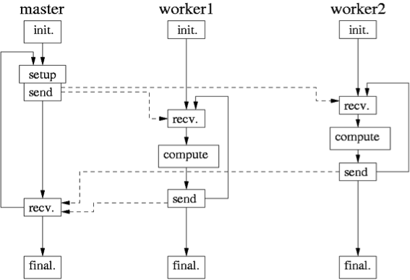
Master-Worker Execution Model (Li Li)
Li Li, “Model-based Automatics Performance Diagnosis of Parallel Computations,” Ph.D. thesis, 2007.

Slide 31
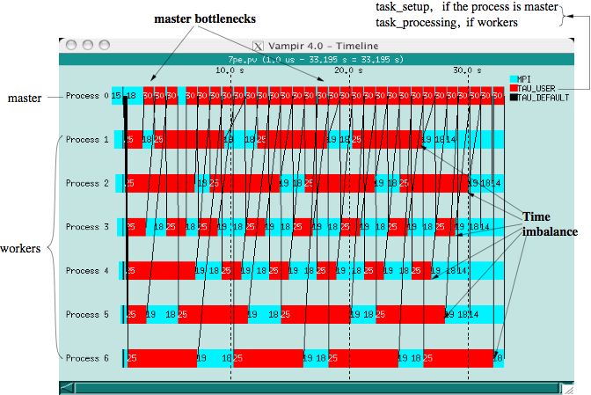
M-W Execution Trace (Li Li)
Notes:
A problematic Master-Worker program run with 7 processes on a SMP cluster with 16 dual processor nodes connected through gigabyte switches.

Slide 32
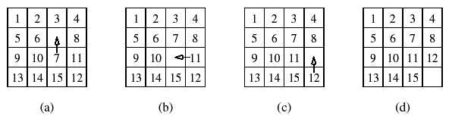
Search-Based (Exploratory) Decomposition
15-puzzle problem
15 tiles numbered 1 through 15 placed in 4x4 grid
  Blank tile located somewhere in grid
  Initial configuration is out of order
  Find shortest sequence of moves to put in order
Sequential search across space of solutions
  May involve some heuristics

Slide 33
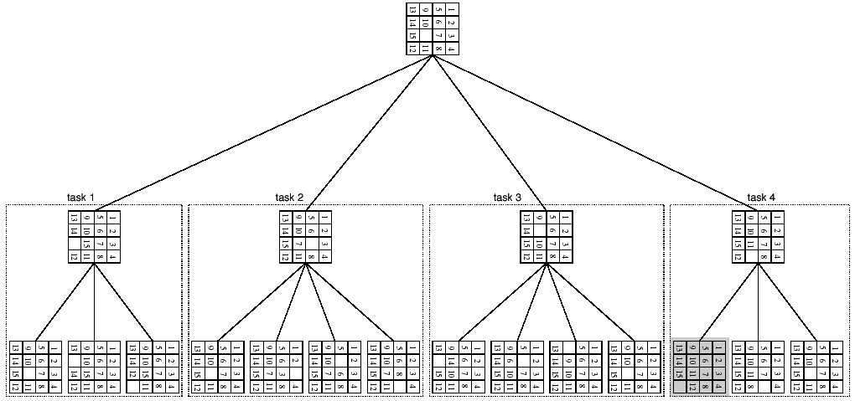
Parallelizing the 15-Puzzle Problem
Enumerate move choices at each stage
Assign to processors
May do pruning
Wasted work

Slide 34
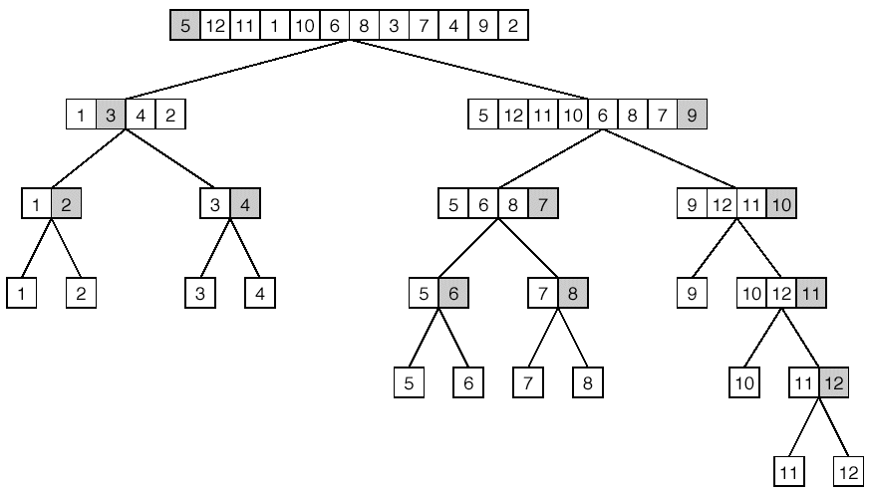
Divide-and-Conquer Parallelism
Break problem up in orderly manner into smaller, more manageable chunks and solve
Quicksort example

Slide 35
Dense Matrix Algorithms
Great deal of activity in algorithms and software for solving linear algebra problems
  Solution of linear systems ( Ax = b )
  Least-squares solution of over- or under-determined systems ( min ||Ax-b|| )
  Computation of eigenvalues and eigenvectors ( Ax=λx )
  Driven by numerical problem solving in scientific computation
Solutions involves various forms of matrix computations
Focus on high-performance matrix algorithms
  Key insight is to maximize computation to communication

Slide 36
Solving a System of Linear Equations
Ax=b
  a_{0,0}x₀ + a_{0,1}x₁ + … + a_{0,n-1}x_{n-1} = b₀
  a_{1,0}x₀ + a_{1,1}x₁ + … + a_{1,n-1}x_{n-1} = b₁
  …
  A_{n-1,0}x₀ + a_{n-1,1}x₁ + … + a_{n-1,n-1}x_{n-1} = b_{n-1}
Gaussian elimination (classic algorithm)
  Forward elimination to Ux=y (U is upper triangular)
    without or with partial pivoting
  Back substitution to solve for x
  Parallel algorithms based on partitioning of A

Slide 37
Sequential Gaussian Elimination
1. procedure GAUSSIAN ELIMINATION (A, b, y)
2. Begin
3. for k := 0 to n - 1 do /* Outer loop */
4. begin
5. for j := k + 1 to n - 1 do
6. A[k, j] := A[k, j ]/A[k, k]; /* Division step */
7. y[k] := b[k]/A[k, k];
8. A[k, k] := 1;
9. for i := k + 1 to n - 1 do
10. begin
11. for j := k + 1 to n - 1 do
12. A[i, j] := A[i, j] - A[i, k] x A[k, j ]; /* Elimination step */
13. b[i] := b[i] - A[i, k] x y[k];
14. A[i, k] := 0;
15. endfor; /*Line9*/
16. endfor; /*Line3*/
17. end GAUSSIAN ELIMINATION

Slide 38
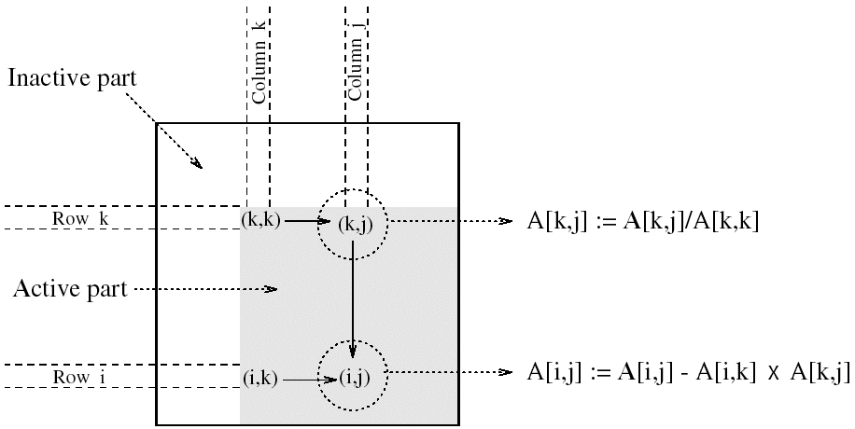
Computation Step in Gaussian Elimination
5x + 3y = 22
8x + 2y = 13
x = (22 - 3y) / 5
8(22 - 3y)/5 + 2y = 13
x = (22 - 3y) / 5
y = (13 - 176/5) / (24/5 + 2)

Slide 39
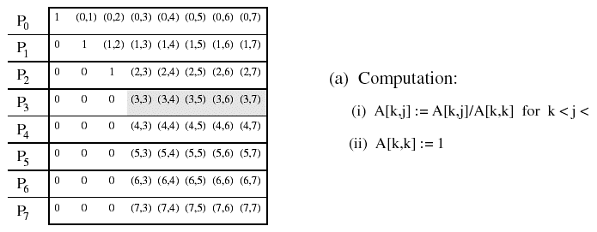
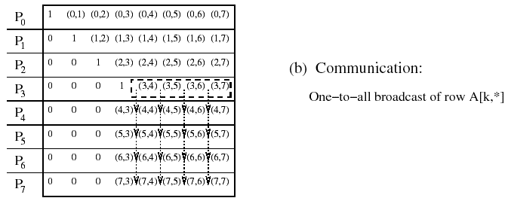
Rowwise Partitioning on Eight Processes
n

Slide 40
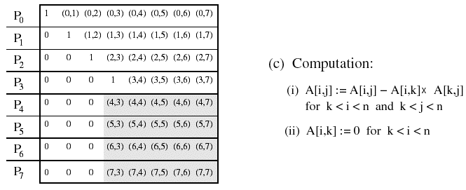
Rowwise Partitioning on Eight Processes

Slide 41
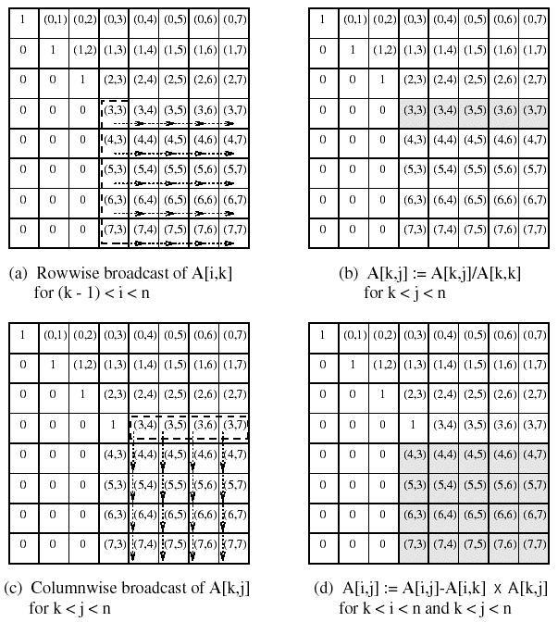
2D Mesh Partitioning on 64 Processes

Slide 42
Back Substitution to Find Solution
1. procedure BACK SUBSTITUTION (U, x, y)
2. begin
3. for k := n - 1 downto 0 do /* Main loop */
4. begin
5. x[k] := y[k];
6. for i := k - 1 downto 0 do
7. y[i] := y[i] - x[k] xU[i, k];
8. endfor;
9. end BACK SUBSTITUTION

Slide 43
Dense Linear Algebra (www.netlib.gov)
Basic Linear Algebra Subroutines (BLAS)
  Level 1 (vector-vector): vectorization
  Level 2 (matrix-vector): vectorization, parallelization
  Level 3 (matrix-matrix): parallelization
LINPACK (Fortran)
  Linear equations and linear least-squares
EISPACK (Fortran)
  Eigenvalues and eigenvectors for matrix classes
LAPACK (Fortran, C) (LINPACK + EISPACK)
  Use BLAS internally
ScaLAPACK (Fortran, C, MPI) (scalable LAPACK)

Slide 44

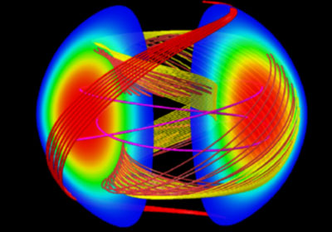
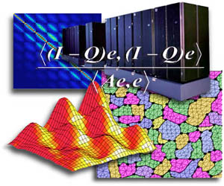
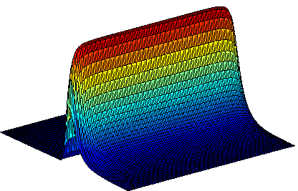

Numerical Libraries
PETSc
  Data structures / routines for partial differential equations
  MPI based
SuperLU
  Large sparse nonsymmetric linear systems
Hypre
  Large sparse linear systems
TAO
  Toolkit for Advanced Optimization
DOE ACTS
  Advanced CompuTational Software

Slide 45
Sorting Algorithms
Task of arranging unordered collection into order
Permutation of a sequence of elements
Internal versus external sorting
  External sorting uses auxiliary storage
Comparison-based
  Compare pairs of elements and exchange
  O(n log n)
Noncomparison-based
  Use known properties of elements
  O(n)

Slide 46
Sorting on Parallel Computers
Where are the elements stored?
  Need to be distributed across processes
  Sorted order will be with respect to process order
How are comparisons performed?
  One element per process
    compare-exchange
    interprocess communication will dominate execution time
  More than one element per process
    compare-split
Sorting networks
  Based on comparison network model
Contrast with shared memory sorting algorithms

Slide 47
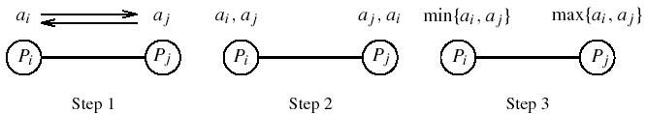
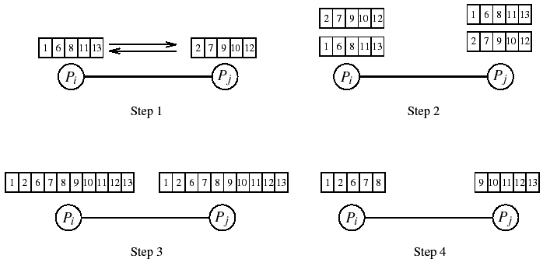
Single vs. Multi Element Comparision
One element per processor
Multiple elements per processor

Slide 48
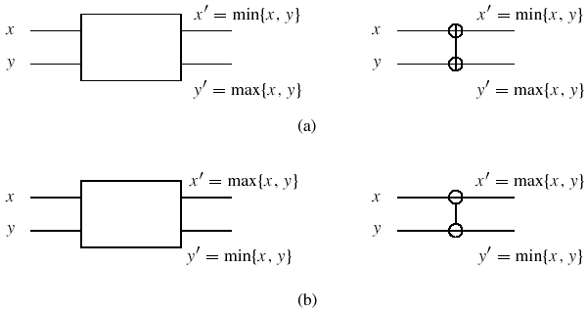
Sorting Networks
Networks to sort n elements in less than O(n log n)
Key component in network is a comparator
  Increasing or decreasing comparator
Comparators connected in parallel and permute elements

Slide 49
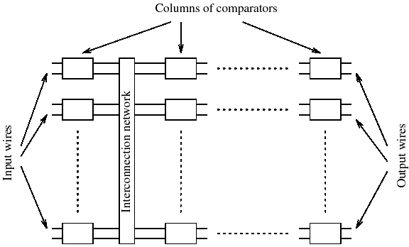
Sorting Network Design
Multiple comparator stages (# stages, # comparators)
Connected together by interconnection network
Output of last stage is the sorted list
O(log2n) sorting time
Convert any
sorting network
to sequential
algorithm

Slide 50
Bitonic Sort
Create a bitonic sequence then sort the sequence
Bitonic sequence
  sequence of elements <a₀, a₁, …, a_{n-1}>
  <a₀, a₁, …, a_{i}> is monotonically increasing
  <a_{i}, a_{i+1}, …, a_{n-1}> is monotonically decreasing
Sorting using bitonic splits is called bitonic merge
Bitonic merge network is a network of comparators
  Implement bitonic merge
Bitonic sequence is formed from unordered sequence
  Bitonic sort creates a bitonic sequence
  Start with sequence of size two (default bitonic)

Slide 51
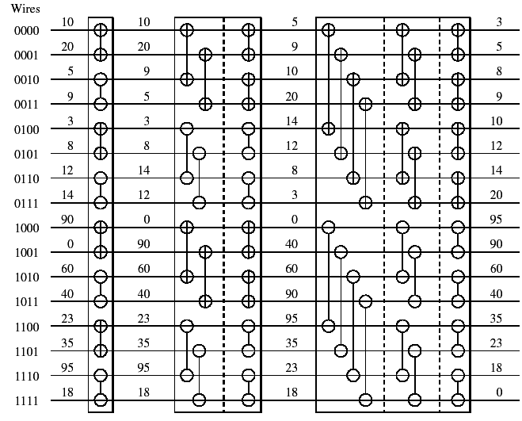
Bitonic Sort Network
Unordered sequence
Bitonic sequence
decrease
increase

Slide 52
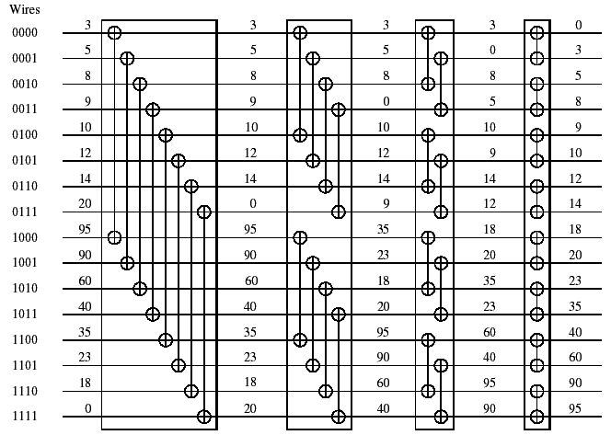
Bitonic Merge Network
Bitonic sequence
Sorted sequence

Slide 53
Parallel Bitonic Sort on a Hypercube
1. procedure BITONIC SORT(label, d)
2. begin
3. for i := 0 to d - 1 do
4. for j := i downto 0 do
5. if (i + 1)st bit of label = j th bit of label then
6. comp exchange max(j);
7. else
8. comp exchange min(j);
9. end BITONIC SORT

Slide 54
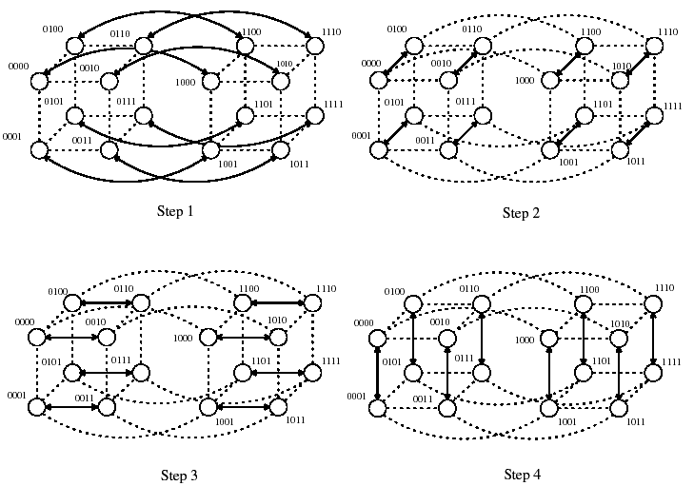
Parallel Bitonic Sort on a Hypercube
Last stage

Slide 55
Bubble Sort and Variants
Can easily parallelize sorting algorithms of O(n²)
Bubble sort compares and exchanges adjacent elements
  O(n) each pass
  O(n) passes
  Available parallelism?
Odd-even transposition sort
  Compares and exchanges odd and even pairs
  After n phases, elements are sorted
  Available parallelism?

Slide 56
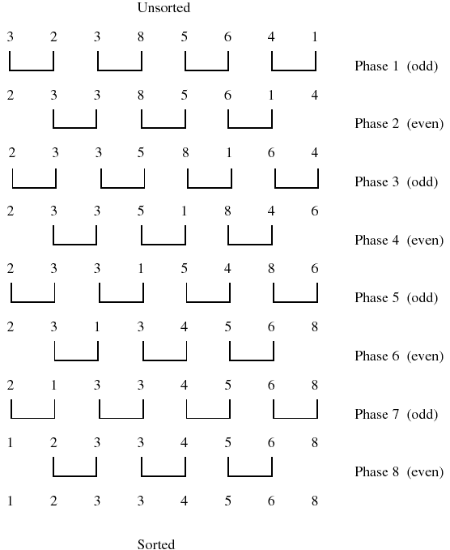
Odd-Even Transposition Sort

Slide 57
Parallel Odd-Even Transposition Sort
1. procedure ODD-EVEN PAR(n)
2. begin
3. id := process’s label
4. for i := 1 to n do
5. begin
6. if i is odd then
7. if id is odd then
8. compare-exchange min(id + 1);
9. else
10. compare-exchange max(id - 1);
11. if i is even then
12. if id is even then
13. compare-exchange min(id + 1);
14. else
15. compare-exchange max(id - 1);
16. end for
17. end ODD-EVEN PAR

Slide 58
Quicksort
Quicksort has average complexity of O(n log n)
Divide-and-conquer algorithm
  Divide into subsequences where every element in first is less than or equal to every element in the second
  Pivot is used to split the sequence
  Conquer step recursively applies quicksort algorithm
Available parallelism?

Slide 59
Sequential Quicksort
1. procedure QUICKSORT (A, q, r )
2. begin
3. if q < r then
4. begin
5. x := A[q];
6. s := q;
7. for i := q + 1 to r do
8. if A[i] ≤ x then
9. begin
10. s := s + 1;
11. swap(A[s], A[i ]);
12. end if
13. swap(A[q], A[s]);
14. QUICKSORT (A, q, s);
15. QUICKSORT (A, s + 1, r );
16. end if
17. end QUICKSORT

Slide 60
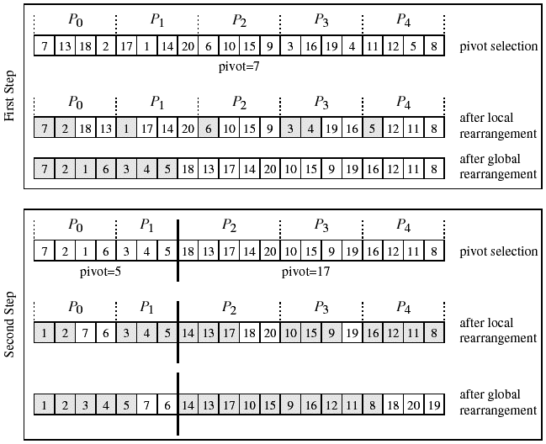
Parallel Shared Address Space Quicksort

Slide 61
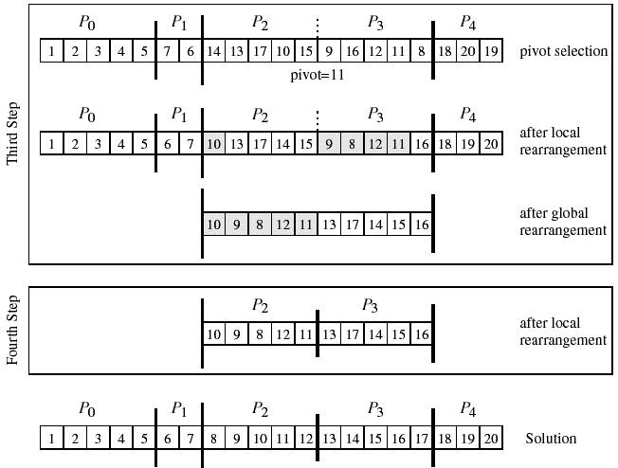
Parallel Shared Address Space Quicksort

Slide 62
Bucket Sort and Sample Sort
Bucket sort is popular when elements (values) are uniformly distributed over an interval
  Create m buckets and place elements in appropriate bucket
  O(n log(n/m))
  If m=n, can use value as index to achieve O(n) time
Sample sort is used when uniformly distributed assumption is not true
  Distributed to m buckets and sort each with quicksort
  Draw sample of size s
  Sort samples and choose m-1 elements to be splitters
  Split into m buckets and proceed with bucket sort

Slide 63
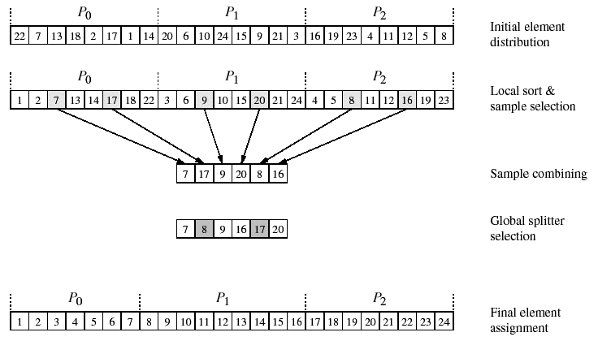
Parallel Sample Sort

Slide 64
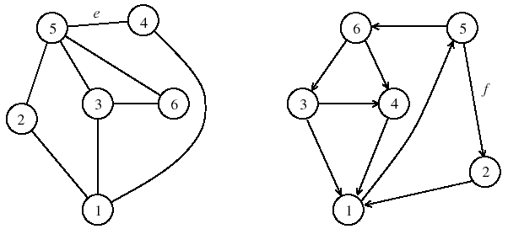
Graph Algorithms
Graph theory important in computer science
Many complex problems are graph problems
G = (V, E)
  V finite set of points called vertices
  E finite set of edges
  e ∈ E is an pair (u,v), where u,v ∈ V
  Unordered and ordered graphs

Slide 65
Graph Terminology
Vertex adjacency if (u,v) is an edge
Path from u to v if there is an edge sequence starting at u and ending at v
If there exists a path, v is reachable from u
A graph is connected if all pairs of vertices are connected by a path
A weighted graph associates weights with each edge
Adjacency matrix is an n x n array A such that
  A_{i,j} = 1 if (v_{i},v_{j}) ∈ E; 0 otherwise
  Can be modified for weighted graphs (∞ is no edge)
  Can represent as adjacency lists

Slide 66
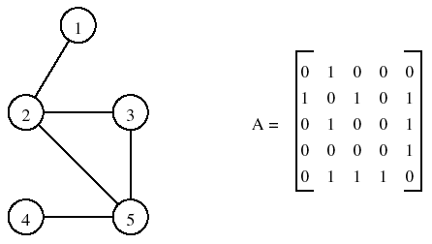
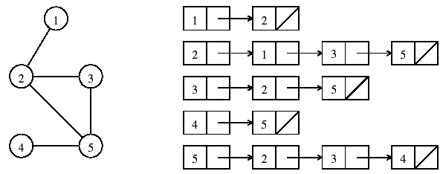
Graph Representations
Adjacency matrix
Adjacency list

Slide 67
Minimum Spanning Tree
A spanning tree of an undirected graph G is a subgraph of G that is a tree containing all the vertices of G
The minimum spanning tree (MST) for a weighted undirected graph is a spanning tree with minimum weight
Prim’s algorithm can be used
  Greedy algorithm
  Selects an arbitrary starting vertex
  Chooses new vertex guaranteed to be in MST
  O(n²)
  Prim’s algorithm is iterative

Slide 68
Prim’s Minimum Spanning Tree Algorithm
1. procedure PRIM MST(V, E,w, r )
2. begin
3. VT := {r };
4. d[r] := 0;
5. for all v ∈ (V - VT ) do
6. if edge (r, v) exists set d[v] := w(r, v);
7. else set d[v] :=∞;
8. while VT ≠ V do
9. begin
10. find a vertex u such that d[u] := min{d[v]|v ∈ (V - VT )};
11. VT := VT ∪ {u};
12. for all v ∈ (V - VT ) do
13. d[v] := min{d[v],w(u, v)};
14. endwhile
15. end PRIM MST
*

Slide 69
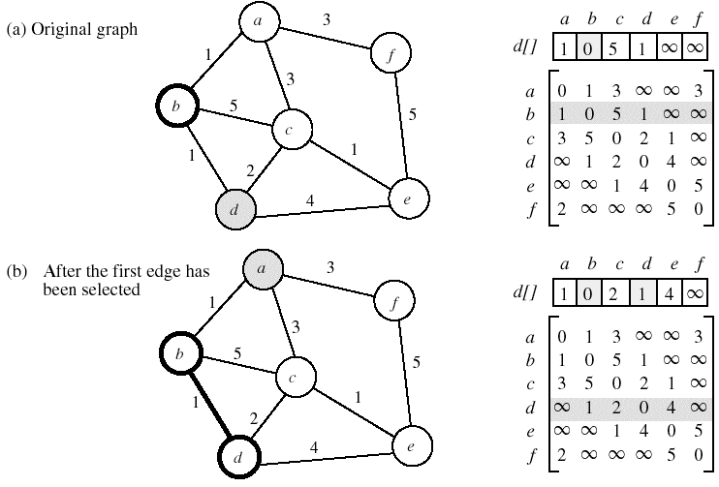
Example: Prim’s MST Algorithm

Slide 70
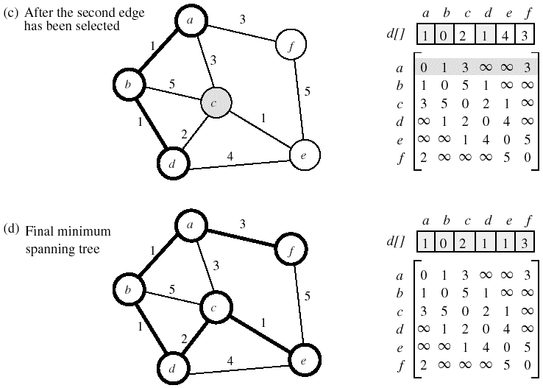
Example: Prim’s MST Algorithm

Slide 71
Parallel Formulation of Prim’s Algorithm
Difficult to perform different iterations of the while loop in parallel because d[v] may change each time
Can parallelize each iteration though
Partition vertices into p subsets V_{i}, i=0,…,p-1
Each process P_{i} computes
  d_{i}[u]=min{d_{i}[v] | v ∈ (V-V_{T}) ∩ V_{i}}
Global minimum is obtained using all-to-one reduction
New vertex is added to V_{T} and broadcast to all processes
New values of d[v] are computed for local vertex
O(n²/p) + O(n log p) (computation + communication)

Slide 72
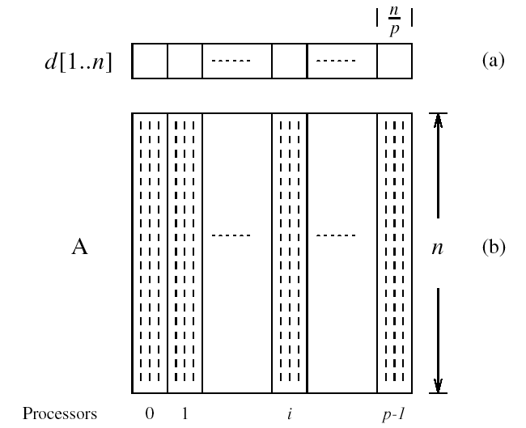
Partitioning in Prim’s Algorithm

Slide 73
Single-Source Shortest Paths
Find shortest path from a vertex v to all other vertices
The shortest path in a weighted graph is the edge with the minimum weight
Weights may represent time, cost, loss, or any other quantity that accumulates additively along a path
Dijkstra’s algorithm finds shortest paths from vertex s
  Similar to Prim’s MST algorithm
    MST with vertex v as starting vertex
  Incrementally finds shortest paths in greedy manner
  Keep track of minimum cost to reach a vertex from s
  O(n²)

Slide 74
Dijkstra’s Single-Source Shortest Path
1. procedure DIJKSTRA SINGLE SOURCE SP(V, E,w, s)
2. begin
3. V_{T} := {s};
4. for all v ∈ (V - V_{T} ) do
5. if (s, v) exists set l[v] := w(s, v);
6. else set l[v] :=∞;
7. while V_{T} ≠ V do
8. begin
9. find a vertex u such that l[u] := min{l[v]|v ∈ (V - V_{T} )};
10. VT := V_{T} ∪ {u};
11. for all v ∈ (V - V_{T} ) do
12. l[v] := min{l[v], l[u] + w(u, v)};
13. endwhile
14. end DIJKSTRA SINGLE SOURCE SP

Slide 75
Parallel Formulation of Dijkstra’s Algorithm
Very similar to Prim’s MST parallel formulation
Use 1D block mapping as before
All processes perform computation and communication similar to that performed in Prim’s algorithm
Parallel performance is the same
  O(n²/p) + O(n log p)
  Scalability
    O(n²) is the sequential time
    O(n²) / [O(n²/p) + O(n log p)]

Slide 76
All Pairs Shortest Path
Find the shortest path between all pairs of vertices
Outcome is a n x n matrix D={d_{i,j}} such that d_{i,j} is the cost of the shortest path from vertex v_{i} to vertex v_{j}
Dijsktra’s algorithm
  Execute single-source algorithm on each process
  O(n³)
  Source-partitioned formulation (use sequential algorithm)
  Source-parallel formulation (use parallel algorithm)
Floyd’s algorithm
  Builds up distance matrix from the bottom up

Slide 77
Floyd’s All-Pairs Shortest Paths Algorithm
1. procedure FLOYD ALL PAIRS SP(A)
2. begin
3. D⁽⁰⁾ = A;
4. for k := 1 to n do
5. for i := 1 to n do
6. for j := 1 to n do
7. d^{(k)}_{i, j} := min d^{(k-1)}_{i, j} , d^{(k-1)}_{i,k} + d^{(k-1)}_{k, j} ;
8. end FLOYD ALL PAIRS SP

Slide 78
Parallel Floyd’s Algorithm
1. procedure FLOYD ALL PAIRS PARALLEL (A)
2. begin
3. D⁽⁰⁾ = A;
4. for k := 1 to n do
5. forall P_{i,j}, where i, j ≤ n, do in parallel
6. d^{(k)}_{i, j} := min d^{(k-1)}_{i, j} , d^{(k-1)}_{i,k} + d^{(k-1)}_{k, j} ;
7. end FLOYD ALL PAIRS PARALLEL

Slide 79
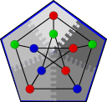
Parallel Graph Algorithm Library – Boost
Parallel Boost Graph Library
  Andrew Lumsdaine, Indiana University
  Generic C++ library for high-performance parallel
  and distributed graph computation
  Builds on the Boost Graph Library (BGL)
    offers similar data structures, algorithms, and syntax
  Targets very large graphs (millions of nodes)
  Distributed-memory parallel processing on clusters

Slide 80
Original BGL: Algorithms
Searches (breadth-first, depth-first, A*)
Single-source shortest paths (Dijkstra, Bellman-Ford, DAG)
All-pairs shortest paths (Johnson, Floyd-Warshall)
Minimum spanning tree (Kruskal, Prim)
Components (connected, strongly connected, biconnected)
Maximum cardinality matching
Max-flow (Edmonds-Karp, push-relabel)
Sparse matrix ordering (Cuthill-McKee, King, Sloan, minimum degree)
Layout (Kamada-Kawai, Fruchterman-Reingold, Gursoy-Atun)
Betweenness centrality
PageRank
Isomorphism
Vertex coloring
Transitive closure
Dominator tree

Slide 81
Original BGL Summary
Original BGL is large, stable, efficient
  Lots of algorithms, graph types
  Peer-reviewed code with many users, nightly regression testing, and so on
  Performance comparable to FORTRAN.
Who should use the BGL?
  Programmers comfortable with C++
  Users with graph sizes from tens of vertices to millions of vertices

Slide 82
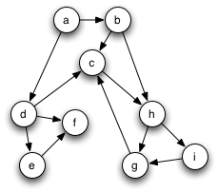
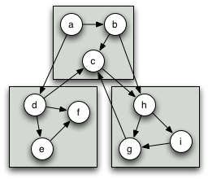
Parallel BGL
A version of C++ BGL for computational clusters
  Distributed memory for huge graphs
  Parallel processing for improved performance
An active research project
Closely related to the original BGL
  Parallelizing BGL programs should be “easy”
A simple, directed graph…
distributed across 3 processors

Slide 83
Parallel Graph Algorithms
Breadth-first search
Eager Dijkstra’s single-source shortest paths
Crauser et al. single-source shortest paths
Depth-first search
Minimum spanning tree (Boruvka, Dehne & Götz)
Connected components
Strongly connected components
Biconnected components
PageRank
Graph coloring
Fruchterman-Reingold layout
Max-flow (Dinic’s)

Slide 84
Big-Data and Map-Reduce
Big-data deals with processing large data sets
Nature of data processing problem makes it amenable to parallelism
  Looking for features in the data
  Extracting certain characteristics
  Analyzing properties with complex data mining algorithms
Data size makes it opportunistic for partitioning into large # of sub-sets and processing these in parallel
We need new algorithms, data structures, and programming models to deal with problems

Slide 85
A Simple Big-Data Problem
Consider a large data collection of text documents
Suppose we want to find how often a particular word occurs and determine a probability distribution for all word occurrences
Sequential algorithm
web | 2
weed | 1
green | 2
sun | 1
moon | 1
land | 1
part | 1
Count words and update statistics
Data
collection
Get next document
Find and count words
Generate probability distributions
Check if more documents

Slide 86
Parallelization Approach
Map: partition the data collection into subsets of documents and process each subset in parallel
Reduce: assemble the partial frequency tables to derive final probability distribution
Parallel algorithm
web | 2
weed | 1
green | 2
sun | 1
moon | 1
land | 1
part | 1
web | 2
weed | 1
green | 2
sun | 1
moon | 1
land | 1
part | 1
web | 2
weed | 1
green | 2
sun | 1
moon | 1
land | 1
part | 1
Data
collection
Get next document
Count words and update statistics
Find and count words
Check if more documents
Generate probability distributions

Slide 87
Parallelization Approach
Map: partition the data collection into subsets of documents and process each subset in parallel
Reduce: assemble the partial frequency tables to derive final probability distribution
Parallel algorithm
web | 2
weed | 1
green | 2
sun | 1
moon | 1
land | 1
part | 1
Data
collection
Get next document
Count words and update statistics
Find and count words
Check if more documents
Generate probability distributions

Slide 88
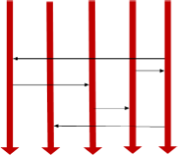
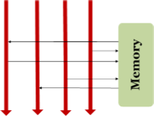
Actually, it is not easy to parallel….
Different programming models
Message Passing Shared Memory
Fundamental issues
Scheduling, data distribution, synchronization, inter-process communication, robustness, fault tolerance, …
Architectural issues
Flynn’s taxonomy (SIMD, MIMD, etc.), network topology, bisection bandwidth, cache coherence, …
Different programming constructs
Mutexes, conditional variables, barriers, …
masters/slaves, producers/consumers, work queues,. …
Common problems
Livelock, deadlock, data starvation, priority inversion, …dining philosophers, sleeping barbers, cigarette smokers, …
Actually, Programmer’s Nightmare….

Slide 89
Map-Reduce Parallel Programming
Become an important distributed parallel programming paradigm for large-scale applications
  Also applies to shared-memory parallelism
  Becomes one of the core technologies powering big IT companies, like Google, IBM, Yahoo and Facebook.
Framework runs on a cluster of machines and automatically partitions jobs into number of small tasks and processes them in parallel
Can capture in combining Map and Reduce parallel patterns

Slide 90
Map-Reduce Example
web | 1
weed | 1
green | 1
sun | 1
moon | 1
land | 1
part | 1
web | 1
green | 1
… | 1
KEY | VALUE
MAP: Input data ➔ <key, value> pair
web | 1
weed | 1
green | 1
sun | 1
moon | 1
land | 1
part | 1
web | 1
green | 1
… | 1
KEY | VALUE
Map
Data
Collection: split1
web | 1
weed | 1
green | 1
sun | 1
moon | 1
land | 1
part | 1
web | 1
green | 1
… | 1
KEY | VALUE
web | 1
weed | 1
green | 1
sun | 1
moon | 1
land | 1
part | 1
web | 1
green | 1
… | 1
KEY | VALUE
Split the data to
Supply multiple
processors
web | 1
weed | 1
green | 1
sun | 1
moon | 1
land | 1
part | 1
web | 1
green | 1
… | 1
KEY | VALUE
Data
Collection:
split 2
Map
……
…
Data
Collection:
split n

Slide 91
MapReduce
MAP: Input data ➔ <key, value> pair
REDUCE: <key, value> pair ➔ <result>
Map
Reduce
Data
Collection: split1
Split the data to
Supply multiple
processors
Data
Collection:
split 2
Reduce
Map
……
…
Data
Collection: split n
Map
Reduce

