Slide 1
Chapter 5: CPU Scheduling

Slide 2
Chapter 5: CPU Scheduling
Basic Concepts
Scheduling Criteria
Scheduling Algorithms
Thread Scheduling
Multi-Processor Scheduling
Real-Time CPU Scheduling
Operating Systems Examples
Algorithm Evaluation

Slide 3
Objectives
Describe various CPU scheduling algorithms
Assess CPU scheduling algorithms based on scheduling criteria
Explain the issues related to multiprocessor and multicore scheduling
Describe various real-time scheduling algorithms
Describe the scheduling algorithms used in the Windows, Linux, and Solaris operating systems
Apply modeling and simulations to evaluate CPU scheduling algorithms

Slide 4
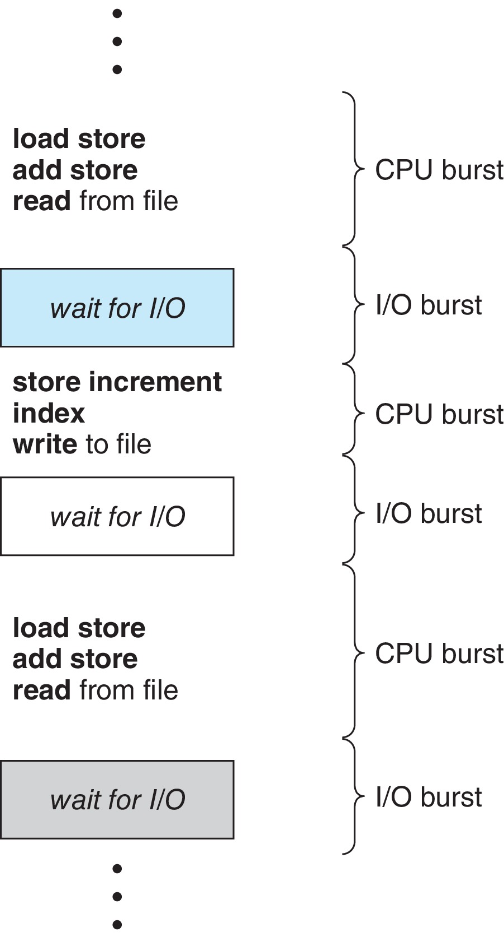
Basic Concepts
Maximum CPU utilization obtained with multiprogramming
  In a system with a single CPU core, only one process can run at a time. Others must wait until the CPU’s core is free and can be rescheduled
  The objective of multiprogramming is to have some process running at all times, to maximize CPU utilization
  By switching the CPU among processes, the operating system can make the computer more productive
Process execution consists of a cycle of CPU execution and I/O wait
  CPU burst followed by I/O burst, which is followed by another CPU burst, then another I/O burst, and so on.
    Eventually, the final CPU burst ends with a system request to terminate execution
  Every time one process has to wait, another process can take over use of the CPU.

Slide 5
Basic Concepts (Cont.)
Several processes are kept in memory at one time.
When one process has to wait, the operating system takes the CPU away from that process and gives the CPU to another process.
  This pattern continues. Every time one process has to wait, another process can take over use of the CPU.
  On a multicore system, this concept of keeping the CPU busy is extended to all processing cores on the system.
Scheduling of this kind is a fundamental operating-system function.
  Almost all computer resources are scheduled before use.
  The CPU is, of course, one of the primary computer resources.
  Thus, scheduling is central to operating-system design

Slide 6
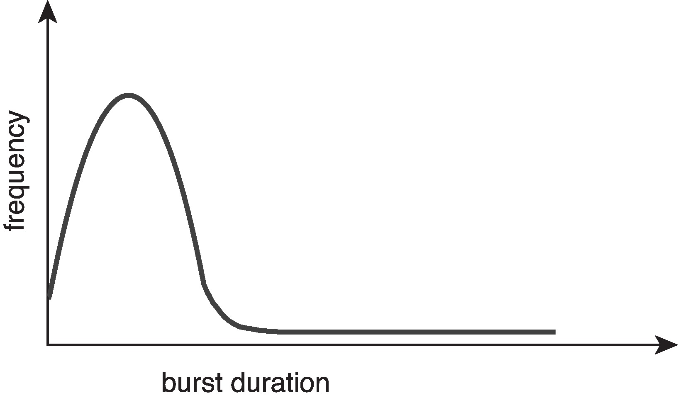
Histogram of CPU-burst Times
CPU burst distribution is of main concern
Large number of short CPU bursts and a small number of long CPU bursts.
  An I/O-bound program typically has many short CPU bursts.
  A CPU-bound program might have a few long CPU bursts.
This distribution can be important when implementing a CPU-scheduling algorithm.

Slide 7
CPU Scheduler
Whenever the CPU becomes idle, the CPU scheduler selects from among the processes in ready queue, and allocates the CPU core to one of them
  Queues may be ordered in various ways; can you think of some -☺
CPU scheduling decisions may take place when a process:
  1. Switches from running to waiting state (i.e. I/O request, wait() for the child)
  2. Switches from running to ready state (i.e. interrupt occurs)
  3. Switches from waiting to ready (i.e. completion of I/O)
  4. Terminates
Scheduling under 1 and 4 is non-preemptive / cooperative;
  Under non-preemptive scheduling, once the CPU has been allocated to a process, the process keeps the CPU until it releases it either by terminating or by switching to the waiting state
All other scheduling is preemptive (what about race conditions ??). However
  Consider access to shared data, Consider preemption while in kernel mode, Consider interrupts occurring during crucial OS activities
  Unfortunately, preemptive scheduling can result in race conditions ☺-☹-☹
    An undesirable situation that occurs when a device or system attempts to perform two or more operations at the same time, but because of the nature of the device or system, the operations must be done in the proper sequence to be done correctly.
  All of Windows, macOS, Linux, and UNIX use preemptive scheduling

Slide 8
Preemptive and Non-preemptive Scheduling
Operating-System kernels can be designed as either non-preemptive or preemptive.
A non-preemptive kernel will wait for a system call to complete or for a process to block while waiting for I/O to complete to take place before doing a context switch.
  This scheme ensures that the kernel structure is simple, the kernel will not preempt a process while the kernel data structures are in an inconsistent state.
Unfortunately, this kernel-execution model is a poor one for supporting real-time computing, where tasks must complete execution within a given time frame.
A preemptive kernel requires mechanisms such as mutex locks to prevent race conditions when accessing shared kernel data structures.
Most modern OSs are now fully preemptive when running in kernel mode.
  Interrupts can occur at any time
  The operating system needs to accept interrupts at almost all times
  Luckily, sections of code that disable interrupts do not occur very often and typically contain few instructions

Slide 9
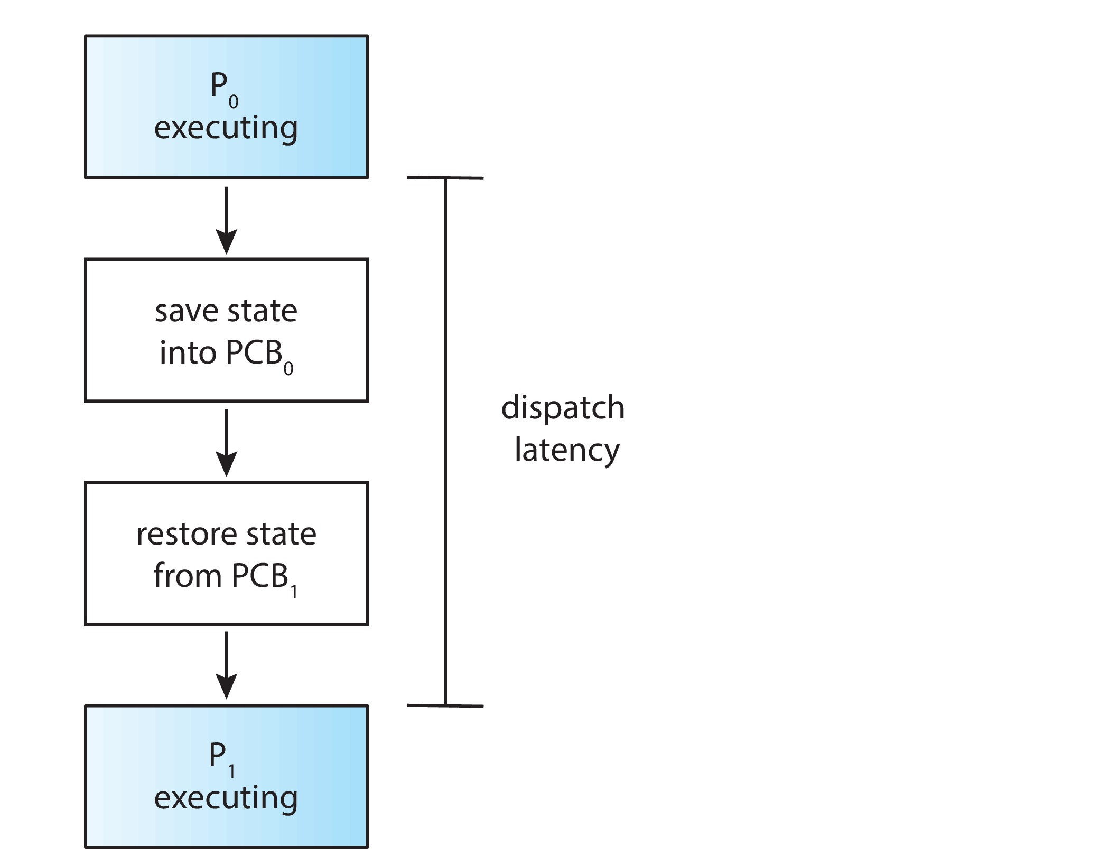
Dispatcher
Dispatcher module gives control of the CPU to the process selected by the scheduler; this involves:
  Switching context from one process to another
  Switching to user mode
  Jumping to the proper location in the user program to resume that program
Dispatch latency –
  time it takes for the dispatcher to stop one process and resume another running
Dispatcher is invoked during every context switch
An interesting question to consider is:
  How often do context switches occur?
On a system-wide level, the number of context switches can be obtained by using the vmstat command that is available on Linux systems, you may
try out $man vmstat

Slide 10
Scheduling Criteria
1- CPU utilization – keep the CPU as busy as possible;
  try out the $top command on Linux, or the Task Manager on Windows
2- Throughput – # of processes that complete their execution per time unit
  For long processes, this rate may be one process over several seconds;
  For short transactions, it may be tens of processes per second.
3- Turnaround time – amount of time to execute a particular process
  How long it takes to execute that process
  The interval from the time of submission of a process to the time of completion
  It is the sum of the periods spent waiting in the ready queue, executing on the CPU, and doing I/O.
4- Waiting time – amount of time a process has been waiting in the ready queue
  Note: The CPU-scheduler does not affect the amount of time during which a process executes or I/O.
5- Response time – amount of time it takes from when a request was submitted until the first response is produced, not output (for time-sharing environment)
  time it takes to start responding, not the time it takes to output the response
  in an interactive system, turnaround time may not be the best criterion.

Slide 11
Scheduling Algorithm Optimization Criteria
It is desirable to:
  Maximize CPU utilization
  Maximize throughput
  Minimize turnaround time
  Minimize waiting time
  Minimize response time
In most cases, we optimize the average measure. However, under some circumstances, we prefer to optimize the minimum or maximum values rather than the average.
  i.e., to guarantee that all users get good service, we may want to minimize the maximum response time.
  for interactive systems (such as a PC desktop or laptop system), maybe it is more important to minimize the variance in the response time than to minimize the average response time.??

Slide 12
Scheduling Algorithms for a single processing core

Slide 13
First-Come First-Serve (FCFS) Scheduling
Process Burst Time
P₁ 24
P₂ 3
P₃ 3
Suppose that the processes arrive in the order: P₁ , P₂ , P₃
The Gantt Chart for the schedule is:
Waiting time for P₁ = 0;
P₂ = 24;
P₃ = 27
Average waiting time: (0 + 24 + 27)/3 = 17

Slide 14
FCFS Scheduling (Cont.)
Is it preemptive or
Non-preemptive ?
Suppose that the processes arrive in the order:
P₂ , P₃ , P₁
The Gantt chart for the schedule is:
Waiting time for P₂ = 0; P₃ = 3, P₁ = 6;
Average waiting time: (0 + 3 + 6) / 3 = 3
Much better than previous case
Convoy effect - short process behind long process
  All the other processes wait for the one big process to get off the CPU
  Results in lower CPU and device utilization than might be possible if the shorter processes were allowed to go first
How is it for interactive systems?
Note that the FCFS scheduling algorithm is non-preemptive. Once the CPU has been allocated to a process, that process keeps the CPU until it releases the CPU, either by terminating or by requesting I/O.

Slide 15
Shortest-Job-First (SJF) Scheduling
Associate with each process the length of its next CPU burst
  Use these lengths to schedule the process with the shortest time
  more appropriate name would be the shortest-next-CPU-burst
  If the next CPU bursts of two processes are the same, FCFS scheduling is used to break the tie.
SJF is optimal –
  It gives minimum average waiting time for a given set of processes
    Moving a short process before a long one decreases the waiting time of the short process more than it increases the waiting time of the long process.
    Consequently, the average waiting time decreases.
  BUT:
    The difficulty is knowing the length of the next CPU request ☹
    However, how to know the length of the next CPU burst
    Could ask the user; (in a batch system, we may do so, but what about interactive )
    What about approximation or prediction?
    what else?

Slide 16
Example of SJF
Is it preemptive or
Non-preemptive ?
ProcessArriva l Time Burst Time
P₁ 0.0 6
P₂ 2.0 8
P₃ 4.0 7
P₄ 5.0 3
SJF scheduling chart
Average waiting time = (3 + 16 + 9 + 0) / 4 = 7
By comparison, if we were using the FCFS scheduling scheme, the average waiting time would be 10.25.

Slide 17
Determining Length of Next CPU Burst
Can only estimate the length – should be similar to the previous one
  Then pick process with shortest predicted next CPU burst
The next CPU burst is generally can be predicted as an exponential average of the measured lengths of previous CPU bursts.
The value of t_{n} contains our most recent information,
τ_{n} stores the past history, initially can be defined as a constant or as an overall system average
Commonly, α set to ½ ; recent history and past history are equally weighted
Preemptive version called shortest-remaining-time-first

Slide 18
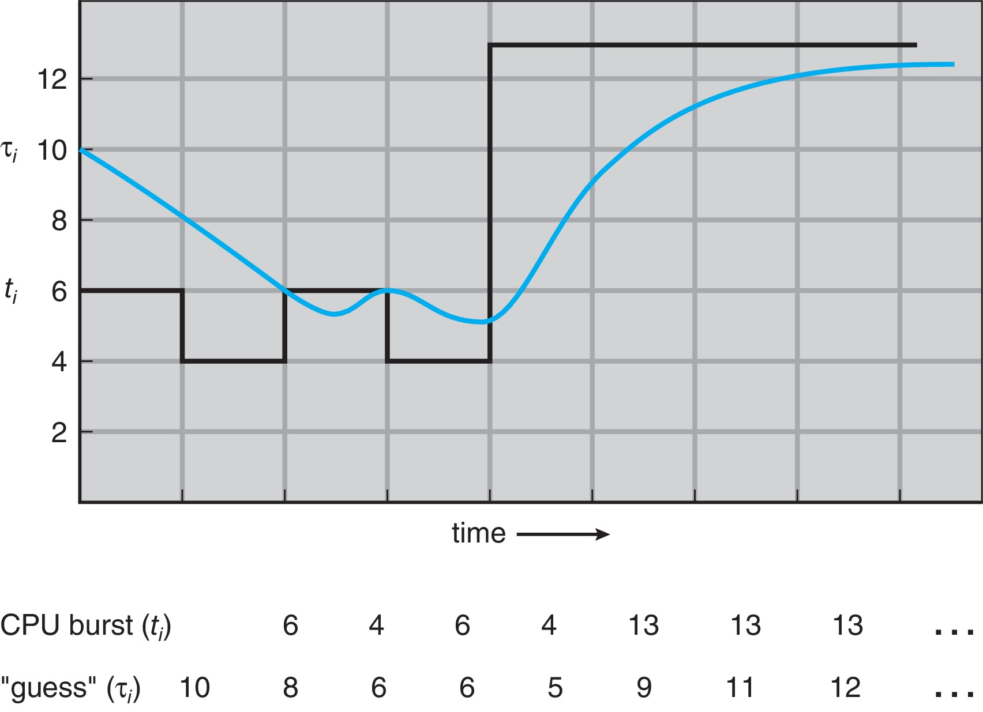
Prediction of the Length of the Next CPU Burst
An exponential average with α = 1/2 and τ₀ = 10.

Slide 19

Examples of Exponential Averaging
α =0
  τ_{n+1} = τ_{n}
  Recent history does not count
α =1
  τ_{n+1} = α t_{n}
  Only the actual last CPU burst counts
Remember that :
we can expand the formula for τ_{n+1} by substituting for τ_{n} , and go down to τ₀
If we expand the formula, we get:
    τ_{n+1} = α t_{n}+(1 - α)α t_{n} ₋₁ + …
    +(1 - α )^{j} α t_{n} _{-j} + …
    +(1 - α )^{n +1} τ₀
Since both α and (1 - α) are less than or equal to 1, each successive term has less weight than its predecessor

Slide 20
Shortest-Remaining-Time-First
Is SJF Preemptive or Non-preemptive ?
  The choice arises when a new process arrives at the ready queue while a previous process is still executing
  The next CPU burst of the newly arrived process may be shorter than what is left of the currently executing process.
A preemptive SJF algorithm will preempt the currently executing process,
whereas a non-preemptive SJF algorithm will allow the currently running process to finish its CPU burst
Preemptive SJF scheduling is sometimes called:
  Shortest-Remaining-Time- First

Slide 21
Example of Shortest-Remaining-Time-First
Now we add the concepts of varying arrival times and preemption to the analysis
ProcessA arri Arrival TimeT Burst Time
P₁ 0 8
P₂ 1 4
P₃ 2 9
P₄ 3 5
Preemptive SJF Gantt Chart
Average waiting time = [(10-1)+(1-1)+(17-2)+5-3)]/4 = 26/4 = 6.5 msec

Slide 22
Round Robin (RR)
Each process gets a small unit of CPU time (time quantum q) or (time slice), usually 10-100 milliseconds. After this time has elapsed, the process is preempted and added to the end of the ready queue;
  Is this similar to FCFS scheduling and how?
If there are n processes in the ready queue and the time quantum is q, then each process gets 1/n of the CPU time in chunks of at most q time units at once.
  No process waits more than (n-1)*q time units.
  The average waiting time under the RR policy is often long.
Timer interrupts every quantum to schedule next process
  So, is it preemptive or non-preemptive?
  Is it possible that the process itself will release the CPU voluntarily ☺
Performance ??
  The ready queue is a circular FIFO queue, new processes are added to the tail (end)
  If q is large enough ⇒ FCFS
  If q is small enough ⇒ q must be large with respect to context switch, otherwise overhead is too high; not worthy ☹

Slide 23
Example : RR with Time Quantum = 4
Process Burst Time
P₁ 24
P₂ 3
P₃ 3
The Gantt chart is:
The average waiting time for this schedule.
  P₁ waits for 6 milliseconds (10 − 4),
  P₂ waits for 4 milliseconds, and
  P₃ waits for 7 milliseconds.
  Thus, the average waiting time is 17/3 = 5.66 milliseconds.
Typically, higher average turnaround than SJF, but better response
q should be large compared to context switch time
q usually 10ms to 100ms, context switch < 10 usec

Slide 24
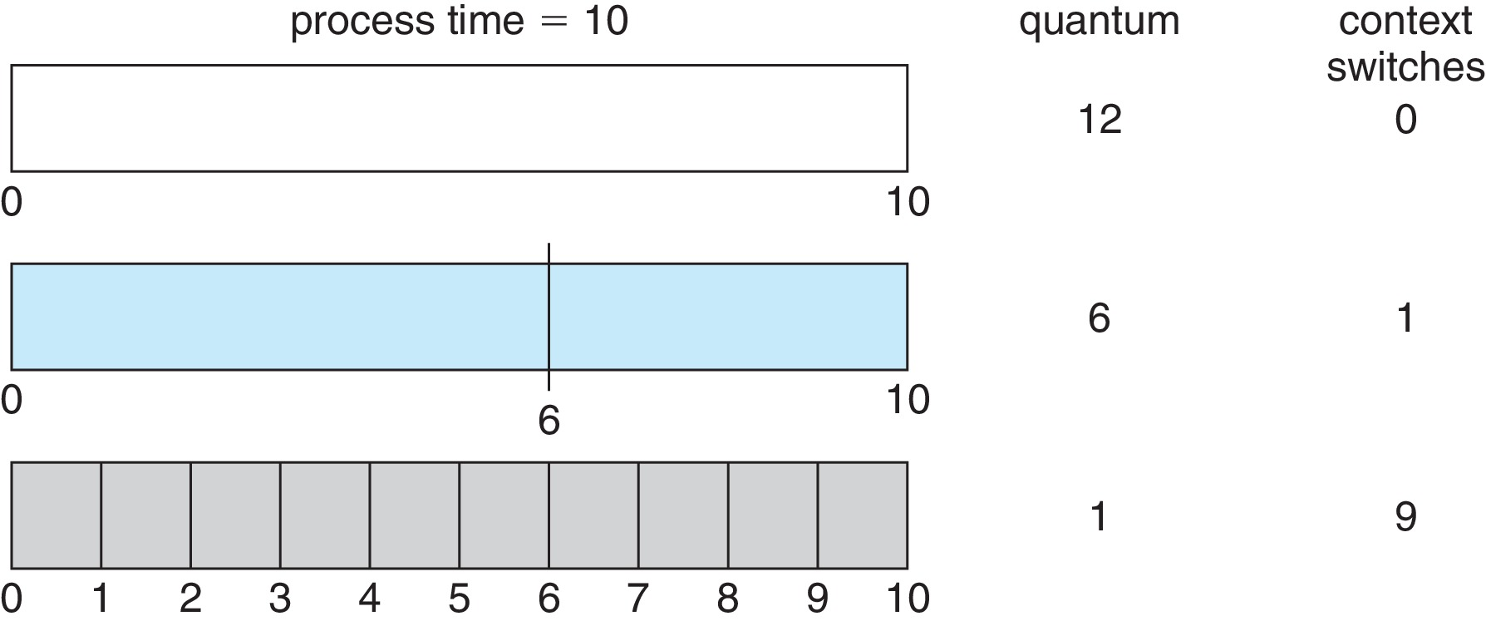
Time Quantum and Context Switch Time
In the RR scheduling algorithm, no process is allocated the CPU for more than 1 time quantum in a row (unless it is the only runnable process).
However, the performance of the RR algorithm depends heavily on the size of the time quantum. Turnaround time also depends on the size of the time quantum.
Thus, we want the time quantum to be large with respect to the context switch time. But it should not be too large; (then it may become FCFS).

Slide 25
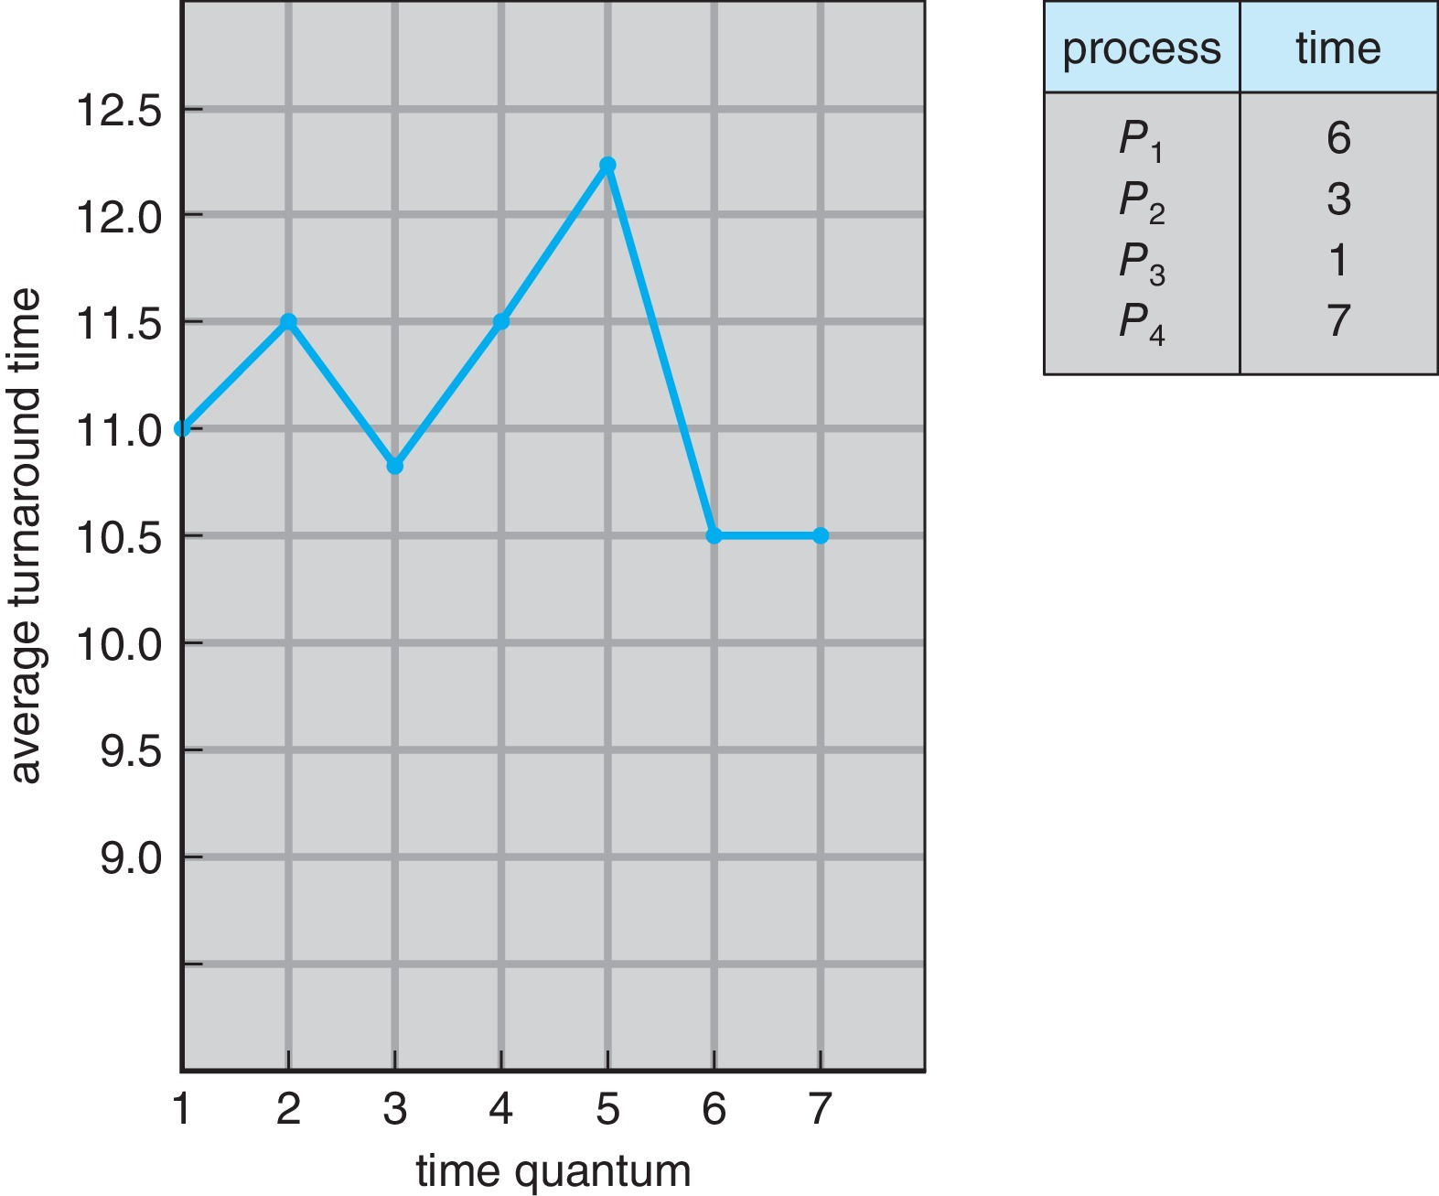
Turnaround Time Varies With The Time Quantum
80% of CPU bursts should be shorter than q

Slide 26
Priority Scheduling
The SJF algorithm is a special case of the general priority-scheduling algorithm
A priority number (integer) is associated with each process
Equal-priority processes are scheduled in FCFS order
The CPU is allocated to the process with the highest priority
(smallest integer ≡ highest priority), it is either:
  Preemptive: simply preempt the CPU if the priority of the newly arrived process is higher than the priority of the currently running process
  Non-preemptive: simply put the new process at the head of the ready queue
SJF is priority scheduling where priority is the inverse of predicted next CPU burst time
  The larger the CPU burst, the lower the priority, and vice versa
Problem ≡ Starvation (indefinite blocking) – low priority processes may never execute (A process that is ready to run but waiting for the CPU can be considered blocked)
Solution ≡ Aging – as time progresses increase the priority of the process ☺
      What about round-robin + priority
(Rumor has it that when they shut down the IBM 7094 at MIT in 1973, they found a low-priority process that had been submitted in 1967 and had not yet been run.)

Slide 27
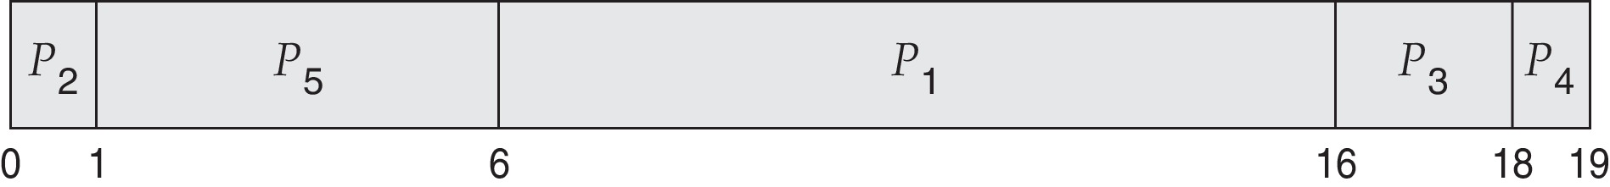
Example : Priority Scheduling
ProcessA arri Burst TimeT Priority
P₁ 10 3
P₂ 1 1
P₃ 2 4
P₄ 1 5
P₅ 5 2
Priority scheduling Gantt Chart
Average waiting time = 8.2 msec
What do you think we need to do if the arrival time is added to the processes?

Slide 28
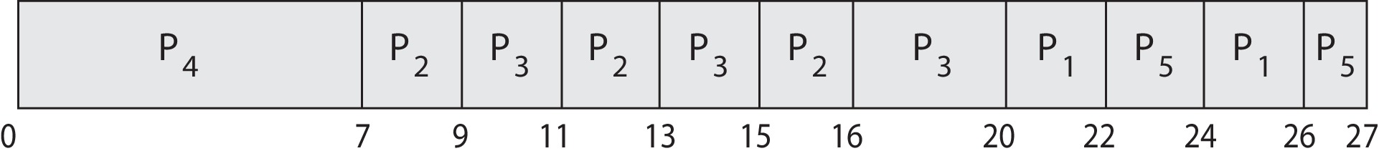
Priority Scheduling w/ Round-Robin
ProcessA arri Burst TimeT Priority
P₁ 4 3
P₂ 5 2
P₃ 8 2
P₄ 7 1
P₅ 3 3
Run the process with the highest priority.
Processes with the same priority run round-robin
  Notice that when process P₂ finishes at time 16, process P₃ is the highest-priority process, so it will run until it completes execution
Gantt Chart with q = 2 ms time quantum

Slide 29
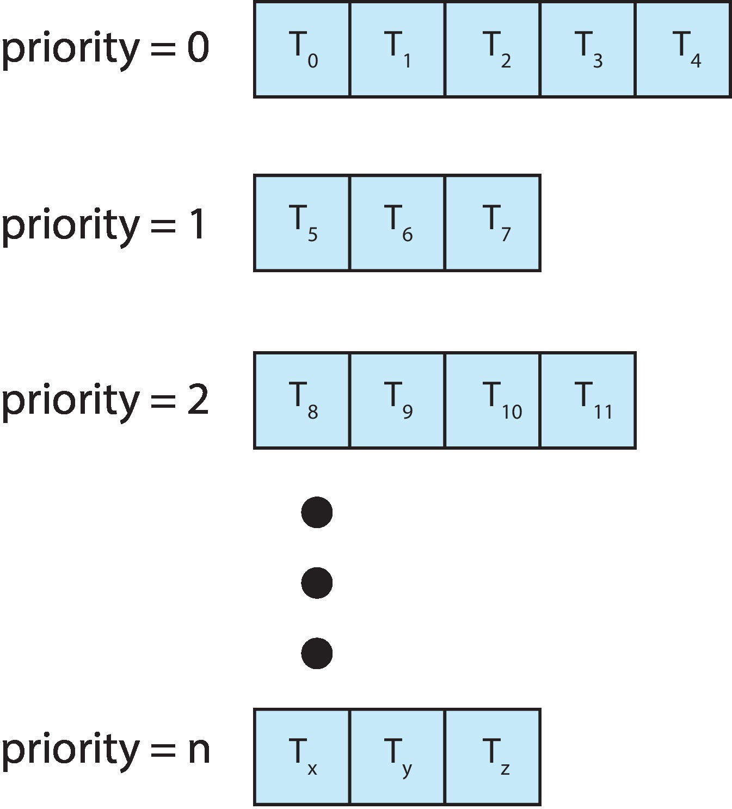
Multilevel Queue Scheduling
With priority scheduling, have separate queues for each priority.
Schedule the process in the highest-priority queue!

Slide 30
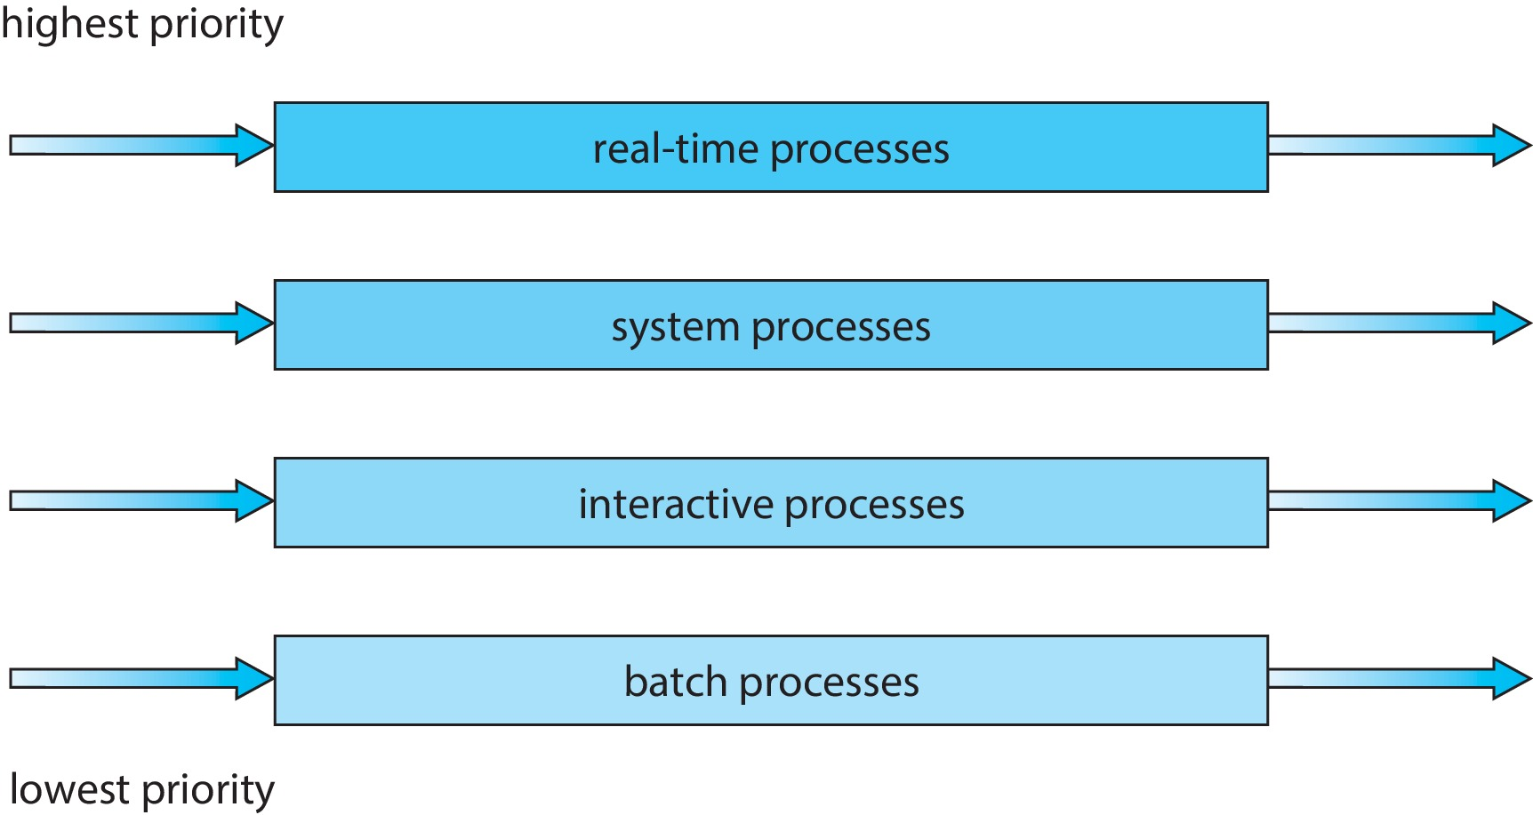
Multilevel Queue Scheduling
Prioritization based upon process type,
  Each queue has absolute priority over lower-priority queues
  Another possibility is to time-slice among the queues
Real Time Processes: i.e. the scheduling algorithm itself (scheduling process);
i.e. the computer inside the Engine Control Unit in a car has to manage the engine at every moment based on what the driver wants to do (in real-time fashion).
Scheduling is a real-time process too
Try out:
$ man chrt
$ chrt -p pid
$ chrt –m

Slide 31
Multilevel Feedback Queue Scheduling
Allows a process to move between the various queues;
  If a process uses too much CPU time, it will be moved to a lower-priority queue and vice versa.
    Processes that are typically characterized as short CPU bursts can be left in the higher-priority queues (i.e. I/O-bound and interactive process)
  Aging can be implemented this way; a process that waits too long in a lower-priority queue may be moved to a higher-priority queue
Multilevel-feedback-queue scheduler defined by the following parameters:
  number of queues
  scheduling algorithms for each queue
  method used to determine when to upgrade a process
  method used to determine when to demote a process
  method used to determine which queue a process will enter when that process needs service

Slide 32
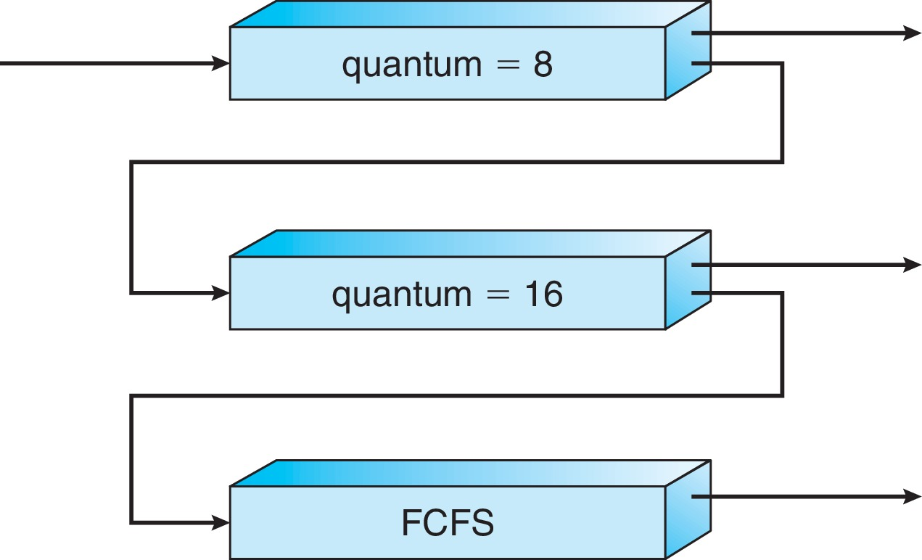
Example : Multilevel Feedback Queue
Three queues:
  Q₀ – RR with time quantum 8 milliseconds
  Q₁ – RR time quantum 16 milliseconds
  Q₂ – FCFS
  Note: Only when Q₀ is empty will it execute processes in Q₁
Scheduling
A new job enters queue Q₀ which is served FCFS
  When it gains CPU, job receives 8 milliseconds
  If it does not finish in 8 milliseconds, job is moved to queue Q₁
At Q₁ job is again served FCFS and receives 16 additional milliseconds
  If it still does not complete, it is preempted and moved to queue Q₂
Q₀
Q₁
Q₂

Slide 33
Thread Scheduling

Slide 34
Thread Scheduling
On most modern operating systems, it is kernel-level threads—not processes—that are being scheduled by the operating system.
  When threads are supported, threads scheduled, not processes
Distinction between user-level and kernel-level threads:
  Distinctions mainly in how they are scheduled, user-level threads are managed by a thread library, and the kernel is unaware of them.
To run on a CPU, user-level threads must ultimately be mapped to an associated kernel-level thread
  this mapping may be indirect and may use a lightweight process (LWP).
User-level thread priorities are set by the programmer and are not adjusted by the thread library

Slide 35
Scheduling Contention Scope
On systems that are Many-to-one and many-to-many models,
  The thread library schedules user-level threads to run an available Lightweight Process (LWP)
    This scheme is known as Process-Contention Scope (PCS), in which competition for the CPU takes place among threads belonging to the same process. (many-to-one & many-to-many)
    Note: When we say the thread library schedules user threads onto available LWPs, we do not mean that the threads are actually running on a CPU as that further requires the operating system to schedule the LWP’s kernel thread onto a physical CPU core.)
To decide which kernel-level thread to schedule onto a CPU,
  the kernel uses System-Contention Scope (SCS), in which competition for the CPU with SCS scheduling takes place among all threads in the system.
  Note: Systems using the one-to-one model such as Windows and Linux schedule threads using only SCS.

Slide 36
Scheduling the PCS
Typically, PCS is done according to priority
  The thread scheduler selects the runnable thread with the highest priority to run
  User-level thread priorities are:
    set by the programmer
    not adjusted by the thread library,
    However, some thread libraries may allow the programmer to change the priority of a thread
  Note:
    PCS will typically preempt the thread currently running in favor of a higher-priority thread
      however, there is no guarantee of time slicing among threads of equal priority.

Slide 37
Pthread Scheduling
POSIX Pthread API allows specifying either PCS or SCS during thread creation
  PTHREAD_SCOPE_PROCESS
    Schedules threads using PCS, passed to the scope parameter
  PTHREAD_SCOPE_SYSTEM
    Schedules threads using SCS, passed to the scope parameter
The Pthread IPC (Inter-process Communication) provides two functions for setting—and getting—the contention scope policy:
  Pthread_attr_setscope(pthread_attr_t *attr, int scope)
  Pthread_attr_getscope(pthread_attr_t *attr, int *scope)
Can be limited by OS –
  Linux and macOS only allow PTHREAD_SCOPE_SYSTEM

Slide 38
Pthread Scheduling API
#include <pthread.h>
#include <stdio.h>
#define NUM_THREADS 5
int main(int argc, char *argv[]) {
int i, scope;
pthread_t tid[NUM THREADS];
pthread_attr_t attr;
/* get the default attributes */
pthread_attr_init(&attr);
/* first inquire on the current scope */
if (pthread_attr_getscope(&attr, &scope) != 0)
fprintf(stderr, "Unable to get scheduling scope\n");
else {
if (scope == PTHREAD_SCOPE_PROCESS)
printf("PTHREAD_SCOPE_PROCESS");
else if (scope == PTHREAD_SCOPE_SYSTEM)
printf("PTHREAD_SCOPE_SYSTEM");
else
fprintf(stderr, "Illegal scope value.\n");
}

Slide 39
Pthread Scheduling API
/* set the scheduling algorithm to PCS or SCS */
pthread_attr_setscope(&attr, PTHREAD_SCOPE_SYSTEM);
/* create the threads */
for (i = 0; i < NUM_THREADS; i++)
pthread_create(&tid[i], &attr , runner, NULL);
/* now join on each thread */
for (i = 0; i < NUM_THREADS; i++)
pthread_join(tid[i] , NULL);
}
/* Each thread will begin control in this function */
void *runner(void *param)
{
/* do some work ... */
pthread_exit(0);
}

Slide 40
Multi-Processor Scheduling

Slide 41
Multi-Processor Scheduling
Our discussion thus far has focused on the problems of scheduling the CPU in a system with a single processing core
If multiple CPUs are available, load sharing, where multiple threads may run in parallel, becomes possible:
  Scheduling issues become correspondingly more complex
  Many possibilities have been tried; and as we saw with CPU scheduling with a single-core CPU, there is no one best solution ☺
Traditionally, the term multiprocessor referred to systems that provided multiple physical processors, where each processor contained one single-core CPU
Now the term Multiprocessor applies to any one of the following architectures:
  Multicore CPUs
  Multithreaded cores
  Non-Uniform Memory Access (NUMA) systems
  Heterogeneous multiprocessing

Slide 42
Multiple-Processor Scheduling- Approaches
Asymmetric Multiprocessing
  One approach is to have all scheduling decisions, I/O processing, and other system activities handled by a single processor —
    the master server
    Other processors execute only user code
  Pros:
    this approach is simple because only one core accesses the system data structures, reducing the need for data sharing
  Cons:
    the master server becomes a potential bottleneck where overall system performance may be reduced
Symmetric Multiprocessing (SMP) strategies for organizing the threads eligible to be scheduled:
  Each processor is self-scheduling;
    scheduler for each processor examine the ready queue and
    select a thread/process to run

Slide 43
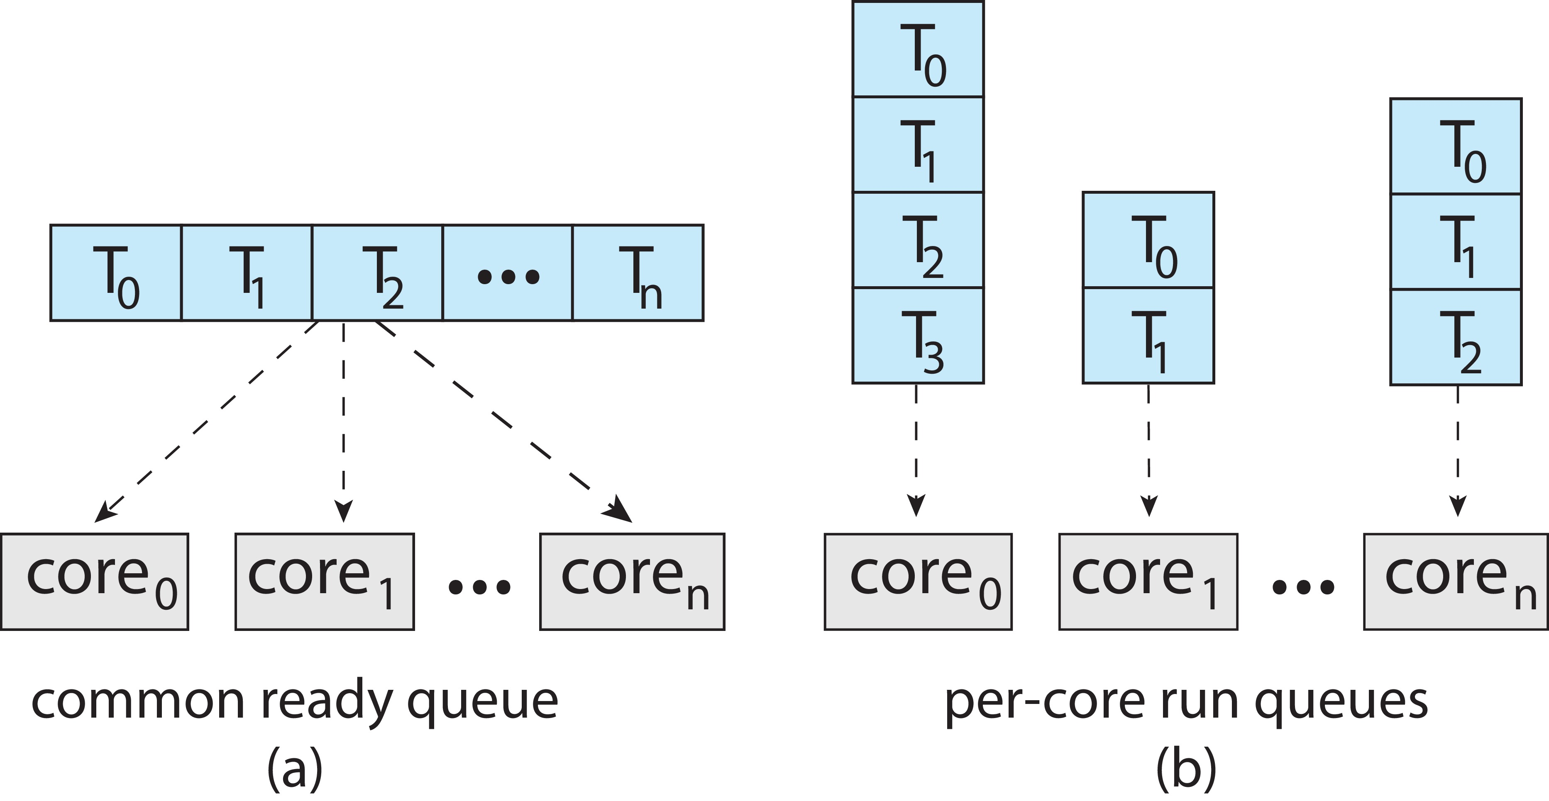
Multiple-Processor Scheduling
Symmetric multiprocessing (SMP); Two possible strategies
  All threads/processes may be in a common ready queue (a) ☹
    a possible race condition on the shared ready queue
    must ensure that two separate processors do not choose to schedule the same thread
  Each processor may have its own private queue of threads (b) ☺
    permits each processor to schedule threads from its private run queue
    does not suffer from the possible performance problems associated with a shared run queue
    more efficient use of cache memory (locality)
    balancing algorithms can be used to equalize workloads among all processors.
Virtually all modern operating systems support SMP Scheduling, including Windows, Linux, and macOS as well as mobile systems including Android and iOS.

Slide 44
Multicore Processors & Multithreaded Multicore Systems

Slide 45
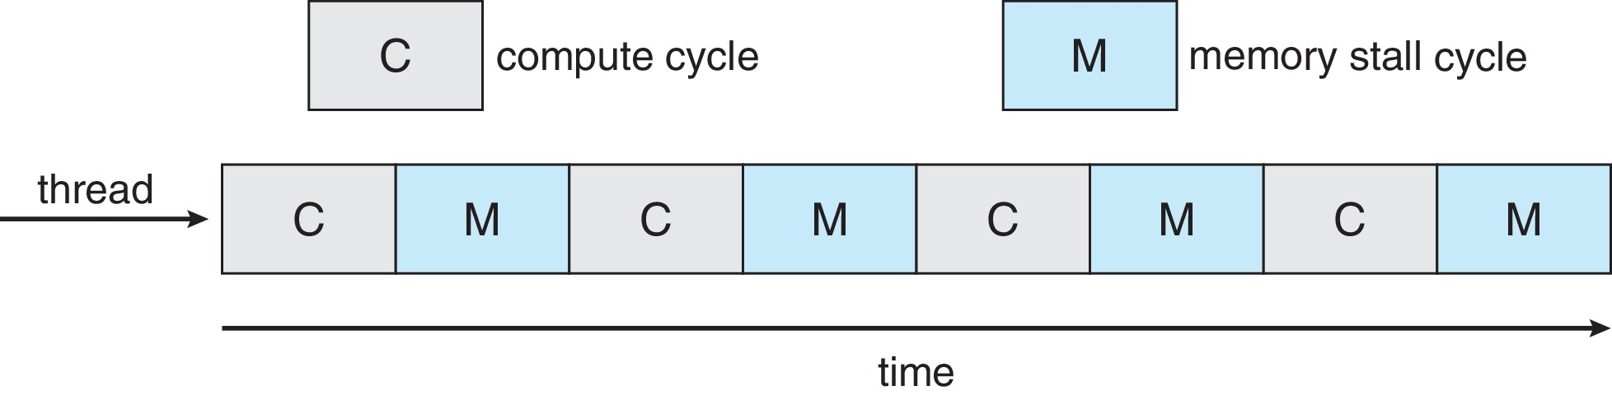
Multicore Processors
SMP systems have allowed several processes to run in parallel by providing multiple physical processors
Recent trend to place multiple processor cores on same physical chip
  Resulting in a multicore processor
    each core maintains its architectural state and
    thus appears to the operating system to be a separate logical CPU
  Faster and consumes less power
  Multiple threads per core also growing and taking advantage of memory stall
      The CPU is stalled while waiting on a memory load or store.
    Modern processors operate at much faster speeds than memory.
    Then, when a processor accesses memory, it spends a significant amount of time waiting for the data to become available
    Or because of a cache miss

Slide 46
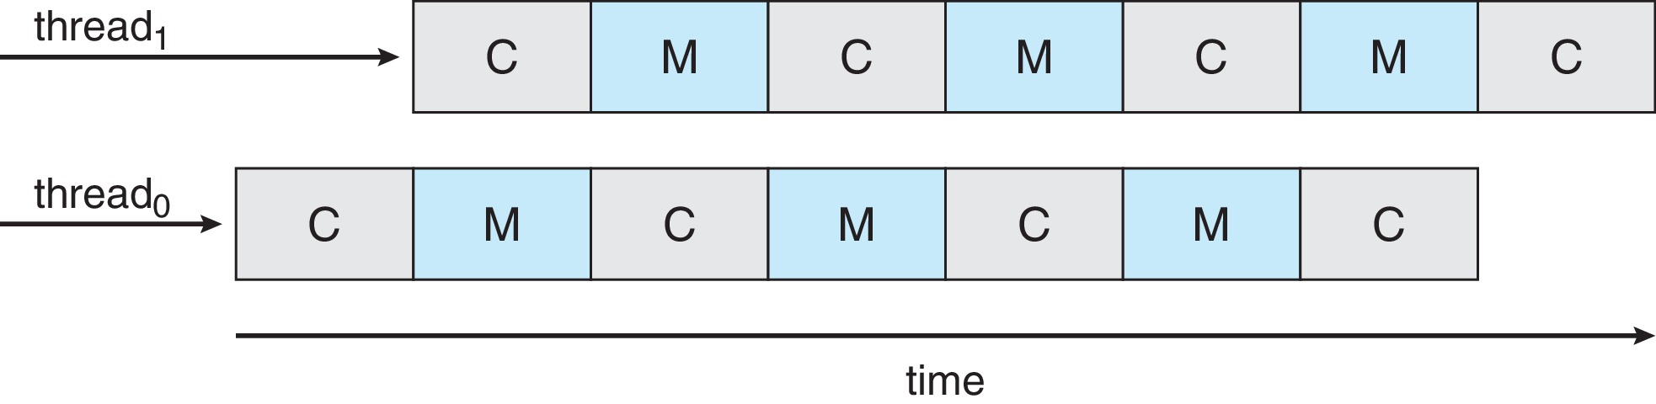
Multithreaded Multicore System
To remedy/overcome the Memory Stall,
  Implement the multithreaded processing cores in which two (or more) hardware threads are assigned to each core:
    each core has > 1 hardware threads
    if one thread has a memory stall, switch to another thread! (hardware thread)
    each hardware thread maintains its architectural state (PC, registers, etc.)
      Called logical CPU
Also called: chip multithreading (CMT)

Slide 47
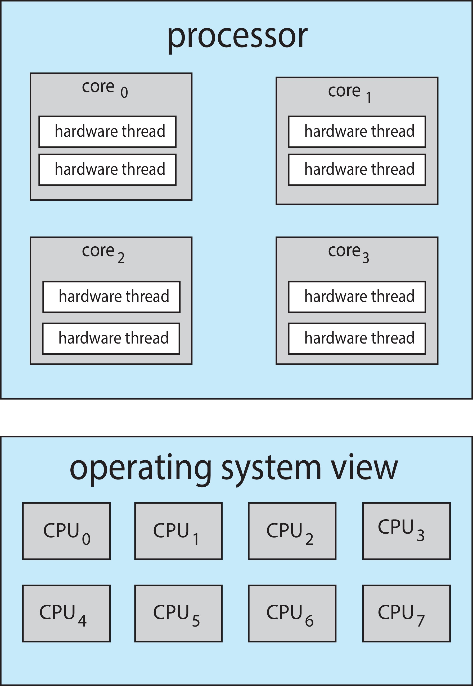
Multithreaded Multicore System
Chip-MultiThreading (CMT) assigns each core multiple hardware threads.
  Intel refers to this as Hyper-Threading,
  Also known as Simultaneous Multithreading or SMT
On a quad-core system with 2 hardware threads per core,
  the OS sees 8 logical processors /
  or 8 logical CPUs
Intel’s i7 processor support 2 threads per core
Oracle’s Sparc M7 processor supports 8 threads per core, with 8 cores per processor, thus providing the operating system with 64 logical CPUs

Slide 48
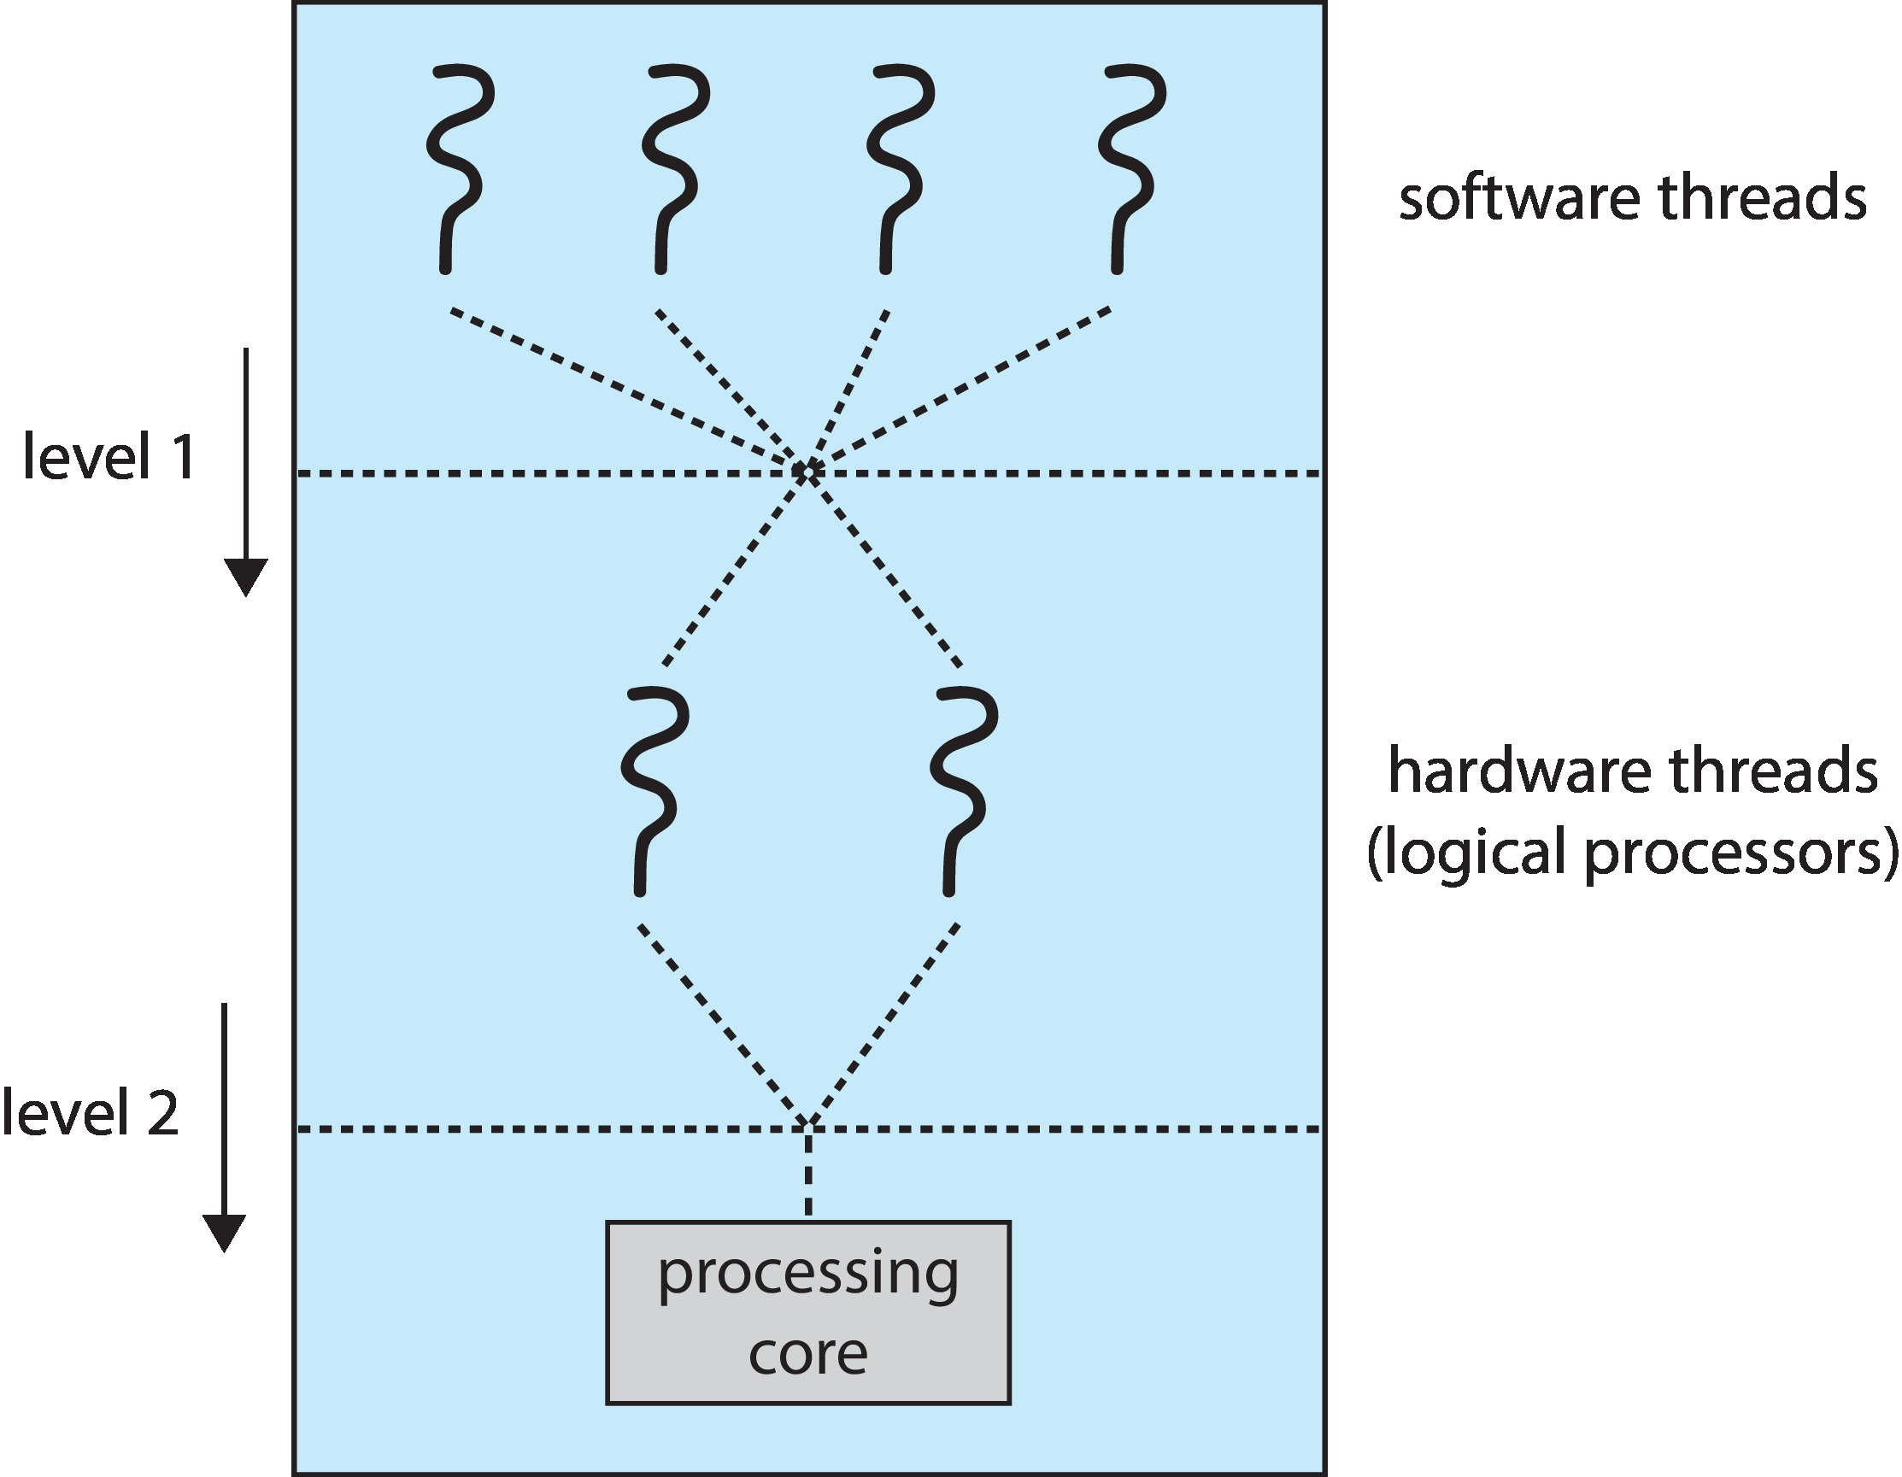
Multithreaded Multicore System
Two levels of scheduling:
The OS decides which software thread to run on a logical CPU
Each core decides which hardware thread to run on the physical core.

Slide 49
Multiple-Processor Scheduling – Load Balancing
If SMP, need to keep all CPUs loaded for efficiency
Load balancing attempts to keep workload evenly distributed
There are two general approaches to load balancing:
  Push migration –
    periodic task checks load on each processor,
      if unbalancing found, it pushes task from overloaded CPU to other CPUs
  Pull migration –
    idle processors pulls waiting task from busy processor

Slide 50
Multiple-Processor Scheduling – Processor Affinity
When a thread has been running on one processor:
  The cache contents of that processor stores the memory accesses by that thread.
  We refer to this as a thread having affinity (alliance) for a processor
  (i.e. “processor affinity”)
Load balancing may affect processor affinity as a thread may be moved from one processor to another to balance loads,
  yet that thread loses the contents of what it had in the cache of the processor it was moved off.
Soft affinity –
  the operating system attempts to keep a thread running on the same processor, but no guarantees.
Hard affinity – allows a process to specify a set of processors it may run on.

Slide 51
NUMA and CPU Scheduling
If the operating system is Non-Uniform Memory Access (NUMA-aware)
it will assign memory closes to the CPU the thread is running on.
NUMA: two physical processor chips each with its own CPU and local memory.
A CPU has faster access to its local memory than to memory local to another CPU.

Slide 52
Simulations

Slide 53
Simulations
To get a accurate evaluation of scheduling algorithms, simulations can be used
Running simulations involves programming a model of the computer system
Software data structures represent the major components of the system
The simulator has a variable representing a clock
  As this variable’s value is increased, the simulator modifies the system state to reflect the:
    activities of the devices,
    the processes, and
    the scheduler.
  As the simulation executes,
    statistics that indicate algorithm performance are gathered and printed.
The data to drive the simulation can be generated in several ways. The most common method uses a random-number generator that is programmed to generate
  Number of processes, CPU burst times, arrivals, departures, and so on, according to probability distributions.

Slide 54
Simulations
Simulations more accurate
  Programmed model of computer system
  Clock is a variable
  Gather statistics indicating algorithm performance
  Data to drive simulation gathered via
    Random number generator according to probabilities
    Distributions defined mathematically or empirically
    Trace tapes record sequences of real events in real systems

Slide 55
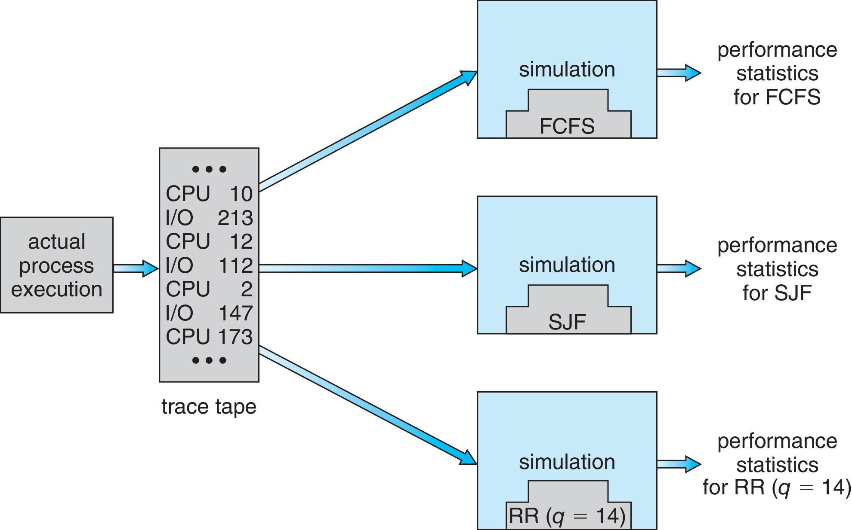
Evaluation of CPU Schedulers by Simulation

Slide 56
End of Chapter 5

Slide 58
Real-Time CPU Scheduling
Can present obvious challenges
Soft real-time systems –
  Critical real-time tasks have the highest priority,
  but no guarantee as to when tasks will be scheduled
Hard real-time systems –
  task must be serviced by its deadline

Slide 59
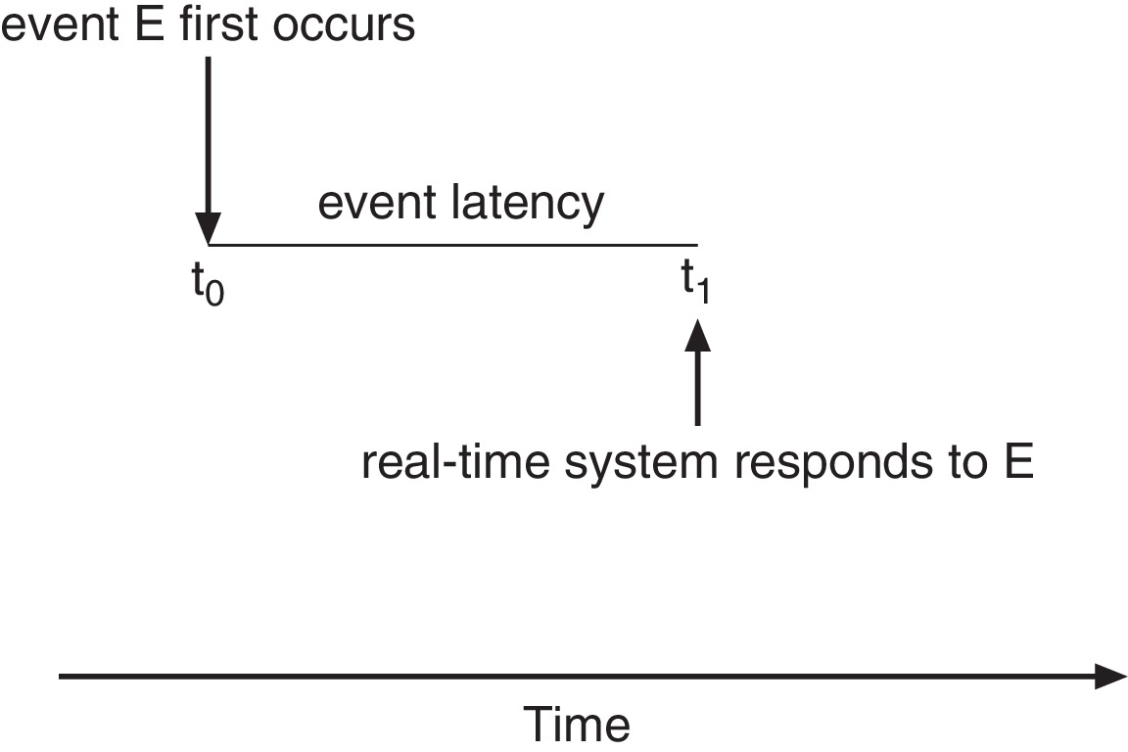
Real-Time CPU Scheduling
Minimizing Latency: Consider the event-driven nature of a real-time system, When an event occurs, the system must respond to and service it as quickly as possible.
Event latency – the amount of time that elapses from when an event occurs to when it is serviced.
Two types of latencies affect performance
  Interrupt latency – time from arrival of interrupt to start of routine that services interrupt
  Dispatch latency – time for schedule to take current process off CPU and switch to another

Slide 60
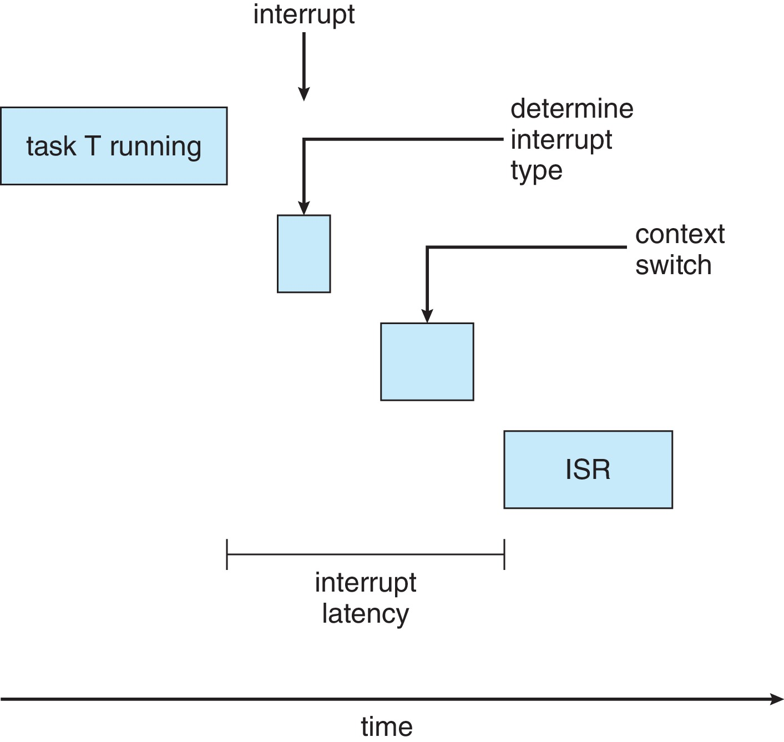
Interrupt Latency

Slide 61
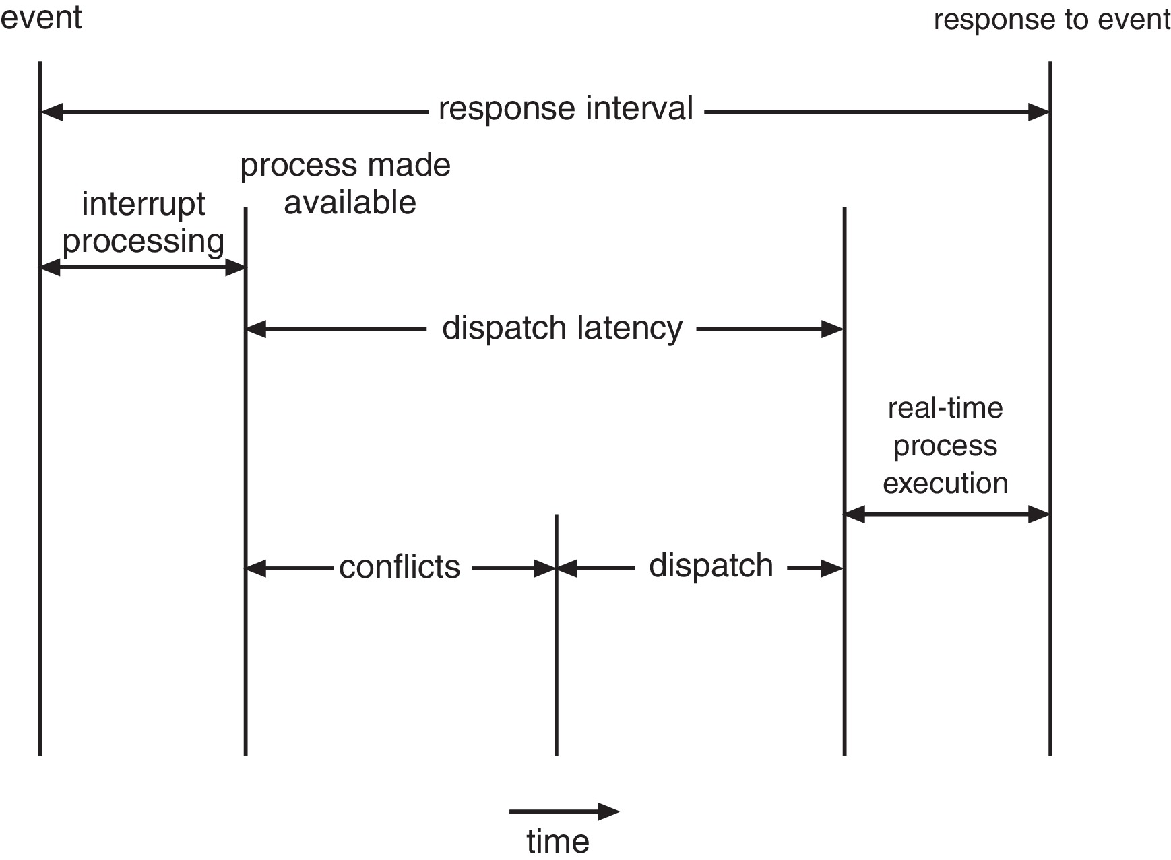
Dispatch Latency
Conflict phase of dispatch latency:
  Preemption of any process running in kernel mode
  Release by low-priority process of resources needed by high-priority processes

Slide 62
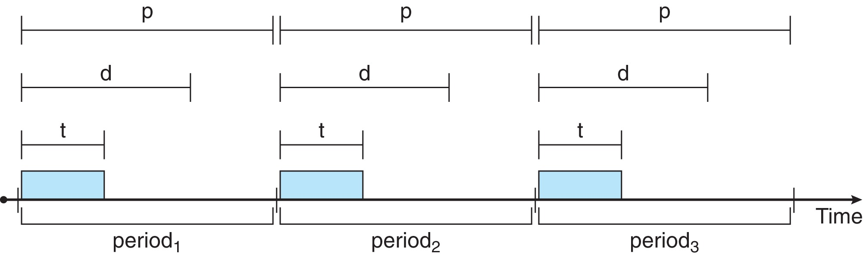
Priority-based Scheduling
For real-time scheduling, scheduler must support preemptive, priority-based scheduling
  But only guarantees soft real-time
For hard real-time must also provide ability to meet deadlines
Processes have new characteristics: periodic ones require CPU at constant intervals
  Has processing time t, deadline d, period p
  0 ≤ t ≤ d ≤ p
  Rate of periodic task is 1/p

Slide 63
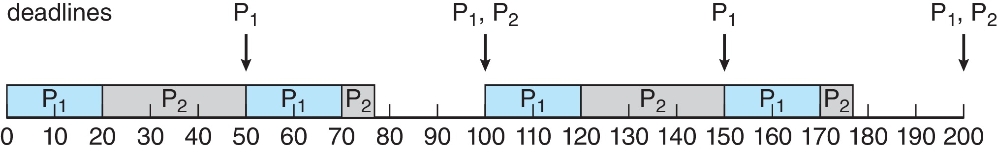
Rate Montonic Scheduling
A priority is assigned based on the inverse of its period
Shorter periods = higher priority;
Longer periods = lower priority
P₁ is assigned a higher priority than P₂.

Slide 64
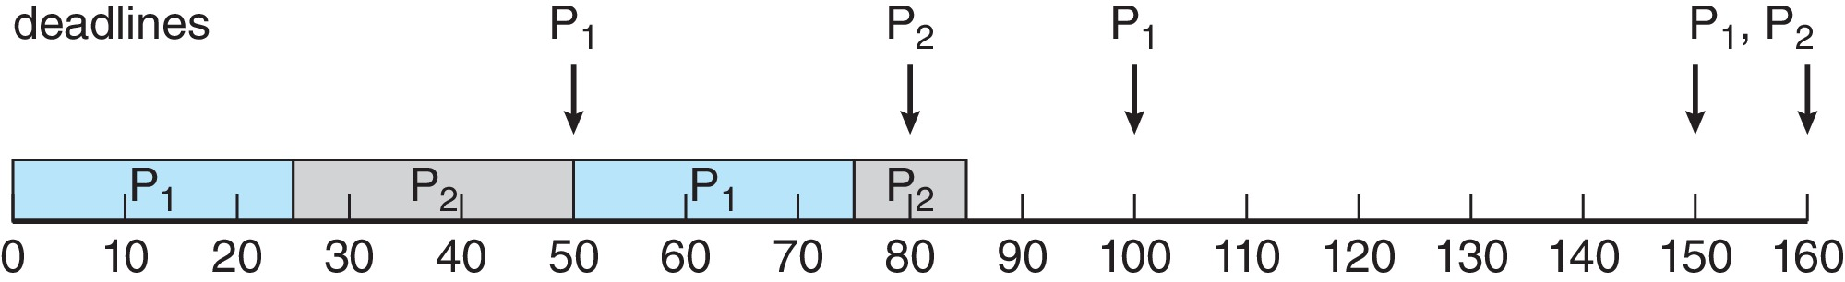
Missed Deadlines with Rate Monotonic Scheduling
Process P2 misses finishing its deadline at time 80

Slide 65
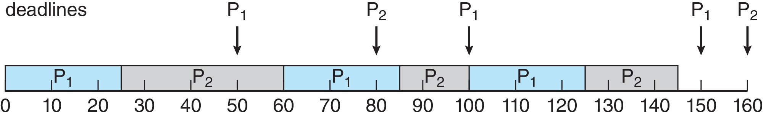
Earliest Deadline First Scheduling (EDF)
Priorities are assigned according to deadlines:
the earlier the deadline, the higher the priority;
the later the deadline, the lower the priority

Slide 66
Proportional Share Scheduling
T shares are allocated among all processes in the system
An application receives N shares where N < T
This ensures each application will receive N / T of the total processor time

Slide 67
POSIX Real-Time Scheduling
The POSIX.1b standard
API provides functions for managing real-time threads
Defines two scheduling classes for real-time threads:
  SCHED_FIFO –
    threads are scheduled using a FCFS strategy with a FIFO queue.
    There is no time-slicing for threads of equal priority
  SCHED_RR –
    similar to SCHED_FIFO except time-slicing occurs for threads of equal priority
Defines two functions for getting and setting scheduling policy:
pthread_attr_getsched_policy(pthread_attr_t *attr, int *policy)
pthread_attr_setsched_policy(pthread_attr_t *attr, int policy)

Slide 68
POSIX Real-Time Scheduling API
#include <pthread.h>
#include <stdio.h>
#define NUM_THREADS 5
int main(int argc, char *argv[])
{
int i, policy;
pthread_t_tid[NUM_THREADS];
pthread_attr_t attr;
/* get the default attributes */
pthread_attr_init(&attr);
/* get the current scheduling policy */
if (pthread_attr_getschedpolicy(&attr, &policy) != 0)
fprintf(stderr, "Unable to get policy.\n");
else {
if (policy == SCHED_OTHER) printf("SCHED_OTHER\n");
else if (policy == SCHED_RR) printf("SCHED_RR\n");
else if (policy == SCHED_FIFO) printf("SCHED_FIFO\n");
}

Slide 69
POSIX Real-Time Scheduling API (Cont.)
/* set the scheduling policy - FIFO, RR, or OTHER */
if (pthread_attr_setschedpolicy(&attr, SCHED_FIFO) != 0)
fprintf(stderr, "Unable to set policy.\n");
/* create the threads */
for (i = 0; i < NUM_THREADS; i++)
pthread_create(&tid[i],&attr,runner,NULL);
/* now join on each thread */
for (i = 0; i < NUM_THREADS; i++)
pthread_join(tid[i], NULL);
}
/* Each thread will begin control in this function */
void *runner(void *param)
{
/* do some work ... */
pthread_exit(0);
}

Slide 70
Operating System Examples (Self-Reading)
Linux scheduling
Windows scheduling
Solaris scheduling

Slide 71
Linux Scheduling Through Version 2.5
Prior to kernel version 2.5, ran variation of standard UNIX scheduling algorithm
Version 2.5 moved to constant order O(1) scheduling time
  Preemptive, priority based
  Two priority ranges: time-sharing and real-time
  Real-time range from 0 to 99 and nice value from 100 to 140
  Map into global priority with numerically lower values indicating higher priority
  Higher priority gets larger q
  Task run-able as long as time left in time slice (active)
  If no time left (expired), not run-able until all other tasks use their slices
  All run-able tasks tracked in per-CPU runqueue data structure
    Two priority arrays (active, expired)
    Tasks indexed by priority
    When no more active, arrays are exchanged
  Worked well, but poor response times for interactive processes

Slide 72
Linux Scheduling in Version 2.6.23 +
Completely Fair Scheduler (CFS)
Scheduling classes
  Each has specific priority
  Scheduler picks highest priority task in highest scheduling class
  Rather than quantum based on fixed time allotments, based on proportion of CPU time
  2 scheduling classes included, others can be added
    default
    real-time
Quantum calculated based on nice value from -20 to +19
  Lower value is higher priority
  Calculates target latency – interval of time during which task should run at least once
  Target latency can increase if say number of active tasks increases
CFS scheduler maintains per task virtual run time in variable vruntime
  Associated with decay factor based on priority of task – lower priority is higher decay rate
  Normal default priority yields virtual run time = actual run time
To decide next task to run, scheduler picks task with lowest virtual run time

Slide 73
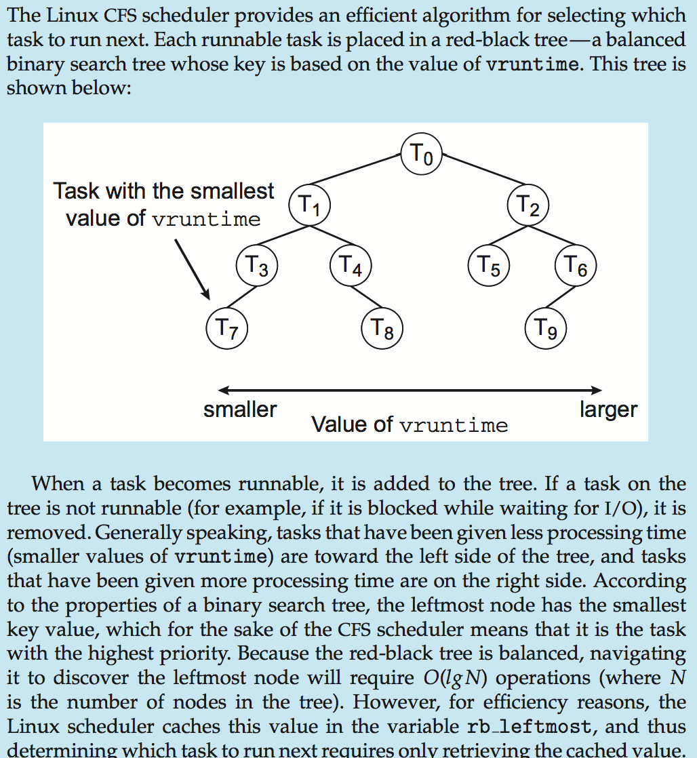
CFS Performance

Slide 74
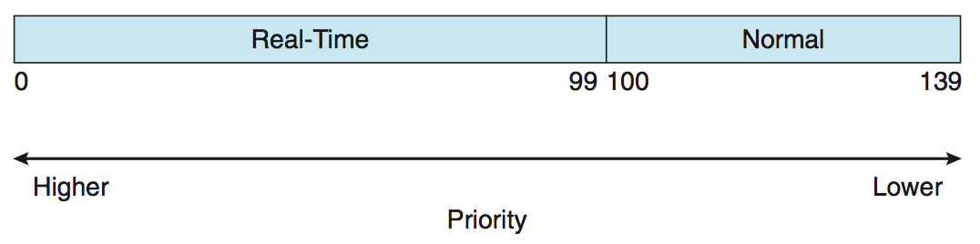
Linux Scheduling (Cont.)
Real-time scheduling according to POSIX.1b
  Real-time tasks have static priorities
Real-time plus normal map into global priority scheme
Nice value of -20 maps to global priority 100
Nice value of +19 maps to priority 139

Slide 75
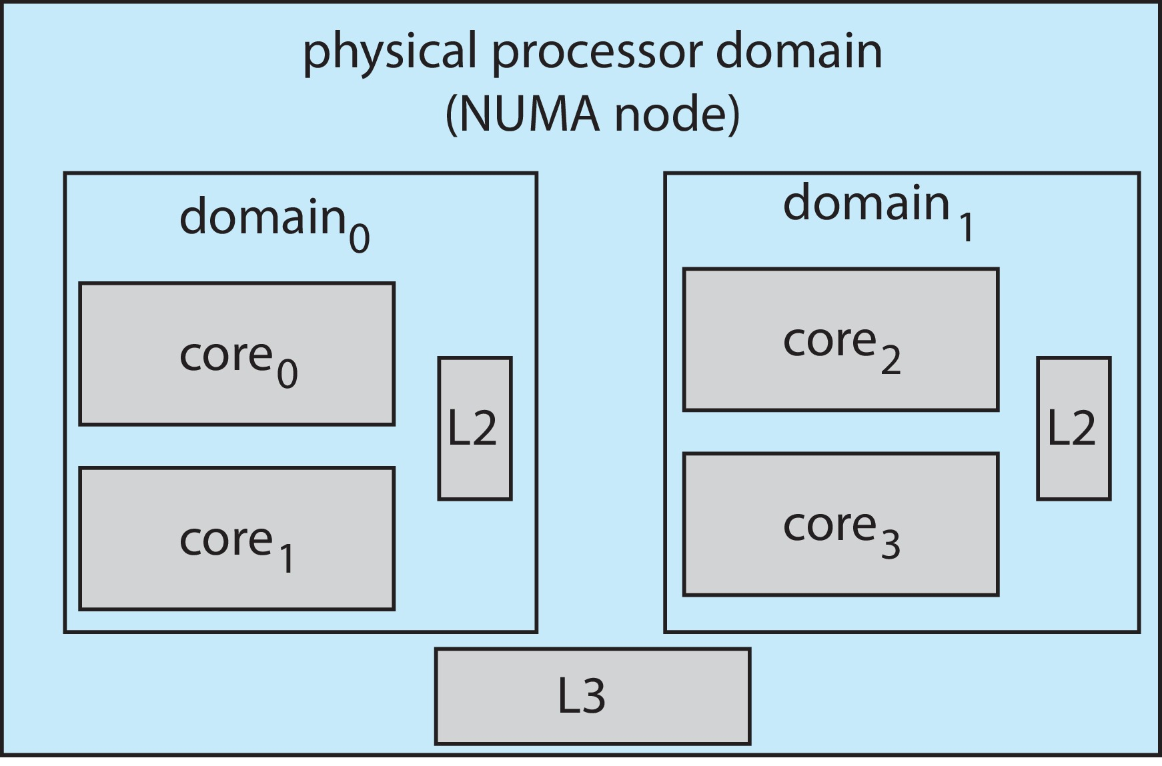
Linux Scheduling (Cont.)
Linux supports load balancing, but is also NUMA-aware.
Scheduling domain is a set of CPU cores that can be balanced against one another.
Domains are organized by what they share (i.e. cache memory.) Goal is to keep threads from migrating between domains.

Slide 76
Windows Scheduling
Windows uses priority-based preemptive scheduling
Highest-priority thread runs next
Dispatcher is scheduler
Thread runs until (1) blocks, (2) uses time slice, (3) preempted by higher-priority thread
Real-time threads can preempt non-real-time
32-level priority scheme
Variable class is 1-15, real-time class is 16-31
Priority 0 is memory-management thread
Queue for each priority
If no run-able thread, runs idle thread

Slide 77
Windows Priority Classes
Win32 API identifies several priority classes to which a process can belong
  REALTIME_PRIORITY_CLASS, HIGH_PRIORITY_CLASS, ABOVE_NORMAL_PRIORITY_CLASS,NORMAL_PRIORITY_CLASS, BELOW_NORMAL_PRIORITY_CLASS, IDLE_PRIORITY_CLASS
  All are variable except REALTIME
A thread within a given priority class has a relative priority
  TIME_CRITICAL, HIGHEST, ABOVE_NORMAL, NORMAL, BELOW_NORMAL, LOWEST, IDLE
Priority class and relative priority combine to give numeric priority
Base priority is NORMAL within the class
If quantum expires, priority lowered, but never below base

Slide 78
Windows Priority Classes (Cont.)
If wait occurs, priority boosted depending on what was waited for
Foreground window given 3x priority boost
Windows 7 added user-mode scheduling (UMS)
  Applications create and manage threads independent of kernel
  For large number of threads, much more efficient
  UMS schedulers come from programming language libraries like C++ Concurrent Runtime (ConcRT) framework

Slide 79
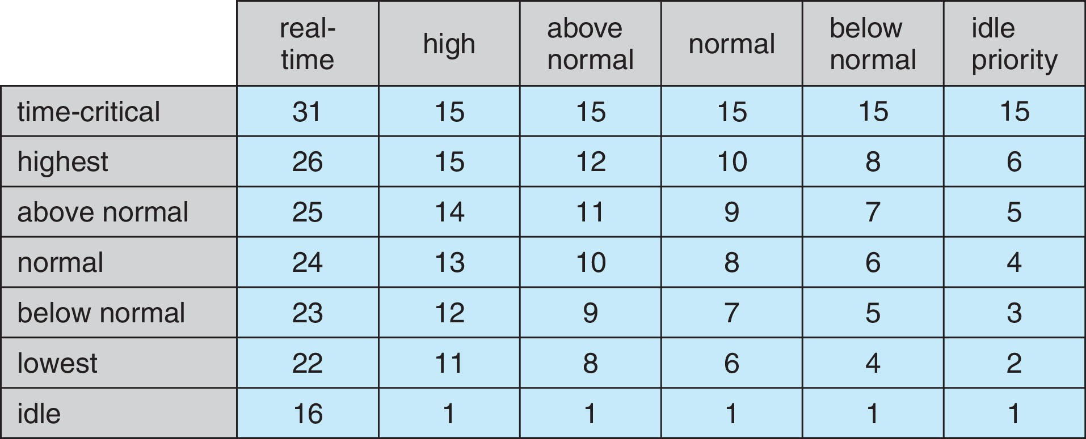
Windows Priorities

Slide 80
Solaris
Priority-based scheduling
Six classes available
  Time sharing (default) (TS)
  Interactive (IA)
  Real time (RT)
  System (SYS)
  Fair Share (FSS)
  Fixed priority (FP)
Given thread can be in one class at a time
Each class has its own scheduling algorithm
Time sharing is multi-level feedback queue
  Loadable table configurable by sysadmin

Slide 81
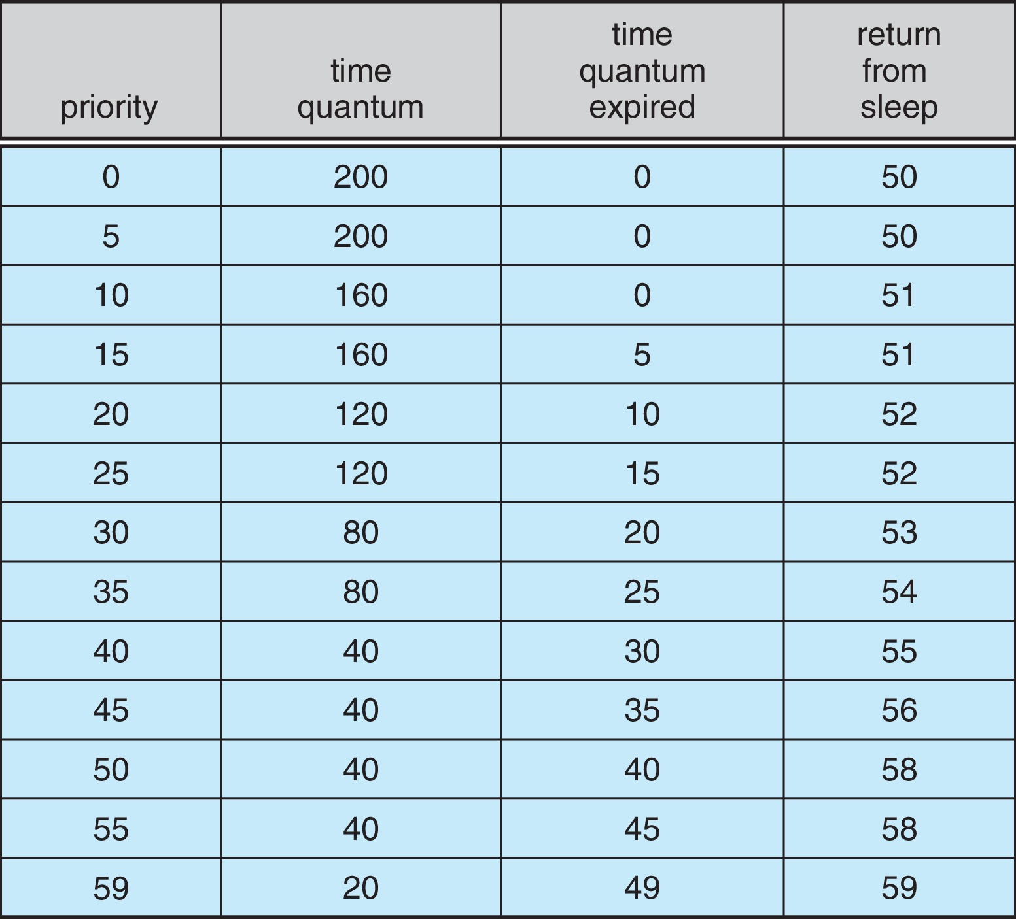
Solaris Dispatch Table

Slide 82
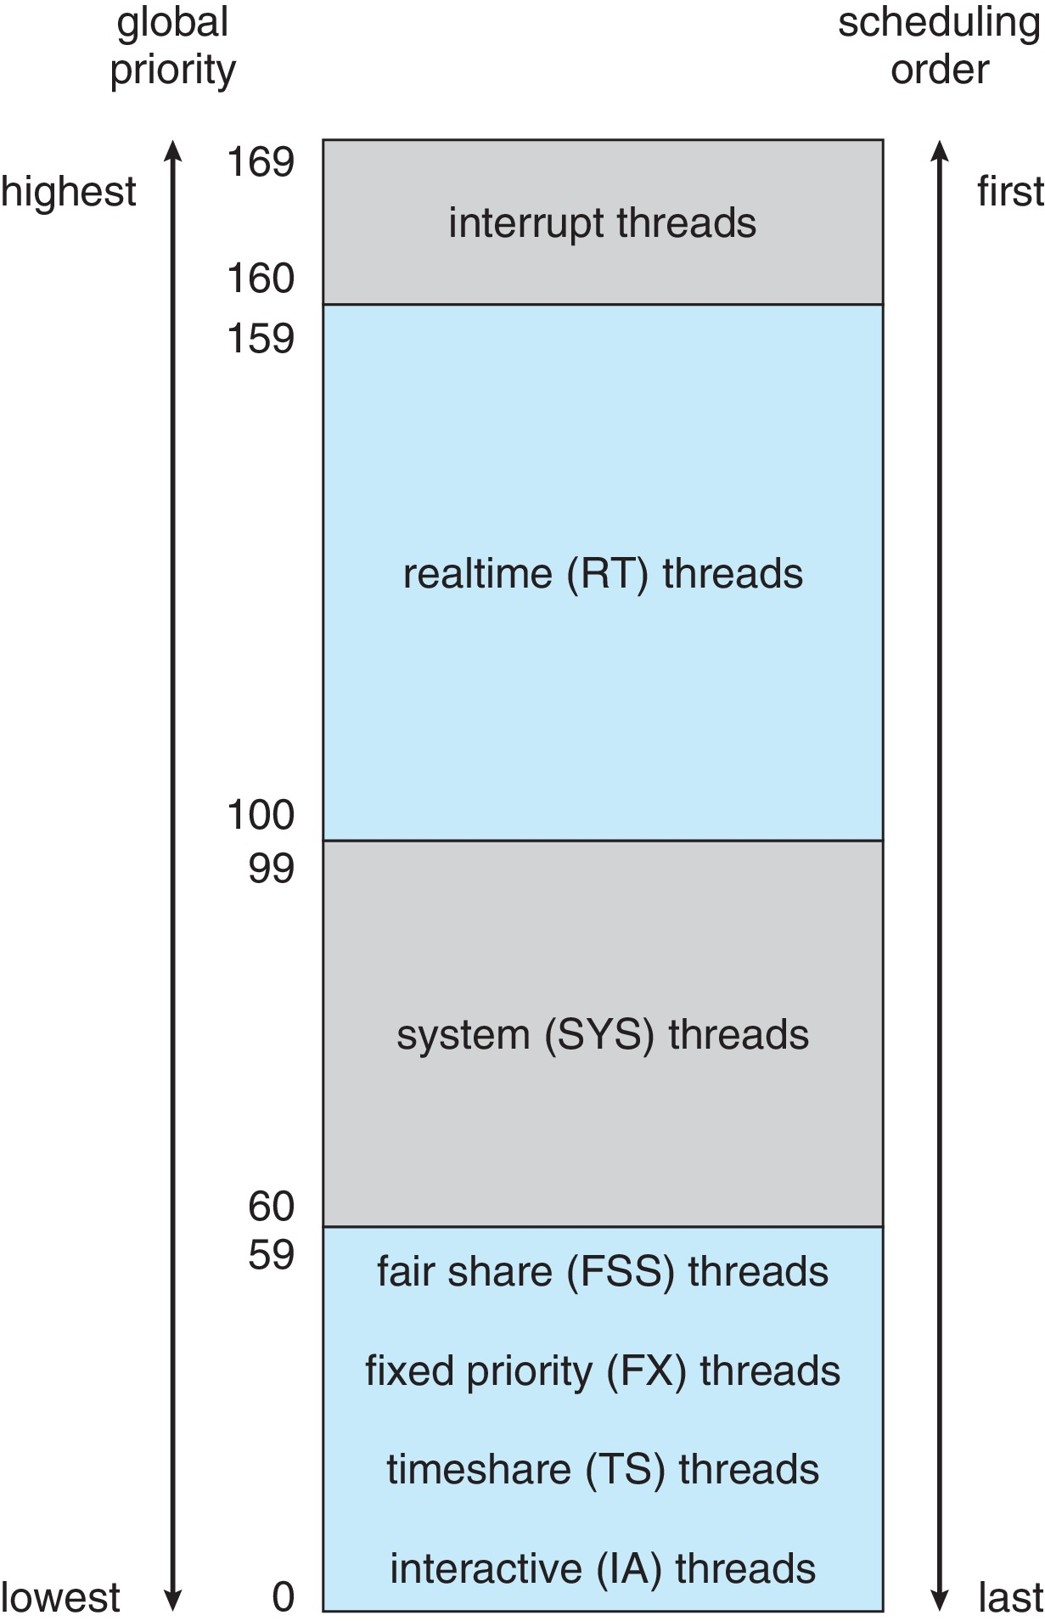
Solaris Scheduling

Slide 83
Solaris Scheduling (Cont.)
Scheduler converts class-specific priorities into a per-thread global priority
  Thread with highest priority runs next
  Runs until (1) blocks, (2) uses time slice, (3) preempted by higher-priority thread
  Multiple threads at same priority selected via RR

Slide 84
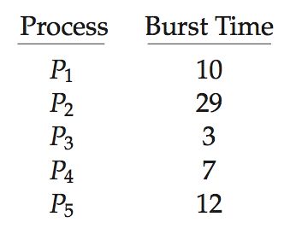
Algorithm Evaluation
How to select CPU-scheduling algorithm for an OS?
Determine criteria, then evaluate algorithms
Deterministic modeling
  Type of analytic evaluation
  Takes a particular predetermined workload and defines the performance of each algorithm for that workload
Consider 5 processes arriving at time 0:

Slide 85
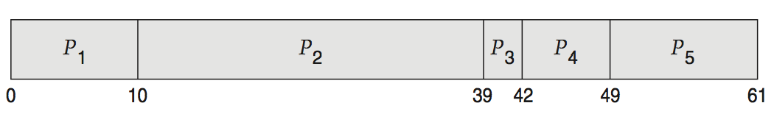
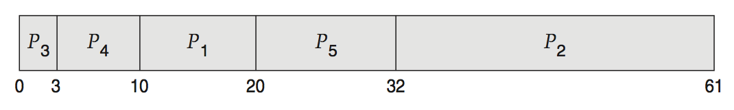
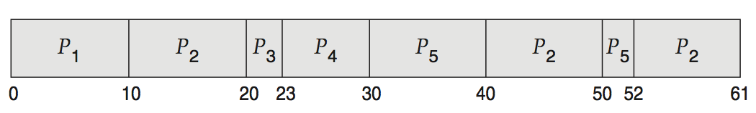
Deterministic Evaluation
For each algorithm, calculate minimum average waiting time
Simple and fast, but requires exact numbers for input, applies only to those inputs
  FCS is 28ms:
  Non-preemptive SFJ is 13ms:
  RR is 23ms:

Slide 86
Queueing Models
Describes the arrival of processes, and CPU and I/O bursts probabilistically
  Commonly exponential, and described by mean
  Computes average throughput, utilization, waiting time, etc
Computer system described as network of servers, each with queue of waiting processes
  Knowing arrival rates and service rates
  Computes utilization, average queue length, average wait time, etc

Slide 87
Little’s Formula
n = average queue length
W = average waiting time in queue
λ = average arrival rate into queue
Little’s law – in steady state, processes leaving queue must equal processes arriving, thus:
n = λ x W
  Valid for any scheduling algorithm and arrival distribution
For example, if on average 7 processes arrive per second, and normally 14 processes in queue, then average wait time per process = 2 seconds

Slide 88
Simulations
Queueing models limited
Simulations more accurate
  Programmed model of computer system
  Clock is a variable
  Gather statistics indicating algorithm performance
  Data to drive simulation gathered via
    Random number generator according to probabilities
    Distributions defined mathematically or empirically
    Trace tapes record sequences of real events in real systems

Slide 89
Evaluation of CPU Schedulers by Simulation

Slide 90
Implementation
Even simulations have limited accuracy
Just implement new scheduler and test in real systems
  High cost, high risk
  Environments vary
Most flexible schedulers can be modified per-site or per-system
Or APIs to modify priorities
But again environments vary

