Slide 1
Scheduling on Parallel Systems
- Sathish Vadhiyar

Slide 2
Parallel Scheduling Categories
Job Scheduling [this class]
  A set of jobs arriving at a parallel system
  Choosing an order of jobs for execution to minimize total turnaround time
Application Scheduling [next class]
  Mapping a single application’s tasks to resources to reduce the total response time
  In general, difficult to achieve for communication-intensive applications
  For applications with independent tasks (pleasingly parallel applications), some methods have been proposed

Slide 3
Job Scheduling

Slide 4
Job Scheduling - Introduction
A parallel job is mapped to a subset of processors
The set of processors dedicated to a certain job is called a partition of the machine
To increase utilization, parallel machines are typically partitioned into several non-overlapping partitions, allocated to different jobs running concurrently – space slicing or space partitioning

Slide 5
Introduction
Users submit their jobs to a machine’s scheduler
Jobs are queued
Jobs in queue considered for allocation whenever state of a machine changes (submission of a new job, exit of a running job)
Allocation – which job in the queue?, which machine?

Slide 6
Introduction
Packing jobs to the processors
Goal – to increase processor utilization
Lack of knowledge of future jobs and job execution times. Hence simple heuristics to perform packing at each scheduling event

Slide 7
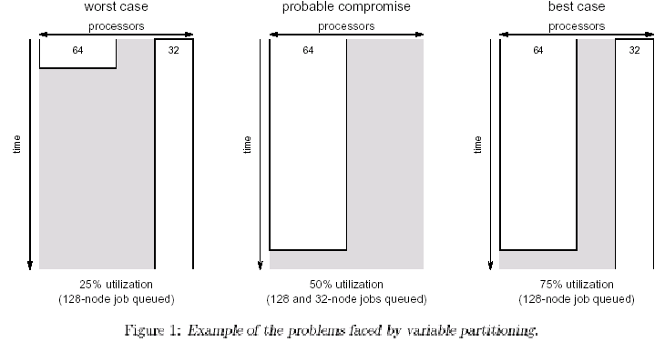
Variable Partitioning
Dilemma about future job arrivals and job terminations
Current scheduling decisions may impact jobs that arrive in the future
Can lead to poor utilization
e.g.: currently running: a 64-node job. Queued: 32-node and 128-node jobs

Slide 8
Scheduling Policies
FCFS
If the machine’s free capacity cannot accommodate the first job, it will not attempt to start any subsequent job
No starvation; But poor utilization
Processing power is wasted if the first job cannot run

Slide 9
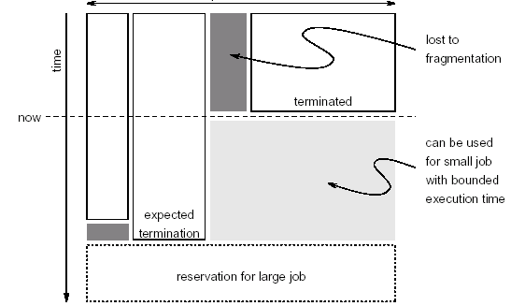
Backfilling
Allows small jobs from the back of the queue to execute before larger jobs that arrived earlier
Requires job runtimes to be known in advance – often specified as runtime upper-bound

Slide 10
Backfilling
Identifies holes in the 2D chart and moves smaller jobs to fill those holes
2 types – conservative and aggressive (EASY)

Slide 11
EASY Backfilling
Aggressive version of backfilling
Any job can be backfilled provided it does not delay the first job in the queue
Starvation cannot occur for the first job since queuing delay for the first job depends only on the running jobs
But jobs other than the first may be repeatedly delayed by newly arriving jobs

Slide 12
Conservative Backfilling
Makes reservations for all queued jobs
Backfilling is done subject to checking that it does not delay any previous job in the queue
Starvation cannot occur at all

Slide 13
Backfilling Variants
Depending on the order in which the queue is scanned to find backfilling jobs
  By estimated runtime or estimated slowdown
    Slowdown – (wait_time + running time)/running_time
Dynamic backfilling/slack-based backfilling – overruling previous reservation if introducing a slight delay will improve utilization considerably\
  Each job in the queue is associated with a slack – maximum delay after reservation.
  Important jobs will have little slack
  Backfilling is allowed only if the backfilled job does not delay any other job by more than that job’s slack
  e.g. reservations to only those jobs whose expected slowdowns > threshold

Slide 14
Backfilling Variants
3. Multiple-queue backfilling
  Each job is assigned to a queue according to its expected execution time
  Each queue is assigned to a disjoint partition of the parallel system on which only jobs from this queue can be executed
  Reduces the likelihood that short jobs get delayed in the queue behind long jobs

Slide 15
LOS (Lookahead Optimizing Scheduler)
Examines all jobs in the queue to maximize utilization
Instead of scanning the queue in any order and starting any job that is small enough not to violate prior reservations
LOS tries to find combination of jobs
Using dynamic programming
Results in local optimum; not global optimum
Global optimum may leave processors idle in anticipation of future arrivals

Slide 16
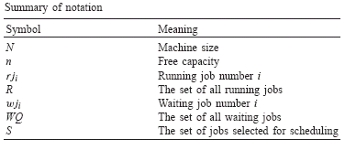
Notations
Scheduler is invoked at t
Machine runs jobs R = {rj₁, rj₂,…,rj_{r}} each with 2 attributes:
  Size
  Estimated remaining time, rem
Machine’s free capacity, n = N – sum(rj_{i}.size)
Waiting jobs in the queue, WQ = {wj₁, wj₂,…,wj_{q}}, each with 2 attributes
  Size requirements
  User’s runtime estimate, time

Slide 17
Objective
Task is to select a subset, S in WQ, selected jobset that maximizes machine utilization; these jobs removed from the queue and started immediately
Selected jobset is safe if it does not impose a risk of starvation

Slide 18
Matrix M
Size of M = (|WQ+1|) x (n+1)
m_{i,j} contains an integer value util, boolean flag selected
util – (i,j) holds the maximum achievable utilization at this time, if machine’s free capacity is j and only waiting jobs [1…i] are considered for scheduling
Maximum achievable utilization – maximal number of processors that can be utilized by the considered waiting jobs

Slide 19
Matrix M
selected – if set, indicates that wj_{i} was chosen for execution; when the algorithm finished calculating M, it will be used to trace the jobs which construct S
i=0 row and j=0 column are filled with zeros

Slide 20
Filling M
M is filled from left-right and top-bottom
If adding another processor (bringing the total to j) allows the currently considered job wj_{i} to be started:
  then check if including wj_{i} will increase utilization
The utilization that would be achieved assuming this job is included is calculated as util’
If util’ higher than utilization without this job, the selected flag is set to true for this job
If not, or if the job size is larger than j, the utilization is what it was without this job, that is m_{i-1,j}.util
The last cell shows the maximal utilization

Slide 21
Constructing M

Slide 22
Example
A machine of size, N = 10
At t=25, the machine runs rj1 with size=5, and rem=3
The machine’s free capacity, n=5
Set of waiting jobs and resulting M is shown
Selected flag is denoted by if set and by if cleared

Slide 23
Table M for Example

Slide 24
Example Explanations
Job 1 requires 7, hence does not fit in any of the 5; hence util is 0 and selected false for the entire row
For job 2, when 3 or more processors are used, it is selected and util is 3
Job 3
  When only 1 or 2 processors are used, it is selected and util 1
  When 3 processors are considered, it is better to select the second one; not the third
  With 4 or more, job 2 and job 3 can be selected; util is 4
Job 4 is selected
  When 2 processors are considered (better than utilizing job 3 with util 1)
  When 5 are considered (together with job 2 with util 5)
Job 5 does not add anything, never selected
Thus max util is 5
Conventional backfilling would have selected jobs 2 and 3 leading to utilization of 4.

Slide 25
Constructing S
Starting at the last computed cell, S is constructed by following the boolean flags backwards
Jobs that are marked as selected are added to S

Slide 26
Algorithm

Slide 27
Scheduling wj2 and wj4

Slide 28
Starvation
Algorithm 1 has the drawback that it might starve large jobs
In our example, the first queued job has size requirements 7
Since it cannot start at t, wj2 and wj4 are started.
But after 3 time units, rj1 releases it processors; however, processors are not available for wj1 since wj2 and wj4 are occupying processors;
This can continue….

Slide 29
Freedom from Starvation
Bound the waiting time of the first queued job
The algorithm tries to start wj1
If wj1.size < n, it removes the job from the queue and starts it
If not, the algorithm computes the shadow time at which wj1 can begin execution
Does this by traversing the running job list until reaching a job rjs, such that wj1.size < n+sum_{i=1tos}(rji.size)
shadow = t+rjs.rem
Reservation is made for wj1 at shadow
In the example, shadow = 28

Slide 30
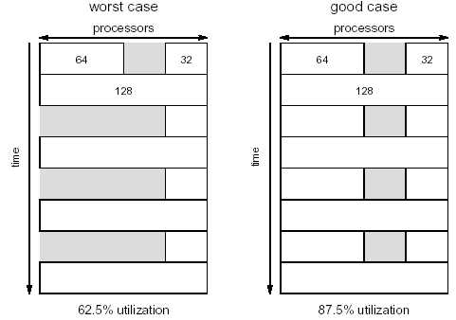
Gang Scheduling
Executing related threads/processes together on a machine
Time sharing. Time slices are created and within a time slice processors are allocated to jobs.
Jobs are context switched between time slices.
Leads to increased utilization

Slide 31
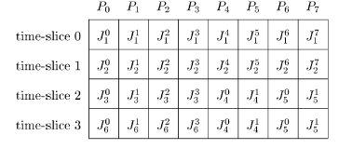
Gang Scheduling
Multi Programming Level: scheduling cycle in gang scheduling
Scheduling matrix recomputed at every scheduling event – job arrival or departure
4 steps – cleanmatrix, compactmatrix, schedule, fillmatrix

Slide 32

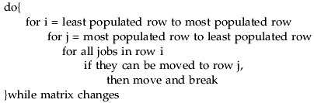
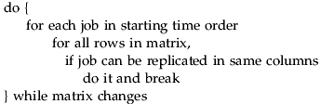
Gang Scheduling Steps
CleanMatrix
CompactMatrix
Schedule other jobs – FCFS
FillMatrix

Slide 33
Application Scheduling

Slide 34
Background
Tasks of a job do not have dependencies
A machine executes a single task at a time
Collection of tasks and machines are known apriori
Matching of tasks to machines done offline
Estimates of execution time for each task on each machine is known

Slide 35
Scheduling Problem
ETC – Expected time to compute matrix
ETC(i,j) – estimated execution time of task i on machine j
Notations:
  mat(j) – machine availability time for machine j, i.e., earliest time at which j has completed all tasks that were previously assigned to it
  Completion time, ct(i,j) = mat(j)+ETC(i,j)
Objective – find a schedule with minimum makespan
Makespan – max (ct(i,j))

Slide 36
Scheduling Heuristics
Opportunistic Load Balancing (OLB)
  Assign next task (arbitrary order) to the next available machine
  Regardless of task’s ETC on that machine
User Directed Allocation (UDA)
  Assign next task (arbitrary order) to the machine with lowest ETC
  Regardless of machine availability

Slide 37
Scheduling Heuristics
Min-Min
  Start with a list of Unmapped tasks, U.
  Determine the set of minimum completion times for U.
  Choose the next task that has min of min completion times and assign to the machine that provides the min. completion time.
  The new mapped task is removed from U and the process is repeated.
  Theme - Map as many tasks as possible to their first choice of machine
  Since short jobs are mapped first, the percentage of tasks that are allocated to their first choice is high

Slide 38
Scheduling Heuristics
Max-Min
  Start with a list of Unmapped tasks, U.
  Determine the set of minimum completion times for U.
  Choose the next task that has max of min completion times and assign to the machine that provides the min. completion time.
  The new mapped task is removed from U and the process is repeated.
  Avoids starvation of long tasks
  Long tasks executed concurrently with short tasks
  Better machine-utilization

Slide 39
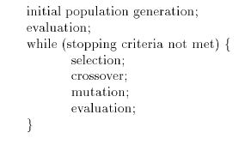
Scheduling Heuristics
Genetic Algorithm
General steps of GA

Slide 40
GA
Operates 200 chromosomes. A chromosome represents a mapping of task to machines, a vector of size t.
Initial population – 200 chromosomes randomly generated with 1 Min-Min seed
Evaluation – initial population evaluated based on fitness value (makespan)
Selection –
  Roulette wheel – probabilistically generate new population, with better mappings, from previous population
  Elitism – guaranteeing that the best solution (fittest) is carried forward

Slide 41
GA - Roulette wheel scheme
Chromosomes 1 2 3 4
Score 4 10 14 2
Probability of 0.13 0.33 0.47 0.07
selection
Select a random number, r, between 0 and 1.
Progressively add the probabilities until the sum is greater than r

Slide 42
GA
Crossover
  Choose pairs of chromosomes.
  For every pair
    Choose a random point
    exchange machine assignments from that point till the end of the chromosome
Mutation. For every chromosome:
  Randomly select a task
  Randomly reassign it to new machine
Evaluation
Stopping criterion:
  Either 1000 iterations or
  No change in elite chromosome for 150 iterations

Slide 43

Simulated Annealing
The procedure is similar to metal annealing/formation process
Poorer solutions accepted with a probability that depends on temperature value
Initial mapping; Initial temperature – initial makespan
Each iteration:
  Generate new mapping based on mutation of prev. mapping. Obtain new makespan
  If new makespan better, accept
  If new makespan worse, accept if a random number z in [0,1] > y where
  Reduce temperature by 10%

Slide 44
Tabu search
Keeps track of regions of solution space that have already been searched
Starts with a random mapping
Generate all possible pairs of tasks, (i,j), t in (0, t-1) and j in (i+1, t)
i and j’s machine assignments are exchanged (short hop) and makespan evaluated
If makespan better (successful short hop), search begins from i=0, else search continues from previous (i,j)

Slide 45
Tabu search
Continue until 1200 successful short hops or all pairs have been evaluated
Add final mapping to tabu list. The list keeps track of solution space searched
A new random mapping generated that differs from solution space by atleast half the machine assignments (long hop)
Search continued until fixed number of short and long hops

