Slide 1
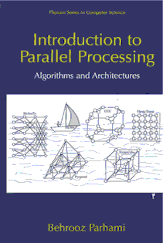
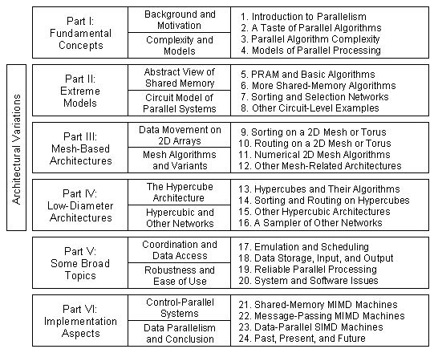
Part V
Some Broad Topic

Slide 2
About This Presentation
This presentation is intended to support the use of the textbook Introduction to Parallel Processing: Algorithms and Architectures (Plenum Press, 1999, ISBN 0-306-45970-1). It was prepared by the author in connection with teaching the graduate-level course
ECE 254B: Advanced Computer Architecture: Parallel Processing, at the University of California, Santa Barbara. Instructors can use these slides in classroom teaching and for other educational purposes. Any other use is strictly prohibited. © Behrooz Parhami
Edition | Released | Revised | Revised | Revised
First | Spring 2005 | Spring 2006 | Fall 2008 | Fall 2010
 |  | Winter 2013 | Winter 2014 | Winter 2016
 |  | Winter 2019* | Winter 2021*
*Chapters 17-18 only

Slide 3
V Some Broad Topics
Study topics that cut across all architectural classes:
  Mapping computations onto processors (scheduling)
  Ensuring that I/O can keep up with other subsystems
  Storage, system, software, and reliability issues
Topics in This Part
Chapter 17 Emulation and Scheduling
Chapter 18 Data Storage, Input, and Output
Chapter 19 Reliable Parallel Processing
Chapter 20 System and Software Issues

Slide 4
17 Emulation and Scheduling
Mapping an architecture or task system onto an architecture
  Learn how to achieve algorithm portability via emulation
  Become familiar with task scheduling in parallel systems
Topics in This Chapter
17.1 Emulations Among Architectures
17.2 Distributed Shared Memory
17.3 The Task Scheduling Problem
17.4 A Class of Scheduling Algorithms
17.5 Some Useful Bounds for Scheduling
17.6 Load Balancing and Dataflow Systems

Slide 5
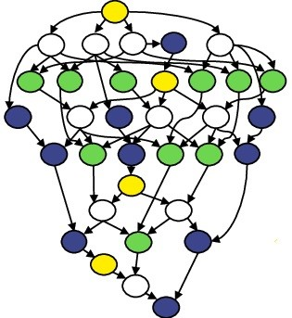
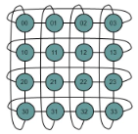
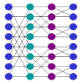
17.1 Emulations Among Architectures
Need for scheduling:
a. Assign tasks to compute nodes so as to optimize system performance
b. The goal of scheduling is to make best use of nodes and links
c. Once derived, schedules may be adjusted via load balancing
Task graph
Architecture 1
Architecture 2
Scheduling
Emulation
Usefulness of emulation:
a. Develop algorithms/schedules quickly for a new architecture
b. Program/schedule on a user-friendly architecture, then emulate it
c. Show versatility of a new architecture by emulating the hypercube on it

Slide 6
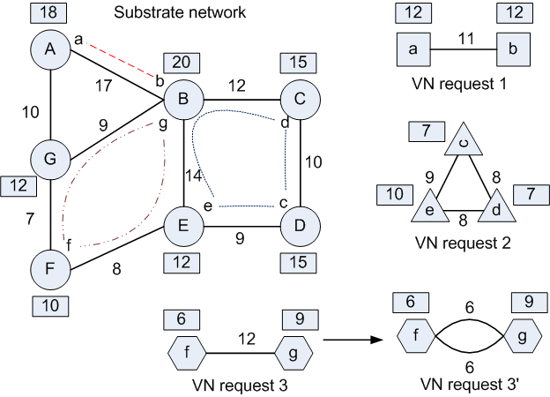
Virtual Network Embedding (VNE)
VN requests & substrate net:
Topologies
Nodes, capacities
Links, capacities
VNE algorithm:
Map VN nodes to substrate nodes
Map VN links to substrate links/paths
Observe limits
Optimize
Image source: “FELL: A Flexible Virtual Network Embedding
Algorithm with Guaranteed Load Balancing,” Proc. ICC, 2011

Slide 7
Simple Emulation Results
Architecture 1: Guest
Architecture 2: Host
We saw, for example, that a 2^{q}-node hypercube has the 2^{q}-node cycle as a subgraph (is Hamiltonian), but not a balanced binary tree with 2^{q} – 1 nodes
Emulation
Two general emulation results:
1. Emulation via graph embedding
Slowdown ≤ dilation × congestion × load factor
Example: K₂ emulating K_{p}
In general, the effects are not multiplicative
Load factor = p/2
Congestion = p²/4
Dilation = 1
2. PRAM emulating a degree-d network
EREW PRAM can emulate any degree-d network with slowdown O(d)

Slide 8
Versatility of the Butterfly Network
A (wrapped) butterfly can emulate any degree-d network with O(d log p) slowdown
Thus, butterfly is a bounded-degree network that is universally efficient
Fig. 17.1 Converting a routing step in a degree-3 network to three permutations or perfect matchings.
Idea used in proof:
One communication step in a degree-d network can be decomposed into at most d permutation routing steps

Slide 9
17.2 Distributed Shared Memory
Randomized emulation of the
p-processor PRAM on p-node butterfly
Use hash function to map memory locations to modules
p locations → p modules,
not necessarily distinct
With high probability, at most O(log p) of the p locations will be in modules located in the same row
Average slowdown = O(log p)
Fig. 17.2 Butterfly distributed-memory machine emulating the PRAM.

Slide 10
PRAM Emulation with Butterfly MIN
Emulation of the p-processor PRAM on (p log p)-node butterfly, with memory modules and processors connected to the two sides; O(log p) avg. slowdown
Less efficient than Fig. 17.2, which uses a smaller butterfly
By using p / (log p) physical processors to emulate the
p-processor PRAM, this new emulation scheme becomes quite efficient (pipeline the memory accesses of the log p virtual processors assigned to each physical processor)
Fig. 17.3 Distributed-memory machine, with a butterfly multistage interconnection network, emulating the PRAM.

Slide 11
Deterministic Shared-Memory Emulation
Deterministic emulation of p-processor PRAM on p-node butterfly
Store log₂ m copies of each of the m memory location contents
Time-stamp each updated value
A “write” is complete once a majority of copies are updated
A “read” is satisfied when a majority of copies are accessed and the one with latest time stamp is used
Why it works: A few congested links won’t delay the operation
Write set
Read set
log₂ m copies

Slide 12
PRAM Emulation Using Information Dispersal
Instead of (log m)-fold replication of data, divide each data element into k pieces and encode the pieces using a redundancy factor of 3, so that any k / 3 pieces suffice for reconstructing the original data
Fig. 17.4 Illustrating the information dispersal approach to PRAM emulation with lower data redundancy.

Slide 13
17.3 The Task Scheduling Problem
Task scheduling parameters
and “goodness” criteria
Running times for tasks
Creation (static / dynamic)
Importance (priority)
Relationships (precedence)
Start times (release times)
End times (deadlines)
Types of scheduling algorithms
Preemptive/nonpreemptive, fine/medium/coarse grain
Fig. 17.5 Example task system showing communications or dependencies.

Slide 14
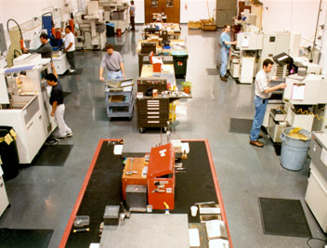
Job-Shop Scheduling
8
Ta2
S
t
a
f
f
6
Tb1
Tc1
4
Td1
Td2
Ta1
Tb2
2
Tb3
0
0
2
4
6
8
10
12
14
Time
Job Task Machine Time Staff
Ja Ta1 M1 2 3
Ja Ta2 M3 6 2
Jb Tb1 M2 5 2
Jb Tb2 M1 3 3
Jb Tb3 M2 3 2
Jc Tc1 M3 4 2
Jd Td1 M1 5 4
Jd Td2 M2 2 1
8
S
t
a
f
f
6
Ta2
Tc1
Ta1
4
Td1
Td2
Tb2
2
Tb1
Tb3
M1 M2 M3
0
0
2
4
6
8
10
12
14
Time
Notes:
Static scheduling: all tasks and resources are known in advance

Slide 15
Schedule Refinement
8
S
t
a
f
f
6
Ta2
Tc1
Ta1
4
Td1
Td2
Tb2
2
Tb1
Tb3
Switch?
0
0
2
4
6
8
10
12
14
Time
Job Task Machine Time Staff
Ja Ta1 M1 2 3
Ja Ta2 M3 6 2
Jb Tb1 M2 5 2
Jb Tb2 M1 3 3
Jb Tb3 M2 3 2
Jc Tc1 M3 4 2
Jd Td1 M1 5 4
Jd Td2 M2 2 1
8
S
t
a
f
f
6
Tb3
Tc1
Ta1
Ta2
4
Td1
Tb2
2
Tb1
M1 M2 M3
0
Td2
0
2
4
6
8
10
12
14
Time
Notes:
Static scheduling: all tasks and resources are known in advance

Slide 16
Complexity of Scheduling Problems
Most scheduling problems, even with 2 processors, are NP-complete
Easy, or tractable (polynomial-time), cases include:
1. Unit-time tasks, with 2 processors
2. Task graphs that are forests, with any number of processors
Surprisingly hard, or intractable, cases include:
1. Tasks of running time 1 or 2, with 2 processors (nonpreemptive)
2. Unit-time tasks on 3 or more processors
Many practical scheduling problems are solved by heuristics
Heuristics typically have decision parameters that can be tuned to make them suitable for a particular application context
The scheduling literature is full of different heuristics and experimental studies of their performance in different domains

Slide 17
17.4 A Class of Scheduling Algorithms
List scheduling
Assign a priority level to each task
Construct task list in priority order; tag tasks that are ready for execution
At each step, assign to an available processor the first tagged task
Update the tags upon each task termination
With identical processors, list schedulers differ only in priority assignment
A possible priority assignment scheme for list scheduling:
1. Find the depth T∞ of the task graph (indicator of min possible exec time)
2. Take T∞ as a goal for the running time T_{p}
3. Determine the latest time when each task can be started if our goal is to be met (done by “layering” the nodes, beginning with the output node)
4. Assign task priorities in order of the latest possible times, breaking ties, e.g., by giving priority to tasks with more descendants

Slide 18
List Scheduling Example
1
1
A possible priority assignment scheme:
1. Find the depth T∞ of the task graph
2. Take T∞ as a goal for the running time T_{p}
3. Determine the latest possible start times
4. Assign priorities in order of latest times
2
2
3
3
4
4
6
5
T∞ = 8 (execution time goal)
Latest start times: see the layered diagram
Priorities: shown on the diagram in red
8
7
5
10
6
11
9
In this particular example, the tie-breaking rule of giving priority to a task with more descendants is of no help, but generally it leads to improvement in execution time
12
7
8
13

Slide 19
Assignment to Processors
1
1
Tasks listed in priority order
1* 2 3 4 6 5 7 8 9 10 11 12 13 t = 1 v₁ scheduled
2* 3 4 6 5 7 8 9 10 11 12 13 t = 2 v₂ scheduled
2
2
3
3
4
4
6
5
8
7
5
10
6
11
9
12
7
Fig. 17.6 Schedules with p = 1, 2, 3 processors for an example task graph with unit-time tasks.
8
13

Slide 20
Scheduling with Non-Unit-Time Tasks
1
1
3
3
2
4
4
5
5
6
7
Fig. 17.8 Schedules with p = 1, 2, 3 processors for an example task graph with nonuniform running times.
Fig. 17.7 Example task system with task running times of 1, 2, or 3 units.

Slide 21
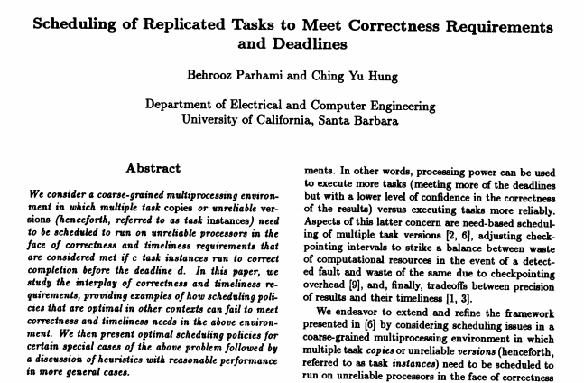
Fault-Tolerant Scheduling
Tasks, or nodes on which they run, may have imperfect reliabilities
[This topic to be developed further]
[Reference 2]
[Reference 1]
B. Parhami,
"A Unified Approach to Correctness and Timeliness Requirements for Ultrareliable Concurrent Systems,"
Proc. 4th Int'l Parallel Processing Symp.,
April 1990,
pp. 733-747.

Slide 22
17.5 Some Useful Bounds for Scheduling
Brent’s scheduling theorem: T_{p} < T∞ + T₁/p
In other words, one can always schedule a task graph so that the total running time does not exceed the best possible (T₁/p) by more than the depth of the task graph (T∞ )
Ideal run time
Ideal speedup
T₁
(Size of task graph)
T∞ (Depth of task graph)
Lower bound on speedup based on Brent’s scheduling theorem:
S > T₁ / (T∞ + T₁/p) = p / (1 + pT∞ / T₁)
[Compare to Amdahl’s law]
A large T∞ / T₁ ratio indicates much sequential dependency (Amdahl’s f)

Slide 23
Proof of Brent’s Theorem: T_{p} < T∞ + T₁/p
First assume the availability of an unlimited number of processors and schedule each node at the earliest possible time
n₁ = 1
1
n₂ = 1
2
Let there be n_{t} nodes scheduled at time t ; Clearly, ∑_{t} n_{t} = T₁
3
n₃ = 1
4
With only p processors, tasks scheduled for time step t can be executed in ⎡n_{t} / p⎤ steps by running them p at a time. Thus:
T_{p} ≤ ∑_{t = 1 to T∞} ⎡n_{t} / p⎤
< ∑_{t = 1 to T∞} (n_{t} / p + 1)
= T∞ + (∑_{t} n_{t})/p
= T∞ + T₁/p
n₄ = 3
5
n₅ = 3
6
7
n₆ = 2
n₇ = 1
8
n₈ = 1

Slide 24
Good-News Corollaries
Brent’s scheduling theorem: T_{p} < T∞ + T₁/p
Ideal run time
Ideal speedup
Corollary 1: For p ≥ T₁/T∞ we have T∞ ≤ T_{p} < 2T∞
T₁/p ≤ T∞ For a sufficiently large number p of processors, we can come within a factor of 2 of the best possible run time, even when we use a naïve scheduling algorithm
Corollary 2: For p ≤ T₁/T∞ we have T₁/p ≤ T_{p} < 2T₁/p
T∞ ≤ T₁/p If we do not have too many processors,
we can come within a factor of 2 of the best possible speedup,
even when we use a naïve scheduling algorithm
Choosing p ≅ T₁/T∞ leads to O(p) speedup and near-minimal run time

Slide 25
ABCs of Parallel Processing in One Slide
A Amdahl’s Law (Speedup Formula)
Bad news – Sequential overhead will kill you, because:
Speedup = T₁/T_{p} ≤ 1/[f + (1 – f)/p] ≤ min(1/f, p)
Morale: For f = 0.1, speedup is at best 10, regardless of peak OPS.
B Brent’s Scheduling Theorem
Good news – Optimal scheduling is very difficult, but even a naïve
scheduling algorithm can ensure:
T₁/p ≤ T_{p} < T₁/p + T∞ = (T₁/p)[1 + p/(T₁/T∞)]
Result: For a reasonably parallel task (large T₁/T∞), or for a suitably
small p (say, p < T₁/T∞), good speedup and efficiency are possible.
C Cost-Effectiveness Adage
Real news – The most cost-effective parallel solution may not be
the one with highest peak OPS (communication?), greatest speed-up
(at what cost?), or best utilization (hardware busy doing what?).
Analogy: Mass transit might be more cost-effective than private cars
even if it is slower and leads to many empty seats.

Slide 26
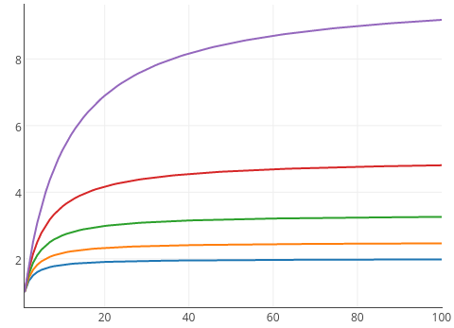
Cost-Effectiveness Adage in Parallel Processing
The most cost-effective parallel solution may not be the one with
- Highest peak OPS (communication?)
- Greatest speed-up (at what cost?)
- Best utilization (hardware busy doing what?)
Why peak ops isn’t a good measure
- 100 PFLOPS peak
- 10 PFLOPS
sustained
Speedup s
f = 0.9
High performance
Cost-effective
f = 0.8
Utilization analogy:
- Bus, 10 riders,
50 seats
- Auto, 2 riders,
5 seats
f = 0.7
f = 0.6
f = 0.5
Processors p

Slide 27
17.6 Load Balancing and Dataflow Systems
Task running times are not constants
A processor may run out of things to do before others complete their tasks
Some processors may remain idle, waiting to hear about prerequisite tasks
In these cases, a load balancing policy may be applied
Dynamic load balancing: Switching unexecuted tasks from overloaded processors to less loaded ones, as we learn about execution times and task interdependencies at run time
Load balancing can be initiated by a lightly loaded or by an overburdened processor (receiver/sender-initiated)
Unfortunately, load balancing may involve significant overhead
The ultimate in automatic load-balancing is a self-scheduling system that tries to keep all processing resources running at maximum efficiency
There may be a central location to which processors refer for work and where they return their results
An idle processor requests that it be assigned new work by the supervisor
This works nicely for tasks with small contexts or relatively long run times

Slide 28
Dataflow Systems
Hardware-level implementation of a self-scheduling scheme
Computation represented by a dataflow graph
Tokens used to keep track of data availability
Once tokens appear on all inputs, node is “fired,” resulting in tokens being removed from its inputs and put on each output
Static dataflow: No more than one token on edge
Dynamic dataflow: Multiple tagged tokens on edges; “consumed” after matching their tags
Fig. 17.9 Example dataflow graph with token distribution at the outset (left) and after 2 time units (right).

Slide 29
18 Data Storage, Input, and Output
Elaborate on problems of data distribution, caching, and I/O:
  Deal with speed gap between processor and memory
  Learn about parallel input and output technologies
Topics in This Chapter
18.1 Data Access Problems and Caching
18.2 Cache Coherence Protocols
18.3 Multithreading and Latency Hiding
18.4 Parallel I/O Technology
18.5 Redundant Disk Arrays
18.6 Interfaces and Standards

Slide 30
18.1 Data Access Problems and Caching
Processor-memory speed gap is aggravated by parallelism
Centralized memory is slower; distributed memory needs remote accesses
Remedies: Judicious data distribution –- good with static data sets
Data caching –- introduces coherence problems
Latency tolerance / hiding –- e.g., via multithreading
Fig. 17.8 of Parhami’s Computer Architecture text (2005)

Slide 31
Why Data Caching Works
Hit rate r (fraction of memory accesses satisfied by cache)
C_{eff} = C_{fast} + (1 – r)C_{slow}
Cache parameters:
Size
Block length (line width)
Placement policy
Replacement policy
Write policy
Fig. 18.1 Data storage and access in a two-way set-associative cache.

Slide 32
Benefits of Caching Formulated as Amdahl’s Law
Hit rate r (fraction of memory accesses satisfied by cache)
C_{eff} = C_{fast} + (1 – r)C_{slow}
S = C_{slow} / C_{eff}
1
=
(1 – r) + C_{fast}/C_{slow}
Fig. 18.3 of Parhami’s Computer Architecture text (2005)
This corresponds to the miss-rate fraction 1 – r of accesses being unaffected
and the hit-rate fraction r (almost 1) being speeded up by a factor C_{slow}/C_{fast}
Generalized form of Amdahl’s speedup formula:
S = 1/(f₁/p₁ + f₂/p₂ + . . . + f_{m}/p_{m}), with f₁ + f₂ + . . . + f_{m} = 1
In this case, a fraction 1 – r is slowed down by a factor (C_{slow} + C_{fast}) / C_{slow}, and a fraction r is speeded up by a factor C_{slow} / C_{fast}

Slide 33
18.2 Cache Coherence Protocols
Fig. 18.2 Various types of cached data blocks in a parallel processor with global memory and processor caches.

Slide 34
Example: A Bus-Based Snoopy Protocol
Each transition is labeled with the event that triggers it, followed by the action(s) that must be taken
Fig. 18.3 Finite-state control mechanism for a bus-based snoopy cache coherence protocol.

Slide 35
Implementing a Snoopy Protocol
A second tags/state storage unit allows snooping to be done concurrently with normal cache operation
Getting all the implementation timing and details right is nontrivial
Fig. 27.7 of Parhami’s Computer Architecture text.

Slide 36
Example: A Directory-Based Protocol
sharing set +
Correction to text
Fig. 18.4 States and transitions for a directory entry in a directory-based coherence protocol (c denotes the cache sending the message).

Slide 37
Implementing a Directory-Based Protocol
0
1
0
0
0
1
0
0
0
0
0
0
0
0
0
0
0
0
1
1
0
0
0
0
0
0
0
1
0
0
0
0
Sharing set implemented as a bit-vector (simple, but not scalable)
When there are many more nodes (caches) than the typical size of a sharing set, a list of sharing units may be maintained in the directory
The sharing set can be maintained as a distributed doubly linked list
(will discuss in Section 18.6 in connection with the SCI standard)

Slide 38
18.3 Multithreading and Latency Hiding
Latency hiding: Provide each processor with useful work to do as
it awaits the completion of memory access requests
Multithreading is one way to implement latency hiding
Fig. 18.5 The concept of multithreaded parallel computation.

Slide 39
Multithreading on a Single Processor
Here, the motivation is to reduce the performance impact of data dependencies and branch misprediction penalty
Fig. 24.9 of Parhami’s Computer Architecture text (2005)

Slide 40
18.4 Parallel I/O Technology
Fig. 18.6 Moving-head magnetic disk elements.
Comprehensive info about disk memory: http://www.storageview.com/guide/

Slide 41
Access Time for a Disk
Average rotational latency =
30 000 / rpm (in ms)
Data transfer time =
Bytes / Data rate
Seek time =
a + b(c – 1)
+ β(c – 1)^{1/2}
The three components of disk access time. Disks that spin faster have a shorter average and worst-case access time.

Slide 42
Amdahl’s Rules of Thumb for System Balance
The need for high-capacity, high-throughput secondary (disk) memory
Processor speed | RAM size | Disk I/O rate | Number of disks | Disk capacity | Number of disks
1 GIPS | 1 GB | 100 MB/s | 1 | 100 GB | 1
1 TIPS | 1 TB | 100 GB/s | 1000 | 100 TB | 100
1 PIPS | 1 PB | 100 TB/s | 1 Million | 100 PB | 100 000
1 EIPS | 1 EB | 100 PB/s | 1 Billion | 100 EB | 100 Million
G Giga
T Tera
P Peta
E Exa
1 RAM byte
for each IPS
1 I/O bit per sec
for each IPS
100 disk bytes
for each RAM byte

Slide 43
Growing Gap Between Disk and CPU Performance
From Parhami’s computer architecture textbook, Oxford, 2005
Fig. 20.11 Trends in disk, main memory, and CPU speeds.

Slide 44
Head-Per-Track Disks
Multiple sets of head reduce rotational latency
Dedicated track heads eliminate seek time (replace it with activation time for a head)
Fig. 18.7 Head-per-track disk concept.

Slide 45
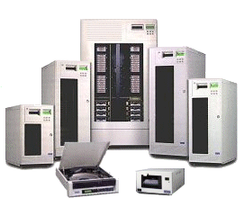

18.5 Redundant Disk Arrays
High capacity
(many disks)
High reliability
(redundant data, back-up disks)
High bandwidth
(parallel accesses)
IBM ESS Model 750

Slide 46
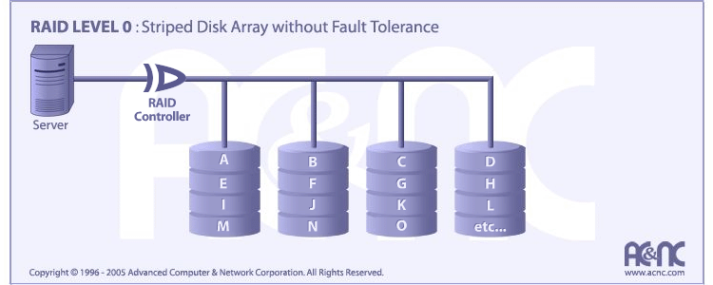
RAID Level 0
http://www.acnc.com/
Structure:
Striped (data broken into blocks & written to separate disks)
Advantages:
Spreads I/O load across many channels and drives
Drawbacks:
No fault tolerance
(data lost with single disk failure)

Slide 47
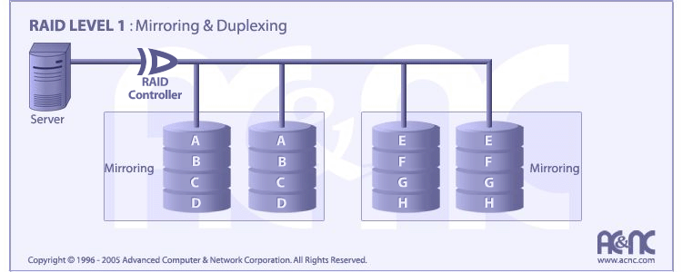
RAID Level 1
http://www.acnc.com/
Structure:
Each disk replaced by a mirrored pair
Advantages:
Can double the read
transaction rate
No rebuild required
Drawbacks:
Overhead is 100%

Slide 48
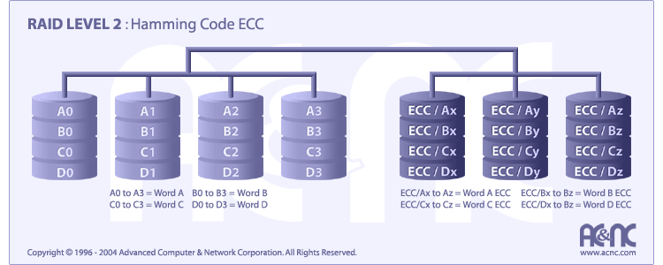
RAID Level 2
http://www.acnc.com/
Structure:
Data bits are written to separate disks and ECC bits to others
Advantages:
On-the-fly correction
High transfer rates
possible (w/ sync)
Drawbacks:
Potentially high
redundancy
High entry-level cost

Slide 49
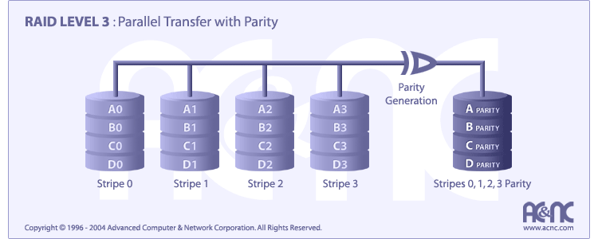
RAID Level 3
http://www.acnc.com/
Structure:
Data striped across several disks, parity provided on another
Advantages:
Maintains good throughput even when a disk fails
Drawbacks:
Parity disk forms a
bottleneck
Complex controller

Slide 50

RAID Level 4
http://www.acnc.com/
Structure:
Independent blocks on multiple disks share a parity disk
Advantages:
Very high read rate
Low redundancy
Drawbacks:
Low write rate
Inefficient data rebuild

Slide 51
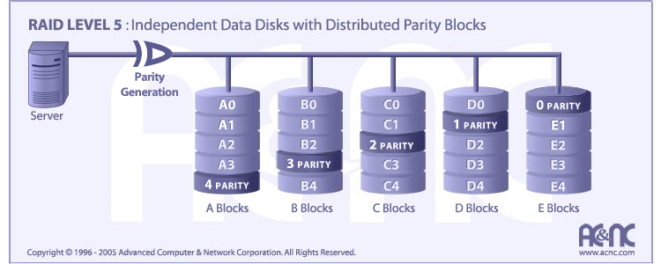
RAID Level 5
http://www.acnc.com/
Structure:
Parity and data blocks distributed on multiple disks
Advantages:
Very high read rate
Medium write rate
Low redundancy
Drawbacks:
Complex controller
Difficult rebuild

Slide 52
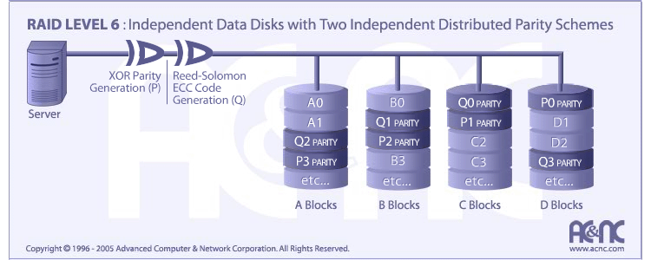
RAID Level 6
http://www.acnc.com/
Structure:
RAID Level 5, extended with second parity check scheme
Advantages:
Tolerates 2 failures
Protected even during
recovery
Drawbacks:
More complex
controller
Greater overhead

Slide 53
RAID Summary
Fig. 18.8 Alternative data organizations on redundant disk arrays.

Slide 54
RAID Performance Considerations
Parity updates may become a bottleneck, because the parity changes with every write, no matter how small
Computing sector parity for a write operation:
New parity = New data ⊕ Old data ⊕ Old parity

Slide 55
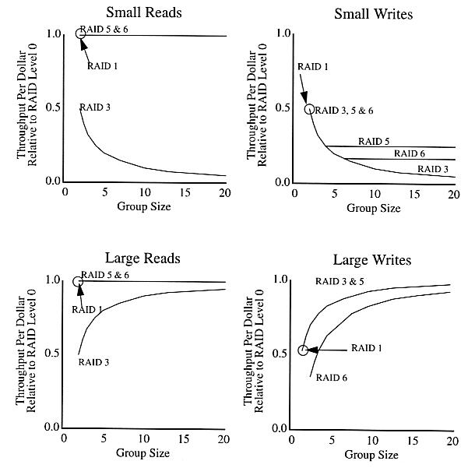
RAID Tradeoffs
Source: Chen, Lee, Gibson, Katz, and Patterson, “RAID:
High-Performance Reliable Secondary Storage,”
ACM Computing Surveys, 26(2):145-185, June 1994.
RAID5 and RAID 6 impose little penalty on read operations
In choosing group size, balance must be struck between the decreasing penalty for small writes
vs. increasing penalty
for large writes

Slide 56
18.6 Interfaces and Standards
The Scalable Coherent Interface (SCI) standard: Allows the implementation of large-scale cache-coherent parallel systems (see Section 21.6 for a parallel computer based on SCI)
Fig. 18.9 Two categories of data blocks and the structure of the sharing set in the Scalable Coherent Interface.

Slide 57
Other Interface Standards
High-Performance Parallel Interface (HiPPI) ANSI standard:
Allows point-to-point connectivity between two devices
(typically a supercomputer and a peripheral)
Data rate of 0.8 or 1.6 Gb/s over a (copper) cable of 25m or less
Uses very wide cables with clock rate of only 25 MHz
Establish, then tear down connections (no multiplexing allowed)
Packet length ranges from 2 B to 4 GB, up to 1016 B of control info
HiPPI (later versions renamed GSN, or gigabyte system network) is no longer in use and has been superseded by new, even faster standards such as Ultra3 SCSI and Fibre Channel
Modern interfaces tend to have fewer wires with faster clock rates

Slide 58
19 Reliable Parallel Processing
Develop appreciation for reliability issues in parallel systems:
  Learn methods for dealing with reliability problems
  Deal with all abstraction levels: components to systems
Topics in This Chapter
19.1 Defects, Faults, . . . , Failures
19.2 Defect-Level Methods
19.3 Fault-Level Methods
19.4 Error-Level Methods
19.5 Malfunction-Level Methods
19.6 Degradation-Level Methods

Slide 59
19.1 Defects, Faults, . . . , Failures
Opportunities for fault tolerance in parallel systems:
Built-in spares, load redistribution, graceful degradation
Difficulties in achieving fault tolerance:
Change in structure, bad units disturbing good ones
The multilevel model of dependable computing
Abstraction level Dealing with deviant
Defect / Component Atomic parts
Fault / Logic Signal values or decisions
Error / Information Data or internal states
Malfunction / System Functional behavior
Degradation / Service Performance
Failure / Result Outputs or actions
Fig. 19.1 System states and state transitions in our multilevel model.

Slide 60
Analogy for the Multilevel Model
Many avoidance and tolerance methods are applicable to more than one level, but we deal with them at the level for which they are most suitable, or at which they have been most successfully applied
Fig. 19.2 An analogy for the multilevel model of dependable computing.

Slide 61
19.2 Defect-Level Methods
Defects are caused in two ways (sideways and downward transitions into the defective state):
a. Design slips leading to defective components
b. Component wear and aging, or harsh
operating conditions (e.g., interference)
A dormant (ineffective) defect is very hard to detect
Methods for coping with defects during dormancy:
Periodic maintenance
Burn-in testing
Goal of defect tolerance methods:
Improving the manufacturing yield
Reconfiguration during system operation

Slide 62
Defect Tolerance Schemes for Linear Arrays
Fig. 19.3 A linear array with a spare processor and reconfiguration switches.
Fig. 19.4 A linear array with a spare processor and embedded switching.

Slide 63
Defect Tolerance in 2D Arrays
Fig. 19.5 Two types of reconfiguration switching for 2D arrays.
Assumption: A malfunctioning processor can be bypassed in its row/column by means of a separate switching mechanism (not shown)

Slide 64
A Reconfiguration Scheme for 2D Arrays
Fig. 19.6 A 5 × 5 working array salvaged from a 6 × 6 redundant mesh through reconfiguration switching.
Fig. 19.7 Seven defective processors and their associated compensation paths.

Slide 65
Limits of Defect Tolerance
A set of three defective nodes, one of which cannot be accommodated by the compensation-path method.
Extension: We can go beyond the 3-defect limit by providing spare rows on top and bottom and spare columns on either side

Slide 66
19.3 Fault-Level Methods
Faults are caused in two ways (sideways and downward transitions into the faulty state):
a. Design slips leading to incorrect logic circuits
b. Exercising of defective components, leading
to incorrect logic values or decisions
Classified as permanent / intermittent / transient, local / catastrophic, and dormant / active
Faults are detected through testing:
Off-line (initially, or periodically in test mode)
On-line or concurrent (self-testing logic)
Goal of fault tolerance methods:
Allow uninterrupted operation in the presence of
faults belonging to a given class (fault model)

Slide 67
Fault Tolerance via Replication
Hardware replication:
Duplication with comparison
Pair and spare
Triplication with voting
These schemes involve high redundancy (100 or 200%)
Lower redundancy possible in some cases: e.g., periodic balanced sorting networks can tolerate certain faults if provided with extra stages
Fig. 19.8 Fault detection or tolerance with replication.

Slide 68
Fault Detection and Bypassing
Fig. 19.9 Regular butterfly and extra-stage butterfly networks.

Slide 69
19.4 Error-Level Methods
Errors are caused in two ways (sideways and downward transitions into the erroneous state):
a. Design slips leading to incorrect initial state
b. Exercising of faulty circuits, leading to
deviations in stored values or machine state
Classified as single / multiple, inversion / erasure, random / correlated, and symmetric / asymmetric
Errors are detected through:
Encoded (redundant) data, plus code checkers
Reasonableness checks or activity monitoring
Goal of error tolerance methods:
Allow uninterrupted operation in the presence of
errors belonging to a given class (error model)

Slide 70
Application of Coding to Error Control
Ordinary codes can be used for storage and transmission errors; they are not closed under arithmetic / logic operations
Error-detecting, error-correcting, or combination codes (e.g., Hamming SEC/DED)
Arithmetic codes can help detect
(or correct) errors during data manipulations:
1. Product codes (e.g., 15x)
2. Residue codes (x mod 15)
Fig. 19.10 A common way of applying information coding techniques.

Slide 71
Algorithm-Based Error Tolerance
Error coding applied to data structures, rather than at the level of atomic data elements
Example: mod-8 checksums used for matrices
Matrix M
Row checksum matrix
2
1
6
2
1
6
1
M =
5
3
4
M _{r} =
5
3
4
4
If Z = X × Y then Z_{f} = X_{c} × Y_{r}
3
2
7
3
2
7
4
Column checksum matrix
Full checksum matrix
In M_{f}, any single error is correctable and any 3 errors are detectable
2
1
6
2
1
6
1
5
3
4
5
3
4
4
M _{c} =
M _{f} =
3
2
7
3
2
7
4
Four errors may go undetected
2
6
1
2
6
1
1

Slide 72
19.5 Malfunction-Level Methods
Malfunctions are caused in two ways (sideways and downward transitions into the malfunctioning state):
a. Design slips leading to incorrect modules
b. Propagation of errors to outside the module
boundary, leading to incorrect interactions
Module or subsystem malfunctions are sometimes referred to as system-level “faults”
Malfunctions are identified through diagnosis:
Begin with a trusted fault-free core, and expand
Process diagnostic data from multiple sources
Goal of malfunction tolerance methods:
Allow uninterrupted (possibly degraded) operation
in the presence of certain expected malfunctions

Slide 73
Malfunction Diagnosis in Parallel Systems
In a p-processor system in which processors can test each other, the diagnosis information can be viewed as a p × p matrix of test outcomes
(D_{ij} represents the assessment of process i regarding processor j)
Assume that a healthy processor can reliably indicate the status of another processor, but that a malfunctioning processor cannot be trusted
p₀ considers p₃ malfunctioning
The given matrix D is consistent with two conclusions:
1. Only P₃ is
malfunctioning
2. Only P₃ is healthy
p₄ considers p₀ healthy
Fig. 19.11 A testing graph and the resulting diagnosis matrix.

Slide 74
Diagnosability Models and Reconfiguration
Problem: Given a diagnosis matrix, identify:
1. All malfunctioning units (complete diagnosability)
2. At least one malfunctioning unit (sequential diagnosability)
3. A subset of processors guaranteed to contain all malfunctioning ones
The last option is useful only if the designated subset is not much larger than the set of malfunctioning modules
When one or more malfunctioning modules have been identified, the system must be reconfigured to allow it to function without the unavailable resources. Reconfiguration may involve:
1. Recovering state info from removed modules or from back-up storage
2. Reassigning tasks and reallocating data
3. Restarting the computation at the point of interruption or from scratch
In bus-based systems, we isolate the bad modules and proceed; otherwise, we need schemes similar to those used for defect tolerance

Slide 75
Malfunction Tolerance with Low Redundancy
The following scheme uses only one spare processor for a 2D mesh (no increase in node degree), yet it allows system reconfiguration to circumvent any malfunctioning processor, replacing it with the spare via relabeling of the nodes
Fig. 19.12 Reconfigurable 4 × 4 mesh with one spare.

Slide 76
19.6 Degradation-Level Methods
Degradations are caused in two ways (sideways and downward transitions into the degraded state):
a. Design slips leading to substandard modules
b. Removal of malfunctioning modules, leading
to fewer computational resources
A system that can degrade “gracefully” is fail-soft; otherwise it is fail-hard
Graceful degradation has two key requirements:
System: Diagnosis and reconfiguration
Application: Scalable and robust algorithms
Goal of degradation tolerance methods:
Allow continued operation while malfunctioning
units are repaired (hot-swap capability is a plus)

Slide 77
Fail-Hard and Fail-Soft Systems
Fail-hard system with performance P_{max} up to the failure time t₁ as well as after off-line repair at time t'₁
Fail-soft system with gradually degrading performance level and with off-line or on-line repair capability
Fig. 19.13 Performance variations in three example parallel computers.

Slide 78
Checkpointing for Recovery from Malfunctions
Periodically save partial results and computation state in stable storage
Upon detected malfunction, roll back the computation to last checkpoint
Figure 19.14 Checkpointing, its overhead, and pitfalls.

Slide 79
The Robust Algorithm Approach
Scalable mesh algorithm: Can run on different mesh sizes
Robust mesh algorithm: Can run on incomplete mesh, with its performance degrading gracefully as the number of unavailable nodes increases
Figure 19.15 Two types of incomplete meshes, with and without bypass links.

Slide 80
The End of the Line: System Failure
Failures are caused in two ways (sideways and downward transitions into the failed state):
a. It is hard to believe, but some systems do not
work as intended from the outset
b. Degradation beyond an acceptable threshold
It is instructive to skip a level and relate failures of a gracefully degrading system directly to malfunctions
Then, failures can be attributed to:
1. Isolated malfunction of a critical subsystem
2. Catastrophic malfunctions (space-domain)
3. Accumulation of malfunctions (time-domain)
4. Resource exhaustion
Experimental studies have shown that the first two causes of failures are the most common

Slide 81
20 System and Software Issues
Fill void in covering system, software and application topics:
  Introduce interaction and synchronization issues
  Review progress in system and application software
Topics in This Chapter
20.1 Coordination and Synchronization
20.2 Parallel Programming
20.3 Software Portability and Standards
20.4 Parallel Operating Systems
20.5 Parallel File Systems
20.6 Hardware/Software Interaction

Slide 82
20.1 Coordination and Synchronization
Task interdependence is often more complicated than the simple prerequisite structure thus far considered
Fig. 20.1 Automatic synchronization in message-passing systems.

Slide 83
Synchronization with Shared Memory
Accomplished by accessing specially designated shared control variables
The fetch-and-add instruction constitutes a useful atomic operation
If the current value of x is c, fetch-and-add(x, a) returns c to the
process and overwrites x = c with the value c + a
A second process executing fetch-and-add(x, b) then gets the now current value c + a and modifies it to c + a + b
Why atomicity of fetch-and-add is important: With ordinary instructions, the 3 steps of fetch-and-add for A and B may be interleaved as follows:
Process A Process B Comments
Time step 1 read x A’s accumulator holds c
Time step 2 read x B’s accumulator holds c
Time step 3 add a A’s accumulator holds c + a
Time step 4 add b B’s accumulator holds c + b
Time step 5 store x x holds c + a
Time step 6 store x x holds c + b (not c + a + b)

Slide 84
Barrier Synchronization
Make each processor, in a designated set, wait at a barrier until all other processors have arrived at the corresponding points in their computations
Software implementation via fetch-and-add or similar instruction
Hardware implementation via an AND tree (raise flag, check AND result)
A problem with the AND-tree:
If a processor can be randomly delayed between raising it flag and checking the tree output, some processors might cross the barrier and lower their flags before others have noticed the change in the AND tree output
Solution: Use two AND trees for alternating barrier points
Fig. 20.4 Example of hardware aid for fast barrier synchronization [Hoar96].

Slide 85
Synchronization Overhead
Given that AND is a semigroup computation, it is only a small step to generalize it to a more flexible “global combine” operation
Reduction of synchronization overhead:
1. Providing hardware aid to do it faster
2. Using less frequent synchronizations
Fig. 20.3 The performance benefit of less frequent synchronization.

Slide 86
20.2 Parallel Programming
Some approaches to the development of parallel programs:
a. Automatic extraction of parallelism
b. Data-parallel programming
c. Shared-variable programming
d. Communicating processes
e. Functional programming
Examples of, and implementation means for, these approaches:
a. Parallelizing compilers
b. Array language extensions, as in HPF
c. Shared-variable languages and language extensions
d. The message-passing interface (MPI) standard
e. Lisp-based languages

Slide 87
Automatic Extraction of Parallelism
An ironic, but common, approach to using parallel computers:
Force naturally parallel computations into sequential molds by coding them in standard languages
Apply the powers of intelligent compilers to determine which of these artificially sequentialized computations can be performed concurrently
Parallelizing compilers extract parallelism from sequential programs, primarily through concurrent execution of loop iterations:
for i = 2 to k do
for j = 2 to k do
a_{i,j} : = (a_{i,j–1} + a_{i,j+1})/2
endfor
endfor
Various iteration of the i loop can be executed on a different processor with complete asynchrony due to their complete independence

Slide 88
Data-Parallel Programming
Has its roots in the math-based APL language that had array data types and array operations (binary and reduction operations on arrays)
C ← A + B {array add}
x ← + / V {reduction}
U ← + / V × W {inner product}
APL’s powerful operators allowed the composition of very complicated computations in a few lines (a write-only language?)
Fortran-90 (superset of Fortran-77) had extensions for array operations
A = SQRT(A) + B ** 2 {A and B are arrays}
WHERE (B /= 0) A = A / B
When run on a distributed-memory machine, some Fortran-90 constructs imply interprocessor communication
A = S/2 {assign scalar value to array}
A(I:J) = B(J:I:–1) {assign a section of B to A}
A(P) = B {A(P(I)) = B(I) for all I}
S = SUM(B) {may require gather operation}

Slide 89
Data-Parallel Languages
High Performance Fortran (HPF) extends Fortran-90 by:
Adding new directives and language constructs
Imposing some restrictions for efficiency reasons
HPF directives assist the compiler in data distribution, but do not alter the program’s semantics (in Fortran-90, they are interpreted as comments and thus ignored)
!HPF ALIGN A(I) WITH B(I + 2)
Data-parallel extensions have also been implemented for several other programming languages
C* language introduced in 1987 by TMC
pC++, based on the popular C++

Slide 90
Other Approaches to Parallel Programming
Shared-variable programming
Languages: Concurrent Pascal, Modula-2, Sequent C
Communicating processes
Languages: Ada, Occam
Language-independent libraries: MPI standard
Functional programming
Based on reduction and evaluation of expressions
There is no concept of storage, assignment, or branching
Results are obtained by applying functions to arguments
One can view a functional programming language as allowing only one assignment of value to each variable, with the assigned value maintained throughout the course of the computation

Slide 91
20.3 Software Portability and Standards
Portable parallel applications that can run on any parallel machine have been elusive thus far
Program portability requires strict adherence to design and specification standards that provide machine-independent views or logical models
Programs are developed according to these logical models and are then adapted to specific hardware by automatic tools (e.g., compilers)
HPF is an example of a standard language that, if implemented correctly, should allow programs to be easily ported across platforms
Two other logical models are: MPI and PVM

Slide 92
The Message Passing Interface (MPI) Standard
The MPI Forum, a consortium of parallel computer vendors and software development specialists, specified a library of functions that implement the message-passing model of parallel computation
MPI provides a high-level view of a message-passing environment that can be mapped to various physical systems
Software implemented using MPI functions can be easily ported among machines that support the MPI model
MPI includes functions for:
Point-to-point communication (blocking/nonblocking send/receive, …)
Collective communication (broadcast, gather, scatter, total exchange, …)
Aggregate computation (barrier, reduction, and scan or parallel prefix)
Group management (group construction, destruction, inquiry, …)
Communicator specification (inter-/intracommunicator construction,
destruction, …)
Virtual topology specification (various topology definitions, …)

Slide 93
The Parallel Virtual Machine (PVM) Standard
Software platform for developing and running parallel applications on a set of independent heterogeneous computers, variously interconnected
PVM defines a suite of user-interface primitives that support both the shared-memory and the message-passing programming paradigms
These primitives provide functions similar to those of MPI and are embedded within a procedural host language (usually Fortran or C)
A support process or daemon (PVMD) runs independently on each host, performing message routing and control functions
PVMDs perform the following functions:
Exchange network configuration information
Allocate memory to in-transit packets
Coordinate task execution on associated hosts
The available pool of processors may change dynamically
Names can be associated with groups or processes
Group membership can change dynamically
One process can belong to many groups
Group-oriented functions (bcast, barrier) take group names as arguments

Slide 94
20.4 Parallel Operating Systems
Classes of parallel processors:
Back-end, front-end, stand-alone
Back-end system: Host computer has a standard OS, and manages the parallel processor essentially like a coprocessor or I/O device
Front-end system: Similar to backend system, except that the parallel processor handles its own data (e.g., an array processor doing radar signal processing) and relies on the host computer for certain postprocessing functions, diagnostic testing, and interface with users
Stand-alone system: A special OS is included that can run on one, several, or all of the processors in a floating or distributed (master-slave or symmetric) fashion
Most parallel OSs are based on Unix

Slide 95
The Mach Operating System
Fig. 20.5 Functions of the supervisor and user modes in the Mach operating system.
Mach is based on Unix and has many similarities with it
To make a compact, modular kernel possible, Mach incorporates a small set of basic abstractions:
a. Task: A “container” for resources like virtual address space and ports
b. Thread: A program with little context; a task may contain many threads
c. Port: A communication channel along with certain access rights
d. Message: A basic unit of information exchange
e. Memory object: A “handle” to part of a task’s virtual memory

Slide 96
Some Features of The Mach OS
Unlike Unix, whose memory consists of contiguous areas, Mach’s virtual address space contains pages with separate protection and inheritance
Messages in Mach are communicated via ports
Messages are typed according to their data and can be sent over a port only if the sending / receiving thread has the appropriate access rights
For efficiency, messages involving a large amount of data do not actually carry the data; instead a pointer to the actual data pages is transmitted
Copying of the data to the receiver’s pages occurs only upon data access
Mach scheduler assigns to each thread a time quantum upon starting its execution. When the time quantum expires, a context switch is made to a thread with highest priority, if such a thread is awaiting execution
To avoid starvation of low-priority threads (and to favor interactive tasks over computation-intensive ones), priorities are reduced based on “age”; the more CPU time a thread uses, the lower its priority becomes.

Slide 97
20.5 Parallel File Systems
A parallel file system efficiently maps data access requests by the processors to high-bandwidth data transfers between primary and secondary memories
Fig. 20.6 Handling of a large read request by a parallel file system [Hell93].
To avoid a performance bottleneck, a parallel file system must be a highly parallel and scalable program that can deal with many access scenarios:
a. Concurrent file access by independent processes
b. Shared access to files by cooperating processes
c. Access to large data sets by a single process

Slide 98
20.6 Hardware / Software Interaction
A parallel application should be executable, with little or no modification, on a variety of hardware platforms that differ in architecture and scale
Changeover from an 8-processor to 16-processor configuration, say, should not require modification in the system or application programs
Ideally, upgrading should be done by simply plugging in new processors, along with interconnects, and rebooting
Scalability in time: Introduction of faster processors and interconnects leads to an increase in system performance with little or no redesign (difficult at present but may become possible in future via the adoption of implementation and interfacing standards)
Scalability in space: Computational power can be increased by simply plugging in more processors (many commercially available parallel processors are scalable in space within a range; say 4-256 processors)

Slide 99
Speedup and Amdahl’s Law Revisited
Speedup, with the problem size n explicitly included, is:
S(n, p) = T(n, 1) / T(n, p)
The total time pT(n, p) spent by the processors can be divided into computation time C(n, p) and overhead time
H(n, p) = pT(n, p) – C(n, p)
Assuming for simplicity that we have no redundancy
C(n, p) = T(n, 1)
H(n, p) = pT(n, p) – T(n, 1)
S(n, p) = p / [1 + H(n, p) / T(n, 1)]
E(n, p) = S(n, p) / p = 1 / [1 + H(n, p) / T(n, 1)]
If the overhead per processor, H(n, p)/p, is a fixed fraction f of T(n, 1), speedup and efficiency become:
S(n, p) = p / (1 + pf) < 1/f {Alternate form of Amdahl’s law}
E(n, p) = 1 / (1 + pf)

Slide 100
Maintaining a Reasonable Efficiency
Speedup and efficiency formulas
E(n, p) = S(n, p) / p = 1 / (1 + pf)
Assume that efficiency is to be kept above 50%, but the arguments that follow apply to any fixed efficiency target
For E(n, p) > ½ to hold, we need pf < 1 or p < 1/f
That is, for a fixed problem size and assuming that the per-processor overhead is a fixed fraction of the single-processor running time, there is a limit to the number of processors that can be used cost-effectively
Going back to our efficiency equation E(n, p) = 1 / [1 + H(n, p) / T(n, 1)], we note that keeping E(n, p) above ½ requires:
T(n, 1) > H(n, p)
Generally, the cumulative overhead H(n, p) goes up with both n and p, whereas T(n, 1) only depends on n

Slide 101
Scaled Speedup and Isoefficiency
Graphical depiction of the limit to cost-effective utilization of processors
Fixed n
H(n, p)
E(n, p) = ½
T(n, 1)
For many problems, good efficiency can be achieved provided that we sufficiently scale up the problem size
p
The growth in problem size that can counteract the effect of increase in machine size p in order to achieve a fixed efficiency is referred to as the isoefficiency function n(p) which can be obtained from:
T(n, 1) = H(n, p)
Scaled speedup of p/2 or more is achievable for suitably large problems
Because the execution time T(n, p) = [T(n, 1) + H(n, p)] / p grows with problem size for good efficiency, usefulness of scaled speedup is limited

