Slide 1
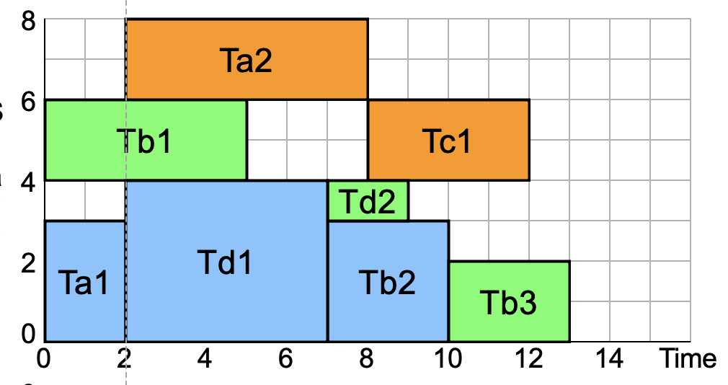
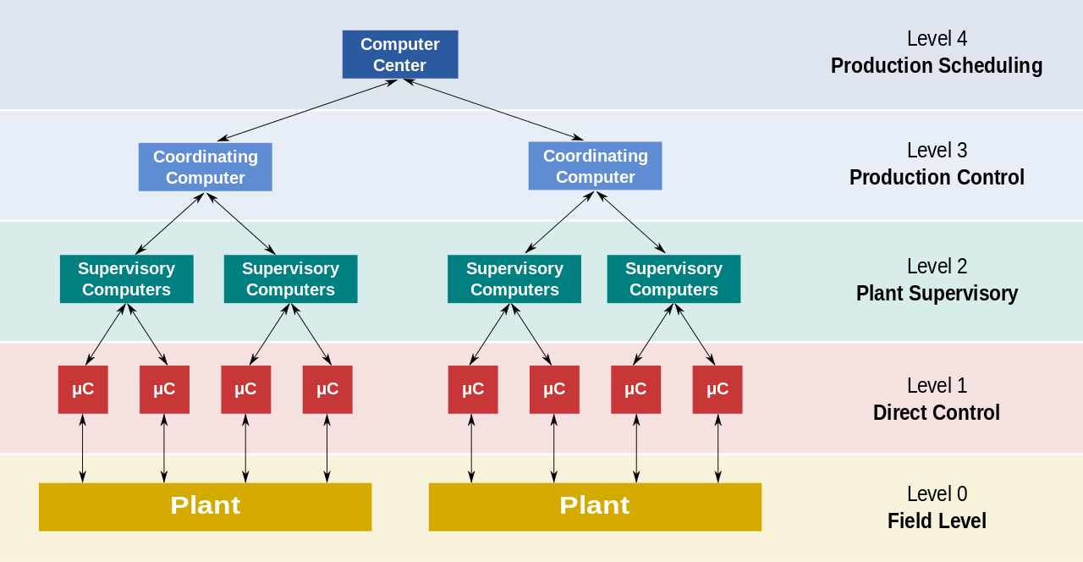
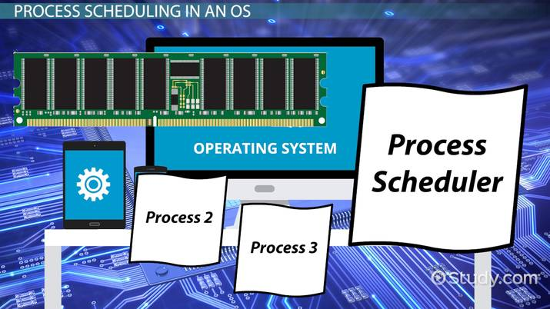
Lecture 36: Advanced Topics – Scheduling for Parallel Processing
Books:
Scheduling for Parallel Processing
Lectures:
Parallel Processing Challenges
Process Scheduling
Topics:
Emulation and Scheduling
Parallel Task Scheduling
Dynamic Programming
Water Filling in Communications
Bus Snooping
Load Balancing

