Slide 1

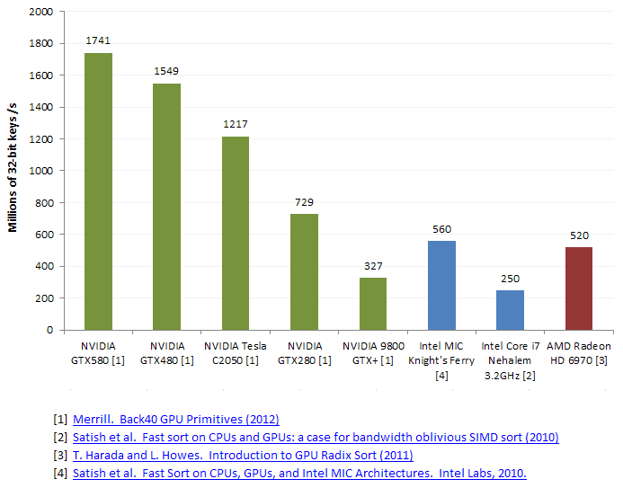
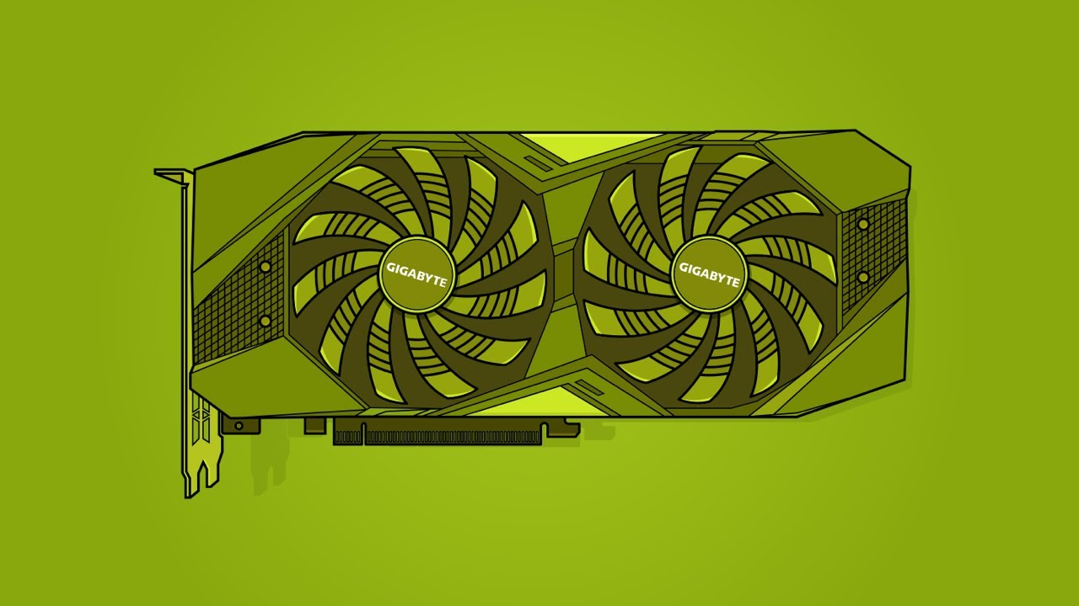
Lecture 35: Advanced Topics – The Thrust Library
Books:
Programming on Parallel Machines
Lectures:
GPU Programming With Thrust and CUDA
Thrust Library Intro
Topics:
Thrust (NVIDIA Developer)
Introduction to Thrust Programming
Matrix Multiplication
Selecting Devices
Thrust Github

