Slide 1
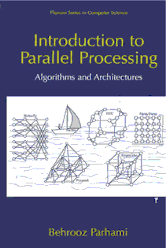
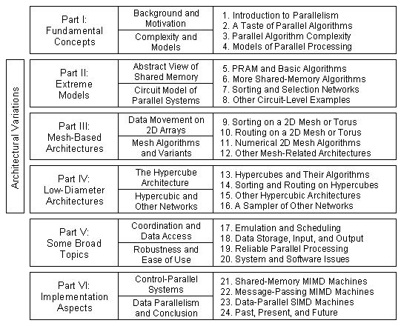
Part VI
Implementation Aspects

Slide 2
About This Presentation
This presentation is intended to support the use of the textbook Introduction to Parallel Processing: Algorithms and Architectures (Plenum Press, 1999, ISBN 0-306-45970-1). It was prepared by the author in connection with teaching the graduate-level course
ECE 254B: Advanced Computer Architecture: Parallel Processing, at the University of California, Santa Barbara. Instructors can use these slides in classroom teaching and for other educational purposes. Any other use is strictly prohibited. © Behrooz Parhami
Edition | Released | Revised | Revised
First | Spring 2005 | Fall 2008*
* Very limited update

Slide 3
About This Presentation
This presentation is intended to support the use of the textbook Introduction to Parallel Processing: Algorithms and Architectures (Plenum Press, 1999, ISBN 0-306-45970-1). It was prepared by the author in connection with teaching the graduate-level course
ECE 254B: Advanced Computer Architecture: Parallel Processing, at the University of California, Santa Barbara. Instructors can use these slides in classroom teaching and for other educational purposes. Any other use is strictly prohibited. © Behrooz Parhami
Edition | Released | Revised | Revised | Revised
First | Spring 2005 | Fall 2008 | Fall 2010*
* Very limited update

Slide 4
VI Implementation Aspects
Study real parallel machines in MIMD and SIMD classes:
  Examine parallel computers of historical significance
  Learn from modern systems and implementation ideas
  Bracket our knowledge with history and forecasts
Topics in This Part
Chapter 21 Shared-Memory MIMD Machines
Chapter 22 Message-Passing MIMD Machines
Chapter 23 Data-Parallel SIMD Machines
Chapter 24 Past, Present, and Future

Slide 5
21 Shared-Memory MIMD Machines
Learn about practical shared-variable parallel architectures:
  Contrast centralized and distributed shared memories
  Examine research prototypes and production machines
Topics in This Chapter
21.1 Variations in Shared Memory
21.2 MIN-Based BBN Butterfly
21.3 Vector-Parallel Cray Y-MP
21.4 Latency-Tolerant Tera MTA
21.5 CC-NUMA Stanford DASH
21.6 SCI-Based Sequent NUMA-Q

Slide 6
21.1 Variations in Shared Memory
Fig. 21.1 Classification of shared-memory hardware architectures and example systems that will be studied in the rest of this chapter.

Slide 7
C.mmp: A Multiprocessor of Historical Significance
Fig. 21.2 Organization of the C.mmp multiprocessor.

Slide 8
Shared Memory Consistency Models
Varying latencies makes each processor’s view of the memory different
Sequential consistency (strictest and most intuitive); mandates that the interleaving of reads and writes be the same from the viewpoint of all processors. This provides the illusion of a FCFS single-port memory.
Processor consistency (laxer); only mandates that writes be observed in the same order by all processors. This allows reads to overtake writes, providing better performance due to out-of-order execution.
Weak consistency separates ordinary memory accesses from synch accesses that require memory to become consistent. Ordinary read and write accesses can proceed as long as there is no pending synch access, but the latter must wait for all preceding accesses to complete.
Release consistency is similar to weak consistency, but recognizes two synch accesses, called “acquire” and “release”, that sandwich protected shared accesses. Ordinary read / write accesses can proceed only when there is no pending acquire access from the same processor and a release access must wait for all reads and writes to be completed.

Slide 9
21.2 MIN-Based BBN Butterfly
Fig. 21.3 Structure of a processing node in the BBN Butterfly.
Fig. 21.4 A small 16-node version of the multistage interconnection network of the BBN Butterfly.

Slide 10
21.3 Vector-Parallel Cray Y-MP
Fig. 21.5 Key elements of the Cray Y-MP processor. Address registers, address function units, instruction buffers, and control not shown.

Slide 11
Cray Y-MP’s Interconnection Network
Fig. 21.6 The processor-to-memory interconnection network of Cray Y-MP.

Slide 12
21.4 Latency-Tolerant Tera MTA
Fig. 21.7
The instruction execution pipelines of Tera MTA.

Slide 13
21.5 CC-NUMA Stanford DASH
Fig. 21.8 The architecture of Stanford DASH.

Slide 14
21.6 SCI-Based Sequent NUMA-Q
Fig. 21.9 The physical placement of Sequent’s quad components on a rackmount baseboard (not to scale)
Fig. 21.10
The architecture of Sequent NUMA-Q 2000.

Slide 15
Details of the IQ-Link in Sequent NUMA-Q
Fig. 21.11
Block diagram of the IQ-Link board.
Fig. 21.12
Block diagram of IQ-Link’s interconnect controller.

Slide 16
22 Message-Passing MIMD Machines
Learn about practical message-passing parallel architectures:
  Study mechanisms that support message passing
  Examine research prototypes and production machines
Topics in This Chapter
22.1 Mechanisms for Message Passing
22.2 Reliable Bus-Based Tandem NonStop
22.3 Hypercube-Based nCUBE3
22.4 Fat-Tree-Based Connection Machine 5
22.5 Omega-Network-Based IBM SP2
22.6 Commodity-Driven Berkeley NOW

Slide 17
22.1 Mechanisms for Message Passing
1. Shared-Medium networks (buses, LANs; e.g., Ethernet, token-based)
2. Router-based networks (aka direct networks; e.g., Cray T3E, Chaos)
3. Switch-based networks (crossbars, MINs; e.g., Myrinet, IBM SP2)
Fig. 22.2 Example 4 × 4 and 2 × 2 switches used as building blocks for larger networks.
Fig. 22.1 The structure of a generic router.

Slide 18
Router-Based Networks
Fig. 22.1 The structure of a generic router.

Slide 19
Case Studies of Message-Passing Machines
Fig. 22.3 Classification of message-passing hardware architectures and example systems that will be studied in this chapter.

Slide 20
22.2 Reliable Bus-Based Tandem NonStop
Fig. 22.4 One section of the Tandem NonStop Cyclone system.

Slide 21
High-Level Structure of the Tandem NonStop
Fig. 22.5 Four four-processor sections interconnected by Dynabus⁺.

Slide 22
22.3 Hypercube-Based nCUBE3
Fig. 22.6
An eight-node nCUBE architecture.

Slide 23
22.4 Fat-Tree-Based Connection Machine 5
Fig. 22.7 The overall structure of CM-5.

Slide 24
Processing Nodes in CM-5
Fig. 22.8
The components of a processing node in CM-5.

Slide 25
The Interconnection Network in CM-5
Fig. 22.9 The fat-tree (hyper-tree) data network of CM-5.

Slide 26
22.5 Omega-Network-Based IBM SP2
Fig. 22.10 The architecture of IBM SP series of systems.

Slide 27
The IBM SP2 Network Interface
Fig. 22.11 The network interface controller of IBM SP2.

Slide 28
The Interconnection Network of IBM SP2
Fig. 22.12 A section of the high-performance switch network of IBM SP2.

Slide 29
22.6 Commodity-Driven Berkeley NOW
NOW aims for building a distributed supercomputer from commercial workstations (high end PCs), linked via switch-based networks
Components and challenges for successful deployment of NOWs
(aka clusters of workstations, or COWs)
Network interface hardware: System-area network (SAN), middle ground between LANs and specialized interconnections
Fast communication protocols: Must provide competitive parameters for the parameters in the LogP model (see Section 4.5)
Distributed file systems: Data files must be distributed among nodes, with no central warehouse or arbitration authority
Global resource management: Berkeley uses GLUnix (global-layer Unix); other systems of comparable functionalities include Argonne Globus, NSCP metacomputing system, Princeton SHRIMP, Rice TreadMarks, Syracuse WWVM, Virginia Legion, Wisconsin Wind Tunnel

Slide 30
23 Data-Parallel SIMD Machines
Learn about practical implementation of SIMD architectures:
  Assess the successes, failures, and potentials of SIMD
  Examine various SIMD parallel computers, old and new
Topics in This Chapter
23.1 Where Have All the SIMDs Gone?
23.2 The First Supercomputer: ILLIAC IV
23.3 Massively Parallel Goodyear MPP
23.4 Distributed Array Processor (DAP)
23.5 Hypercubic Connection Machine 2
23.6 Multiconnected MasPar MP-2

Slide 31
23.1 Where Have All the SIMDs Gone?
Associative or content-addressable memories/processors constituted early forms of SIMD parallel processing
Fig. 23.1 Functional view of an associative memory/processor.

Slide 32
Search Functions in Associative Devices
Exact match: Locating data based on partial knowledge of contents
Inexact match: Finding numerically or logically proximate values
Membership: Identifying all members of a specified set
Relational: Determining values that are less than, less than or equal, etc.
Interval: Marking items that are between or outside given limits
Extrema: Finding the maximum, minimum, next higher, or next lower
Rank-based: Selecting kth or k largest/smallest elements
Ordered retrieval: Repeated max- or min-finding with elimination (sorting)

Slide 33
Mixed-Mode SIMD / MIMD Parallelism
Fig. 23.2 The architecture of Purdue PASM.

Slide 34
23.2 The First Supercomputer: ILLIAC IV
Fig. 23.3 The ILLIAC IV computer (the inter-processor routing network is only partially shown).

Slide 35
23.3 Massively Parallel Goodyear MPP
Fig. 23.4 The architecture of Goodyear MPP.

Slide 36
Processing Elements in the Goodyear MPP
Fig. 23.5
The single-bit processor of MPP.

Slide 37
23.4 Distributed Array Processor (DAP)
Fig. 23.6
The bit-serial processor of DAP.

Slide 38
DAP’s High-Level Structure
Fig. 23.7 The high-level architecture of DAP system.

Slide 39
23.5 Hypercubic Connection Machine 2
Fig. 23.8
The architecture of CM-2.

Slide 40
The Simple Processing Elements of CM-2
Fig. 23.9 The bit-serial ALU of CM-2.

Slide 41
23.6 Multiconnected MasPar MP-2
Fig. 23.10
The architecture of MasPar MP-2.

Slide 42
The Interconnection Network of MasPar MP-2
Fig. 23.11 The physical packaging of processor clusters and the 3-stage global router in MasPar MP-2 .

Slide 43
The Processing Nodes of MasPar MP-2
Fig. 23.12
Processor architecture in MasPar MP-2.

Slide 44
24 Past, Present, and Future
Put the state of the art in context of history and future trends:
  Quest for higher performance, and where it is leading us
  Interplay between technology progress and architecture
Topics in This Chapter
24.1 Milestones in Parallel Processing
24.2 Current Status, Issues, and Debates
24.3 TFLOPS, PFLOPS, and Beyond
24.4 Processor and Memory Technologies
24.5 Interconnection Technologies
24.6 The Future of Parallel Processing

Slide 45
24.1 Milestones in Parallel Processing
1840s Desirability of computing multiple values at the same time was noted in connection with Babbage’s Analytical Engine
1950s von Neumann’s and Holland’s cellular computers were proposed
1960s The ILLIAC IV SIMD machine was designed at U Illinois based on the earlier SOLOMON computer
1970s Vector machines, with deeply pipelined function units, emerged and quickly dominated the supercomputer market; early experiments with shared memory multiprocessors, message-passing multicomputers, and gracefully degrading systems paved the way for further progress
1980s Fairly low-cost and massively parallel supercomputers, using hypercube and related interconnection schemes, became available
1990s Massively parallel computers with mesh or torus interconnection, and using wormhole routing, became dominant
2000s Commodity and network-based parallel computing took hold, offering speed, flexibility, and reliability for server farms and other areas

Slide 46
24.2 Current Status, Issues, and Debates
Design choices and key debates:
Architecture
General- or special-purpose system?
SIMD, MIMD, or hybrid?
Interconnection
Shared-medium, direct, or multistage?
Custom or commodity?
Routing
Oblivious or adaptive?
Wormhole, packet, or virtual cut-through?
Programming
Shared memory or message passing?
New languages or libraries?
Related user concerns:
Cost per MIPS
Scalability, longevity
Cost per MB/s
Expandability, reliability
Speed, efficiency
Overhead, saturation limit
Ease of programming
Software portability

Slide 47
24.3 TFLOPS, PFLOPS, and Beyond
Fig. 24.1 Milestones in the Accelerated Strategic Computing Initiative (ASCI) program, sponsored by the US Department of Energy, with extrapolation up to the PFLOPS level.

Slide 48
Performance Milestones in Supercomputers
Performance
1993 and later milestones based on top500.com data
EFLOPS
PFLOPS
TFLOPS
GFLOPS
Cray Y-MP
CDC
Cray 1
IBM
MFLOPS
1960
1980
2000
2020
Year

Slide 49
24.4 Processor and Memory Technologies
Fig. 24.2 Key parts of the CPU in the Intel Pentium Pro microprocessor.

Slide 50
24.5 Interconnection Technologies
Fig. 24.3 Changes in the ratio of a 1-cm wire delay to device switching time as the feature size is reduced.

Slide 51
Intermodule and Intersystem Connection Options
Fig. 24.4 Various types of intermodule and intersystem connections.

Slide 52
System Interconnection Media
Fig. 24.5 The three commonly used media for computer and network connections.

Slide 53
24.6 The Future of Parallel Processing
In the early 1990s, it was unclear whether the TFLOPS performance milestone would be reached with a thousand or so GFLOPS nodes or with a million or so simpler MFLOPS processors
The eventual answer was closer to 1K × GFLOPS than 1M × MFLOPS
PFLOPS performance was achieved in more or less the same manner
Asynchronous design for its speed and greater energy economy: Because pure asynchronous circuits create some difficulties, designs that are locally synchronous and globally asynchronous are flourishing
Intelligent memories to help remove the memory wall:
Memory chips have high internal bandwidths, but are limited by pins in how much data they can handle per clock cycle
Reconfigurable systems for adapting hardware to application needs:
Raw hardware that can be configured via “programming” to adapt to application needs may offer the benefits of special-purpose processing
Network and grid computing to allow flexible, ubiquitous access:
Resource of many small and large computers can be pooled together via a network, offering supercomputing capability to anyone

Slide 54
Parallel Processing for Low-Power Systems
Figure 25.1 of Parhami’s computer architecture textbook.

Slide 55
Peak Performance of Supercomputers
PFLOPS
Earth Simulator
× 10 / 5 years
ASCI White Pacific
TFLOPS
ASCI Red
TMC CM-5
Cray T3D
Cray X-MP
TMC CM-2
Cray 2
GFLOPS
1980
1990
2000
2010
Dongarra, J., “Trends in High Performance Computing,”
Computer J., Vol. 47, No. 4, pp. 399-403, 2004. [Dong04]

Slide 56
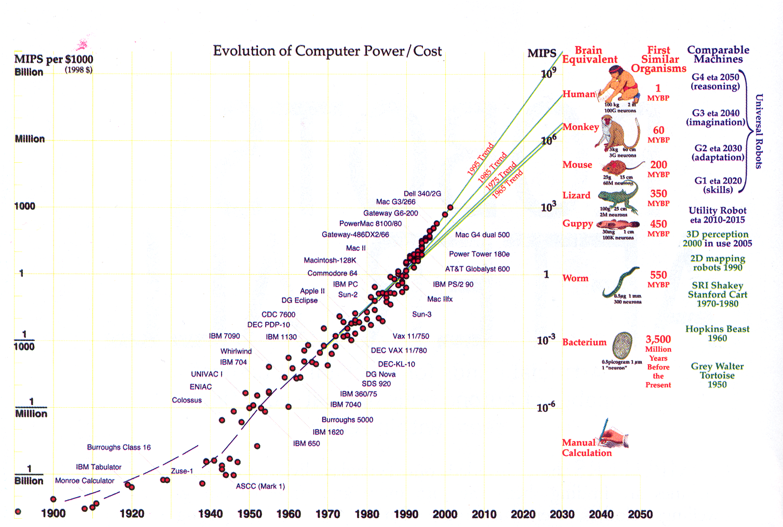
Evolution of Computer Performance/Cost
From:
“Robots After All,”
by H. Moravec, CACM, pp. 90-97, October 2003.
Mental power in four scales

Slide 57
Two Approaches to Parallel Processing
Architecture (topology) and algorithm considered in tandem
+ Potentially very high performance
– Large effort to develop efficient algorithms
Users interact with topology-independent platforms
+ Less steep learning curve
+ Program portability
– Sacrifice some performance for ease of use
Main examples:
Virtual shared memory
Message-passing interface
The topology-independent approach is currently dominant

Slide 58
ABCs of Parallel Processing in One Slide
A Amdahl’s Law (Speedup Formula)
Bad news – Sequential overhead will kill you, because:
Speedup = T₁/T_{p} ≤ 1/[f + (1 – f)/p] ≤ min(1/f, p)
Morale: For f = 0.1, speedup is at best 10, regardless of peak OPS.
B Brent’s Scheduling Theorem
Good news – Optimal scheduling is very difficult, but even a naive
scheduling algorithm can ensure:
T₁/p ≤ T_{p} < T₁/p + T∞ = (T₁/p)[1 + p/(T₁/T∞)]
Result: For a reasonably parallel task (large T₁/T∞), or for a suitably
small p (say, p < T₁/T∞), good speedup and efficiency are possible.
C Cost-Effectiveness Adage
Real news – The most cost-effective parallel solution may not be
the one with highest peak OPS (communication?), greatest speed-up
(at what cost?), or best utilization (hardware busy doing what?).
Analogy: Mass transit might be more cost-effective than private cars
even if it is slower and leads to many empty seats.

Slide 59
Gordon Bell Prize for High-Performance Computing
Established in 1988 by Gordon Bell, one of the pioneers in the field
Prizes are given annually in several categories (there are small cash awards, but the prestige of winning is the main motivator)
The two key categories are as follows; others have varied over time
Peak performance: The entrant must convince the judges that the submitted program runs faster than any other comparable application
Price/Performance: The entrant must show that performance of the application divided by the list price of the smallest system needed to achieve the reported performance is better than that of any other entry
Different hardware/software combinations have won the competition
Supercomputer performance improvement has outpaced Moore’s law; however, progress shows signs of slowing down due to lack of funding
In past few years, improvements have been due to faster uniprocessors (2004 NRC Report Getting up to Speed: The Future of Supercompuing)

Slide 60
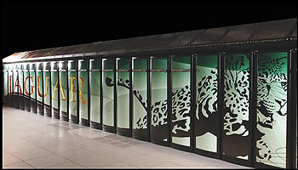
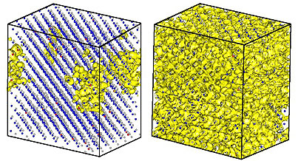
Recent Gordon Bell Prizes, November 2008
Performance in a Scientific Application: superconductor simulation
Oak Ridge National Lab: Cray XT Jaguar, 150 000 cores, 1.35 PFLOPS
http://www.supercomputingonline.com/
article.php?sid=16648
Special Prize for Algorithm Innovation
Lawrence Berkeley National Lab: harnessing potential of nanostructures
http://newscenter.lbl.gov/press-releases/2008/11/24/berkeley-lab-team-wins-special-acm-gordon-bell-prize-for-algorithm-innovation/

