Slide 1

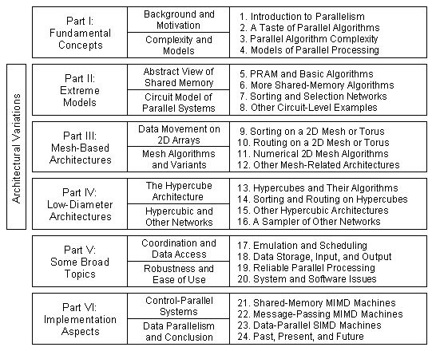
Part IV
Low-Diameter Architectures

Slide 2
About This Presentation
This presentation is intended to support the use of the textbook Introduction to Parallel Processing: Algorithms and Architectures (Plenum Press, 1999, ISBN 0-306-45970-1). It was prepared by the author in connection with teaching the graduate-level course
ECE 254B: Advanced Computer Architecture: Parallel Processing, at the University of California, Santa Barbara. Instructors can use these slides in classroom teaching and for other educational purposes. Any other use is strictly prohibited. © Behrooz Parhami
Edition | Released | Revised | Revised | Revised
First | Spring 2005 | Spring 2006 | Fall 2008 | Fall 2010
 |  | Winter 2013 | Winter 2014 | Winter 2016
 |  | Winter 2019 | Winter 2020 | Winter 2021

Slide 3
IV Low-Diameter Architectures
Study the hypercube and related interconnection schemes:
  Prime example of low-diameter (logarithmic) networks
  Theoretical properties, realizability, and scalability
  Complete our view of the “sea of interconnection nets”
Topics in This Part
Chapter 13 Hypercubes and Their Algorithms
Chapter 14 Sorting and Routing on Hypercubes
Chapter 15 Other Hypercubic Architectures
Chapter 16 A Sampler of Other Networks

Slide 4
13 Hypercubes and Their Algorithms
Study the hypercube and its topological/algorithmic properties:
  Develop simple hypercube algorithms (more in Ch. 14)
  Learn about embeddings and their usefulness
Topics in This Chapter
13.1 Definition and Main Properties
13.2 Embeddings and Their Usefulness
13.3 Embedding of Arrays and Trees
13.4 A Few Simple Algorithms
13.5 Matrix Multiplication
13.6 Inverting a Lower-Triangular Matrix

Slide 5
13.1 Definition and Main Properties
Begin studying networks that are intermediate between diameter-1 complete network and diameter-p^{1/2} mesh

Slide 6
Very-High-Dimensional Meshes and Tori
qD mesh with m processors along each dimension: p = m^{q}
Diameter D = q(m – 1) = q (p^{1/q} – 1)
Bisection width: B = p^{1–1/q} when m = p^{1/q} is even
Node degree d = 2q
qD torus with m processors along each dimension = m-ary q-cube
What happens when q becomes as large as log₂ p?
Diameter D = q (p^{1/q} – 1) = log₂ p * = O(log p)
Bisection width: B = p^{1–1/q} = p / p^{1/q} = p/2 * = O(p)
Node degree d = 2q = log₂ p ** = O(log p)
qD torus with 2 processors along each dimension same as mesh
* What is the value of m = p^{1/q} = p^{1/log2 p} ?
m = p^{1/log2 p} m^{log2 p} = p m = 2
** When m = 2, node degree becomes q instead of 2q

Slide 7
Hypercube and Its History
Binary tree has logarithmic diameter, but small bisection
Hypercube has a much larger bisection
Hypercube is a mesh with the maximum possible number of dimensions
2 × 2 × 2 × . . . × 2
←⎯ q = log₂ p ⎯→
We saw that increasing the number of dimensions made it harder to design and visualize algorithms for the mesh
Oddly, at the extreme of log₂ p dimensions, things become simple again!
Brief history of the hypercube (binary q-cube) architecture
Concept developed: early 1960s [Squi63]
Direct (single-stage) and indirect (multistage) versions: mid 1970s
Initial proposals [Peas77], [Sull77] included no hardware
Caltech’s 64-node Cosmic Cube: early 1980s [Seit85]
Introduced an elegant solution to routing (wormhole switching)
Several commercial machines: mid to late 1980s
Intel PSC (personal supercomputer), CM-2, nCUBE (Section 22.3)

Slide 8
Basic Definitions
Hypercube is generic term; 3-cube, 4-cube, . . . , q-cube in specific cases
Fig. 13.1 The recursive structure of binary hypercubes.
Parameters:
p = 2^{q}
B = p/2 = 2^{q–1}
D = q = log₂p
d = q = log₂p

Slide 9
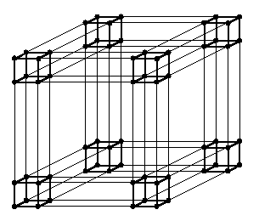
The 64-Node Hypercube
Only sample wraparound links are shown to avoid clutter
Isomorphic to the 4 × 4 × 4 3D torus (each has 64 × 6/2 links)

Slide 10
Neighbors of a Node in a Hypercube
x_{q–1}x_{q–2} . . . x₂x₁x₀ ID of node x
x_{q–1}x_{q–2} . . . x₂x₁x₀′ dimension-0 neighbor; N₀(x)
x_{q–1}x_{q–2} . . . x₂x₁′x₀ dimension-1 neighbor; N₁(x)
. .
. .
. .
x_{q–1}′x_{q–2} . . . x₂x₁x₀ dimension-(q – 1) neighbor; N_{q–1}(x)
The q neighbors of node x
Nodes whose labels differ in k bits (at Hamming distance k) connected by shortest path of length k
Both node- and edge-symmetric
Strengths: symmetry, log diameter, and linear bisection width
Weakness: poor scalability

Slide 11
13.2 Embeddings and Their Usefulness
Dilation = 1
Congestion = 1
Load factor = 1
Fig. 13.2 Embedding a seven-node binary tree into 2D meshes of various sizes.
Dilation = 2
Congestion = 2
Load factor = 1
Dilation = 1
Congestion = 2
Load factor = 2
Expansion:
ratio of the number of nodes (9/7, 8/7, and 4/7 here)
Dilation: Longest path onto which an edge is mapped (routing slowdown)
Congestion: Max number of edges mapped onto one edge (contention slowdown)
Load factor: Max number of nodes mapped onto one node (processing slowdown)

Slide 12
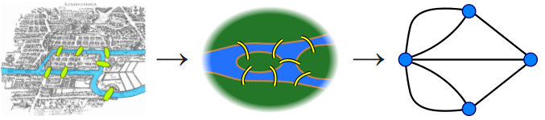
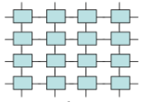
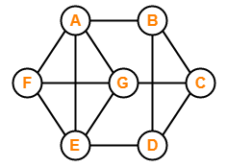
13.3 Embedding of Arrays and Trees
Hamiltonicity is an important property of a graph
A graph with n nodes is Hamiltonian if the n-node cycle is its subgraph
More generally, embedding of cycles of various lengths in an intact or faulty network of nodes may be sought
Bridges of Konigsberg: Find a path that crosses each bridge once
Hamiltonian
Non-Hamiltonian
Hamiltonian?

Slide 13
Hamiltonicity of the Hypercube
(q – 1)-bit Gray code
0
0
0
0
000 . . . 000
000 . . . 001
000 . . . 011
.
.
.
100 . . . 000
1
1
1
1
100 . . . 000
.
.
.
000 . . . 011
000 . . . 010
000 . . . 000
Fig. 13.3 Hamiltonian cycle in the q-cube.
Alternate inductive proof: Hamiltonicity of the q-cube is equivalent to the existence of a q-bit Gray code
Basis: q-bit Gray code beginning with the all-0s codeword and ending with 10^{q–1} exists for q = 2: 00, 01, 11, 10
(q – 1)-bit Gray code
in reverse

Slide 14
Mesh/Torus Embedding in a Hypercube
Fig. 13.5 The 4 × 4 mesh/torus is a subgraph of the 4-cube.
Is a mesh or torus a subgraph of the hypercube of the same size?
We prove this to be the case for a torus (and thus for a mesh)

Slide 15
Torus is a Subgraph of Same-Size Hypercube
A tool used in our proof
Product graph G₁ × G₂:
Has n₁ × n₂ nodes
Each node is labeled by a pair of labels, one from each component graph
Two nodes are connected if either component of the two nodes were connected in the component graphs
Fig. 13.4 Examples of product graphs.
The 2ª × 2^{b} × 2^{c} . . . torus is the product of 2ª-, 2^{b}-, 2^{c}-, . . . node rings
The (a + b + c + ... )-cube is the product of a-cube, b-cube, c-cube, . . .
The 2^{q}-node ring is a subgraph of the q-cube
If a set of component graphs are subgraphs of another set, the product graphs will have the same relationship

Slide 16
Embedding Trees in the Hypercube
The (2^{q} – 1)-node complete binary tree is not a subgraph of the q-cube
Proof by contradiction based on the parity of node label weights (number of 1s is the labels)
The 2^{q}-node double-rooted complete binary tree is a subgraph of the q-cube
Fig. 13.6
The 2^{q}-node double-rooted complete binary tree is a subgraph of the q-cube.

Slide 17
A Useful Tree Embedding in the Hypercube
The (2^{q} – 1)-node complete binary tree can be embedded into the (q – 1)-cube
Despite the load factor of q, many tree algorithms entail no slowdown
Fig. 13.7 Embedding a 15-node complete binary tree into the 3-cube.

Slide 18
13.4 A Few Simple Algorithms
Semigroup computation on the q-cube
Processor x, 0 ≤ x < p do t[x] := v[x]
{initialize “total” to own value}
for k = 0 to q – 1 processor x, 0 ≤ x < p, do
get y :=t[N_{k}(x)]
set t[x] := t[x] ⊗ y
endfor
Dim 2
Dim 0
Dim 1
Commutativity
of the operator ⊗ is implicit here.
How can we remove this assumption?
Fig. 13.8 Semigroup computation on a 3-cube.

Slide 19
Parallel Prefix Computation
Parallel prefix computation on the q-cube
Processor x, 0 ≤ x < p, do t[x] := u[x] := v[x]
{initialize subcube “total” and partial prefix}
for k = 0 to q – 1 processor x, 0 ≤ x < p, do
get y :=t[N_{k}(x)]
set t[x] := t[x] ⊗ y
if x > N_{k}(x) then set u[x] := y ⊗ u[x]
endfor
t : subcube “total”
u : subcube prefix
Dim 2
Dim 0
Dim 1
Commutativity
of the operator ⊗ is implicit in this algorithm as well.
How can we remove this assumption?
Fig. 13.8 Semigroup computation on a 3-cube.

Slide 20
Sequence Reversal on the Hypercube
Reversing a sequence on the q-cube
for k = 0 to q – 1 Processor x, 0 ≤ x < p, do
get y := v[N_{k}(x)]
set v[x] := y
endfor
Dim 2
Dim 0
Dim 1
Fig. 13.11 Sequence reversal on a 3-cube.

Slide 21
Ascend, Descend, and Normal Algorithms
Semigroup
Dimension-order communication
Parallel prefix
Sequence reversal
Graphical depiction of ascend, descend, and normal algorithms.

Slide 22
13.5 Matrix Multiplication
Dim 2
Dim 0
p = m³ = 2^{q} processors, indexed as ijk (with three q/3-bit segments)
Dim 1
1. Place elements
of A and B in registers R_{A} & R_{B} of m² processors with the IDs 0jk
2. Replicate inputs: communicate across 1/3 of the dimensions
6. Move C_{jk} to processor 0jk
3, 4. Rearrange the data by communicating across the remaining 2/3 of dimensions so that processor ijk has A_{ji} and B_{ik}
Fig. 13.12 Multiplying two 2 × 2 matrices on a 3-cube.

Slide 23
Analysis of Matrix Multiplication
The algorithm involves communication steps in three loops, each with
q / 3 iterations (in one of the 4 loops, 2 values are exchanged per iteration)
T_{mul} (m, m³) =
O(q) = O(log m)
Analysis in the case of block matrix multiplication (m × m matrices):
Matrices are partitioned into p^{1/3} × p^{1/3} blocks of size (m / p^{1/3}) × (m / p^{1/3})
Each communication step deals with m² / p^{2/3} block elements
Each multiplication entails 2m³/p arithmetic operations
T_{mul}(m, p) = m² / p^{2/3} × O(log p) + 2m³ / p
Communication Computation
Dim 2
Dim 0
Dim 1

Slide 24
13.6 Inverting a Lower-Triangular Matrix
B 0 B^{–1} 0
For A = we have A^{–1} =
C D –D^{–1}CB^{–1} D^{–1}
I
B 0 B^{–1} 0 BB^{–1} 0
× =
C D –D^{–1}CB^{–1} D^{–1} CB^{–1} – DD^{–1}CB^{–1} DD^{–1}
0
I
Because B and D are both lower triangular, the same algorithm can be used recursively to invert them in parallel
T_{inv}(m) = T_{inv}(m/2) + 2T_{mul}(m/2) = T_{inv}(m/2) + O(log m) = O(log²m)

Slide 25
Recursive Lower-Triangular Matrix Inversion Algorithm
B 0 B^{–1} 0
For A = we have A^{–1} =
C D –D^{–1}CB^{–1} D^{–1}
Invert lower-triangular matrices B and D
B
Inv
Inv
0
0
0
Inv
–1
Inv
Send B^{–1} and D^{–1} to the subcube holding C
Inv
0
Inv
C
D
Inv
Inv
0
0
Compute –D^{–1}C B^{–1} to in the subcube
–1
–D^{–1}CB^{–1}
Inv
Inv
Inv
0
Inv
q-cube and its four
(q – 2)-subcubes

Slide 26
14 Sorting and Routing on Hypercubes
Study routing and data movement problems on hypercubes:
  Learn about limitations of oblivious routing algorithms
  Show that bitonic sorting is a good match to hypercube
Topics in This Chapter
14.1 Defining the Sorting Problem
14.2 Bitonic Sorting on a Hypercube
14.3 Routing Problems on a Hypercube
14.4 Dimension-Order Routing
14.5 Broadcasting on a Hypercube
14.6 Adaptive and Fault-Tolerant Routing

Slide 27
14.1 Defining the Sorting Problem
Review of the hypercube:
Fully symmetric with respect to dimensions
Typical computations involve communication across all dimensions
Dim 1
Dim 2
Dimension-order communication
is known as “ascend” or “descend”
(0 up to q – 1, or q – 1 down to 0)
Dim 0
Due to symmetry, any hypercube dimension
can be labeled as 0, any other as 1, and so on

Slide 28
Hypercube Sorting: Goals and Definitions
Arrange data in order of processor ID numbers (labels)
The ideal parallel sorting algorithm:
T(p) = Θ((n log n)/p)
This ideal has not been achieved in all cases for the hypercube
Smallest
value
1-1 sorting (p items to sort, p processors)
Largest
value
Batcher’s odd-even merge or bitonic sort: O(log²p) time
O(log p)-time deterministic algorithm not known
k-k sorting (n = kp items to sort, p processors)
Optimal algorithms known for n >> p or when average running time is considered (randomized)

Slide 29
Hypercube Sorting: Attempts and Progress
No bull’s eye yet!
There are three categories of practical sorting algorithms:
1. Deterministic 1-1,
O(log²p)-time
2. Deterministic k-k,
optimal for n >> p
(that is, for large k)
3. Probabilistic
(1-1 or k-k)
Pursuit of O(log p)-time algorithm is of theoretical interest only

Slide 30
Bitonic Sequences
Bitonic sequence:
1 3 3 4 6 6 6 2 2 1 0 0 Rises, then falls
8 7 7 6 6 6 5 4 6 8 8 9 Falls, then rises
8 9 8 7 7 6 6 6 5 4 6 8 The previous sequence, right-rotated by 2
In Chapter 7, we designed bitonic sorting nets
Bitonic sorting is ideally suited to hypercube
Fig. 14.1 Examples of bitonic sequences.

Slide 31
Sorting a Bitonic Sequence on a Linear Array
Time needed to sort a bitonic sequence on a p-processor linear array:
B(p) = p + p/2
+ p/4 + . . . + 2 = 2p – 2
Not competitive, because we can sort an arbitrary sequence in 2p – 2 unidirectional communication steps using odd-even transposition
Fig. 14.2 Sorting a bitonic sequence on a linear array.

Slide 32
Bitonic Sorting on a Linear Array
5 9 10 15 3 7 14 12 8 1 4 13 16 11 6 2
----> <---- ----> <---- ----> <---- ----> <----
5 9 15 10 3 7 14 12 1 8 13 4 11 16 6 2
------------> <------------ ------------> <------------
5 9 10 15 14 12 7 3 1 4 8 13 16 11 6 2
----------------------------> <----------------------------
3 5 7 9 10 12 14 15 16 13 11 8 6 4 2 1
------------------------------------------------------------>
1 2 3 4 5 6 7 8 9 10 11 12 13 14 15 16
Fig. 14.3 Sorting an arbitrary sequence on a linear array through recursive application of bitonic sorting.
Sorting an arbitrary sequence of length p:
T(p) = T(p/2) + B(p) = T(p/2) + 2p – 2 = 4p – 4 – 2 log₂p
Recall that
B(p) = 2p – 2
Alternate derivation:
T(p) = B(2) + B(4) + . . . + B(p) = 2 + 6 + . . . + (2p – 2) = 4p – 4 – 2 log₂p

Slide 33
Visualizing Bitonic Sorting on a Linear Array
Initial data sequence, stored one per processor
Phase 1: Sort half-arrays
in opposite directions
Phase 2: Shift data leftward to compare half-arrays
Phase 3: Send larger item in each pair to the right
Phase 4: Sort each bitonic half-sequence separately

Slide 34
14.2 Bitonic Sorting on a Hypercube
For linear array, the 4p-step bitonic sorting algorithm is inferior to odd-even transposition which requires p compare-exchange steps (or 2p unidirectional communications)
The situation is quite different for a hypercube
Sorting a bitonic sequence on a hypercube: Compare-exchange values in the upper subcube (nodes with x_{q–1} = 1) with those in the lower subcube (x_{q–1} = 0); sort the resulting bitonic half-sequences
B(q) = B(q – 1) + 1 = q
Complexity: 2q communication steps
Sorting a bitonic sequence of size n on q-cube, q = log₂n
for l = q – 1 downto 0 processor x, 0 ≤ x < p, do
if x_{l} = 0
then get y := v[N_{l}(x)]; keep min(v(x), y); send max(v(x), y) to N_{l}(x)
endif
endfor
This is a “descend” algorithm

Slide 35
Bitonic Sorting on a Hypercube
Fig. 14.4 Sorting a bitonic sequence of size 8 on the 3-cube.
T(q) = T(q – 1) + B(q)
= T(q – 1) + q
= q(q + 1)/2
= O(log² p)
Dim 2
Dim 0
Dim 1

Slide 36
14.3 Routing Problems on a Hypercube
Recall the following categories of routing algorithms:
Off-line: Routes precomputed, stored in tables
On-line: Routing decisions made on the fly
Oblivious: Path depends only on source & destination
Adaptive: Path may vary by link and node conditions
Good news for routing on a hypercube:
Any 1-1 routing problem with p or fewer packets can be solved in O(log p) steps, using an off-line algorithm; this is a consequence of there being many paths to choose from
Bad news for routing on a hypercube:
Oblivious routing requires Ω(p^{1/2}/log p) time in the worst case
(only slightly better than mesh)
In practice, actual routing performance is usually much closer to the log-time best case than to the worst case.

Slide 37
Limitations of Oblivious Routing
Theorem 14.1: Let G = (V, E) be a p-node, degree-d network. Any oblivious routing algorithm for routing p packets in G needs Ω(p^{1/2}/d) worst-case time
Proof Sketch: Let P_{u,v} be the unique path
used for routing messages from u to v
There are p(p – 1) possible paths for
routing among all node pairs
These paths are predetermined and do not
depend on traffic within the network
Our strategy: find k node pairs u_{i}, v_{i} (1 ≤ i ≤ k)
such that u_{i} ≠ u_{j} and v_{i} ≠ v_{j} for i ≠ j, and
P_{ui,vi} all pass through the same edge e
Because ≤ 2 packets can go through a link in one step, Ω(k) steps
will be needed for some 1-1 routing problem
The main part of the proof consists of showing that k can be
as large as p^{1/2}/d

Slide 38
14.4 Dimension-Order Routing
Source 01011011
Destination 11010110
Differences ^ ^^ ^
Path: 01011011
11011011
11010011
11010111
11010110
Unfolded hypercube (indirect cube, butterfly) facilitates the discussion, visualization, and analysis of routing algorithms
Fig. 14.5 Unfolded 3-cube or the 32-node butterfly network.
Dimension-order routing between nodes i and j in q-cube can be viewed as routing from node i in column 0 (q) to node j in column q (0) of the butterfly

Slide 39
Self-Routing on a Butterfly Network
Fig. 14.6 Example dimension-order routing paths.
Number of cross links taken = length of path in hypercube
From node 3 to 6: routing tag = 011 ⊕ 110 = 101 “cross-straight-cross”
From node 3 to 5: routing tag = 011 ⊕ 101 = 110 “straight-cross-cross”
From node 6 to 1: routing tag = 110 ⊕ 001 = 111 “cross-cross-cross”

Slide 40
Butterfly Is Not a Permutation Network
Fig. 14.7 Packing is a “good” routing problem for dimension-order routing on the hypercube.
Fig. 14.8 Bit-reversal permutation is a “bad” routing problem for dimension-order routing on the hypercube.

Slide 41
Why Bit-Reversal Routing Leads to Conflicts?
Consider the (2a + 1)-cube and messages that must go from nodes 0 0 0 . . . 0 x₁ x₂ . . . x_{a–1} x_{a} to nodes x_{a} x_{a–1} . . . x₂ x₁ 0 0 0 . . . 0
a + 1 zeros a + 1 zeros
If we route messages in dimension order, starting from the right end, all of these 2ª = Θ(p^{1/2}) messages will pass through node 0
Consequences of this result:
1. The Θ(p^{1/2}) delay is even worse than Ω(p^{1/2}/d) of Theorem 14.1
2. Besides delay, large buffers are needed within the nodes
True or false? If we limit nodes to a constant number of message buffers, then the Θ(p^{1/2}) bound still holds, except that messages are queued at several levels before reaching node 0
Bad news (false): The delay can be Θ(p) for some permutations
Good news: Performance usually much better; i.e., log₂ p + o(log p)

Slide 42
Wormhole Routing on a Hypercube
Good/bad routing problems are good/bad for wormhole routing as well
Dimension-order routing is deadlock-free

Slide 43
14.5 Broadcasting on a Hypercube
Flooding: applicable to any network with all-port communication
00000 Source node
00001, 00010, 00100, 01000, 10000 Neighbors of source
00011, 00101, 01001, 10001, 00110, 01010, 10010, 01100, 10100, 11000 Distance-2 nodes
00111, 01011, 10011, 01101, 10101, 11001, 01110, 10110, 11010, 11100 Distance-3 nodes
01111, 10111, 11011, 11101, 11110 Distance-4 nodes
11111 Distance-5 node
Binomial broadcast tree with single-port communication
Fig. 14.9
The binomial broadcast tree for a 5-cube.

Slide 44
Hypercube Broadcasting Algorithms
Fig. 14.10 Three hypercube broadcasting schemes as performed on a 4-cube.
Dim 2
Dim 0
Dim 1
Dim 3

Slide 45
14.6 Adaptive and Fault-Tolerant Routing
There are up to q node-disjoint and edge-disjoint shortest paths between any node pairs in a q-cube
Thus, one can route messages around congested or failed nodes/links
A useful notion for designing adaptive wormhole routing algorithms is that of virtual communication networks
Each of the two subnetworks in Fig. 14.11 is acyclic
Hence, any routing scheme that begins by using links in subnet 0, at some point switches the path to subnet 1, and from then on remains in subnet 1, is deadlock-free
Fig. 14.11 Partitioning a 3-cube into subnetworks for deadlock-free routing.

Slide 46
Robustness of the Hypercube
Rich connectivity provides many alternate paths for message routing
Source
S
X
X
Dim 2
Three faulty nodes
Dim 0
Dim 1
Dim 3
X
The node that is furthest from S is not its diametrically opposite node in the fault-free hypercube
Destination
The fault diameter of the q-cube is q + 1.

Slide 47
15 Other Hypercubic Architectures
Learn how the hypercube can be generalized or extended:
  Develop algorithms for our derived architectures
  Compare these architectures based on various criteria
Topics in This Chapter
15.1 Modified and Generalized Hypercubes
15.2 Butterfly and Permutation Networks
15.3 Plus-or-Minus-2^{i} Network
15.4 The Cube-Connected Cycles Network
15.5 Shuffle and Shuffle-Exchange Networks
15.6 That’s Not All, Folks!

Slide 48
15.1 Modified and Generalized Hypercubes
Fig. 15.1 Deriving a twisted 3-cube by redirecting two links in a 4-cycle.
Diameter is one less than the original hypercube

Slide 49
Folded Hypercubes
Fig. 15.2 Deriving a folded 3-cube by adding four diametral links.
Diameter is half that of the original hypercube
Fig. 15.3 Folded 3-cube viewed as
3-cube with a redundant dimension.

Slide 50
Generalized Hypercubes
A hypercube is a power or homogeneous product network
q-cube = (o⎯o)^{q} ; q th power of K₂
Generalized hypercube = qth power of K_{r}
(node labels are radix-r numbers)
Node x is connected to y iff x and y differ in one digit
Each node has r – 1 dimension-k links
x₃
Example: radix-4 generalized hypercube
Node labels are radix-4 numbers
x₂
x₁
x₀
Dimension-0 links

Slide 51
Bijective Connection Graphs
Beginning with a c-node seed network, the network size is recursively doubled in each step by linking nodes in the two halves via an arbitrary one-to-one mapping. Number of nodes = c 2^{q}
Hypercube is a special case, as are many hypercube variant networks (twisted, crossed, mobius, . . . , cubes)
Bijective
mapping
Special case of c = 1:
Diameter upper bound is q
Diameter lower bound is an open problem (it is better than ⎡q + 1⎤/2)

Slide 52
15.2 Butterfly and Permutation Networks
Fig. 7.4 Butterfly and wrapped butterfly networks.

Slide 53
Structure of Butterfly Networks
Fig. 15.5 Butterfly network with permuted dimensions.
The 16-row butterfly network.

Slide 54
Fat Trees
Fig. 15.6 Two representations of a fat tree.
Skinny tree?
Fig. 15.7 Butterfly network redrawn as a fat tree.

Slide 55
Butterfly as Multistage Interconnection Network
Fig. 6.9 Example of a multistage memory access network
Fig. 15.8 Butterfly network used to connect modules that are on the same side
Generalization of the butterfly network
High-radix or m-ary butterfly, built of m × m switches
Has m^{q} rows and q + 1 columns (q if wrapped)

Slide 56
Beneš Network
Fig. 15.9 Beneš network formed from two back-to-back butterflies.
A 2^{q}-row Beneš network:
Can route any 2^{q} × 2^{q} permutation
It is “rearrangeable”

Slide 57
Routing Paths in a Beneš Network
To which memory modules can we connect proc 4 without rearranging the other paths?
What about
proc 6?
Fig. 15.10 Another example of a Beneš network.

Slide 58
15.3 Plus-or-Minus-2^{i} Network
Fig. 15.11 Two representations of the eight-node PM2I network.
The hypercube is a subgraph of the PM2I network

Slide 59
Unfolded PM2I Network
Data manipulator network was used in Goodyear MPP, an early SIMD parallel machine.
“Augmented” means that switches in a column are independent, as opposed to all being set to same state (simplified control).
Fig. 15.12 Augmented data manipulator network.

Slide 60
15.4 The Cube-Connected Cycles Network
L7
L0
The cube-connected cycles network (CCC) is the earliest example of what later became known as
X-connected cycles, with X being an arbitrary network
Original degree-8 node in a network, with its links labeled L0 through L7
L6
L1
x
L2
L5
L4
L3
L7
L0
Replacement
8-node cycle, with each of
its 8 nodes accommodating one of the links L0 through L7
Transform a p-node, degree-d network into a pd-node, degree-3 network by replacing each of the original network nodes with a d-node cycle
x7
L6
x0
L1
x6
x1
x5
x2
L2
L5
x3
x4
L4
L3

Slide 61
A View of The CCC Network
Example of hierarchical substitution to derive a lower-cost network from a basis network
Fig. 15.14 Alternate derivation of CCC from a hypercube.
Replacing each node of a high-dimensional q-cube by a cycle of length q is how CCC was originally proposed

Slide 62
Another View of the Cube-Connected Cycles Network
The cube-connected cycles network (CCC) can be viewed as a simplified wrapped butterfly whose node degree is reduced from 4 to 3.
Fig. 15.13 A wrapped butterfly (left) converted into cube-connected cycles.

Slide 63
Emulation of a 6-Cube by a 64-Node CCC
With proper node mapping, dim-0 and dim-1 neighbors of each node will map onto the same cycle
Suffices to show how to communicate along other dimensions of the 6-cube

Slide 64
Emulation of Hypercube Algorithms by CCC
Ascend, descend,
and normal algorithms.
Node (x, j) is communicating along dimension j; after the next rotation, it will be linked to its dimension-(j + 1) neighbor.
Fig. 15.15 CCC emulating
a normal hypercube algorithm.

Slide 65
15.5 Shuffle and Shuffle-Exchange Networks
Fig. 15.16 Shuffle, exchange, and shuffle–exchange connectivities.

Slide 66
Shuffle-Exchange Network
SE
S
SE
S
SE
S
S
S
SE
SE
S
S
S
SE
SE
SE
Fig. 15.17 Alternate views of an eight-node shuffle–exchange network.

Slide 67
Routing in Shuffle-Exchange Networks
In the 2^{q}-node shuffle network, node x = x_{q–1}x_{q–2} . . . x₂x₁x₀
is connected to x_{q–2} . . . x₂x₁x₀x_{q–1} (cyclic left-shift of x)
In the 2^{q}-node shuffle-exchange network, node x is additionally connected to x_{q–2} . . . x₂x₁x₀x _{q–1}′
01011011 Source
11010110 Destination
^ ^^ ^ Positions that differ
01011011 Shuffle to 10110110 Exchange to 10110111
10110111 Shuffle to 01101111
01101111 Shuffle to 11011110
11011110 Shuffle to 10111101
10111101 Shuffle to 01111011 Exchange to 01111010
01111010 Shuffle to 11110100 Exchange to 11110101
11110101 Shuffle to 11101011
11101011 Shuffle to 11010111 Exchange to 11010110

Slide 68
Diameter of Shuffle-Exchange Networks
For 2^{q}-node shuffle-exchange network: D = q = log₂p, d = 4
With shuffle and exchange links provided separately, as in Fig. 15.18, the diameter increases to 2q – 1 and node degree reduces to 3
E
S
S
S
S
S
E
E
S
S
S
E
Fig. 15.18 Eight-node network with separate shuffle and exchange links.

Slide 69
Multistage
Shuffle-Exchange
Network
Fig. 15.19 Multistage
shuffle–exchange network
(omega network)
is the same as butterfly network.

Slide 70
15.6 That’s Not All, Folks!
When q is a power of 2, the 2^{q}q-node cube-connected cycles network derived from the q-cube, by replacing each node with a q-node cycle,
is a subgraph of the (q + log₂q)-cube ➔ CCC is a pruned hypercube
Other pruning strategies are possible, leading to interesting tradeoffs
D = log₂ p + 1
d = (log₂ p + 1)/2
B = p/4
Fig. 15.20 Example of a pruned hypercube.

Slide 71
Möbius Cubes
Dimension-i neighbor of x = x_{q–1}x_{q–2} ... x_{i+1}x_{i} ... x₁x₀ is:
x_{q–1}x_{q–2} ... 0x_{i}′... x₁x₀ if x_{i+1} = 0 (x_{i} complemented, as in q-cube)
x_{q–1}x_{q–2} ... 1x_{i}′... x₁′x₀′ if x_{i+1} = 1 (x_{i} and bits to its right complemented)
For dimension q – 1, since there is no x_{q}, the neighbor can be defined
in two possible ways, leading to 0- and 1-Mobius cubes
A Möbius cube has a diameter of about 1/2 and an average internode distance of about 2/3 of that of a hypercube
Fig. 15.21 Two 8-node Möbius cubes.

Slide 72
16 A Sampler of Other Networks
Complete the picture of the “sea of interconnection networks”:
  Examples of composite, hybrid, and multilevel networks
  Notions of network performance and cost-effectiveness
Topics in This Chapter
16.1 Performance Parameters for Networks
16.2 Star and Pancake Networks
16.3 Ring-Based Networks
16.4 Composite or Hybrid Networks
16.5 Hierarchical (Multilevel) Networks
16.6 Multistage Interconnection Networks

Slide 73
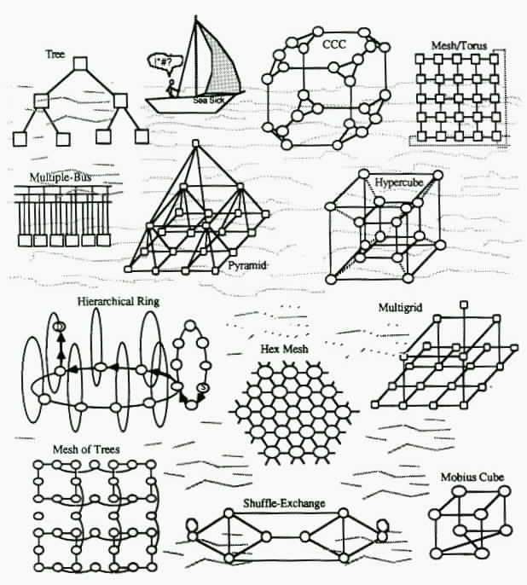
16.1 Performance Parameters for Networks
A wide variety of direct interconnection networks have been proposed for, or used in, parallel computers
They differ in topological, performance, robustness, and realizability attributes.
Fig. 4.8 (expanded)
The sea of direct interconnection networks.

Slide 74
Diameter and Average Distance
Diameter D (indicator of worst-case message latency)
Routing diameter D(R); based on routing algorithm R
Average internode distance Δ (indicator of average-case latency)
Routing average internode distance Δ(R)
For the 3 × 3 mesh:
Δ = (4 × 18 + 4 × 15 +12)
/ (9 × 8) = 2
[or 144 / 81 = 16 / 9]
For the 3 × 3 torus:
Δ = (4 × 1 + 4 × 2) / 8
= 1.5 [or 12 / 9 = 4 / 3]
Finding the average internode distance of a 3 × 3 mesh.

Slide 75
Bisection Width
Indicator or random communication capacity
Node bisection and link bisection
Hard to determine; Intuition can be very misleading
Fig. 16.2 A network whose bisection width is not as large at it appears.

Slide 76
Determining the Bisection Width
Establish upper bound by taking a number of trial cuts.
Then, try to match the upper bound by a lower bound.
Establishing a lower bound on B:
Embed K_{p} into p-node network
Let c be the maximum congestion
B ≥ ⎣p²/4⎦/c
Improved,
corrected
version of
this diagram
on next slide

Slide 77
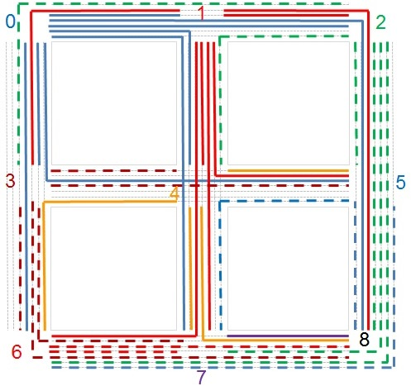
Example for Bounding the Bisection Width
Embed K₉ into
3 × 3 mesh
Observe the max congestion of 7
⎣p²/4⎦ = 20
Must cut at least
3 bundles to
sever 20 paths
Bisection width of a 3 × 3 mesh is at least 3
Given the upper bound of 4:
3 ≤ B ≤ 4
7
6
5
7
6
4
5
6
7
5
7
7

Slide 78
Degree-Diameter Relationship
Age-old question: What is the best way to interconnect p nodes of degree d to minimize the diameter D of the resulting network?
Alternatively: Given a desired diameter D and nodes of degree d, what is the max number of nodes p that can be accommodated?
Moore bounds (digraphs)
p ≤ 1 + d + d² + . . . + d^{D} = (d^{D+1} – 1)/(d – 1)
D ≥ log_{d} [p(d – 1) + 1] – 1
Only ring and K_{p} match these bounds
d ² nodes
d nodes
x
Moore bounds (undirected graphs)
p ≤ 1 + d + d(d – 1) + . . . + d(d – 1)^{D–1}
= 1 + d [(d – 1)^{D} – 1]/(d – 2)
D ≥ log_{d–1}[(p – 1)(d – 2)/d + 1]
Only ring with odd size p and a few other
networks match these bounds
d (d – 1) nodes
d nodes
x

Slide 79
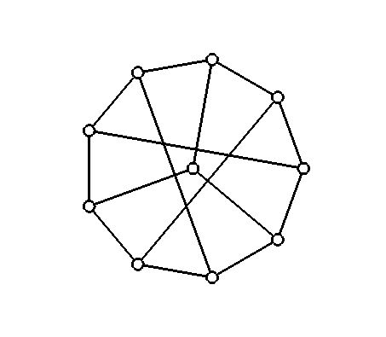

Moore Graphs
A Moore graph matches the bounds on diameter and number of nodes.
For d = 2, we have p ≤ 2D + 1
Odd-sized ring satisfies this bound
For d = 3, we have p ≤ 3 × 2^{D} – 2
D = 1 leads to p ≤ 4 (K₄ satisfies the bound)
D = 2 leads to p ≤ 10 and the first nontrivial example (Petersen graph)
Fig. 16.1 The 10-node Petersen graph.

Slide 80
How Good Are Meshes and Hypercubes?
For d = 4, we have D ≥ log₃[(p + 1)/2]
So, 2D mesh and torus networks are far from optimal in diameter, whereas butterfly is asymptotically optimal within a constant factor
For d = log₂ p (as for d-cube), we have D = Ω(d / log d)
So the diameter d of a d-cube is a factor of log d over the best possible
We will see that star graphs match this bound asymptotically
Summary:
For node degree d, Moore’s bounds establish the lowest possible diameter D that we can hope to achieve with p nodes, or the largest number p of nodes that we can hope to accommodate for a given D.
Coming within a constant factor of the bound is usually good enough; the smaller the constant factor, the better.

Slide 81
Layout Area and Longest Wire
The VLSI layout area required by an interconnection network is intimately related to its bisection width B
If B wires must cross the bisection in 2D layout of a network and wire separation is 1 unit, the smallest dimension of the VLSI chip will be ≥ B
The chip area will thus be Ω(B²) units
p-node 2D mesh needs O(p) area
p-node hypercube needs at least Ω(p²) area
The longest wire required in VLSI layout affects network performance
For example, any 2D layout of a p-node hypercube requires wires of length Ω((p / log p)^{1/2}); wire length of a mesh does not grow with size
When wire length grows with size, the per-node performance is bound to degrade for larger systems, thus implying sublinear speedup

Slide 82
Measures of Network Cost-Effectiveness
Composite measures, that take both the network performance and its implementation cost into account, are useful in comparisons
One such measure is the degree-diameter product, dD
Mesh / torus: Θ(p^{1/2})
Binary tree: Θ(log p)
Pyramid: Θ(log p)
Hypercube: Θ(log² p)
However, this measure is somewhat misleading, as the node degree d is not an accurate measure of cost; e.g., VLSI layout area also depends on wire lengths and wiring pattern and bus based systems have low node degrees and diameters without necessarily being cost-effective
Not quite similar in cost-performance
Robustness must be taken into account in any practical comparison of interconnection networks (e.g., tree is not as attractive in this regard)

Slide 83
16.2 Star and Pancake Networks
Has p = q ! nodes
Each node labeled with a string x₁x₂ ... x_{q} which is a permutation of {1, 2, ... , q}
Node x₁x₂ ... x_{i} ... x_{q} is connected to x_{i} x₂ ... x₁ ... x_{q} for each i (note that x₁ and x_{i} are interchanged)
When the i th symbol is switched with x₁ , the corresponding link is called a dimension-i link
d = q – 1; D = ⎣3(q – 1)/2⎦
D, d = O(log p / log log p)
Fig. 16.3 The four-dimensional star graph.

Slide 84
Routing in the Star Graph
Source node 1 5 4 3 6 2
Dimension-2 link to 5 1 4 3 6 2
Dimension-6 link to 2 1 4 3 6 5
Last symbol now adjusted
Dimension-2 link to 1 2 4 3 6 5
Dimension-5 link to 6 2 4 3 1 5
Last 2 symbols now adjusted
Dimension-2 link to 2 6 4 3 1 5
Dimension-4 link to 3 6 4 2 1 5
Last 3 symbols now adjusted
Dimension-2 link to 6 3 4 2 1 5
Dimension-3 link to 4 3 6 2 1 5
Last 4 symbols now adjusted
Dimension-2 link (Dest’n) 3 4 6 2 1 5
The diameter of star is in fact somewhat less D = ⎣3(q – 1)/2⎦
Clearly, this is not a shortest-path routing algorithm.
Correction to text, p. 328: diameter is not 2q – 3
We need a maximum of two routing steps per symbol, except that last two symbols need at most 1 step for adjustment ➔ D ≤ 2q – 3

Slide 85
Star’s Sublogarithmic Degree and Diameter
d = Θ(q) and D = Θ(q); but how is q related to the number p of nodes?
p = q ! ≅ e^{–q}q^{q} (2πq)^{1/2} [ using Striling’s approximation to q ! ]
ln p ≅ –q + (q + 1/2) ln q + ln(2π)/2 = Θ(q log q) or q = Θ(log p / log log p)
Hence, node degree and diameter are sublogarithmic
Star graph is asymptotically optimal to within a constant factor with regard to Moore’s diameter lower bound
Routing on star graphs is simple and reasonably efficient; however, virtually all other algorithms are more complex than the corresponding algorithms on hypercubes
Network diameter 4 5 6 7 8 9
Star nodes 24 -- 120 720 -- 5040
Hypercube nodes 16 32 64 128 256 512

Slide 86
The Star-Connected Cycles Network
Replace degree-(q – 1) nodes with (q – 1)-cycles
This leads to a scalable version of the star graph whose node degree of 3 does not grow with size
The diameter of SCC is about the same as that of a comparably sized CCC network
However, routing and other algorithms for SCC are more complex
Fig. 16.4 The four-dimensional star-connected cycles network.

Slide 87
Pancake Networks
1234
Similar to star networks in terms of node degree and diameter
Dimension-i neighbor obtained by “flipping” the first i symbols;
hence, the name “pancake”
Dim 4
Dim 2
4321
Dim 3
We need two flips per symbol in the worst case; D ≤ 2q – 3
3214
2134
Source node 1 5 4 3 6 2
Dimension-2 link to 5 1 4 3 6 2
Dimension-6 link to 2 6 3 4 1 5
Last 2 symbols now adjusted
Dimension-4 link to 4 3 6 2 1 5
Last 4 symbols now adjusted
Dimension-2 link (Dest’n) 3 4 6 2 1 5

Slide 88
Cayley Networks
Node x
Group:
A semigroup with an identity element and inverses for all elements.
Example 1: Integers with addition or multiplication operator form a group.
Example 2: Permutations, with the composition operator, form a group.
Gen γ₃
Gen γ₁
x ⊗ γ₃
Gen γ₂
x ⊗ γ₂
x ⊗ γ₁
Star and pancake networks are instances of Cayley graphs
Cayley graph:
Node labels are from a group G, and a subset S of G defines the connectivity via the group operator ⊗
Node x is connected to node y
iff x ⊗ γ = y for some γ ∈ S
Elements of S are “generators” of G if every element of G can be expressed as a finite product of their powers

Slide 89
Star as a Cayley Network
(1 4) (2) (3)
Four-dimensional star:
Group G of the permutations of {1, 2, 3, 4}
The generators are the following permutations:
(1 2) (3) (4)
(1 3) (2) (4)
(1 4) (2) (3)
The identity element is:
(1) (2) (3) (4)
(1 3) (2) (4)
Fig. 16.3 The four-dimensional star graph.

Slide 90
16.3 Ring-Based Networks
Rings are simple, but have low performance and lack robustness
Hence, a variety of multilevel and augmented ring networks have been proposed
Fig. 16.5 A 64-node ring-of-rings architecture composed of eight 8-node local rings and one second-level ring.

Slide 91
Chordal Ring Networks
Routing algorithm: Greedy routing
Given one chord type s, the optimal length for s is approximately p^{1/2}
Fig. 16.6 Unidirectional ring, two chordal rings, and node connectivity in general.

Slide 92
Chordal Rings Compared to Torus Networks
The ILLIAC IV interconnection scheme, often described as
8 × 8 mesh or torus, was really a 64-node chordal ring with skip distance 8.
Fig. 16.7 Chordal rings redrawn to show their similarity to torus networks.
Perfect Difference Networks
A class of chordal rings, studied at UCSB (two-part paper in IEEE TPDS, August 2005) have a diameter of D = 2
Perfect difference {0, 1, 3}: All numbers in the range 1-6 mod 7 can be formed as the difference of two numbers in the set.

Slide 93
Periodically Regular Chordal Rings
Fig. 16.8 Periodically regular chordal ring.
Modified greedy routing: first route to the head of a group; then use pure greedy routing

Slide 94
Some Properties of PRC Rings
Fig. 16.9 VLSI layout for a 64-node periodically regular chordal ring.
Remove some skip links for cost-performance tradeoff; similar in nature to CCC network with longer cycles
Fig. 16.10 A PRC ring redrawn as a butterfly- or ADM-like network.

Slide 95
16.4 Composite or Hybrid Networks
Motivation: Combine the connectivity schemes from two (or more) “pure” networks in order to:
• Achieve some advantages from each structure
• Derive network sizes that are otherwise unavailable
• Realize any number of performance / cost benefits
A very large set of combinations have been tried
New combinations are still being discovered

Slide 96
Composition by Cartesian Product Operation
Properties of product graph G = G′ × G″:
Nodes labeled (x ′, x ″), x ′ ∈ V ′, x ″ ∈ V ″
p = p′p″
d = d ′ + d ″
D = D′ + D″
Δ = Δ′ + Δ″
Routing: G ′-first
(x ′, x ″) → (y ′, x ″)
→ (y ′, y ″)
Broadcasting
Semigroup & parallel prefix computations
Fig. 13.4 Examples of product graphs.

Slide 97
Other Properties and Examples of Product Graphs
If G′ and G″ are Hamiltonian, then the p′ × p″ torus is a subgraph of G
For results on connectivity and fault diameter, see [Day00], [AlAy02]
Mesh of trees (Section 12.6)
Product of two trees
Fig. 16.11 Mesh of trees compared with mesh-connected trees.

Slide 98
16.5 Hierarchical (Multilevel) Networks
We have already seen several examples of hierarchical networks: multilevel buses (Fig. 4.9); CCC; PRC rings
Can be defined
from the bottom up or from the top down
Fig. 16.13 Hierarchical or multilevel bus network.
Take first-level ring networks and interconnect them as a hypercube
Take a top-level hypercube and replace its nodes with given networks

Slide 99
Example: Mesh of Meshes Networks
The same idea can be used to form ring of rings, hypercube of hypercubes, complete graph of complete graphs, and more generally, X of Xs networks
When network topologies at the two levels are different, we have X of Ys networks
Generalizable to three levels (X of Ys of Zs networks), four levels, or more
Fig. 16.12 The mesh of meshes network exhibits greater modularity than a mesh.

Slide 100
Example: Swapped Networks
Build a p²-node network using p-node building blocks (nuclei or clusters) by connecting node i in cluster j to node j in cluster i
Also known in the literature as OTIS (optical transpose interconnect system) network
Cluster #
Node #
00
10
01
11
Cluster #
Node #
Level-2 link
20
30
21
31
We can square the network size by adding one link per node
Level-1 link
0
1
02
12
03
13
2
3
22
32
23
33
Two-level swapped network with 2 × 2 mesh as its nucleus.

Slide 101
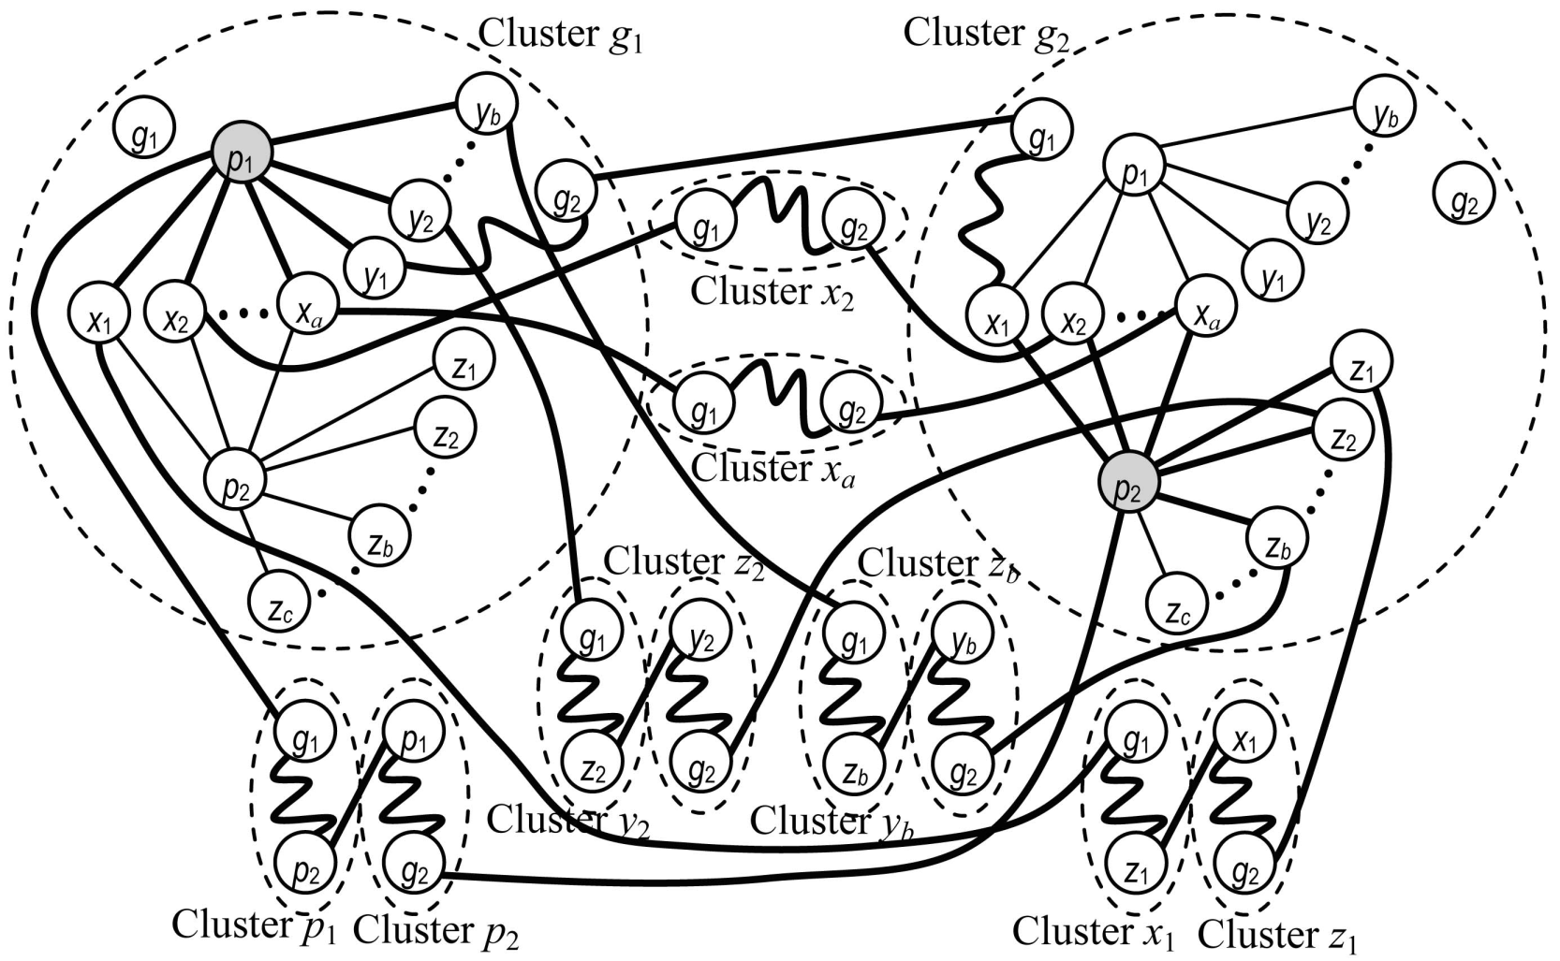
Swapped Networks Are Maximally Fault-Tolerant
For any connected, degree-d basis network G, Swap(G) = OTIS(G) has the maximal connectivity of d and can thus tolerate up to d – 1 faults
One case of several cases in the proof, corresponding to source and destination nodes being in different clusters
Source: Chen, Xiao, Parhami,
IEEE TPDS, March 2009

Slide 102
Example: Biswapped Networks
Build a 2p²-node network using p-node building blocks (nuclei or clusters) by connecting node i in cluster j of part 0 to node j in cluster i of part 1
p copies
p-node basis network
0
Two parts
1

Slide 103
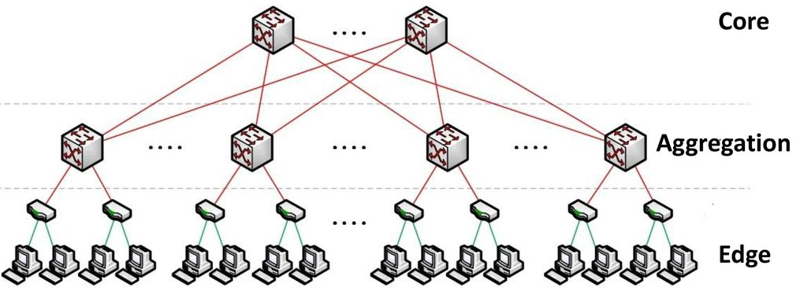
Data-Center Networks
Data-center communication patterns are different from parallel processors
Current networks are variations of the fat-tree concept
Two competing approaches:
- Specialized hardware and communication protocols (e.g., InfiniBand)
- Commodity Ethernet switches and routers for interconnecting clusters

Slide 104
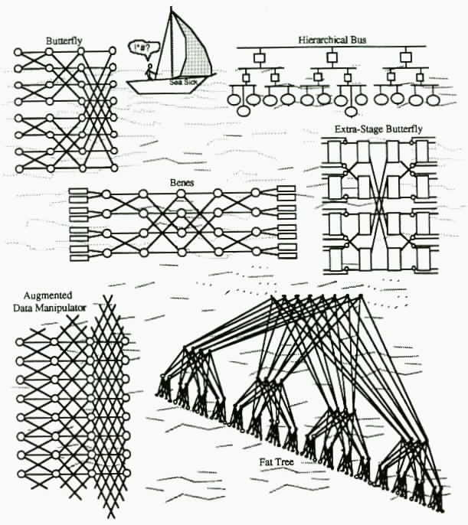
16.6 Multistage Interconnection Networks
Numerous indirect or multistage interconnection networks (MINs) have been proposed for, or used in, parallel computers
They differ in topological, performance, robustness, and realizability attributes
We have already seen the butterfly, hierarchical bus, beneš, and ADM networks
Fig. 4.8 (modified)
The sea of indirect interconnection networks.

Slide 105
Self-Routing Permutation Networks
Do there exist self-routing permutation networks? (The butterfly network is self-routing, but it is not a permutation network)
Permutation routing through a MIN is the same problem as sorting
Fig. 16.14 Example of sorting on a binary radix sort network.

Slide 106
Partial List of Important MINs
Augmented data manipulator (ADM): aka unfolded PM2I (Fig. 15.12)
Banyan: Any MIN with a unique path between any input and any output (e.g. butterfly)
Baseline: Butterfly network with nodes labeled differently
Beneš: Back-to-back butterfly networks, sharing one column (Figs. 15.9-10)
Bidelta: A MIN that is a delta network in either direction
Butterfly: aka unfolded hypercube (Figs. 6.9, 15.4-5)
Data manipulator: Same as ADM, but with switches in a column restricted to same state
Delta: Any MIN for which the outputs of each switch have distinct labels (say 0 and 1
for 2 × 2 switches) and path label, composed of concatenating switch output labels
leading from an input to an output depends only on the output
Flip: Reverse of the omega network (inputs × outputs)
Indirect cube: Same as butterfly or omega
Omega: Multi-stage shuffle-exchange network; isomorphic to butterfly (Fig. 15.19)
Permutation: Any MIN that can realize all permutations
Rearrangeable: Same as permutation network
Reverse baseline: Baseline network, with the roles of inputs and outputs interchanged

Slide 107
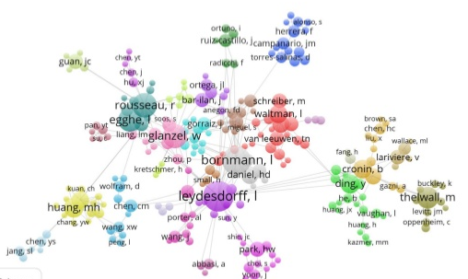
16.6* Natural and Human-Made Networks
Since multistage networks will move to Part II’ (shared memory), the new version of this subsection will discuss the classes of small-world and scale-free networks
Image credit:
Univ. Leiden
Example of a collaboration network
(e.g., co-authors of papers) showing clusters and inter-cluster connectivity

Slide 108
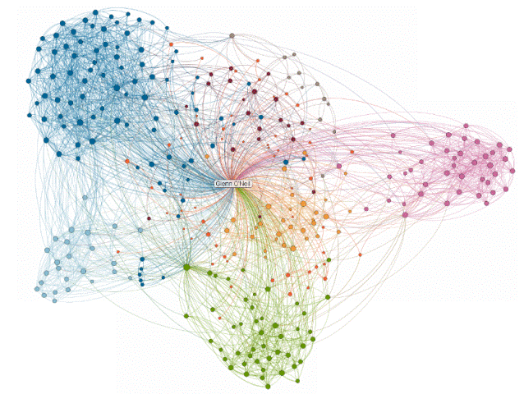
Professional Connections Networks
Image credit:
LinkedIn

