Slide 1
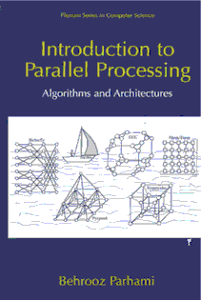
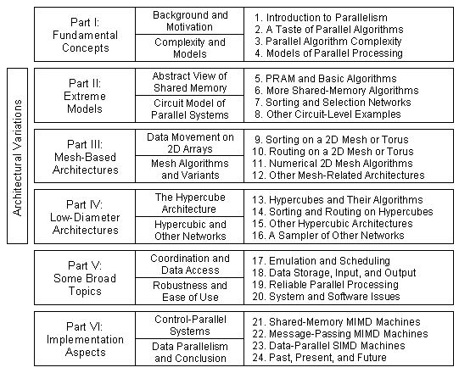
Part I
Fundamental Concepts

Slide 2
About This Presentation
This presentation is intended to support the use of the textbook Introduction to Parallel Processing: Algorithms and Architectures (Plenum Press, 1999, ISBN 0-306-45970-1). It was prepared by the author in connection with teaching the graduate-level course
ECE 254B: Advanced Computer Architecture: Parallel Processing, at the University of California, Santa Barbara. Instructors can use these slides in classroom teaching and for other educational purposes. Any other use is strictly prohibited. © Behrooz Parhami
Edition | Released | Revised | Revised | Revised
First | Spring 2005 | Spring 2006 | Fall 2008 | Fall 2010
 |  | Winter 2013 | Winter 2014 | Winter 2016
 |  | Winter 2019 | Winter 2020 | Winter 2021

Slide 3
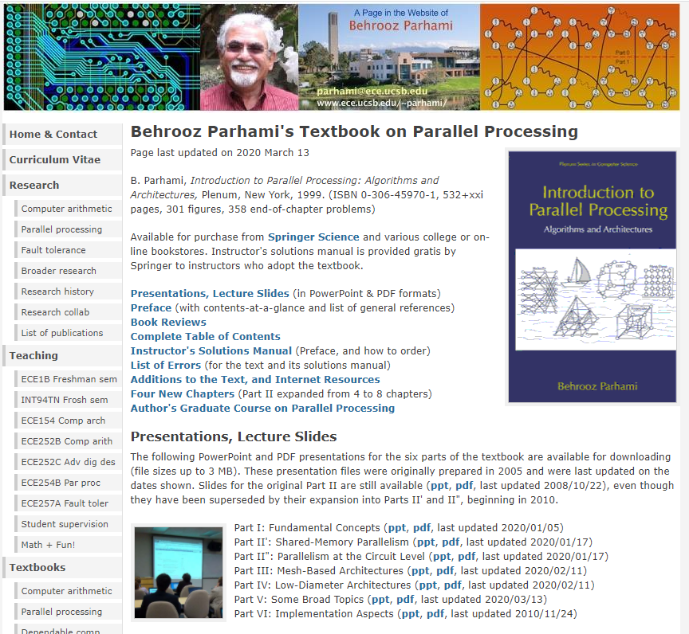

The Two Web Pages You Will Need
Notes:
Since around 2005, the rate of performance growth has slowed down, so that my extrapolated performance level for year 2010 was not achieved before the year 2020. Meanwhile, performance has been increasing via the introduction of multicore chips.

Slide 4
I Fundamental Concepts
Provide motivation, paint the big picture, introduce the 3 Ts:
  Taxonomy (basic terminology and models)
  Tools for evaluation or comparison
  Theory to delineate easy and hard problems
Topics in This Part
Chapter 1 Introduction to Parallelism
Chapter 2 A Taste of Parallel Algorithms
Chapter 3 Parallel Algorithm Complexity
Chapter 4 Models of Parallel Processing

Slide 5
1 Introduction to Parallelism
Set the stage for presenting the course material, including:
  Challenges in designing and using parallel systems
  Metrics to evaluate the effectiveness of parallelism
Topics in This Chapter
1.1 Why Parallel Processing?
1.2 A Motivating Example
1.3 Parallel Processing Ups and Downs
1.4 Types of Parallelism: A Taxonomy
1.5 Roadblocks to Parallel Processing
1.6 Effectiveness of Parallel Processing

Slide 6
Some Resources
Our textbook; followed closely in lectures
Parhami, B., Introduction to Parallel Processing: Algorithms and Architectures, Plenum Press, 1999
Recommended book; complementary software topics
Rauber, T. and G. Runger, Parallel Programming for Multicore and Cluster Systems, 2nd ed., Springer, 2013
Free on-line book (Creative Commons License)
Matloff, N., Programming on Parallel Machines: GPU, Multicore, Clusters and More, 341 pp., PDF file
http://heather.cs.ucdavis.edu/~matloff/158/PLN/ParProcBook.pdf
Useful free on-line course, sponsored by NVIDIA
“Introduction to Parallel Programming,” CPU/GPU-CUDA
https://developer.nvidia.com/udacity-cs344-intro-parallel-programming
1
2
3
Complete
Unified
Device
Architecture
4

Slide 7
1.1 Why Parallel Processing?
Projection,
circa 1998
Projection,
circa 2012
The number of cores has been increasing from a few in 2005
to the current 10s, and is projected to reach 100s by 2020
Cores
1000
100
10
1
2020
Fig. 1.1 The exponential growth of microprocessor performance, known as Moore’s Law, shown over the past two decades (extrapolated).
Notes:
Since around 2005, the rate of performance growth has slowed down, so that my extrapolated performance level for year 2010 was not achieved before the year 2020. Meanwhile, performance has been increasing via the introduction of multicore chips.

Slide 8
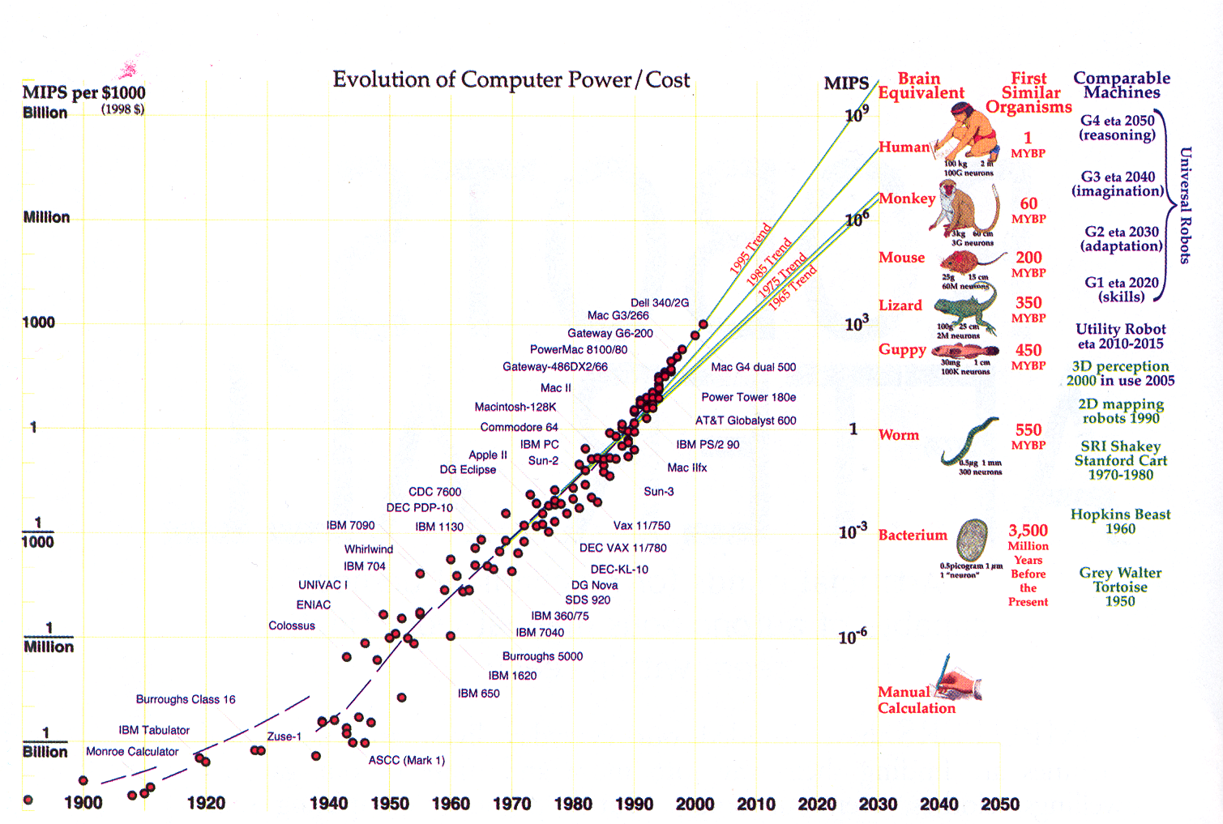
Evolution of Computer Performance/Cost
From:
“Robots After All,”
by H. Moravec, CACM, pp. 90-97, October 2003.
Mental power in four scales

Slide 9
The Semiconductor Technology Roadmap
Calendar year → | 2001 | 2004 | 2007 | 2010 | 2013 | 2016
Halfpitch (nm) | 140 | 90 | 65 | 45 | 32 | 22
Clock freq. (GHz) | 2 | 4 | 7 | 12 | 20 | 30
Wiring levels | 7 | 8 | 9 | 10 | 10 | 10
Power supply (V) | 1.1 | 1.0 | 0.8 | 0.7 | 0.6 | 0.5
Max. power (W) | 130 | 160 | 190 | 220 | 250 | 290
2015
2020
2025
19
12
8
3.6
4.1
4.6
4.4
5.3
6.5
0.6
From the 2001 edition of the roadmap [Alla02]
From the 2011 edition
(Last updated in 2013)
Actual halfpitch (Wikipedia, 2019): 2001, 130; 2010, 32; 2014, 14; 2018, 7
Factors contributing to the validity of Moore’s law
Denser circuits; Architectural improvements
Measures of processor performance
Instructions/second (MIPS, GIPS, TIPS, PIPS)
Floating-point operations per second
(MFLOPS, GFLOPS, TFLOPS, PFLOPS)
Running time on benchmark suites
Notes:
The updated half-pitch numbers are averages cited for flash and DRAM.

Slide 10
Trends in Processor Chip Density, Performance, Clock Speed, Power, and Number of Cores
Transistors per chip (1000s)
Relative performance
Clock speed (MHz)
Power dissipation (W)
Number of cores per chip
Density
Perfor-
mance
Clock
Power
Cores
Year of Introduction
NRC Report (2011): The Future of Computing Performance: Game Over or Next Level?

Slide 11
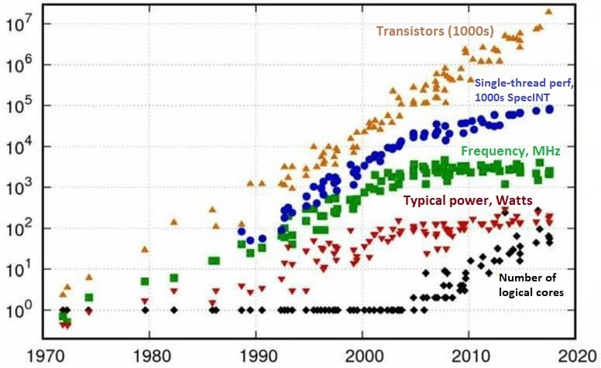
Trends in Processor Chip Density, Performance, Clock Speed, Power, and Number of Cores
Year of Introduction
Original data up to 2010 collected/plotted by M. Horowitz et al.; Data for 2010-2017 extension collected by K. Rupp

Slide 12
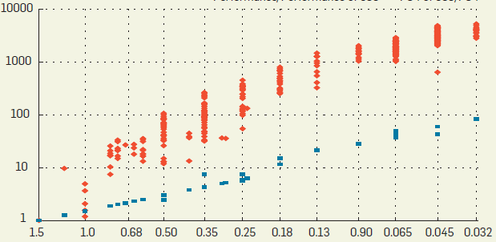
Shares of Technology and Architecture in Processor Performance Improvement
Overall Performance Improvement
(SPECINT, relative to 386)
Gate Speed Improvement
(FO4, relative to 386)
Feature Size (μm)
~1985
--------- 1995-2000 ---------
Much of arch. improvements already achieved
~2005
~2010
Source: [DANO12] “CPU DB: Recording Microprocessor History,” CACM, April 2012.
Notes:
An initial period, when architectural enhancements contributed more than technology advancements to processor performance ended around the year 2000. Since then, technology has been responsible for the bulk of performance improvements.

Slide 13
Why High-Performance Computing?
Higher speed (solve problems faster)
Important when there are “hard” or “soft” deadlines;
e.g., 24-hour weather forecast
Higher throughput (solve more problems)
Important when we have many similar tasks to perform;
e.g., transaction processing
Higher computational power (solve larger problems)
e.g., weather forecast for a week rather than 24 hours,
or with a finer mesh for greater accuracy
1
2
3
Categories of supercomputers
Uniprocessor; aka vector machine
Multiprocessor; centralized or distributed shared memory
Multicomputer; communicating via message passing
Massively parallel processor (MPP; 1K or more processors)

Slide 14
The Speed-of-Light Argument
The speed of light is about 30 cm/ns.
Signals travel at 40-70% speed of light (say, 15 cm/ns).
If signals must travel 1.5 cm during the execution of an instruction, that instruction will take at least 0.1 ns;
thus, performance will be limited to 10 GIPS.
This limitation is eased by continued miniaturization,
architectural methods such as cache memory, etc.; however, a fundamental limit does exist.
How does parallel processing help? Wouldn’t multiple processors need to communicate via signals as well?

Slide 15
Interesting Quotes about Parallel Programming
“There are 3 rules to follow when parallelizing large codes. Unfortunately, no one knows what these rules are.”
~ W. Somerset Maugham, Gary Montry
“The wall is there. We probably won’t have any more products without multicore processors [but] we see a lot of problems in parallel programming.” ~ Alex Bachmutsky
“We can solve [the software crisis in parallel computing], but only if we work from the algorithm down to the hardware — not the traditional hardware-first mentality.” ~ Tim Mattson
“[The processor industry is adding] more and more cores, but nobody knows how to program those things. I mean, two, yeah; four, not really; eight, forget it.” ~ Steve Jobs
1
2
3
4

Slide 16
The Three Walls of High-Performance Computing
1
Memory-wall challenge:
Memory already limits single-processor performance. How can we design a memory system that provides a bandwidth of several terabytes/s for data-intensive high-performance applications?
Power-wall challenge:
When there are millions of processing nodes, each drawing a few watts of power, we are faced with the energy bill and cooling challenges of MWs of power dissipation, even ignoring the power needs of the interconnection network and peripheral devices
Reliability-wall challenge:
Ensuring continuous and correct functioning of a system with many thousands or even millions of processing nodes is non-trivial, given that a few of the nodes are bound to malfunction at an given time
2
3

Slide 17
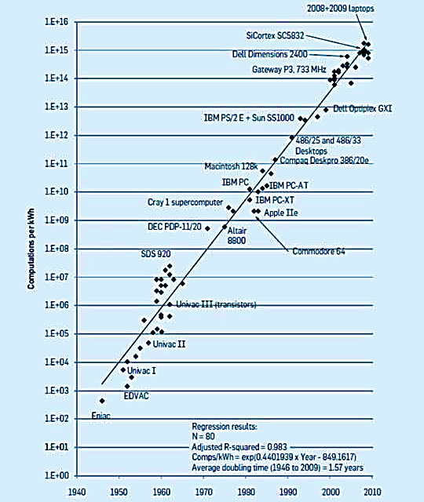
Power-Dissipation Challenge
A challenge at both ends:
- Supercomputers
- Personal electronics
Koomey’s Law:
Exponential improvement in energy-efficient computing, with computations performed per KWh doubling every 1.57 years
How long will Koomey’s law be in effect? It will come to an end, like Moore’s Law
https://cacm.acm.org/magazines/2017/1/211094-exponential-laws-of-computing-growth/fulltext

Slide 18
Why Do We Need TIPS or TFLOPS Performance?
Reasonable running time = Fraction of hour to several hours (10³-10⁴ s)
In this time, a TIPS/TFLOPS machine can perform 10¹⁵-10¹⁶ operations
Example 1: Southern oceans heat Modeling
(10-minute iterations)
300 GFLOP per iteration ×
300 000 iterations per 6 yrs =
10¹⁶ FLOP
4096 E-W regions
1024 N-S
regions
12 layers
in depth
Example 2: Fluid dynamics calculations (1000 × 1000 × 1000 lattice)
10⁹ lattice points × 1000 FLOP/point × 10 000 time steps = 10¹⁶ FLOP
Example 3: Monte Carlo simulation of nuclear reactor
10¹¹ particles to track (for 1000 escapes) × 10⁴ FLOP/particle = 10¹⁵ FLOP
Decentralized supercomputing: A grid of tens of thousands networked computers discovered the Mersenne prime 2⁸² ⁵⁸⁹ ⁹³³ – 1 as the largest known prime number as of Jan. 2021 (it has 24 862 048 digits in decimal)
Notes:
See the page “The Largest Known Primes”: https://primes.utm.edu/largest.html

Slide 19
Supercomputer Performance Growth
Fig. 1.2 The exponential growth in supercomputer performance over the past two decades (from [Bell92], with ASCI performance goals and microprocessor peak FLOPS superimposed as dotted lines).

Slide 20
The ASCI Program
Fig. 24.1 Milestones in the Accelerated Strategic (Advanced Simulation &) Computing Initiative (ASCI) program, sponsored by the US Department of Energy, with extrapolation up to the PFLOPS level.

Slide 21
The Quest for Higher Performance
Top Three Supercomputers in 2005 (IEEE Spectrum, Feb. 2005, pp. 15-16)
1. IBM Blue Gene/L | 2. SGI Columbia | 3. NEC Earth Sim
LLNL, California | NASA Ames, California | Earth Sim Ctr, Yokohama
Material science, nuclear stockpile sim | Aerospace/space sim, climate research | Atmospheric, oceanic, and earth sciences
32,768 proc’s, 8 TB, 28 TB disk storage | 10,240 proc’s, 20 TB, 440 TB disk storage | 5,120 proc’s, 10 TB, 700 TB disk storage
Linux + custom OS | Linux | Unix
71 TFLOPS, $100 M | 52 TFLOPS, $50 M | 36 TFLOPS*, $400 M?
Dual-proc Power-PC chips (10-15 W power) | 20x Altix (512 Itanium2) linked by Infiniband | Built of custom vector microprocessors
Full system: 130k-proc, 360 TFLOPS (est) |  | Volume = 50x IBM, Power = 14x IBM
* Led the top500 list for 2.5 yrs

Slide 22
The Quest for Higher Performance: 2008 Update
Top Three Supercomputers in June 2008 (http://www.top500.org)
1. IBM Roadrunner | 2. IBM Blue Gene/L | 3. Sun Blade X6420
LANL, New Mexico | LLNL, California | U Texas Austin
Nuclear stockpile calculations, and more | Advanced scientific simulations | Open science research
122,400 proc’s, 98 TB, 0.4 TB/s file system I/O | 212,992 proc’s, 74 TB, ≈2 PB disk storage | 62,976 proc’s, 126 TB
Red Hat Linux | CNK/SLES 9 | Linux
1.38 PFLOPS, $130M | 0.596 PFLOPS, $100M | 0.504 PFLOPS*
PowerXCell 8i 3.2 GHz, AMD Opteron (hybrid) | PowerPC 440 700 MHz | AMD X86-64 Opteron quad core 2 GHz
2.35 MW power, expands to 1M proc’s | 1.60 MW power, expands to 0.5M proc’s | 2.00 MW power, Expands to 0.3M proc’s
* Actually 4th on top-500 list, with the 3rd being another IBM Blue Gene system at 0.557 PFLOPS

Slide 23
The Quest for Higher Performance: 2012 Update
Top Three Supercomputers in November 2012 (http://www.top500.org)
1. Cray Titan | 2. IBM Sequoia | 3. Fujitsu K Computer
ORNL, Tennessee | LLNL, California | RIKEN AICS, Japan
XK7 architecture | Blue Gene/Q arch | RIKEN architecture
560,640 cores, 710 TB, Cray Linux | 1,572,864 cores, 1573 TB, Linux | 705,024 cores, 1410 TB, Linux
Cray Gemini interconn’t | Custom interconnect | Tofu interconnect
17.6/27.1 PFLOPS* | 16.3/20.1 PFLOPS* | 10.5/11.3 PFLOPS*
AMD Opteron, 16-core, 2.2 GHz, NVIDIA K20x | Power BQC, 16-core, 1.6 GHz | SPARC64 VIIIfx, 2.0 GHz
8.2 MW power | 7.9 MW power | 12.7 MW power
* max/peak performance
In the top 10, IBM also occupies ranks 4-7 and 9-10. Dell and NUDT (China) hold ranks 7-8.

Slide 24
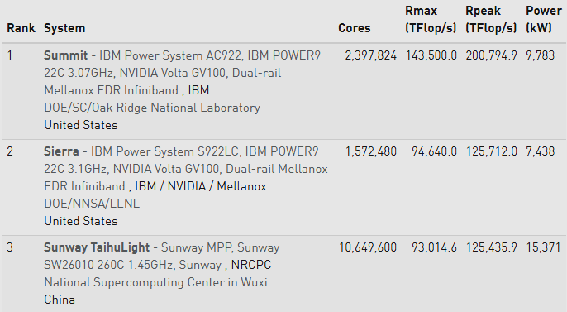
The Quest for Higher Performance: 2018 Update
Top Three Supercomputers in November 2018 (http://www.top500.org)

Slide 25
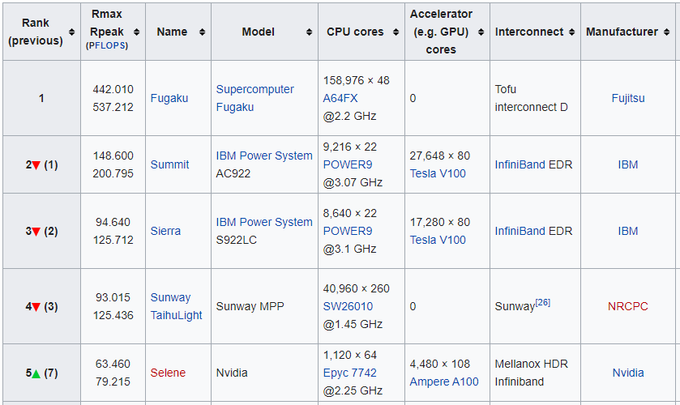
The Quest for Higher Performance: 2020 Update
Top Five Supercomputers in November 2020 (http://www.top500.org)

Slide 26
Top 500 Supercomputers in the World
2014
2016
2018
2020

Slide 27
What Exactly is Parallel Processing?
Parallelism = Concurrency
Doing more than one thing at a time
Has been around for decades, since early computers
I/O channels, DMA, device controllers, multiple ALUs
The sense in which we use it in this course
Multiple agents (hardware units, software processes) collaborate to perform our main computational task
- Multiplying two matrices
- Breaking a secret code
- Deciding on the next chess move

Slide 28
1.2 A Motivating Example
Init. Pass 1 Pass 2 Pass 3
2←m 2 2 2
3 3←m 3 3
4
5 5 5←m 5
6
7 7 7 7 ← m
8
9 9
10
11 11 11 11
12
13 13 13 13
14
15 15
16
17 17 17 17
18
19 19 19 19
20
21 21
22
23 23 23 23
24
25 25 25
26
27 27
28
29 29 29 29
30
Fig. 1.3 The sieve of Eratosthenes yielding a list of 10 primes for n = 30. Marked elements have been distinguished by erasure from the list.
Any composite number
has a prime factor
that is no greater than its square root.

Slide 29
Single-Processor Implementation of the Sieve
Bit-vector
Fig. 1.4 Schematic representation of single-processor solution for the sieve of Eratosthenes.

Slide 30
Control-Parallel Implementation of the Sieve
Fig. 1.5 Schematic representation of a control-parallel solution for the sieve of Eratosthenes.

Slide 31
Running Time of the Sequential/Parallel Sieve
Fig. 1.6 Control-parallel realization of the sieve of Eratosthenes with n = 1000 and 1 ≤ p ≤ 3.

Slide 32
Data-Parallel Implementation of the Sieve
Assume at most √n processors, so that all prime factors dealt with are in P1 (which broadcasts them)
√ n < n / p
Fig. 1.7 Data-parallel realization of the sieve of Eratosthenes.

Slide 33
One Reason for Sublinear Speedup:
Communication Overhead
Fig. 1.8 Trade-off between communication time and computation time in the data-parallel realization of the sieve of Eratosthenes.

Slide 34
Another Reason for Sublinear Speedup:
Input/Output Overhead
Fig. 1.9 Effect of a constant I/O time on the data-parallel realization of the sieve of Eratosthenes.

Slide 35
1.3 Parallel Processing Ups and Downs
Fig. 1.10 Richardson’s circular theater for weather forecasting calculations.
Using thousands of “computers” (humans + calculators) for 24-hr weather prediction in a few hours
1960s: ILLIAC IV (U Illinois) –
four 8 × 8 mesh quadrants, SIMD
1980s: Commercial interest – technology was driven by government grants & contracts.
Once funding dried up,
many companies went bankrupt
2000s: Internet revolution –
info providers, multimedia, data mining, etc. need lots of power
2020s: Cloud, big-data, AI/ML

Slide 36
Trends in High-Technology Development
Evolution of parallel processing has been quite different from other high tech fields
Development of some technical fields into $1B businesses and the roles played by government research and industrial R&D over time (IEEE Computer, early 90s?).

Slide 37
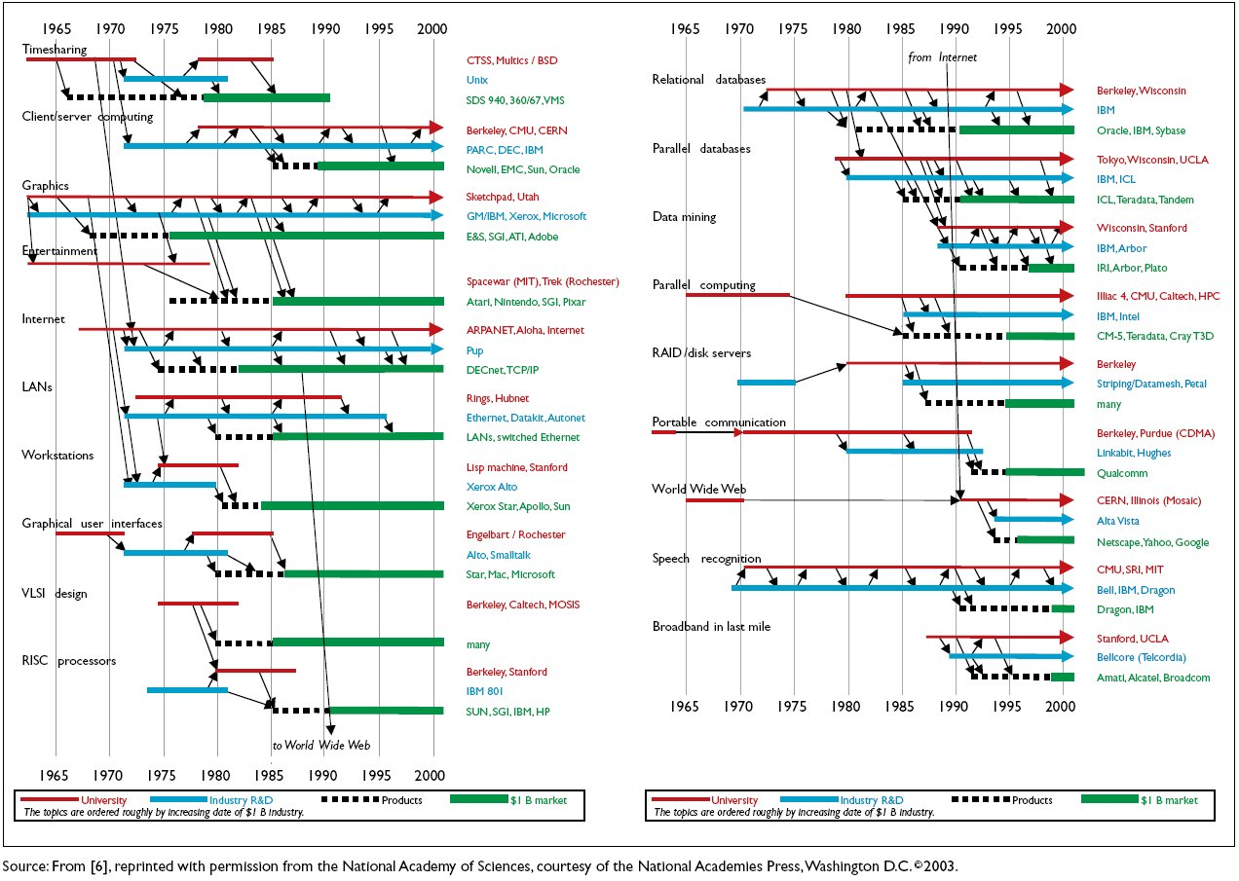
Trends in Hi-Tech Development (2003)

Slide 38
Status of Computing Power (circa 2000)
2010
2020
TFLOPS
PFLOPS (Peta = 10¹⁵)
GFLOPS on desktop: Apple Macintosh, with G4 processor
TFLOPS in supercomputer center:
1152-processor IBM RS/6000 SP (switch-based network)
Cray T3E, torus-connected
PFLOPS on the drawing board:
1M-processor IBM Blue Gene (2005?)
32 proc’s/chip, 64 chips/board, 8 boards/tower, 64 towers
Processor: 8 threads, on-chip memory, no data cache
Chip: defect-tolerant, row/column rings in a 6 × 6 array
Board: 8 × 8 chip grid organized as 4 × 4 × 4 cube
Tower: Boards linked to 4 neighbors in adjacent towers
System: 32×32×32 cube of chips, 1.5 MW (water-cooled)
PFLOPS
EFLOPS (Exa = 10¹⁸)
EFLOPS
ZFLOPS (Zeta = 10²¹)

Slide 39
1.4 Types of Parallelism: A Taxonomy
Fig. 1.11 The Flynn-Johnson classification of computer systems.

Slide 40
1.5 Roadblocks to Parallel Processing
• Grosch’s law: Economy of scale applies, or power = cost²
• Minsky’s conjecture: Speedup tends to be proportional to log p
• Tyranny of IC technology: Uniprocessors suffice (x10 faster/5 yrs)
• Tyranny of vector supercomputers: Familiar programming model
• Software inertia: Billions of dollars investment in software
• Amdahl’s law: Unparallelizable code severely limits the speedup
No longer valid; in fact we can get more bang per buck in micros
Has roots in analysis of memory bank conflicts; can be overcome
Faster ICs make parallel machines faster too; what about x1000?
Not all computations involve vectors; parallel vector machines
New programs; even uniprocessors benefit from parallelism spec

Slide 41
Amdahl’s Law
f = fraction
unaffected
p = speedup
of the rest
s =
≤ min(p, 1/f)
1
f + (1 – f)/p
Fig. 1.12 Limit on speed-up according to Amdahl’s law.

Slide 42
1.6 Effectiveness of Parallel Processing
Fig. 1.13 Task graph exhibiting limited inherent parallelism.
p Number of processors
W(p) Work performed by p processors
T(p) Execution time with p processors
T(1) = W(1); T(p) ≤ W(p)
S(p) Speedup = T(1) / T(p)
E(p) Efficiency = T(1) / [p T(p)]
R(p) Redundancy = W(p) / W(1)
U(p) Utilization = W(p) / [p T(p)]
Q(p) Quality = T³(1) / [p T²(p) W(p)]
W(1) = 13
T(1) = 13
T(∞) = 8

Slide 43
Reduction or Fan-in Computation
Example: Adding 16 numbers, 8 processors, unit-time additions
Zero-time communication
E(8) = 15 / (8 × 4) = 47%
S(8) = 15 / 4 = 3.75
R(8) = 15 / 15 = 1
Q(8) = 1.76
Unit-time communication
E(8) = 15 / (8 × 7) = 27%
S(8) = 15 / 7 = 2.14
R(8) = 22 / 15 = 1.47
Q(8) = 0.39
Fig. 1.14 Computation graph for finding the sum of 16 numbers .

Slide 44
ABCs of Parallel Processing in One Slide
A Amdahl’s Law (Speedup Formula)
Bad news – Sequential overhead will kill you, because:
Speedup = T₁/T_{p} ≤ 1/[f + (1 – f)/p] ≤ min(1/f, p)
Morale: For f = 0.1, speedup is at best 10, regardless of peak OPS.
B Brent’s Scheduling Theorem
Good news – Optimal scheduling is very difficult, but even a naive
scheduling algorithm can ensure:
T₁/p ≤ T_{p} < T₁/p + T∞ = (T₁/p)[1 + p/(T₁/T∞)]
Result: For a reasonably parallel task (large T₁/T∞), or for a suitably
small p (say, p < T₁/T∞), good speedup and efficiency are possible.
C Cost-Effectiveness Adage
Real news – The most cost-effective parallel solution may not be
the one with highest peak OPS (communication?), greatest speed-up
(at what cost?), or best utilization (hardware busy doing what?).
Analogy: Mass transit might be more cost-effective than private cars
even if it is slower and leads to many empty seats.
Notes:
Parhami, B., “ABCs of Parallel Processing in One Transparency,” Computer Architecture News, Vol. 27, No. 1, p. 2, March 1999.

Slide 45
2 A Taste of Parallel Algorithms
Learn about the nature of parallel algorithms and complexity:
  By implementing 5 building-block parallel computations
  On 4 simple parallel architectures (20 combinations)
Topics in This Chapter
2.1 Some Simple Computations
2.2 Some Simple Architectures
2.3 Algorithms for a Linear Array
2.4 Algorithms for a Binary Tree
2.5 Algorithms for a 2D Mesh
2.6 Algorithms with Shared Variables

Slide 46
Two Kinds of Parallel Computing/Processing Courses
Centered on Programming and Applications
Assume language-level facilities for parallel programming
Shared variables and structures
Message passing primitives
Architecture-independent to a large extent
Knowledge of architecture helpful, but not required for decent results
Analogy: Programmer need not know about cache memory, but …
Requires attention to data distribution for optimal performance
Focused on Architectures and Algorithms
Develop algorithms with close attention to low-level hardware support
Data distribution affects algorithm design
Communication with neighboring nodes only
Each architecture needs its own set of algorithms
Building-block computations can be used to save effort
Interconnection topology is the key to high performance

Slide 47
Architecture/Algorithm Combinations
Semi-group
Parallel prefix
Packet routing
Broad-casting
Sorting
We will spend more time on linear array and binary tree
and less time on mesh and shared memory (studied later)

Slide 48
2.1 Some Simple Computations
s = x₀ ⊗ x₁ ⊗ . . . ⊗ x_{n–1}
Fig. 2.1 Semigroup computation on a uniprocessor.

Slide 49
Parallel Semigroup Computation
log₂ n levels
s = x₀ ⊗ x₁ ⊗ . . . ⊗ x_{n–1}
Semigroup computation viewed as tree or fan-in computation.

Slide 50
Parallel Prefix Computation
Parallel version much trickier compared to that of semigroup computation
Requires a minimum of log₂ n levels
s = x₀ ⊗ x₁ ⊗ x₂ ⊗ . . . ⊗ x_{n–1}
Prefix computation on a uniprocessor.

Slide 51
The Five Building-Block Computations
Reduction computation: aka tree, semigroup, fan-in comp.
All processors to get the result at the end
Scan computation: aka parallel prefix comp.
The ith processor to hold the ith prefix result at the end
Packet routing:
Send a packet from a source to a destination processor
Broadcasting:
Send a packet from a source to all processors
Sorting:
Arrange a set of keys, stored one per processor, so that
the ith processor holds the ith key in ascending order

Slide 52
2.2 Some Simple Architectures
Fig. 2.2 A linear array of nine processors and its ring variant.
Max node degree d = 2
Network diameter D = p – 1 ( ⎣p/2⎦ )
Bisection width B = 1 ( 2 )

Slide 53
(Balanced) Binary Tree Architecture
Complete binary tree
2^{q} – 1 nodes, 2^{q–1} leaves
Balanced binary tree
Leaf levels differ by 1
Max node degree d = 3
Network diameter D = 2 ⎣log₂ p⎦ ( − 1 )
Bisection width B = 1
Fig. 2.3 A balanced (but incomplete) binary tree of nine processors.

Slide 54
Two-Dimensional (2D) Mesh
Nonsquare
mesh
(r rows,
p/r col’s)
also possible
Max node degree d = 4
Network diameter D = 2√p – 2 ( √p )
Bisection width B ≅ √p ( 2√p )
Fig. 2.4 2D mesh of 9 processors and its torus variant.

Slide 55
Shared-Memory Architecture
Max node degree d = p – 1
Network diameter D = 1
Bisection width B = ⎣p/2⎦ ⎡p/2⎤
Costly to implement
Not scalable
But . . .
Conceptually simple
Easy to program
Fig. 2.5 A shared-variable architecture modeled as a complete graph.

Slide 56
2.3 Algorithms for a Linear Array
Fig. 2.6 Maximum-finding on a linear array of nine processors.
For general semigroup computation:
Phase 1: Partial result is propagated from left to right
Phase 2: Result obtained by processor p – 1 is broadcast leftward

Slide 57
Linear Array Prefix Sum Computation
Fig. 2.7 Computing prefix sums on a linear array of nine processors.
Diminished parallel prefix computation:
The ith processor obtains the result up to element i – 1

Slide 58
Linear-Array Prefix Sum Computation
Fig. 2.8 Computing prefix sums on a linear array with two items per processor.

Slide 59
Linear Array Routing and Broadcasting
Routing and broadcasting on a linear array of nine processors.
To route from processor i to processor j:
Compute j – i to determine distance and direction
To broadcast from processor i:
Send a left-moving and a right-moving broadcast message

Slide 60
Linear Array Sorting (Externally Supplied Keys)
Fig. 2.9 Sorting on a linear array with the keys input sequentially from the left.

Slide 61
Linear Array Sorting (Internally Stored Keys)
Fig. 2.10 Odd-even transposition sort on a linear array.
T(1) = W(1) = p log₂ p T(p) = p W(p) ≅ p²/2
S(p) = log₂ p (Minsky’s conjecture?) R(p) = p/(2 log₂ p)

Slide 62
2.4 Algorithms for a Binary Tree
Reduction computation and broadcasting on a binary tree.

Slide 63
Binary Tree Scan Computation
Upward
propagation
Fig. 2.11 Scan computation on a binary tree of processors.
Downward
propagation

Slide 64
Node Function in Binary Tree Scan Computation
Two binary operations: one during the upward propagation phase, and another during downward propagation
[i, k]
[0, i – 1]
⊗
Upward
propagation
Insert latches for systolic operation (no long wires or propagation path)
Downward
propagation
⊗
[i, j – 1]
[0, j – 1]
[0, i – 1]
[ j, k]

Slide 65
Usefulness of Scan Computation
Ranks of 1s in a list of 0s/1s:
Data: 0 0 1 0 1 0 0 1 1 1 0
Prefix sums: 0 0 1 1 2 2 2 3 4 5 5
Ranks of 1s: 1 2 3 4 5
Priority arbitration circuit:
Data: 0 0 1 0 1 0 0 1 1 1 0
Dim’d prefix ORs: 0 0 0 1 1 1 1 1 1 1 1
Complement: 1 1 1 0 0 0 0 0 0 0 0
AND with data: 0 0 1 0 0 0 0 0 0 0 0
Carry-lookahead network:
p g a g g p p p g a c_{in}
←⎯⎯⎯⎯⎯⎯⎯⎯⎯⎯⎯⎯⎯⎯⎯⎯⎯ g or a
Direction of indexing
p ¢ x = x
a ¢ x = a
g ¢ x = g

Slide 66
Binary Tree Packet Routing
Preorder indexing
Node index is a representation of the path from the tree root
Packet routing on a binary tree with two indexing schemes.

Slide 67
Binary Tree Sorting
Small values “bubble up,” causing the root to “see” the values in ascending order
Linear-time sorting (no better than linear array)
Fig. 2.12 The first few steps of the sorting algorithm on a binary tree.

Slide 68
The Bisection-Width Bottleneck in a Binary Tree
Linear-time sorting is the best possible due to B = 1
Fig. 2.13 The bisection width of a binary tree architecture.

Slide 69
2.5 Algorithms for a 2D Mesh
Finding the max value on a 2D mesh.
Computing prefix sums on a 2D mesh

Slide 70
Routing and Broadcasting on a 2D Mesh
Nonsquare
mesh
(r rows,
p/r col’s)
also possible
Routing: Send along the row to the correct column; route in column
Broadcasting: Broadcast in row; then broadcast in all column
Routing and broadcasting on a 9-processors 2D mesh or torus

Slide 71
Sorting on a 2D Mesh Using Shearsort
Number of iterations = log₂ √p
Compare-exchange steps in each iteration = 2√p
Total steps = (log₂ p + 1) √p
1
2
3
Fig. 2.14 The shearsort algorithm on a 3 × 3 mesh.

Slide 72
2.6 Algorithms with Shared Variables
12
Reduction computation: Each processor can perform the computation locally
Scan computation: Same as reduction, except only data from smaller-index processors are combined
Packet routing: Trivial
Broadcasting: One step with all-port (p – 1 steps with single-port) communication
Sorting: Each processor determines the rank of its data element; followed by routing
3
8
6
5
10
1
Rank[15] = 8
(8 others smaller)
Rank[4] = 2
(1 & 3 smaller)
15
4

Slide 73
3 Parallel Algorithm Complexity
Review algorithm complexity and various complexity classes:
  Introduce the notions of time and time/cost optimality
  Derive tools for analysis, comparison, and fine-tuning
Topics in This Chapter
3.1 Asymptotic Complexity
3.2 Algorithms Optimality and Efficiency
3.3 Complexity Classes
3.4 Parallelizable Tasks and the NC Class
3.5 Parallel Programming Paradigms
3.6 Solving Recurrences

Slide 74
3.1 Asymptotic Complexity
f(n) = O(g(n)) f(n) = Ω(g(n)) f(n) = Θ(g(n))
Fig. 3.1 Graphical representation of the notions of asymptotic complexity.
3n log n = O(n²)
½ n log² n = Ω(n)
3n² + 200n = Θ(n²)

Slide 75
Little Oh, Big Oh, and Their Buddies
Notation Growth rate Example of use
f(n) = o(g(n)) strictly less than T(n) = cn² + o(n²)
f(n) = O(g(n)) no greater than T(n, m) = O(n log n + m)
f(n) = Θ(g(n)) the same as T(n) = Θ(n log n)
f(n) = Ω(g(n)) no less than T(n, m) = Ω(√n + m^{3/2})
f(n) = ω(g(n)) strictly greater than T(n) = ω(log n)
<
≤
=
≥
>

Slide 76
Growth Rates for Typical Functions
Sublinear Linear Superlinear
log²n n^{1/2} n n log²n n^{3/2}
-------- -------- -------- -------- --------
9 3 10 90 30
36 10 100 3.6 K 1 K
81 31 1 K 81 K 31 K
169 100 10 K 1.7 M 1 M
256 316 100 K 26 M 31 M
361 1 K 1 M 361 M 1000 M
Table 3.1 Comparing the Growth Rates of Sublinear and Superlinear Functions (K = 1000, M = 1 000 000).
n (n/4) log²n n log²n 100 n^{1/2} n^{3/2}
-------- -------- -------- -------- --------
10 20 s 2 min 5 min 30 s
100 15 min 1 hr 15 min 15 min
1 K 6 hr 1 day 1 hr 9 hr
10 K 5 day 20 day 3 hr 10 day
100 K 2 mo 1 yr 9 hr 1 yr
1 M 3 yr 11 yr 1 day 32 yr
Table 3.3 Effect of Constants on the Growth Rates of Running Times Using Larger Time Units and Round Figures.
Warning: Table 3.3 in text needs corrections.

Slide 77
Some Commonly Encountered Growth Rates
Notation Class name Notes
O(1) Constant Rarely practical
O(log log n) Double-logarithmic Sublogarithmic
O(log n) Logarithmic
O(log^{k} n) Polylogarithmic k is a constant
O(nª), a < 1 e.g., O(n^{1/2}) or O(n^{1–ε})
O(n / log^{k} n) Still sublinear
-------------------------------------------------------------------------------------------------------------------------------------------------------------------
O(n) Linear
-------------------------------------------------------------------------------------------------------------------------------------------------------------------
O(n log^{k} n) Superlinear
O(n^{c}), c > 1 Polynomial e.g., O(n^{1+ε}) or O(n^{3/2})
O(2^{n}) Exponential Generally intractable
O(2^{2n}) Double-exponential Hopeless!

Slide 78




3.2 Algorithm Optimality and Efficiency
Lower bounds: Theoretical arguments based on bisection width, and the like
Upper bounds: Deriving/analyzing algorithms and proving them correct
Fig. 3.2 Upper and lower bounds may tighten over time.

Slide 79
Complexity History of Some Real Problems
Examples from the book Algorithmic Graph Theory and Perfect Graphs [GOLU04]:
Complexity of determining whether an n-vertex graph is planar
Exponential Kuratowski 1930
O(n³) Auslander and Porter 1961
Goldstein 1963
Shirey 1969
O(n²) Lempel, Even, and Cederbaum 1967
O(n log n) Hopcroft and Tarjan 1972
O(n) Hopcroft and Tarjan 1974
Booth and Leuker 1976
A second, more complex example: Max network flow, n vertices, e edges:
ne² → n²e → n³ → n²e^{1/2} → n^{5/3}e^{2/3} → ne log² n → ne log(n²/e)
→ ne + n^{2+ε} → ne log_{e/(n log n)} n → ne log_{e/n} n + n² log^{2+ε} n

Slide 80
Some Notions of Algorithm Optimality
Time optimality (optimal algorithm, for short)
T(n, p) = g(n, p), where g(n, p) is an established lower bound
Problem size
Number of processors
Cost-time optimality (cost-optimal algorithm, for short)
pT(n, p) = T(n, 1); i.e., redundancy = utilization = 1
Cost-time efficiency (efficient algorithm, for short)
pT(n, p) = Θ(T(n, 1)); i.e., redundancy = utilization = Θ(1)

Slide 81
Beware of Comparing Step Counts
For example, one algorithm may need 20 GFLOP, another 4 GFLOP (but float division is a factor of ≅10 slower than float multiplication
Fig. 3.2 Five times fewer steps does not necessarily mean five times faster.

Slide 82
3.3 Complexity Classes
This diagram
has been replaced with a more complete one
Conceptual view of the P, NP, NP-complete, and NP-hard classes.

Slide 83
Computational Complexity Classes
The Aug. 2010 claim that P ≠ NP by V. Deolalikar was found to be erroneous
Conceptual view of the P, NP, NP-complete, and NP-hard classes.

Slide 84
Some NP-Complete Problems
Subset sum problem: Given a set of n integers and a target sum s, determine if a subset of the integers adds up to s.
Satisfiability: Is there an assignment of values to variables in a product-of-sums Boolean expression that makes it true?
(Is in NP even if each OR term is restricted to have exactly three literals)
Circuit satisfiability: Is there an assignment of 0s and 1s to inputs of a logic circuit that would make the circuit output 1?
Hamiltonian cycle: Does an arbitrary graph contain a cycle that goes through all of its nodes?
Traveling salesperson: Find a lowest-cost or shortest tour of a number of cities, given travel costs or distances.

Slide 85
3.4 Parallelizable Tasks and the NC Class
NC (Nick’s class): Subset of problems
in P for which there exist parallel algorithms using
p = n^{c} processors (polynomially many) that run in O(log^{k} n) time (polylog time).
Efficiently parallelizable
P-complete problem: Given a logic circuit with known inputs, determine its output (circuit value problem).
Fig. 3.4 A conceptual view of complexity classes and their relationships.

Slide 86
3.5 Parallel Programming Paradigms
Divide and conquer
Decompose problem of size n into smaller problems; solve subproblems independently; combine subproblem results into final answer
T(n) = T_{d}(n) + T_{s} + T_{c}(n)
Decompose Solve in parallel Combine
Randomization
When it is impossible or difficult to decompose a large problem into subproblems with equal solution times, one might use random decisions that lead to good results with very high probability.
Example: sorting with random sampling
Other forms: Random search, control randomization, symmetry breaking
Approximation
Iterative numerical methods may use approximation to arrive at solution(s).
Example: Solving linear systems using Jacobi relaxation.
Under proper conditions, the iterations converge to the correct solutions; more iterations ⇒ greater accuracy

Slide 87
3.6 Solving Recurrences
f(n) = f(n – 1) + n {rewrite f(n – 1) as f((n – 1) – 1) + n – 1}
= f(n – 2) + n – 1 + n
= f(n – 3) + n – 2 + n – 1 + n
. . .
= f(1) + 2 + 3 + . . . + n – 1 + n
= n(n + 1)/2 – 1 = Θ(n²)
This method is known as unrolling
f(n) = f(n/2) + 1 {rewrite f(n/2) as f((n/2)/2 + 1}
= f(n/4) + 1 + 1
= f(n/8) + 1 + 1 + 1
. . .
= f(n/n) + 1 + 1 + 1 + . . . + 1
-------- log₂ n times --------
= log₂ n = Θ(log n)

Slide 88
More Example of Recurrence Unrolling
f(n) = 2f(n/2) + 1
= 4f(n/4) + 2 + 1
= 8f(n/8) + 4 + 2 + 1
. . .
= n f(n/n) + n/2 + . . . + 4 + 2 + 1
= n – 1 = Θ(n)
Solution via guessing:
Guess f(n) = Θ(n) = cn + g(n)
cn + g(n) = cn/2 + g(n/2) + n
Thus, c = 2 and g(n) = g(n/2)
f(n) = f(n/2) + n
= f(n/4) + n/2 + n
= f(n/8) + n/4 + n/2 + n
. . .
= f(n/n) + 2 + 4 + . . . + n/4 + n/2 + n
= 2n – 2 = Θ(n)

Slide 89
Still More Examples of Unrolling
f(n) = 2f(n/2) + n
= 4f(n/4) + n + n
= 8f(n/8) + n + n + n
. . .
= n f(n/n) + n + n + n + . . . + n
--------- log₂ n times ---------
= n log₂n = Θ(n log n)
Alternate solution method:
f(n)/n = f(n/2)/(n/2) + 1
Let f(n)/n = g(n)
g(n) = g(n/2) + 1 = log₂ n
f(n) = f(n/2) + log₂ n
= f(n/4) + log₂(n/2) + log₂ n
= f(n/8) + log₂(n/4) + log₂(n/2) + log₂ n
. . .
= f(n/n) + log₂ 2 + log₂ 4 + . . . + log₂(n/2) + log₂ n
= 1 + 2 + 3 + . . . + log₂ n
= log₂ n (log₂ n + 1)/2 = Θ(log² n)

Slide 90
Master Theorem for Recurrences
Theorem 3.1:
Given f(n) = a f(n/b) + h(n); a, b constant, h arbitrary function
the asymptotic solution to the recurrence is (c = log_{b} a)
f(n) = Θ(n ^{c}) if h(n) = O(n ^{c – ε}) for some ε > 0
f(n) = Θ(n ^{c} log n) if h(n) = Θ(n ^{c})
f(n) = Θ(h(n)) if h(n) = Ω(n ^{c + ε}) for some ε > 0
Example: f(n) = 2 f(n/2) + 1
a = b = 2; c = log_{b} a = 1
h(n) = 1 = O( n ^{1 – ε})
f(n) = Θ(n ^{c}) = Θ(n)

Slide 91
Intuition Behind the Master Theorem
Theorem 3.1:
Given f(n) = a f(n/b) + h(n); a, b constant, h arbitrary function
the asymptotic solution to the recurrence is (c = log_{b} a)
f(n) = Θ(n ^{c}) if h(n) = O(n ^{c – ε}) for some ε > 0
f(n) = Θ(n ^{c} log n) if h(n) = Θ(n ^{c})
f(n) = Θ(h(n)) if h(n) = Ω(n ^{c + ε}) for some ε > 0
f(n) = 2f(n/2) + 1 = 4f(n/4) + 2 + 1 = . . .
= n f(n/n) + n/2 + . . . + 4 + 2 + 1
The last term
dominates
f(n) = 2f(n/2) + n = 4f(n/4) + n + n = . . .
= n f(n/n) + n + n + n + . . . + n
All terms are
comparable
f(n) = f(n/2) + n = f(n/4) + n/2 + n = . . .
= f(n/n) + 2 + 4 + . . . + n/4 + n/2 + n
The first term
dominates

Slide 92
4 Models of Parallel Processing
Expand on the taxonomy of parallel processing from Chap. 1:
  Abstract models of shared and distributed memory
  Differences between abstract models and real hardware
Topics in This Chapter
4.1 Development of Early Models
4.2 SIMD versus MIMD Architectures
4.3 Global versus Distributed Memory
4.4 The PRAM Shared-Memory Model
4.5 Distributed-Memory or Graph Models
4.6 Circuit Model and Physical Realizations

Slide 93
4.1 Development of Early Models
Associative memory
Parallel masked search of all words
Bit-serial implementation with RAM
Associative processor
Add more processing logic to PEs
100111010110001101000
Comparand
Mask
Memory array with comparison logic
Table 4.1 Entering the second half-century of associative processing
–––––––––––––––––––––––––––––––––––––––––––––––––––––––––––––––––––––
Decade Events and Advances Technology Performance
–––––––––––––––––––––––––––––––––––––––––––––––––––––––––––––––––––––
1940s Formulation of need & concept Relays
1950s Emergence of cell technologies Magnetic, Cryogenic Mega-bit-OPS
1960s Introduction of basic architectures Transistors
1970s Commercialization & applications ICs Giga-bit-OPS
1980s Focus on system/software issues VLSI Tera-bit-OPS
1990s Scalable & flexible architectures ULSI, WSI Peta-bit-OPS
–––––––––––––––––––––––––––––––––––––––––––––––––––––––––––––––––––––

Slide 94
The Flynn-Johnson Classification Revisited
Fig. 4.2
Fig. 4.1 The Flynn-Johnson classification of computer systems.

Slide 95
4.2 SIMD versus MIMD Architectures
Most early parallel machines had SIMD designs
Attractive to have skeleton processors (PEs)
Eventually, many processors per chip
High development cost for custom chips, high cost
MSIMD and SPMD variants
Most modern parallel machines have MIMD designs
COTS components (CPU chips and switches)
MPP: Massively or moderately parallel?
Tightly coupled versus loosely coupled
Explicit message passing versus shared memory
Network-based NOWs and COWs
Networks/Clusters of workstations
Grid computing
Vision: Plug into wall outlets for computing power
SIMD Timeline
1960
ILLIAC IV
1970
DAP
1980
Goodyear MPP
TMC CM-2
MasPar MP-1
1990
2000
Clearspeed
array coproc
2010

Slide 96
4.3 Global versus Distributed Memory
Options:
Crossbar
Bus(es)
MIN
Bottleneck
Complex
Expensive
Fig. 4.3 A parallel processor with global memory.

Slide 97
Removing the Processor-to-Memory Bottleneck
Challenge:
Cache coherence
Fig. 4.4 A parallel processor with global memory and processor caches.

Slide 98
Distributed Shared Memory
Some Terminology:
NUMA
Nonuniform memory access
(distributed shared memory)
UMA
Uniform memory access
(global shared memory)
COMA
Cache-only memory arch
Fig. 4.5 A parallel processor with distributed memory.

Slide 99
4.4 The PRAM Shared-Memory Model
Fig. 4.6 Conceptual view of a parallel random-access machine (PRAM).

Slide 100
PRAM Implementation and Operation
PRAM Cycle:
All processors
read memory locations of their choosing
All processors compute one step independently
All processors store results into memory locations of their choosing
Fig. 4.7 PRAM with some hardware details shown.

Slide 101
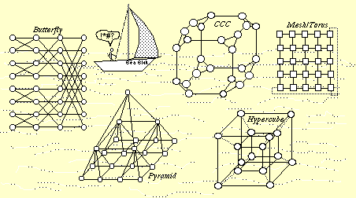
4.5 Distributed-Memory or Graph Models
Fig. 4.8 The sea of interconnection networks.

Slide 102
Some Interconnection Networks (Table 4.2)
–––––––––––––––––––––––––––––––––––––––––––––––––––––––––––––––––
Number Network Bisection Node Local
Network name(s) of nodes diameter width degree links?
–––––––––––––––––––––––––––––––––––––––––––––––––––––––––––––––––
1D mesh (linear array) k k – 1 1 2 Yes
1D torus (ring, loop) k k/2 2 2 Yes
2D Mesh k² 2k – 2 k 4 Yes
2D torus (k-ary 2-cube) k² k 2k 4 Yes¹
3D mesh k³ 3k – 3 k² 6 Yes
3D torus (k-ary 3-cube) k³ 3k/2 2k² 6 Yes¹
Pyramid (4k² – 1)/3 2 log₂ k 2k 9 No
Binary tree 2^{l} – 1 2l – 2 1 3 No
4-ary hypertree 2^{l}(2^{l+1} – 1) 2l 2^{l+1} 6 No
Butterfly 2^{l}(l + 1) 2l 2^{l} 4 No
Hypercube 2^{l} l 2^{l–1} l No
Cube-connected cycles 2^{l} l 2l 2^{l–1} 3 No
Shuffle-exchange 2^{l} 2l – 1 ≥ 2^{l–1}/l 4 unidir. No
De Bruijn 2^{l} l 2^{l} /l 4 unidir. No
––––––––––––––––––––––––––––––––––––––––––––––––––––––––––––––––
¹ With folded layout

Slide 103
4.6 Circuit Model and Physical Realizations
Scalability dictates hierarchical connectivity
Fig. 4.9 Example of a hierarchical interconnection architecture.

Slide 104
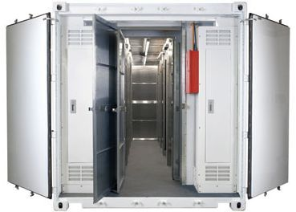
A Million-Server Data Center
Container with 2500 servers

Slide 105


Warehouse-Scale Supercomputers
This book, authored by three Google researchers as part of the series
"Synthesis Lectures in Computer Architecture,“
explains the concepts in its 2019 third edition
The 2013 second edition is available on-line:
http://web.eecs.umich.edu/~mosharaf/Readings/DC-Computer.pdf
Computer as:
Industrial
installation
Office machine

Slide 106
Signal Delay on Wires No Longer Negligible
Wire Delay (ns)
Wire Length (nm)
Fig. 4.10 Intrachip wire delay as a function of wire length.

Slide 107
Pitfalls of
Scaling up
(Fig. 4.11)
If the weight of ant grows by a factor of one trillion, the thickness of its legs must grow by a factor of one million to support the new weight
Ant scaled up in length from 5 mm to 50 m
Leg thickness must grow from 0.1 mm to 100 m

