Slide 1
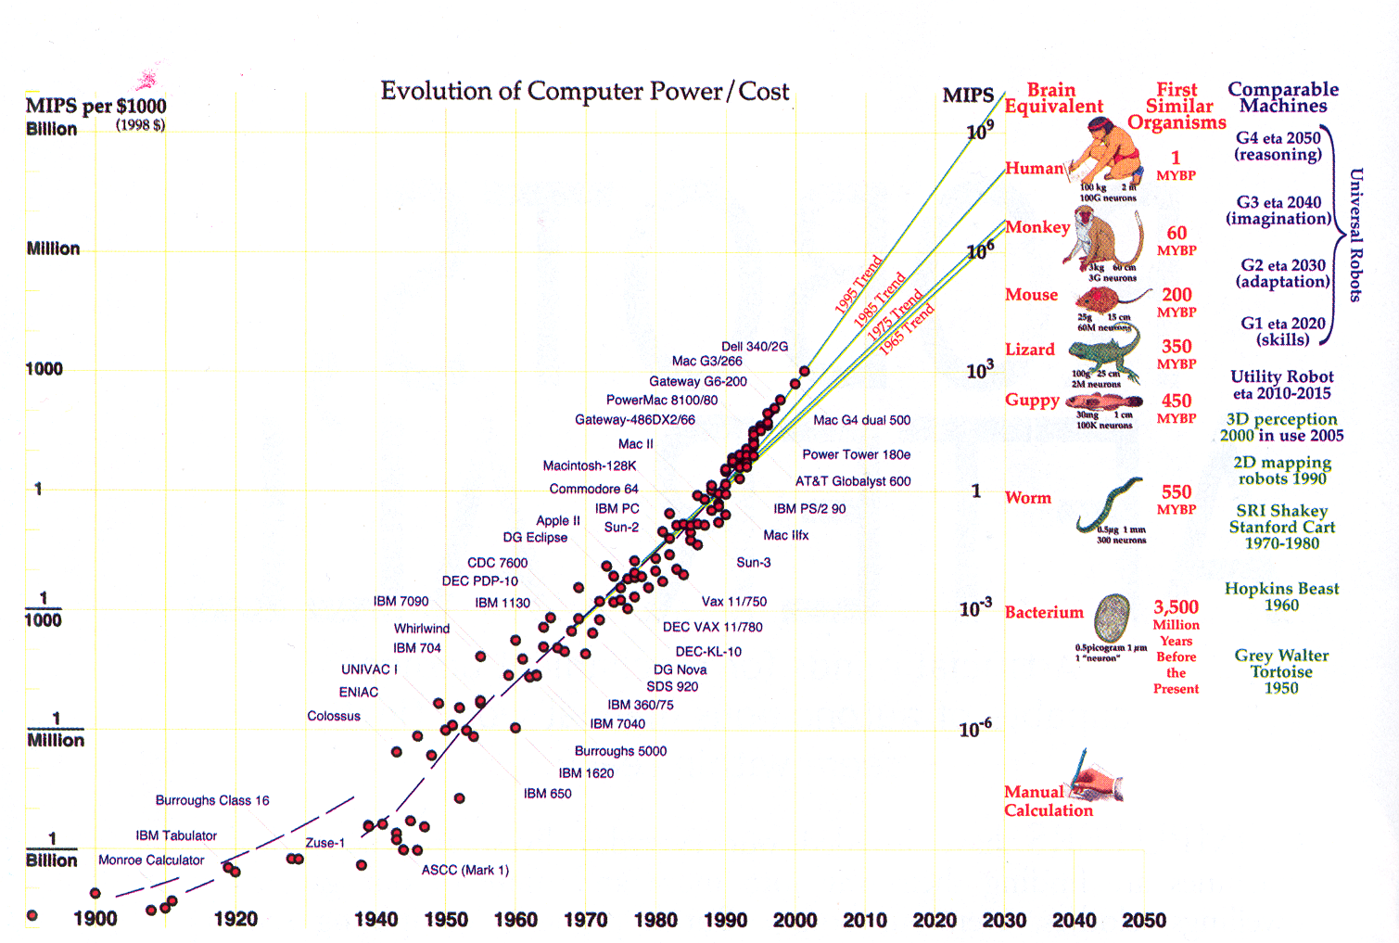
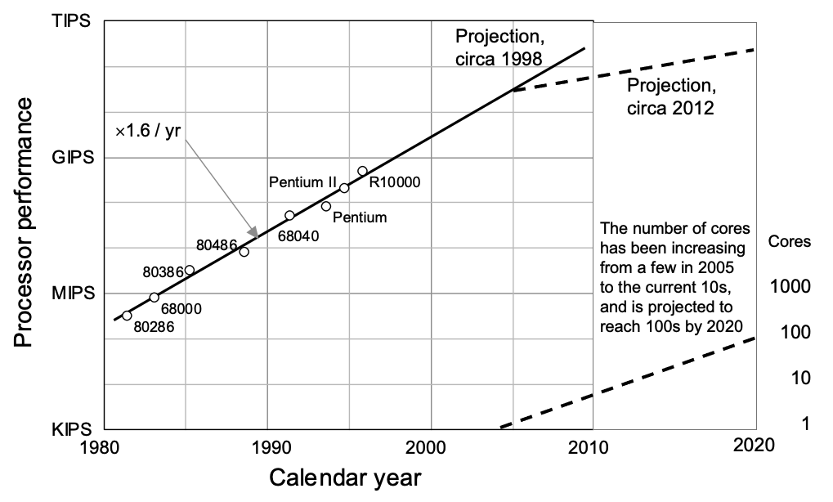
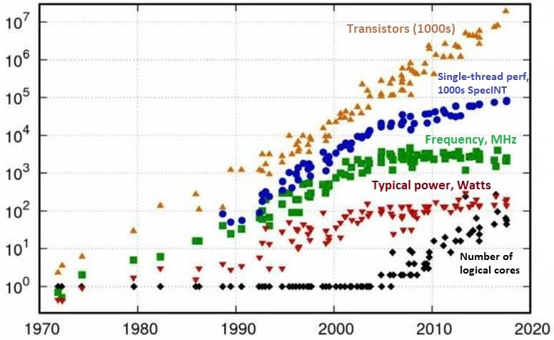
Lecture 34: Advanced Topics – Industry Trends
Books:
Amazon Best Sellers (Nov 2021)
Programming on Parallel Machines
Lectures:
Introduction to GPU Programming
The GPUs of the Future
Topics:
Recent Trends in Parallel Computing
The End of Moore’s Law

