Slide 1


Hadoop, a distributed framework for Big Data
Class: CS 237 Distributed Systems Middleware
Instructor: Nalini Venkatasubramanian

Slide 2

Introduction
Introduction: Hadoop’s history and advantages
Architecture in detail
Hadoop in industry

Slide 3

What is Hadoop?
Apache top level project, open-source implementation of frameworks for reliable, scalable, distributed computing and data storage.
It is a flexible and highly-available architecture for large scale computation and data processing on a network of commodity hardware.

Slide 4
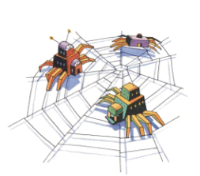
Brief History of Hadoop
Designed to answer the question: “How to process big data with reasonable cost and time?”

Slide 5
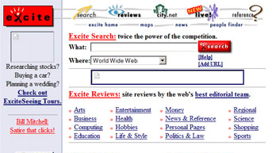
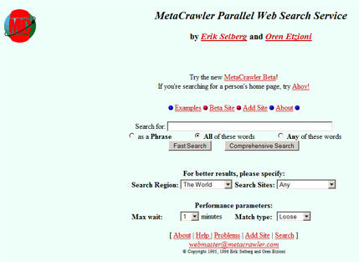


Search engines in 1990s
1996
1996
1996
1997

Slide 6
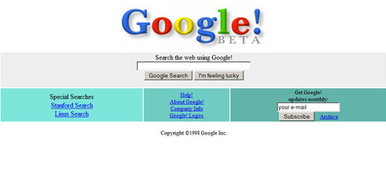

Google search engines
1998
2013

Slide 7




Hadoop’s Developers
2005: Doug Cutting and Michael J. Cafarella developed Hadoop to support distribution for the Nutch search engine project.
The project was funded by Yahoo.
2006: Yahoo gave the project to Apache
Software Foundation.
Doug Cutting

Slide 8
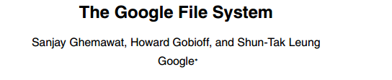

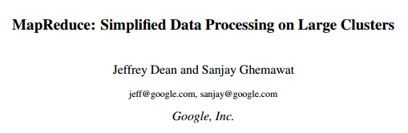


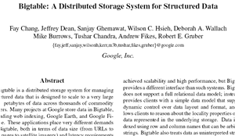
Google Origins
2003
2004
2006

Slide 9
Some Hadoop Milestones
2008 - Hadoop Wins Terabyte Sort Benchmark (sorted 1 terabyte of data in 209 seconds, compared to previous record of 297 seconds)
2009 - Avro and Chukwa became new members of Hadoop Framework family
2010 - Hadoop's Hbase, Hive and Pig subprojects completed, adding more computational power to Hadoop framework
2011 - ZooKeeper Completed
2013 - Hadoop 1.1.2 and Hadoop 2.0.3 alpha.
- Ambari, Cassandra, Mahout have been added

Slide 10
What is Hadoop?
Hadoop:
  an open-source software framework that supports data-intensive distributed applications, licensed under the Apache v2 license.
Goals / Requirements:
  Abstract and facilitate the storage and processing of large and/or rapidly growing data sets
    Structured and non-structured data
    Simple programming models
  High scalability and availability
  Use commodity (cheap!) hardware with little redundancy
  Fault-tolerance
  Move computation rather than data

Slide 11
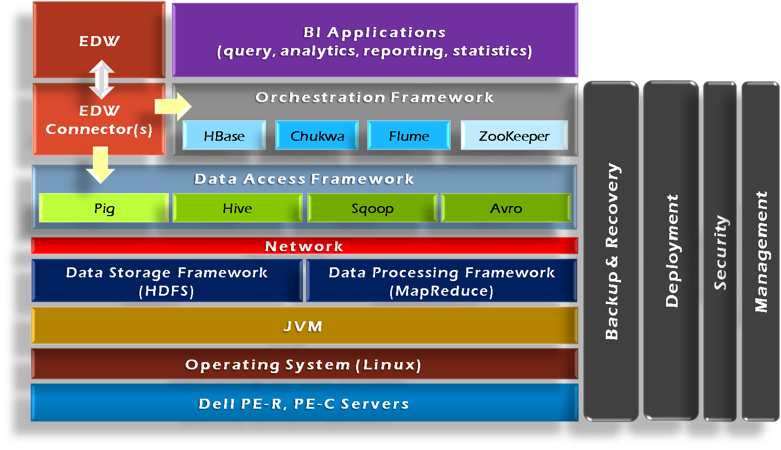
Hadoop Framework Tools

Slide 12
Hadoop’s Architecture
Distributed, with some centralization
Main nodes of cluster are where most of the computational power and storage of the system lies
Main nodes run TaskTracker to accept and reply to MapReduce tasks, and also DataNode to store needed blocks closely as possible
Central control node runs NameNode to keep track of HDFS directories & files, and JobTracker to dispatch compute tasks to TaskTracker
Written in Java, also supports Python and Ruby

Slide 13
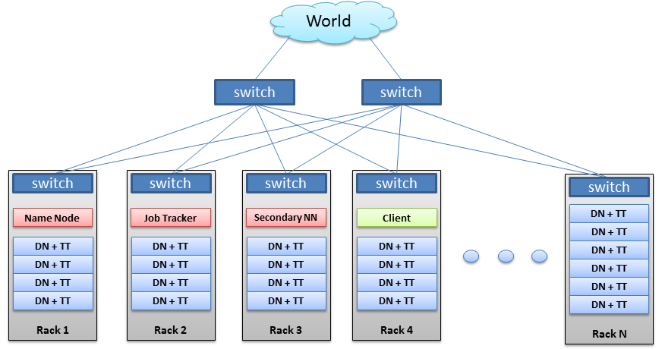
Hadoop’s Architecture

Slide 14
Hadoop’s Architecture
Hadoop Distributed Filesystem
Tailored to needs of MapReduce
Targeted towards many reads of filestreams
Writes are more costly
High degree of data replication (3x by default)
No need for RAID on normal nodes
Large blocksize (64MB)
Location awareness of DataNodes in network

Slide 15
Hadoop’s Architecture
NameNode:
Stores metadata for the files, like the directory structure of a typical FS.
The server holding the NameNode instance is quite crucial, as there is only one.
Transaction log for file deletes/adds, etc. Does not use transactions for whole blocks or file-streams, only metadata.
Handles creation of more replica blocks when necessary after a DataNode failure

Slide 16
Hadoop’s Architecture
DataNode:
Stores the actual data in HDFS
Can run on any underlying filesystem (ext3/4, NTFS, etc)
Notifies NameNode of what blocks it has
NameNode replicates blocks 2x in local rack, 1x elsewhere

Slide 17
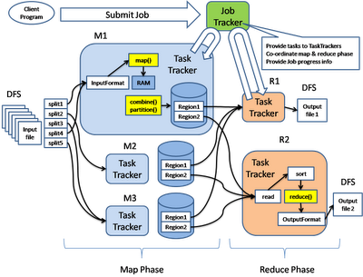
Hadoop’s Architecture: MapReduce Engine

Slide 18
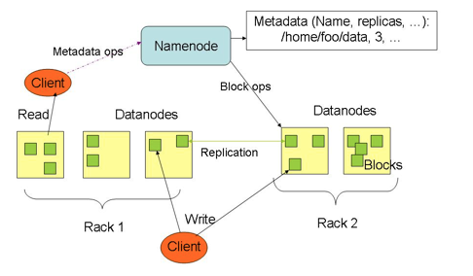

Slide 19
Hadoop’s Architecture
MapReduce Engine:
JobTracker & TaskTracker
JobTracker splits up data into smaller tasks(“Map”) and sends it to the TaskTracker process in each node
TaskTracker reports back to the JobTracker node and reports on job progress, sends data (“Reduce”) or requests new jobs

Slide 20
Hadoop’s Architecture
None of these components are necessarily limited to using HDFS
Many other distributed file-systems with quite different architectures work
Many other software packages besides Hadoop's MapReduce platform make use of HDFS

Slide 21
Hadoop in the Wild
Hadoop is in use at most organizations that handle big data:
  Yahoo!
  Facebook
  Amazon
  Netflix
  Etc…
Some examples of scale:
  Yahoo!’s Search Webmap runs on 10,000 core Linux cluster and powers Yahoo! Web search
  FB’s Hadoop cluster hosts 100+ PB of data (July, 2012) & growing at ½ PB/day (Nov, 2012)
  (In 2021: FB handles 2.2 Billion users per month, generates 4 PB/day; 300 PB total)

Slide 22
Hadoop in the Wild
Three main applications of Hadoop:
Advertisement (Mining user behavior to generate recommendations)
Searches (group related documents)
Security (search for uncommon patterns)

Slide 23
Hadoop in the Wild
Non-realtime large dataset computing:
  NY Times was dynamically generating PDFs of articles from 1851-1922
  Wanted to pre-generate & statically serve articles to improve performance
  Using Hadoop + MapReduce running on EC2 / S3, converted 4TB of TIFFs into 11 million PDF articles in 24 hrs

Slide 24

Hadoop in the Wild: Facebook Messages
Design requirements:
  Integrate display of email, SMS and chat messages between pairs and groups of users
  Strong control over who users receive messages from
  Suited for production use between 500 million people immediately after launch
  Stringent latency & uptime requirements

Slide 25

Hadoop in the Wild
System requirements
  High write throughput
  Cheap, elastic storage
  Low latency
  High consistency (within a single data center good enough)
  Disk-efficient sequential and random read performance

Slide 26
Hadoop in the Wild
Classic alternatives
  These requirements typically met using large MySQL cluster & caching tiers using Memcached
  Content on HDFS could be loaded into MySQL or Memcached if needed by web tier
Problems with previous solutions
  MySQL has low random write throughput… BIG problem for messaging!
  Difficult to scale MySQL clusters rapidly while maintaining performance
  MySQL clusters have high management overhead, require more expensive hardware

Slide 27
Hadoop in the Wild
Facebook’s solution
  Hadoop + HBase as foundations
  Improve & adapt HDFS and HBase to scale to FB’s workload and operational considerations
    Major concern was availability: NameNode is SPOF & failover times are at least 20 minutes
    Proprietary “AvatarNode”: eliminates SPOF, makes HDFS safe to deploy even with 24/7 uptime requirement
    Performance improvements for realtime workload: RPC timeout. Rather fail fast and try a different DataNode

Slide 29
Hadoop Highlights
Distributed File System
Fault Tolerance
Open Data Format
Flexible Schema
Queryable Database

Slide 30
Why use Hadoop?
Need to process Multi Petabyte Datasets
Data may not have strict schema
Expensive to build reliability in each application
Nodes fails everyday
Need common infrastructure
Very Large Distributed File System
Assumes Commodity Hardware
Optimized for Batch Processing
Runs on heterogeneous OS

Slide 31
DataNode
A Block Sever
  Stores data in local file system
  Stores meta-data of a block - checksum
  Serves data and meta-data to clients
Block Report
  Periodically sends a report of all existing blocks to NameNode
Facilitate Pipelining of Data
  Forwards data to other specified DataNodes

Slide 32
Block Placement
Replication Strategy
  One replica on local node
  Second replica on a remote rack
  Third replica on same remote rack
  Additional replicas are randomly placed
Clients read from nearest replica

Slide 33
Data Correctness
Use Checksums to validate data – CRC32
File Creation
  Client computes checksum per 512 byte
  DataNode stores the checksum
File Access
  Client retrieves the data and checksum from DataNode
  If validation fails, client tries other replicas

Slide 34
Data Pipelining
Client retrieves a list of DataNodes on which to place replicas of a block
Client writes block to the first DataNode
The first DataNode forwards the data to the next DataNode in the Pipeline
When all replicas are written, the client moves on to write the next block in file

Slide 35
Hadoop MapReduce
MapReduce programming model
  Framework for distributed processing of large data sets
  Pluggable user code runs in generic framework
Common design pattern in data processing
  cat * | grep | sort | uniq -c | cat > file
  input | map | shuffle | reduce | output

Slide 36
MapReduce Usage
Log processing
Web search indexing
Ad-hoc queries

Slide 37
Closer Look
MapReduce Component
  JobClient
  JobTracker
  TaskTracker
  Child
Job Creation/Execution Process

Slide 38
MapReduce Process (org.apache.hadoop.mapred)
JobClient
  Submit job
JobTracker
  Manage and schedule job, split job into tasks
TaskTracker
  Start and monitor the task execution
Child
  The process that really execute the task

Slide 39
Inter Process Communication
IPC/RPC (org.apache.hadoop.ipc)
Protocol
  JobClient <-------------> JobTracker
  TaskTracker <------------> JobTracker
  TaskTracker <-------------> Child
JobTracker impliments both protocol and works as server in both IPC
TaskTracker implements the TaskUmbilicalProtocol; Child gets task information and reports task status through it.
JobSubmissionProtocol
InterTrackerProtocol
TaskUmbilicalProtocol

Slide 40
JobClient.submitJob - 1
Check input and output, e.g. check if the output directory is already existing
  job.getInputFormat().validateInput(job);
  job.getOutputFormat().checkOutputSpecs(fs, job);
Get InputSplits, sort, and write output to HDFS
  InputSplit[] splits = job.getInputFormat().
  getSplits(job, job.getNumMapTasks());
  writeSplitsFile(splits, out); // out is $SYSTEMDIR/$JOBID/job.split

Slide 41
JobClient.submitJob - 2
The jar file and configuration file will be uploaded to HDFS system directory
  job.write(out); // out is $SYSTEMDIR/$JOBID/job.xml
JobStatus status = jobSubmitClient.submitJob(jobId);
  This is an RPC invocation, jobSubmitClient is a proxy created in the initialization

Slide 42
Job initialization on JobTracker - 1
JobTracker.submitJob(jobID) <-- receive RPC invocation request
JobInProgress job = new JobInProgress(jobId, this, this.conf)
Add the job into Job Queue
  jobs.put(job.getProfile().getJobId(), job);
  jobsByPriority.add(job);
  jobInitQueue.add(job);

Slide 43
Job initialization on JobTracker - 2
Sort by priority
  resortPriority();
  compare the JobPrioity first, then compare the JobSubmissionTime
Wake JobInitThread
  jobInitQueue.notifyall();
  job = jobInitQueue.remove(0);
  job.initTasks();

Slide 44
JobInProgress - 1
JobInProgress(String jobid, JobTracker jobtracker, JobConf default_conf);
JobInProgress.initTasks()
  DataInputStream splitFile = fs.open(new Path(conf.get(“mapred.job.split.file”)));
  // mapred.job.split.file --> $SYSTEMDIR/$JOBID/job.split

Slide 45
JobInProgress - 2
splits = JobClient.readSplitFile(splitFile);
numMapTasks = splits.length;
maps[i] = new TaskInProgress(jobId, jobFile, splits[i], jobtracker, conf, this, i);
reduces[i] = new TaskInProgress(jobId, jobFile, splits[i], jobtracker, conf, this, i);
JobStatus --> JobStatus.RUNNING

Slide 46
JobTracker Task Scheduling - 1
Task getNewTaskForTaskTracker(String taskTracker)
Compute the maximum tasks that can be running on taskTracker
  int maxCurrentMap Tasks = tts.getMaxMapTasks();
  int maxMapLoad = Math.min(maxCurrentMapTasks, (int)Math.ceil(double) remainingMapLoad/numTaskTrackers));

Slide 47
JobTracker Task Scheduling - 2
int numMaps = tts.countMapTasks(); // running tasks number
If numMaps < maxMapLoad, then more tasks can be allocated, then based on priority, pick the first job from the jobsByPriority Queue, create a task, and return to TaskTracker
  Task t = job.obtainNewMapTask(tts, numTaskTrackers);

Slide 48
Start TaskTracker - 1
initialize()
  Remove original local directory
  RPC initialization
    TaskReportServer = RPC.getServer(this, bindAddress, tmpPort, max, false, this, fConf);
    InterTrackerProtocol jobClient = (InterTrackerProtocol) RPC.waitForProxy(InterTrackerProtocol.class, InterTrackerProtocol.versionID, jobTrackAddr, this.fConf);

Slide 49
Start TaskTracker - 2
run();
offerService();
TaskTracker talks to JobTracker with HeartBeat message periodically
  HeatbeatResponse heartbeatResponse = transmitHeartBeat();

Slide 50
Run Task on TaskTracker - 1
TaskTracker.localizeJob(TaskInProgress tip);
launchTasksForJob(tip, new JobConf(rjob.jobFile));
  tip.launchTask(); // TaskTracker.TaskInProgress
  tip.localizeTask(task); // create folder, symbol link
  runner = task.createRunner(TaskTracker.this);
  runner.start(); // start TaskRunner thread

Slide 51
Run Task on TaskTracker - 2
TaskRunner.run();
  Configure child process’ jvm parameters, i.e. classpath, taskid, taskReportServer’s address & port
  Start Child Process
    runChild(wrappedCommand, workDir, taskid);

Slide 52
Child.main()
Create RPC Proxy, and execute RPC invocation
  TaskUmbilicalProtocol umbilical = (TaskUmbilicalProtocol) RPC.getProxy(TaskUmbilicalProtocol.class, TaskUmbilicalProtocol.versionID, address, defaultConf);
  Task task = umbilical.getTask(taskid);
task.run(); // mapTask / reduceTask.run

Slide 53
Finish Job - 1
Child
  task.done(umilical);
    RPC call: umbilical.done(taskId, shouldBePromoted)
TaskTracker
  done(taskId, shouldPromote)
    TaskInProgress tip = tasks.get(taskid);
    tip.reportDone(shouldPromote);
      taskStatus.setRunState(TaskStatus.State.SUCCEEDED)

Slide 54
Finish Job - 2
JobTracker
  TaskStatus report: status.getTaskReports();
  TaskInProgress tip = taskidToTIPMap.get(taskId);
  JobInProgress update JobStatus
    tip.getJob().updateTaskStatus(tip, report, myMetrics);
      One task of current job is finished
      completedTask(tip, taskStatus, metrics);
      If (this.status.getRunState() == JobStatus.RUNNING && allDone) {this.status.setRunState(JobStatus.SUCCEEDED)}

Slide 55
Demo
Word Count
  hadoop jar hadoop-0.20.2-examples.jar wordcount <input dir> <output dir>
Hive
  hive -f pagerank.hive

