Slide 1
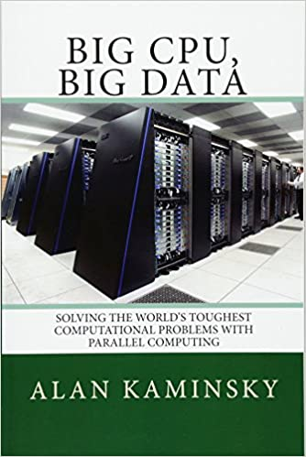
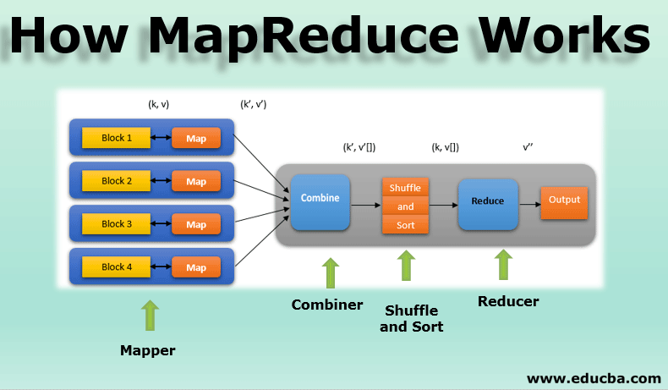
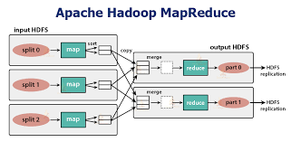
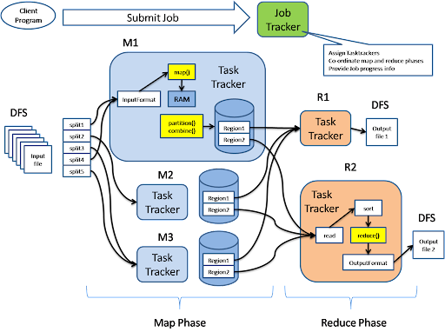
Lecture 32: MapReduce and Data Parallelism
Books:
Large Scale Parallel Data Processing
Lectures:
What is MapReduce?
MapReduce By Example
Map, Reduce and Filter in Python
Topics:
Parallel Programming and MapReduce
MapReduce/Hadoop
Page Rank
Cosine Similarity Measure

Slide 2
Lecture 2 – MapReduce
CPE 458 – Parallel Programming, Spring 2009
Except as otherwise noted, the content of this presentation is licensed under the Creative Commons Attribution 2.5 License.http://creativecommons.org/licenses/by/2.5

Slide 3
Outline
MapReduce: Programming Model
MapReduce Examples
A Brief History
MapReduce Execution Overview
Hadoop
MapReduce Resources

Slide 4
MapReduce
“A simple and powerful interface that enables automatic parallelization and distribution of large-scale computations, combined with an implementation of this interface that achieves high performance on large clusters of commodity PCs.”
Dean and Ghermawat, “MapReduce: Simplified Data Processing on Large Clusters”,
Google Inc.

Slide 5
MapReduce
More simply, MapReduce is:
  A parallel programming model and associated implementation.

Slide 6
Programming Model
Description
  The mental model the programmer has about the detailed execution of their application.
Purpose
  Improve programmer productivity
Evaluation
  Expressibility
  Simplicity
  Performance

Slide 7
Programming Models
von Neumann model
  Execute a stream of instructions (machine code)
  Instructions can specify
    Arithmetic operations
    Data addresses
    Next instruction to execute
  Complexity
    Track billions of data locations and millions of instructions
    Manage with:
      Modular design
      High-level programming languages (isomorphic)

Slide 8
Programming Models
Parallel Programming Models
  Message passing
    Independent tasks encapsulating local data
    Tasks interact by exchanging messages
  Shared memory
    Tasks share a common address space
    Tasks interact by reading and writing this space asynchronously
  Data parallelization
    Tasks execute a sequence of independent operations
    Data usually evenly partitioned across tasks
    Also referred to as “Embarrassingly parallel”

Slide 9
MapReduce:
Programming Model
Process data using special map() and reduce() functions
  The map() function is called on every item in the input and emits a series of intermediate key/value pairs
  All values associated with a given key are grouped together
  The reduce() function is called on every unique key, and its value list, and emits a value that is added to the output

Slide 10
MapReduce:
Programming Model
M
<How,1>
<now,1>
<brown,1>
<cow,1>
<How,1>
<does,1>
<it,1>
<work,1>
<now,1>
How now
Brown cow
<How,1 1>
<now,1 1>
<brown,1>
<cow,1>
<does,1>
<it,1>
<work,1>
M
R
brown 1
cow 1
does 1
How 2
it 1
now 2
work 1
M
R
How does
It work now
M
Reduce
MapReduce
Framework
Map
Input
Output

Slide 11
MapReduce:
Programming Model
More formally,
  Map(k1,v1) --> list(k2,v2)
  Reduce(k2, list(v2)) --> list(v2)

Slide 12
MapReduce Runtime System
Partitions input data
Schedules execution across a set of machines
Handles machine failure
Manages interprocess communication

Slide 13
MapReduce Benefits
Greatly reduces parallel programming complexity
  Reduces synchronization complexity
  Automatically partitions data
  Provides failure transparency
  Handles load balancing
Practical
  Approximately 1000 Google MapReduce jobs run everyday.

Slide 14
MapReduce Examples
Word frequency
Runtime
System
Map
Reduce
<word,1>
<word,1>
<word,1,1,1>
<word,1>
doc
<word,3>

Slide 15
MapReduce Examples
Distributed grep
  Map function emits <word, line_number> if word matches search criteria
  Reduce function is the identity function
URL access frequency
  Map function processes web logs, emits <url, 1>
  Reduce function sums values and emits <url, total>

Slide 16
A Brief History
Functional programming (e.g., Lisp)
  map() function
    Applies a function to each value of a sequence
  reduce() function
    Combines all elements of a sequence using a binary operator

Slide 17
MapReduce Execution Overview
The user program, via the MapReduce library, shards the input data
Input
Data
Shard 0
User
Program
Shard 1
Shard 2
Shard 3
Shard 4
Shard 5
Shard 6
* Shards are typically 16-64mb in size

Slide 18
MapReduce Execution Overview
The user program creates process copies distributed on a machine cluster. One copy will be the “Master” and the others will be worker threads.
Master
User
Program
Workers
Workers
Workers
Workers
Workers

Slide 19
MapReduce Resources
The master distributes M map and R reduce tasks to idle workers.
  M == number of shards
  R == the intermediate key space is divided into R parts
Master
Message(Do_map_task)
Idle
Worker

Slide 20
MapReduce Resources
Each map-task worker reads assigned input shard and outputs intermediate key/value pairs.
  Output buffered in RAM.
Map
worker
Shard 0
Key/value pairs

Slide 21
MapReduce Execution Overview
Each worker flushes intermediate values, partitioned into R regions, to disk and notifies the Master process.
Master
Disk locations
Map
worker
Local
Storage

Slide 22
MapReduce Execution Overview
Master process gives disk locations to an available reduce-task worker who reads all associated intermediate data.
Master
Disk locations
Reduce
worker
remote
Storage

Slide 23
MapReduce Execution Overview
Each reduce-task worker sorts its intermediate data. Calls the reduce function, passing in unique keys and associated key values. Reduce function output appended to reduce-task’s partition output file.
Partition
Output file
Sorts data
Reduce
worker

Slide 24
MapReduce Execution Overview
Master process wakes up user process when all tasks have completed. Output contained in R output files.
Master
User
Program
Output
files
wakeup

Slide 25
MapReduce Execution Overview
Fault Tolerance
  Master process periodically pings workers
    Map-task failure
      Re-execute
        All output was stored locally
    Reduce-task failure
      Only re-execute partially completed tasks
        All output stored in the global file system

Slide 26
Hadoop
Open source MapReduce implementation
  http://hadoop.apache.org/core/index.html
Uses
  Hadoop Distributed Filesytem (HDFS)
    http://hadoop.apache.org/core/docs/current/hdfs_design.html
  Java
  ssh

Slide 27
References
Introduction to Parallel Programming and MapReduce, Google Code University
  http://code.google.com/edu/parallel/mapreduce-tutorial.html
Distributed Systems
  http://code.google.com/edu/parallel/index.html
MapReduce: Simplified Data Processing on Large Clusters
  http://labs.google.com/papers/mapreduce.html
Hadoop
  http://hadoop.apache.org/core/

