Slide 1
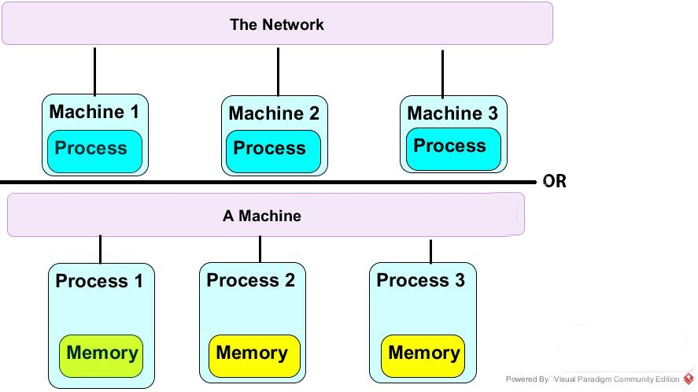
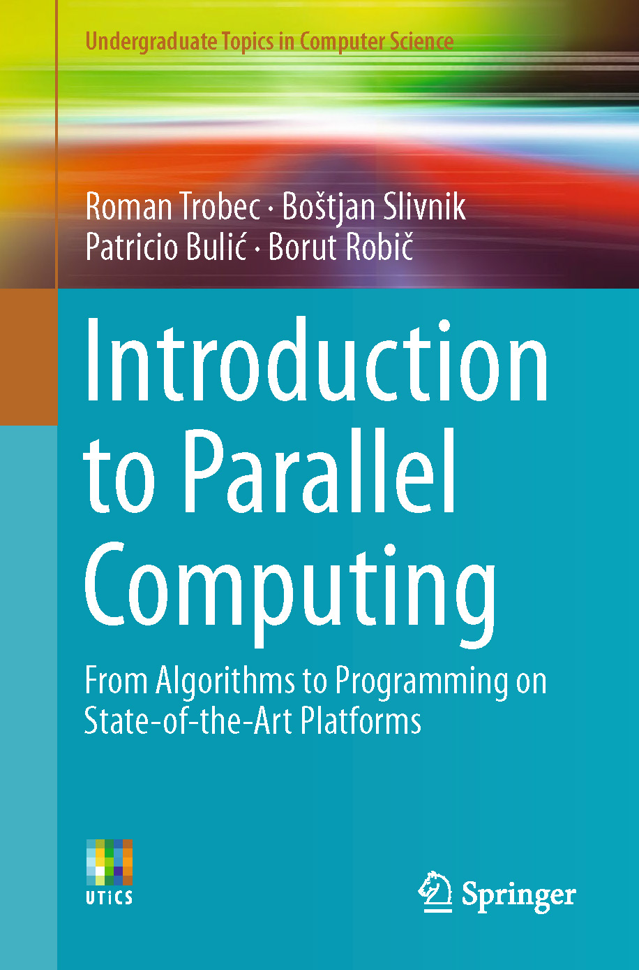
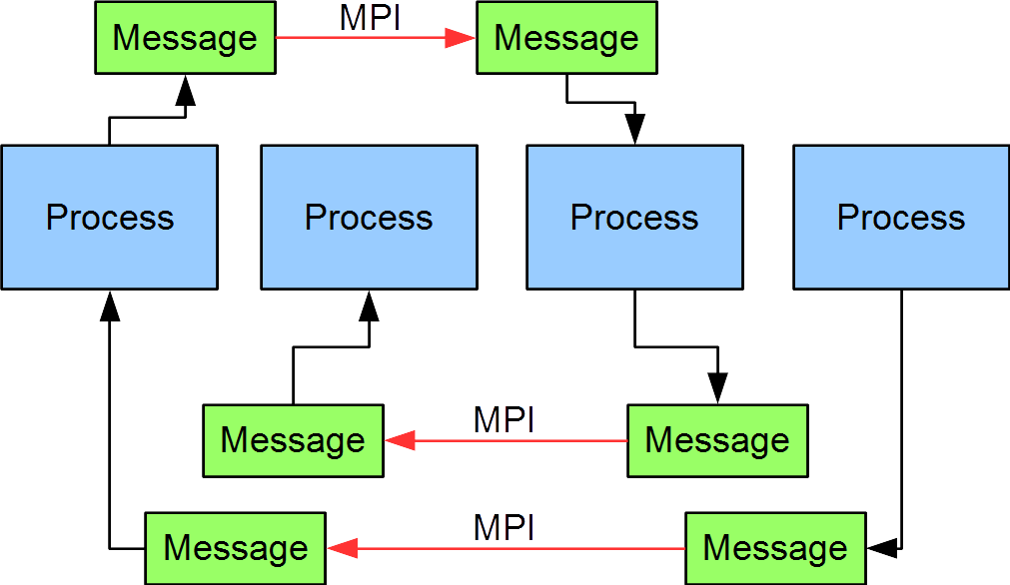
Lecture 30: Message Passing
Books:
Introduction to Parallel Computing
Lectures:
MPI Quick Look
Message Passing Interface - Part I
Introduction to MPI - Part 2
Topics:
Message Passing Interface
The MPI Interface Standard
Open MPI

