Slide 1
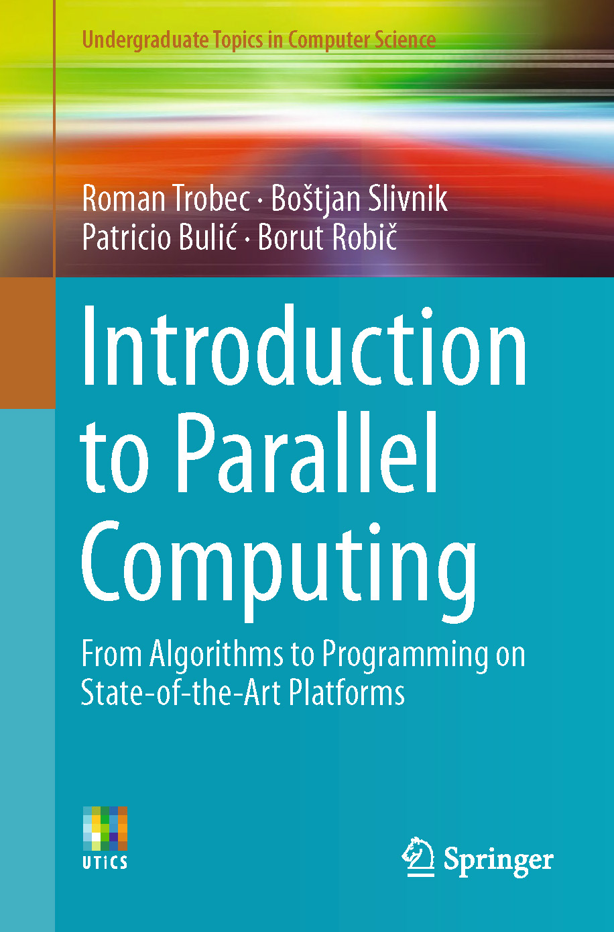
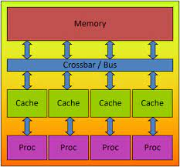
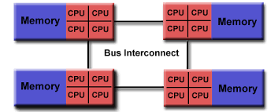
Lecture 28: OpenMP – Shared Memory and Multithreading
Books:
Introduction to Parallel Computing
Lectures:
OpenMP Shared Memory
Multithreading OpenMP
Hands On Introduction
Topics:
OpenMP API Specification
Easy Multithreading in OpenMP
OpenMP by Example

