Slide 1
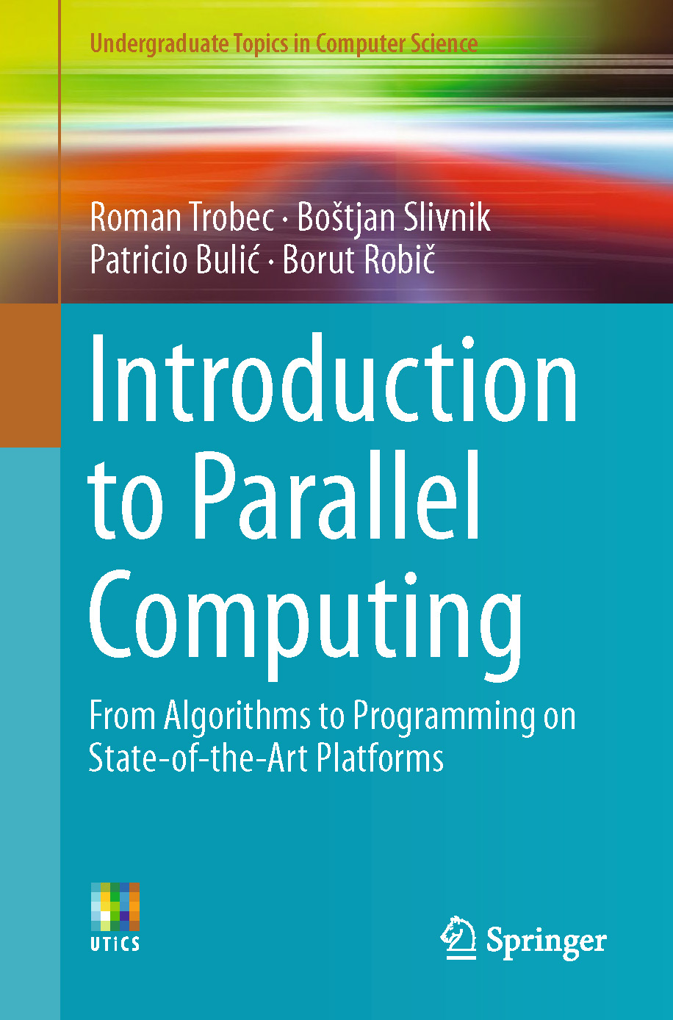
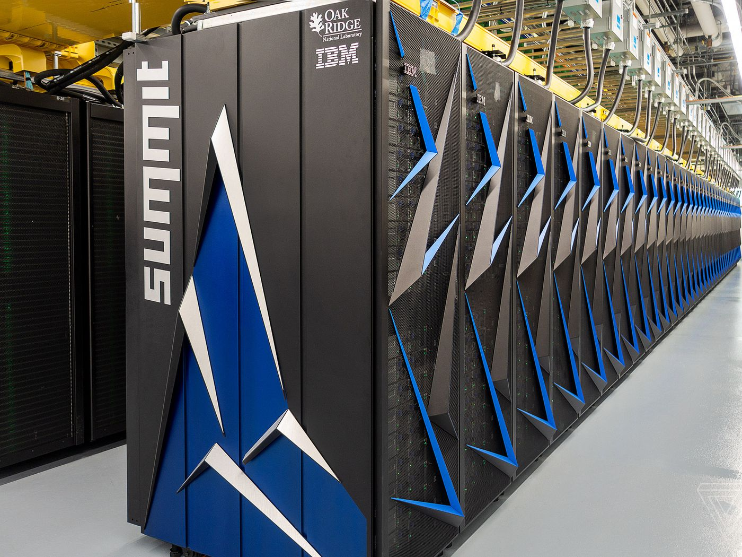
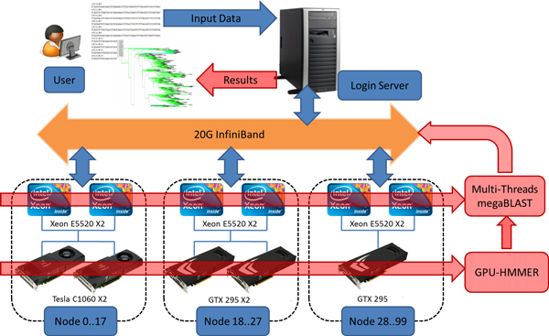
Lecture 26: Parallel Computational Complexity
Books:
Introduction to Parallel Computing
Lectures:
Coursera
Slideplayer
Topics:
Analysis of Parallel Algorithms
Amdahl's Law
Time Complexity

