Slide 1
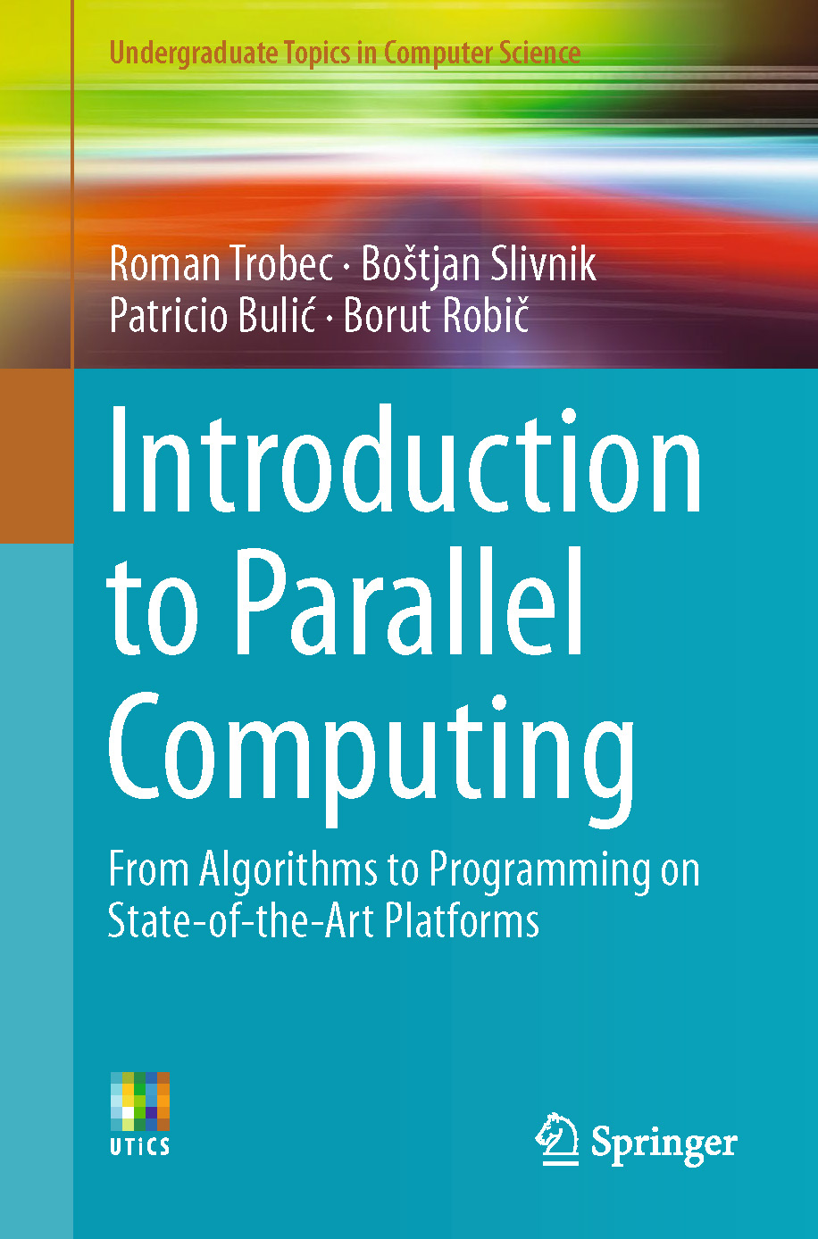
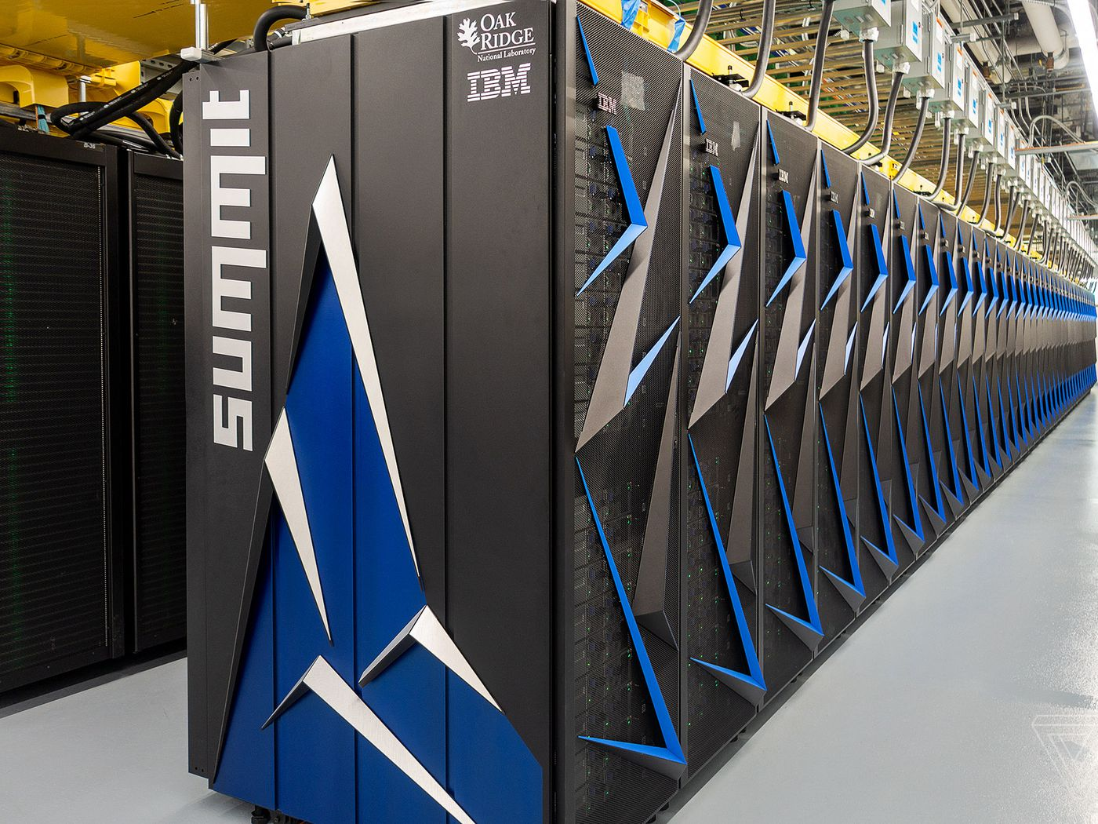
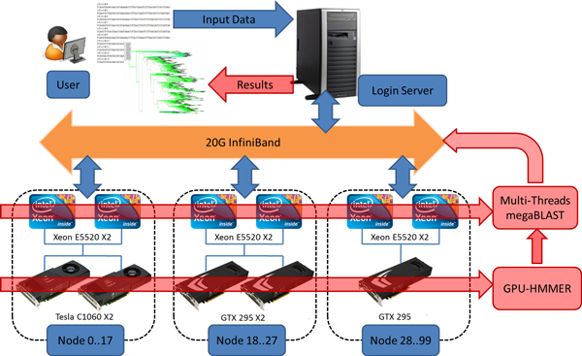
Lecture 25: Interconnectivity and Communications
Books:
Introduction to Parallel Computing
Lectures:
Coursera
Slideplayer
Topics:
Parallel Computing Overview
Interconnection Network Design
Interconnections and Communications

