Slide 1
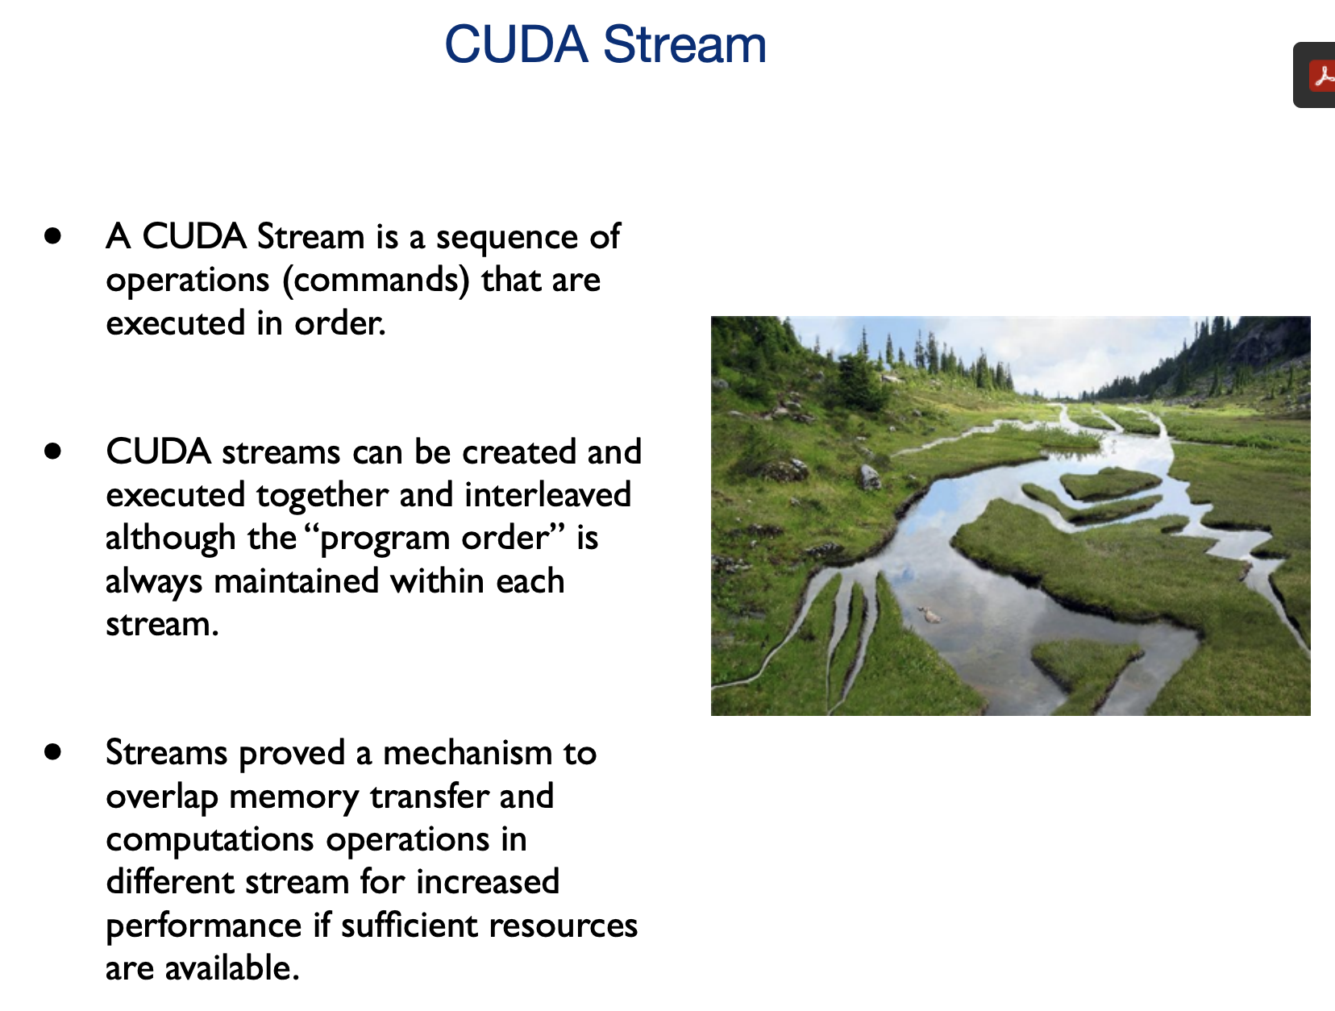
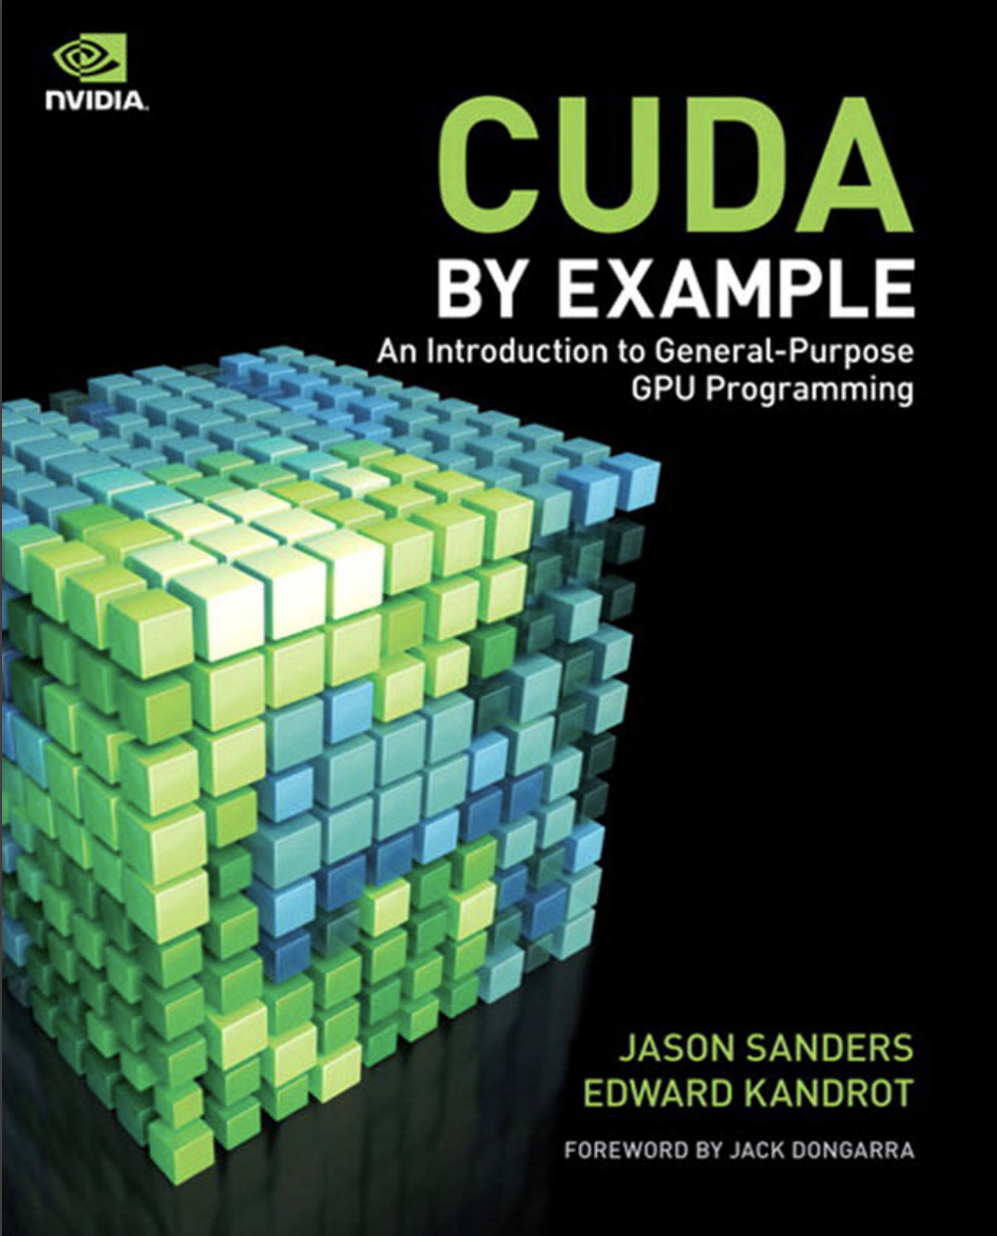
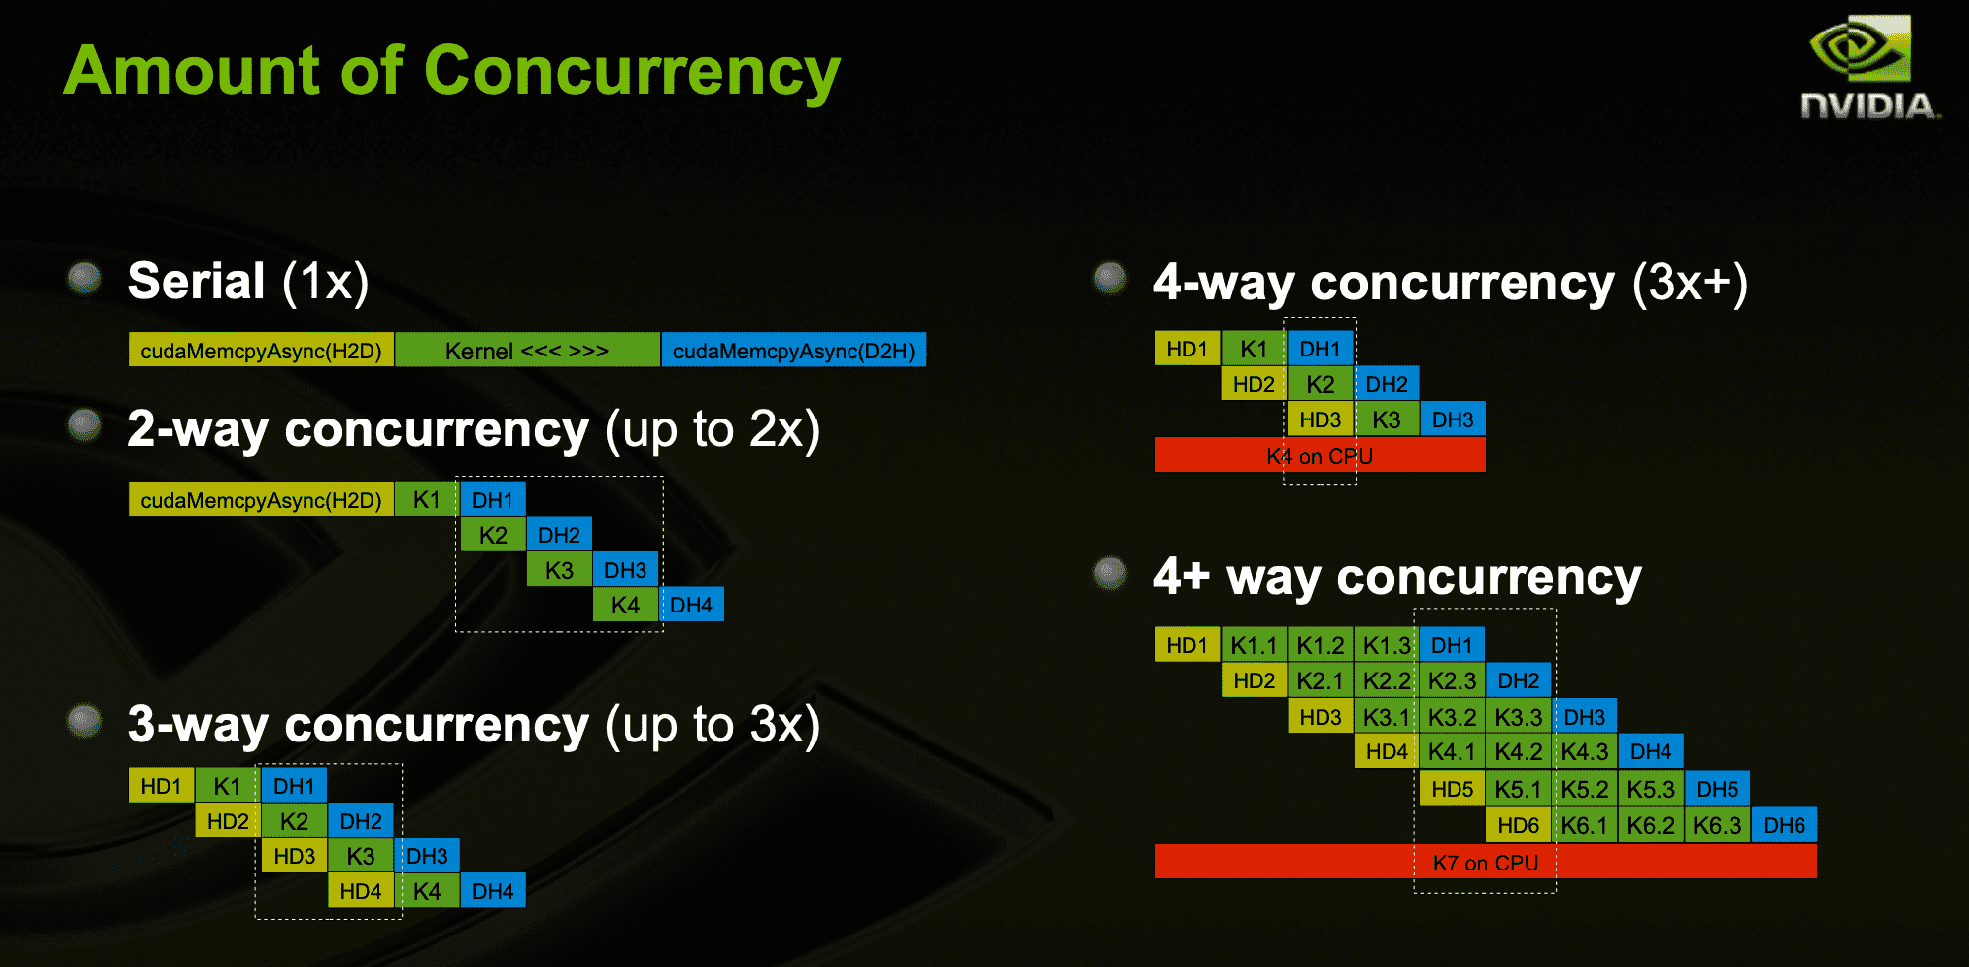
Lecture 23: Matrix Multiplication on a GPU
Books:
CUDA By Example
Lectures:
CUDA in Your Python
Multi-GPU Programming
Topics:
Matrix Multiplication on a Single GPU
Using Multiple GPUs
NCSA GPU Programming

