Slide 1
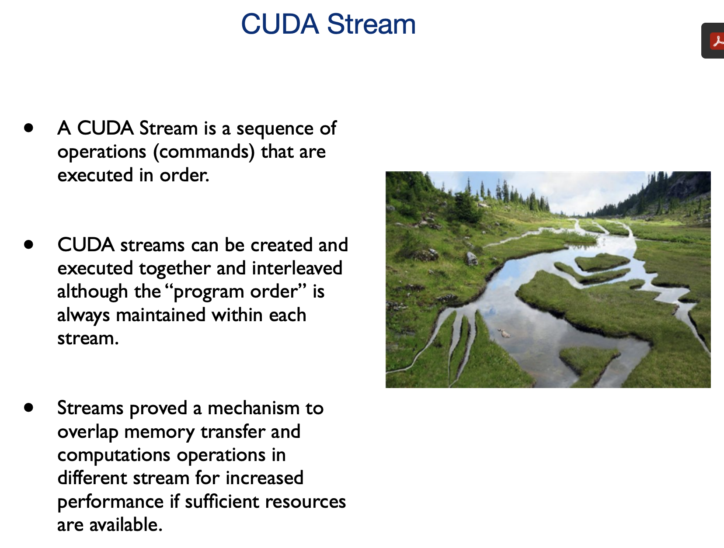
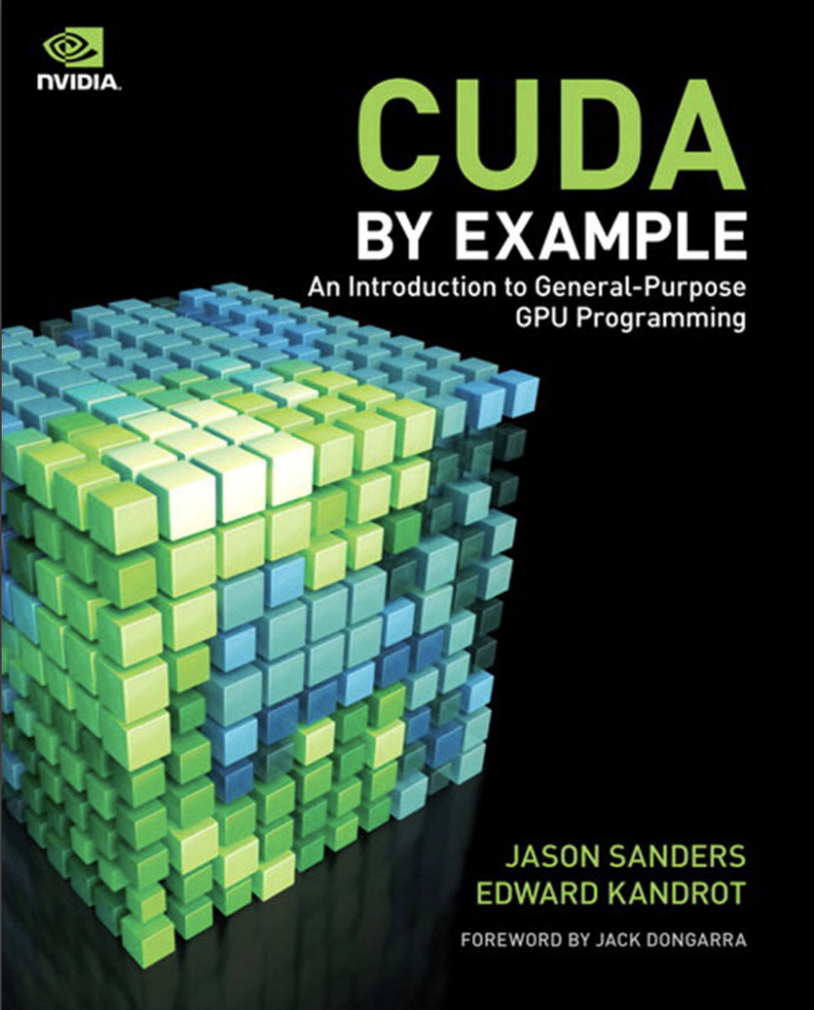
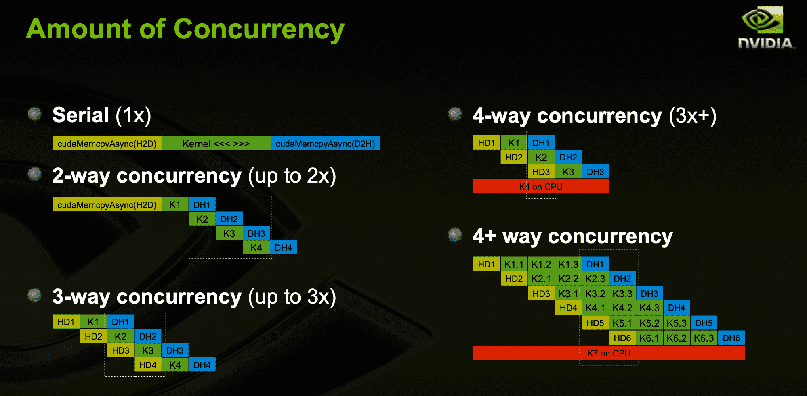
Lecture 22: Multi-GPU Programming
Books:
CUDA By Example
Lectures:
CUDA in Your Python
Multi-GPU Programming
Topics:
Multi-GPU Programming
Multi-GPU Programming (Chapter 11)
Multi-GPU Programming (Medium)
Matrix Multiply using Cuda BLAS

