Slide 1
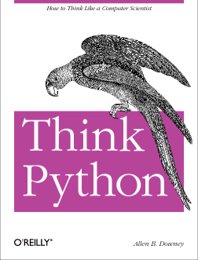
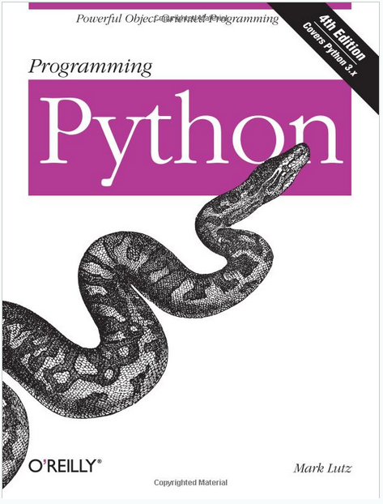
Lecture 19: An Introduction to Python
Books:
Learn Python
Python for Data Analysis
Lectures:
ECE 1111 Lectures 30-41
Lynda: Up and Running
YouTube: Google Python
YouTube: MIT Python
YouTube: O'Reilly Python
Python: Getting Started
Python: Tutorial
Topics:
Python Distributions
The Interpreter
Importing Libraries
The Main Program
Command Line Arguments

