Slide 1
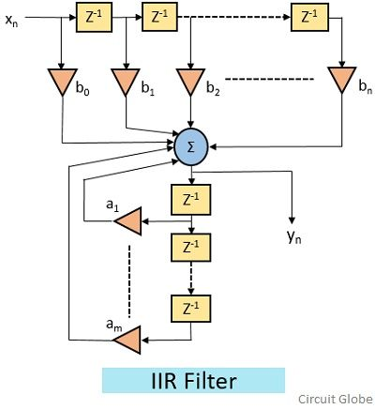
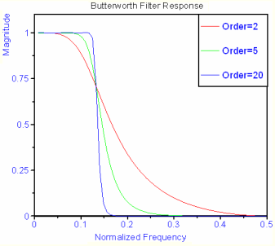
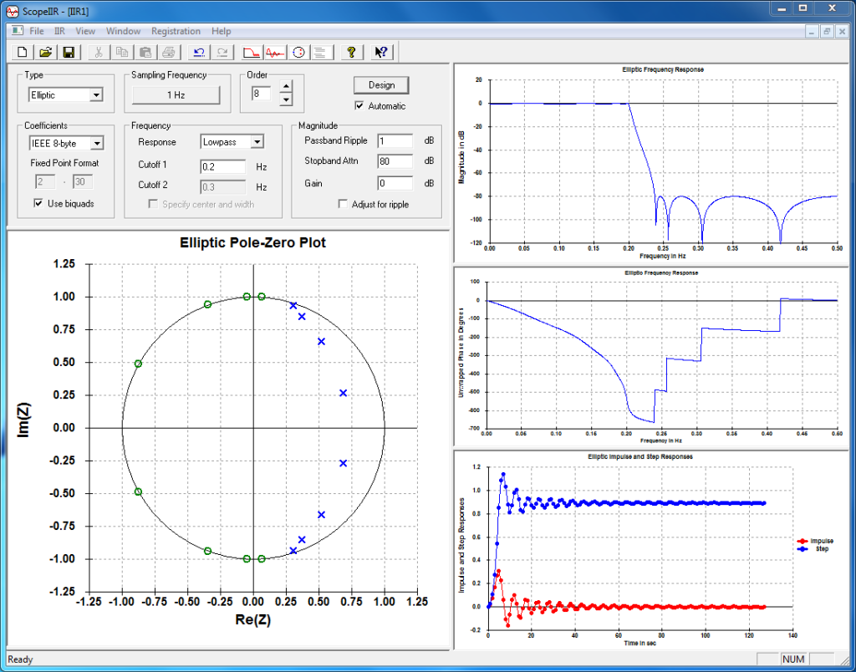
Lecture 18: Infinite Impulse Response (IIR) Filters
Books:
Digital Signal Processing
The Scientist’s and Engineer’s Guide
Lectures:
FIR Filter Design and Implementation
Direct Form Implementation in C
Topics:
Infinite Impulse Response Filters
GPU Implementation

Slide 2
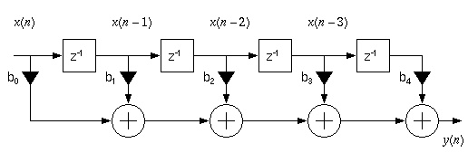
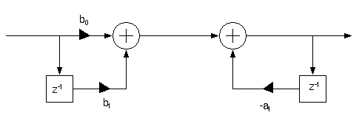
Infinite Impulse Response Filters – Direct Form

Slide 3
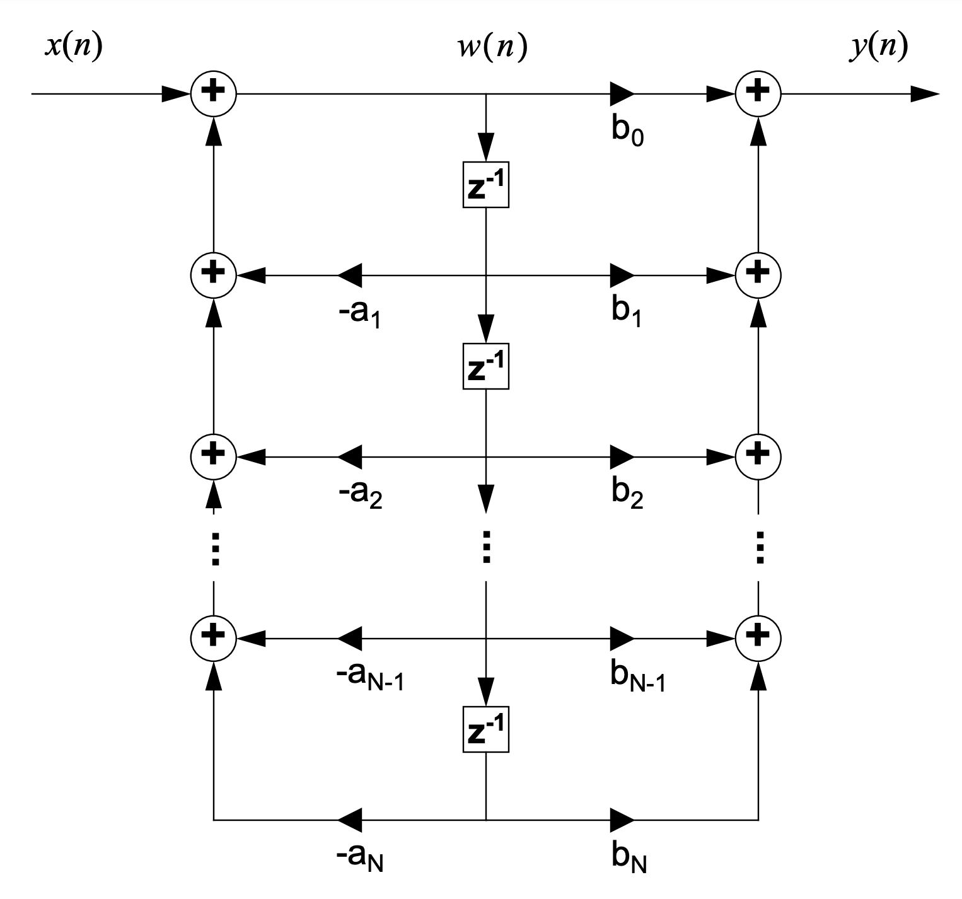
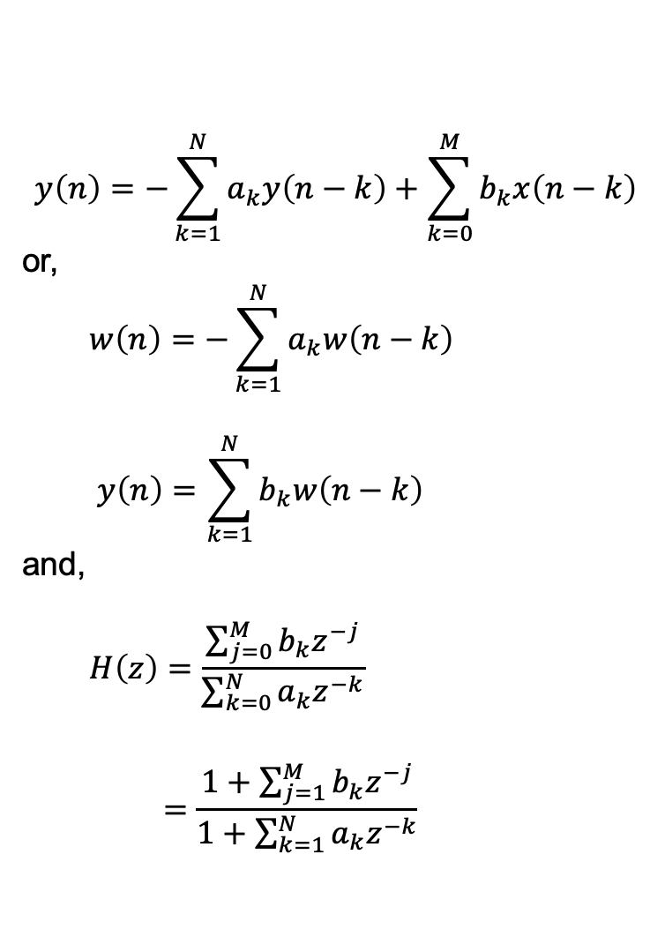
Infinite Impulse Response Filters – Direct Form
$$y\left(n\right)=−\sum_{k=1}^{N}{a_{k}y\left(n−k\right)+\sum_{k=0}^{M}{b_{k}x\left(n−k\right)}}$$
or,
$$w\left(n\right)=−\sum_{k=1}^{N}{a_{k}w\left(n−k\right)}$$
$$y\left(n\right)=\sum_{k=1}^{N}{b_{k}w\left(n−k\right)}$$
and,
$$H\left(z\right)=\frac{\sum_{j=0}^{M}{b_{k}z^{−j}}}{\sum_{k=0}^{N}{a_{k}z^{−k}}}$$
$$=\frac{1+\sum_{j=1}^{M}{b_{k}z^{−j}}}{1+\sum_{k=1}^{N}{a_{k}z^{−k}}}$$

Slide 4
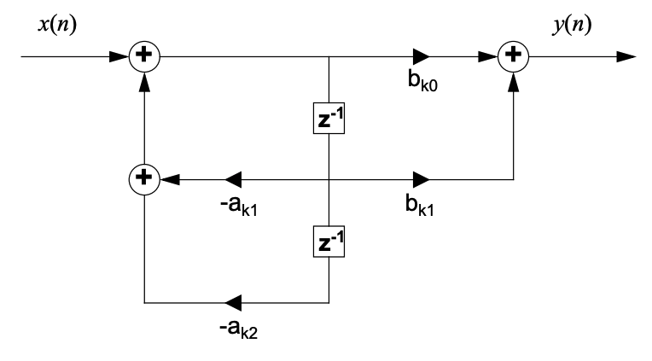
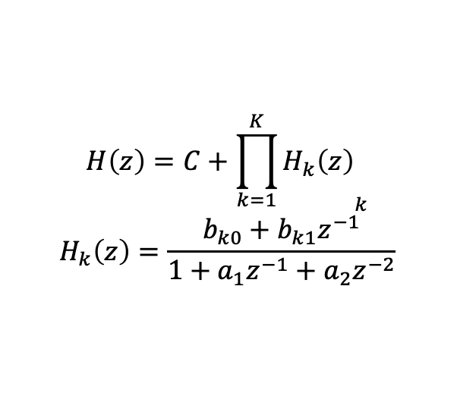
Parallel Form Implementation
$$H\left(z\right)=C+{\prod_{k=1}^{K}{H_{k}\left(z\right)}}_{k}$$
$$H_{k}\left(z\right)=\frac{b_{k0}+b_{k1}z^{−1}}{1+a_{1}z^{−1}+a_{2}z^{−2}}$$

Slide 5
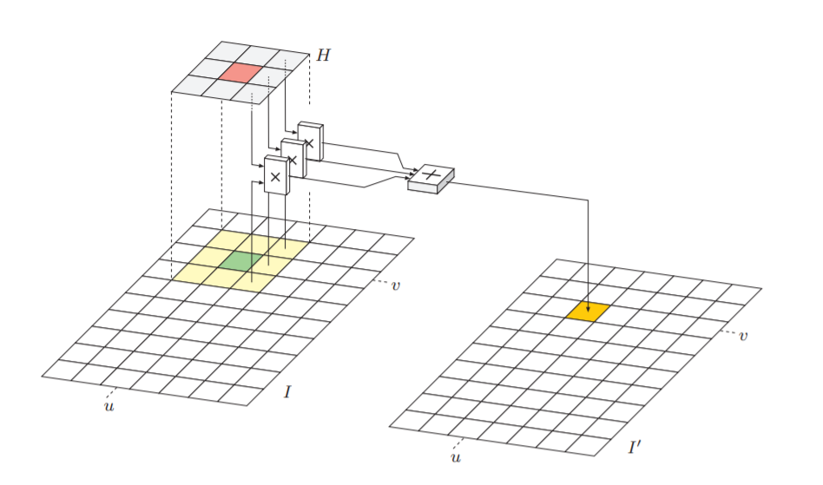
Digital Filtering in Multiple Dimensions (Image)

Slide 6
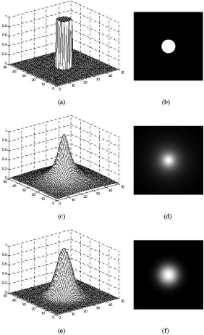
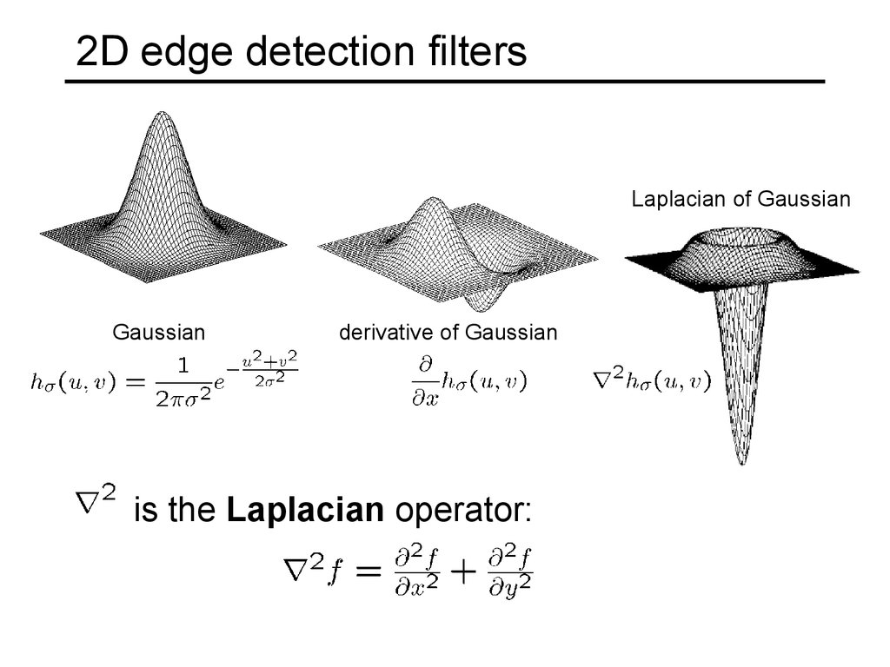
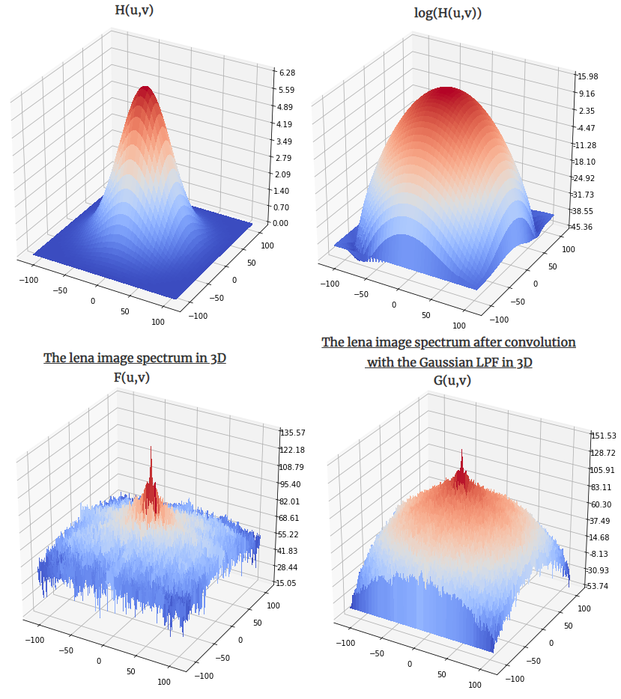
Frequency Response of 2D Digital Filters

