Slide 1
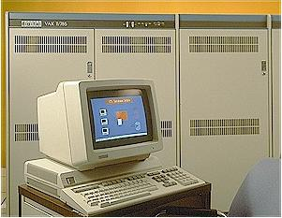
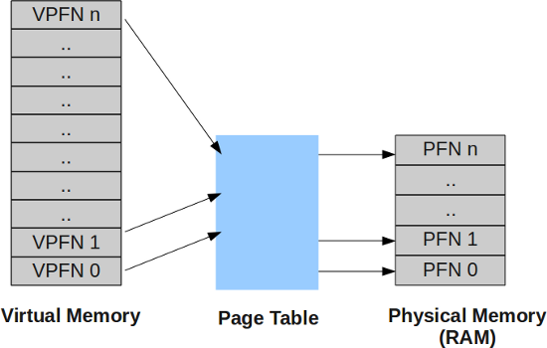
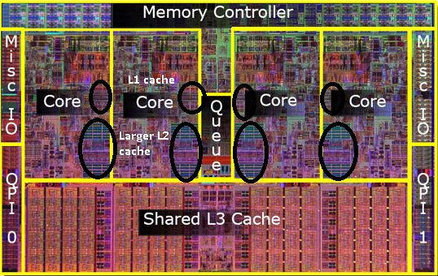
Lecture 15: Computer Engineering 101 –
How Do I Make My Programs Run Fast?
Books:
CUDA By Example
Lectures:
Python Parallel Programming Solutions
Topics:
Virtual Memory
Memory Paging
CPU Cache
Multithreading
Hyper-threading
Digital Equipment Corporation and the Vax

