Slide 1
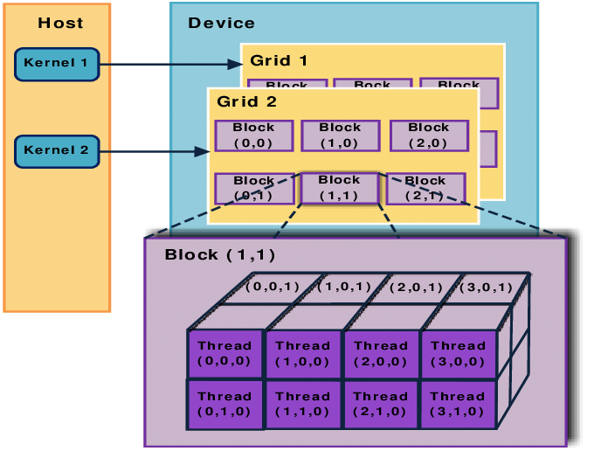
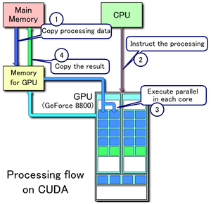
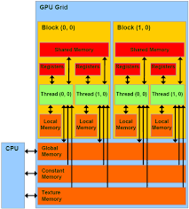
Lecture 14: Basic GPU Programming – Examples
Books:
CUDA By Example
Professional CUDA C Programming
Nvidia Archive
Lectures:
Python Parallel Programming Solutions
CUDA In Your Python
CUDA C/C++ Basics
Topics:
GPU Libraries and Programming Environments
TensorFlow and PyTorch
CUDA C Basics
Introduction to CUDA Programming
An Even Easier Introduction to CUDA
Examples

